Slide 1
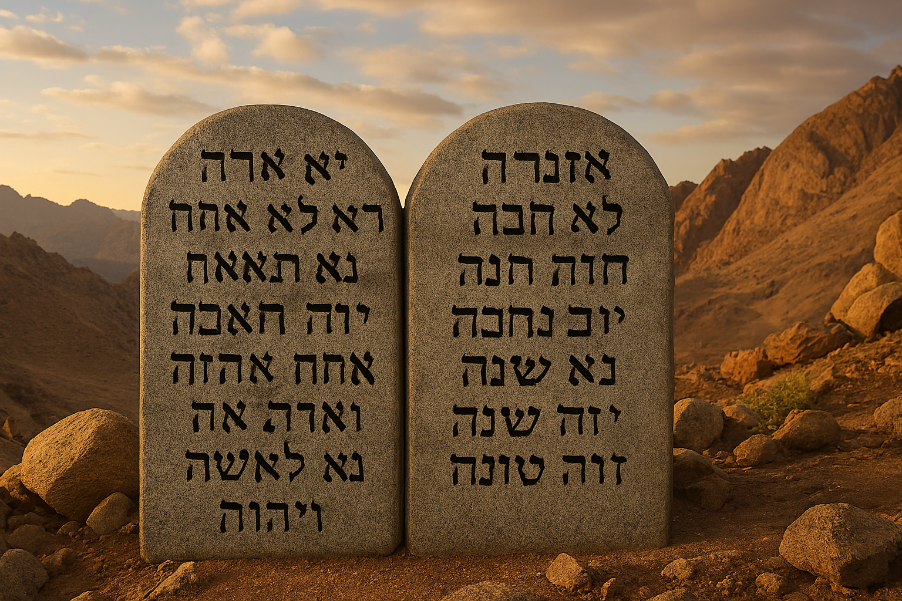

Slide 2
The Greatest Command
Deuteronomy 6:4-5
“Hear, O Israel: The Lord our God, the Lord is one! You shall love the Lord your God with all your heart, with all your soul, and with all your strength.”

Slide 3

Love the Lord with all your Heart
Loving with the heart is loyalty to God.
  Worship God alone – Deut. 11:16.
  Long to keep His commands – Deut. 8:2; Jn. 14:15, 21.
The Lord will not tolerate disloyalty.
  Disloyalty is adultery toward God – Jer. 9:1-2; Eze. 6:9.
  Punishment for disloyalty is death – Deut. 29:18-20; 13:6-11; 30:17-18.
When we place our desires over God’s, we betray Him.
  Monetary desires – Mt. 6:24.
  Fleshly lusts – Rom. 6:19; 7:5; Gal. 5:16
  Do we put ourselves before God?

Slide 4
Love the Lord with all your Soul
Loving with your soul is with your true desire.
  Your soul is your true self – Gen. 2:7 (ASV);1 Thess. 5:23; Ps. 103:1.
  Your soul is revealed by your true desires – Ps. 63:1.
The Lord accepts nothing less than our deepest desire to please Him.
  Our desires must be His desires – Gal. 5:22-24; Prov. 3:5-6; Ps. 40:8.
  We must reshape our desires to the Lord’s – Gal. 5:25; Col. 3:5; Is 55:7-8.
Christians must truly desire to please God above self.
  God is deserving of our desire – Deut. 7:9.
  We cannot hide our true desires from God – Lk. 12:2; Ecc. 12:14.
  Do we desire the Lord and His righteousness?

Slide 5
Love the Lord with all your Strength
Loving with your strength is with all your ability – Col. 3:23-24.
  Observing all His commandments – Deut. 28:1.
  Doing His work – Mt. 16:24; Gal. 6:4-5
  Not allowing anything to distract us from pleasing Him – Deut. 28:14.
We cannot be lazy in doing His work – Deut. 28:47-48.
  The Lord has much work to do, and it is our privilege to be one of His workers – Mt. 25:26-30.
  The Lord has no need for servants who have something better to do.
The workload is light.
  Christ promised us a light burden – Mt. 11:28-30.
  Christ strengthens us – Phil. 4:13.
  Do give our all for Christ and the church?

Slide 6
Obey god’s Greatest Command
Love God with all your LOYALTY
Love God with all your DESIRE
Love God with all your ABILITY

Slide 7
Have you Obeyed God’s commands to be saved?
BELIEVE – Jn. 3:16
REPENT – Acts 2:38
CONFESS – Rom. 10:9
Be BAPTIZED – Mk. 16:16
LIVE FAITHFULLY – Rev. 2:10

