Slide 1
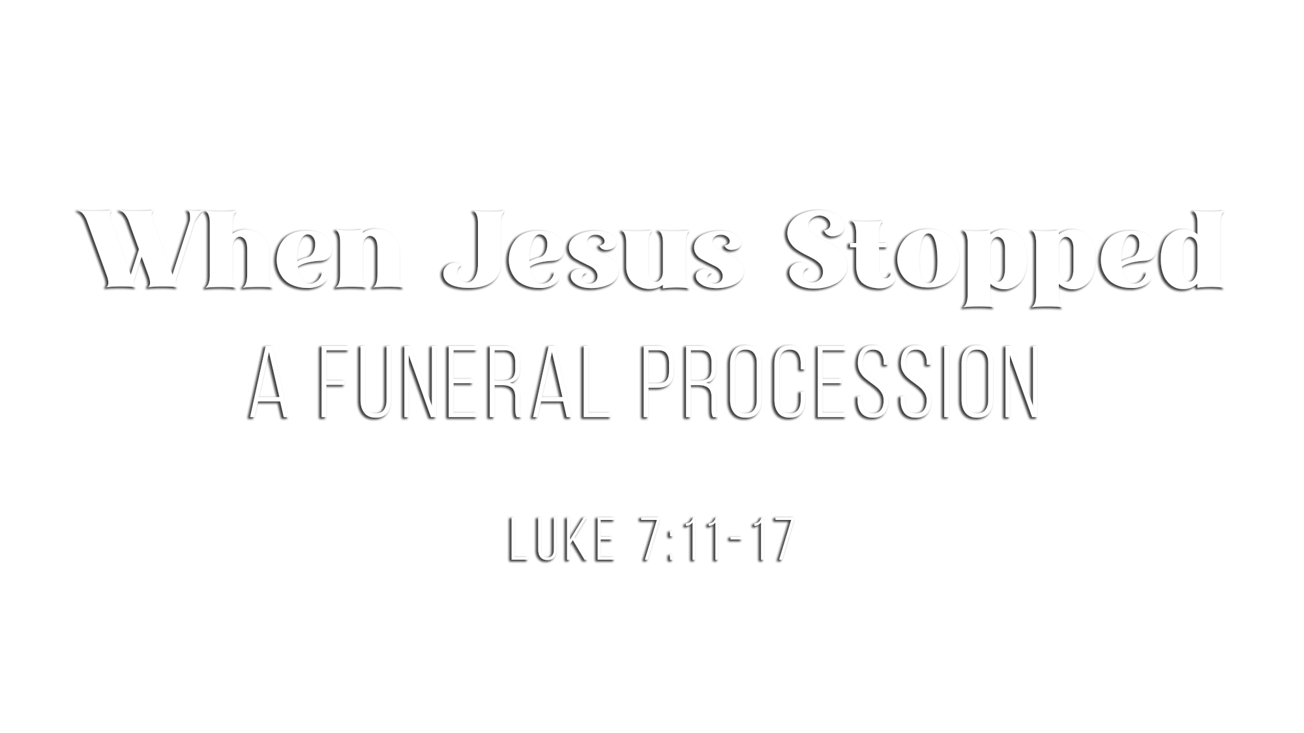

Slide 2
Two very different groups converged at just the right time
on the road leading into Nain
We know nothing of the reason for Jesus’ visit to Nain
other than this occasion
Two large crowds met and were witnesses to the glory of God

Slide 3
The woman had lost her only son – deepest of grief
(Jer. 6:26; Zech. 12:10; Amos 8:10)
The woman was “weeping”
(Greek: klaio) – crying aloud, sob, wail, loud expression of grief

Slide 4
“Jesus saw” the woman (7:13) – “to perceive” or “to know”
  He saw her with His eyes and with His mind and His heart
Jesus “had compassion on her” (7:13)
  He felt for her “in His bowels” (seat of deepest, innermost emotions)
  He spoke to her heart, knowing what He was going to do: “Stop weeping”

Slide 5
Jesus touched the “coffin” on which the wrapped body was carried
Jesus spoke to the dead, “Young man, I say to you, arise” (7:14)
  When Jesus spoke to the dead, they heard and obeyed (cf. John 11:25)
  This is a preview of what will happen at His return (John 5:28-29)
The boy who was dead sat up and began to speak (7:15)
  He was restored to life, health and strength

Slide 6
Jesus gave the young man back to his mother
Jesus gave her reason to stop weeping, as He had bid her to do
There will be reunions after death (Matt. 8:11; 1 Thess. 4:13-18)

Slide 7
“Fear came upon all”
  They realized they were in the presence of divinity
Fear gave place to praise: “They kept on glorifying God”
Their rational conclusion (based on the evidence):
  “A great prophet has risen up among us” (cf. Deut. 18:15-19)
  “God has visited His people” (cf. Luke 1:68) = look upon with care to help
The news of Jesus could not be kept

Slide 8
Believe Jesus is the Son of God – John 3:16
Repent of your sins and turn toward God – Luke 13:3
Confess your faith in Jesus Christ – Romans 10:9
Be baptized into Christ – Galatians 3:27
  God will forgive all of your sins – Acts 2:38
  God will add you to His church – Acts 2:47
  God will register you in heaven – Hebrews 12:23
Walk faithfully with the Lord – 1 John 1:7

