Slide 1
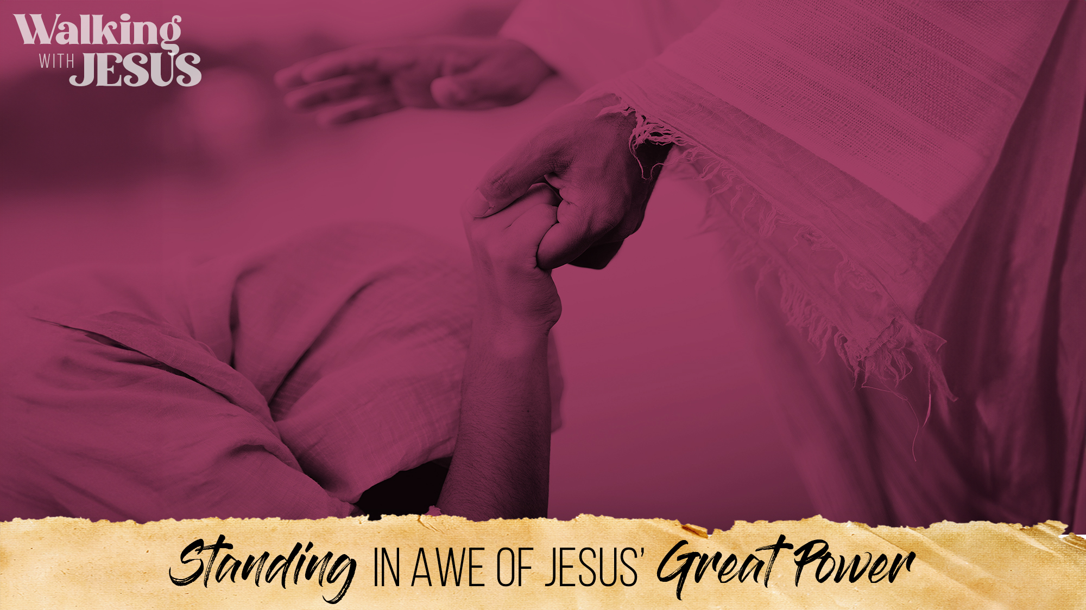



Slide 2
Jesus had the power to stop death
(7:1-2; cf. John 4:46-47)
Jesus had the heart to help others in need
(7:3-6; cf. Matt. 9:36)
Jesus had the authority to command disease to “Go” from anywhere
(7:7-10; cf. Matt. 8:16)

Slide 3
Be the one who Jesus praises (7:9; cf. Heb. 2:11)
Be the one who believes big (7:1-3; cf. Luke 18:27)
Be the one who cares deep (7:1-5; cf. Matt. 25:45)
Be the one who stays humble (7:6-7a; cf. Luke 5:8; Isa. 6:5)
Be the one who respects His authority (7:7b-8; cf. John 12:48)
Be the one who trusts Him completely (7:1-10; cf. 1 Sam. 3:18; 2 Sam. 15:26)
Be the one who stands out from the crowd (7:9; cf. Rom. 12:2; Phil. 2:15)

Slide 4
Believe today that Jesus is the Son of God (Acts 16:31)
Repent of your sins and turn toward God today (Acts 3:19)
Confess your faith in Jesus Christ today (Romans 10:9)
Be baptized into Christ today (Mark 16:16)
  God will forgive all of your sins today – Acts 2:38
  God will add you to His church today – Acts 2:47
  God will enroll you in heaven today – Hebrews 12:23
Live faithfully for the Lord from today forward (Revelation 2:10)

