Slide 1
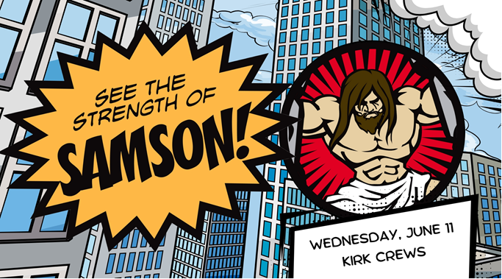

Slide 3
Samson’s Physical Strength
Killed the lion with bare hands (14:6)
Killed 30 Philistines to pay his debts (14:19)
Caught 300 foxes, tied their tails together with torches and burned the Philistine’s grain fields, vineyards and olive groves (15:3-5)
Out of revenge for killing his wife, killed the Philistines in a “great slaughter” (15:8)
Broke his bonds and killed 1,000 Philistines with donkey jawbone (15:14-17)
Pulled apart the doors of the of the gate to Gaza and carried to top of hill facing Hebron ~35-40 miles away (16:3)
Broke the seven fresh bowstrings and new ropes Delilah used to bound him (16:9,12)
Knocked down the pillars in the Philistine temple (16:30)

Slide 4
Samson’s Weakness
Acted on his selfish desire to be with foreign women
Woman in Timnah (14:1-15:20), Harlot in Gaza (16:1-3), and Delilah (16:4-21)
Violated God’s covenant and command (Ex 34:10-16; Deut 7:1-5)
Committed fornication (16:1)
Invited temptation into his life (14:1-15:2; 16:1-21)
Ultimately broke his Nazirite vow (16:17)

Slide 5
But God still used him!
Killed the Philistines (14:19; 15:8,15; 16:30)
Destroyed the Philistine’s crops (15:5)
Avoided capture by the Philistines (15:9-15)
Motivated the Philistine lords to bribe Delilah to capture their enemy (16:5,18)
Exacted revenge for Philistine party (16:23-30)

Slide 6
Samson trusted God!
Accepted his role as a deliverer of God’s people (13:5; 14:4; 16:28)
(Mostly) honored his Nazirite vow (16:17; Num 6)
Realized God was with him
“Spirit of the Lord came upon him…”(13:25; 14:6,19; 15:14)
Relied on God to provided for him (15:18,19)
Prayed to God (15:18;16:28)
Faith grounded at an early age by parent’s example (13:8,12; Heb 11:32)

Slide 7
True strength comes from trusting God!
“Finally be strong in the Lord and in the strength of His might”
- Ephesians 6:10
“It is God who arms me with strength and makes my way perfect”
- Psalms 18:32

