Slide 1
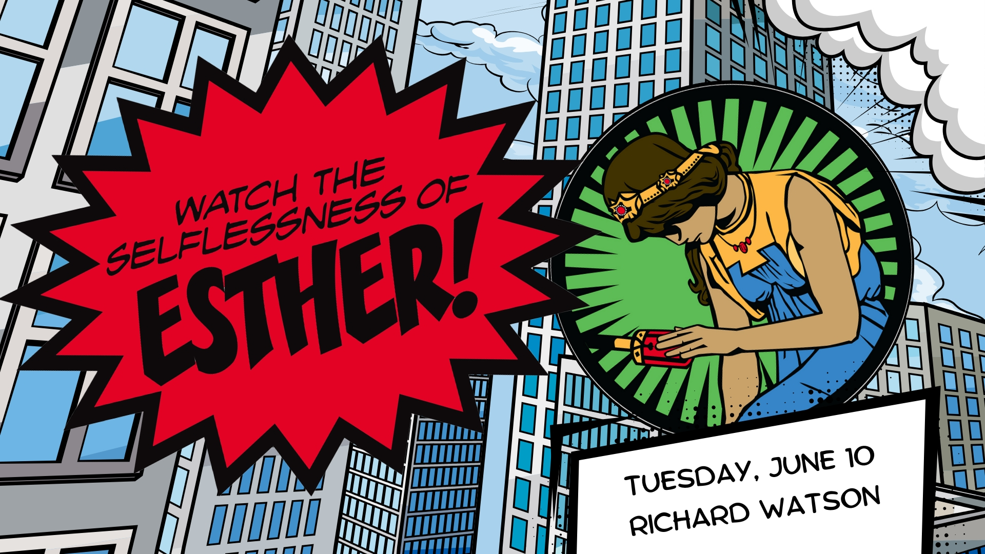

Slide 2
QUEEN ESTHER God’s Call to Selflessness
Putting others first pleases
God wants us to be selfless
We are to trust and obey God, even when we do not understand the circumstances
Philippians 2:4 Each of you should look not only to your own interests, but also to the interests of others.
Esther 4:14 Yet who knows whether you have come to the kingdom for such a time as this?

Slide 3
QUEEN ESTHER God’s Call to Selflessness
Esther is one of only 2 books in the Bible that do not mention God by name (Song of Solomon is the other)
King Ahasuerus is the grandson of King Cyrus that Daniel served
The timing of Esther is about 483 BC
When the going gets tough the tough get on their knees and pray

Slide 4
QUEEN ESTHER God’s Call to Selflessness
Haman had several character flaws that led directly to his death
Jealousy
Pride
Hatred
Anger
Insecurity
Fear
Esther was afraid but she was more afraid of what would happen to her people than she was of what would happen to herself

Slide 5
QUEEN ESTHER God’s Call to Selflessness
We are to trust and obey God, even when we do not understand the circumstances
God wants us to be selfless
Putting others first pleases God

