Slide 1
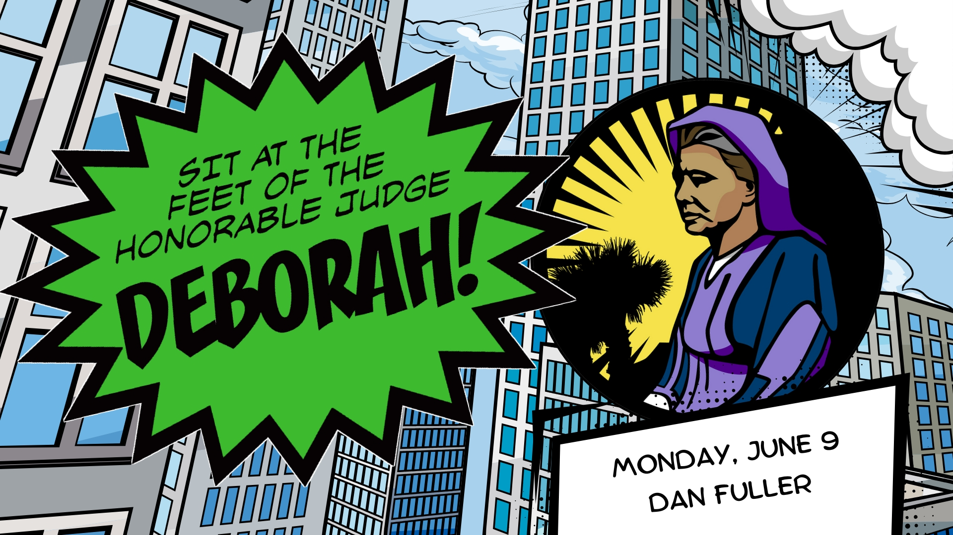
Deborah Being Honorable- Doing What’s Right
Judges 4-5

Slide 2
Deborah Being Honorable- Doing What’s Right
Judges 4-5

Slide 3
Deborah
Key Verses-
1 Corinthians 16: 13 “ Be watchful, stand firm in
the faith, act like men, be strong”. ESV
Judges 5:31 “Let all your enemies perish, O Lord!
But let those that love Him be like the Sun When it
comes out in full strength”.

Slide 4
Deborah
Honorable
The word honorable has to do with people and
actions that are fair, honest, and worthy of respect.
An honorable person believes in truth and doing
the right thing.

Slide 5
Deborah
Looking At Philippians 4:8
True, Honorable (ESV), Just, Pure, Lovely, Good report
Any thing of virtue, Anything praiseworthy

Slide 6
Deborah
-True Honor does not forget God.
-True Honor does not cower to an enemy.
-True Honor does not forget God’s commands.
-True Honor does not seek its own glory.
-True Honor grows stronger in the Lord.

Slide 7
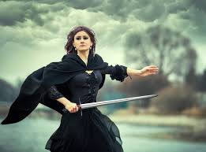
Deborah, Judge of Israel
Judges 4 & 5

Slide 9
Deborah
How Did Israel Get Here ?
1. Time of the Judges was about 410 years.
2.The title “Judge” means deliverer.
3.The people of God were in a cycle.
They did evil, God punished them, they called out for
deliverance, God sent a person, the foe was vanquished.

Slide 10
Deborah
The Judges Mentioned In The Book Of Judges
Othniel Ehud Shamgar Deborah Gideon
Tola Jair Jephthah Ibzan Elon Abdon Samson
Eli and Samuel mentioned in 1 Samuel

Slide 11
Deborah
Lesson Facts
1. Deborah was the only woman judge of Israel
2. Barak was appointed by Debroah to lead
Israel in battle.
3. Sisera, the commander of the Canaanite army
was killed with a tent peg through his head.

Slide 12
Deborah
Lesson Facts
4. Barak refused to go out to battle unless
Debroah went with him.
5. Deborah told Barak that there would be no glory for him
in battle- that the Lord would sell Sisera into the hand
of a woman.
6. Sisera was killed by Jael, the wife of Heber, the Kenite.

Slide 13
Deborah
Israel enjoyed 80 years of peace.
4:1 Israel again did evil in the sight of the Lord.
Jabin was king of the Canaanites, Sisera was the
military leader.
God’s people called out for help, not repentance.
Psalm 139:24.

Slide 14
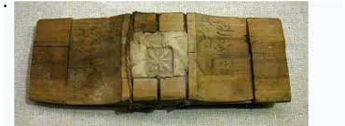
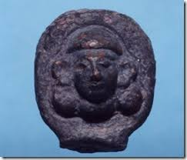
Deborah
Archaeology and Haroseth Haggoyim

Slide 15
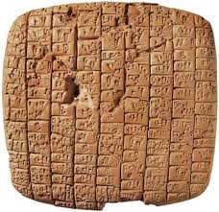
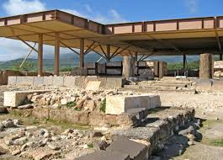
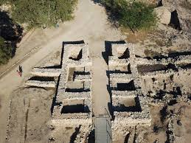
Deborah
Archaeological finds from Hazor, city of King Jabin

Slide 16
Deborah
God’s People Called Out For Help, Not Repentance
-Repentance is change. Change of mind that brings a change of life.
-Repentance is clarifying. A right path and right direction is found.
-Repentance is commanded. Matt 4: 17. Acts 2:38
-Repentance is continual. Matt 4:17 Acts 17:30
-Repentance is catchall. It is directed to everyone.
I need to change, and I need to move to where God is.

Slide 17
Deborah
God’s People Called Out For Help, Not Repentance
-There is nothing else on Earth that separates
me from God like sin.
-If I want to be saved, I need to repent.
-Heaven rejoices when someone repents of their sins. Luke 15:7
-There is a judgement coming to all.

Slide 18
Deborah
God’s Timing Is Always Right
God’s timing is never too early. Psalm 27:14
God’s timing is never too late. Isaiah 55: 8-9
God’s timing is perfect. Galatians 4:4-5
God’s timing is a testament to His wisdom and His power.

Slide 19
Deborah
7 Leadership Traits of Debroah
1. She was courageous
2. She served with wisdom and knowledge
3. She supported the people
4. She was trustworthy

Slide 20
Deborah
7 Leadership Traits of Debroah
5. She was direct
6. She was confident
7. She was humble

Slide 21
Deborah
Honorable Traits in Godly Women
Proverbs 31: 10- 31

Slide 22
Deborah
Judges 5 Song of Deborah
Vs 2 Rulers and the people offer themselves.
Vs 24- 27 Jael is a hero
Vs 30 They plundered the Canaanites
Vs 31 So the land had rest for 40 years.

Slide 23
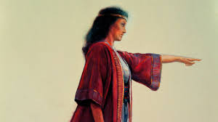
Deborah
Deborah believed in God’s people and was there for them

Slide 24
Deborah
Women in the Kingdom
You Are The Daughter Of A King
1 Timothy 2: 8- 15
1 Corinthians 14: 34-35
Some people misinterpret Galatians 3:28.
God values women. Godly men should value women.

Slide 25
Deborah
From Charles Darwin
“The chief distinction in the intellectual powers of the
two sexes is shown by man’s attaining to a higher
eminence whatever he takes up, than can that of a woman.
….the average mental power of a man must be higher than
that of a woman. The Descent of Man 1871 p.873,874

Slide 26
Deborah
From Atheist, Dan Barker
“Although the Bible is neither antiabortion nor pro-family,
it does provide modern antiabortionists for the real
motivation behind their views….A patriarchal system
cannot stand women who are free”

Slide 27
Deborah
“Amid the polarization that plagues American civilization in
general, and Christendom in particular, one chasm continues
to widen between those who, on one hand, want to conform
to Bible protocol, and those who, on the other hand, wish to
modernize, update, adjust, and adapt, Scripture, to a changing
society” Dave Miller PhD, Apologetics Press

Slide 28
Deborah
How Jesus Treated Women
*Speaks to women in public. Widow at Nain. Luke 7:11-17
*Heals a woman. Calls her “daughter of Abraham” Luke 13
*The Samaritan woman at the well. John 4.
*Jesus had followers that were women.

Slide 29
Deborah
Adam and Eve
*Eve is a called “a helper” Gen. 2:18. Hebrew word ezer.
*Jesus said He would send a Helper .
John 14:16, John 15: 26-27
Conclusion- Eve was the perfect compliment to Adam.

Slide 30
Deborah
Women in the Kingdom
Women can not be an Elder. 1 Tim. 3: 2
Women can not be a Deacon. 1 Tim 3: 12
Women can not be in a position of authority

Slide 31
Deborah
Women Play a Vital Role in the Kingdom
Teaching the Gospel to others
Teaching Bible class. Ladies class, children’s classes.
Serving others faithfully
Show hospitality
Provide transportation
Excellent examples for all to see

Slide 32
Deborah
Women Play a Vital Role in the Kingdom.
*Like Deborah, she can serve the Lord in power and speak
His word without fear.
*Like Esther, she can help God’s people.
*Like Abigail, she can humble herself at the feet of
the Lord’s servants.

Slide 33
Deborah
Women Play a Vital Role in the Kingdom.
*Like Lydia, she can be a worshiper of God and open her
home to His servants.
*Like Tabitha, she can always do good and help the poor.

Slide 34
Deborah
Application
Why do you think God was displeased by Barak’s response?
What lessons do we learn from the story of Deborah?
Sisera was a very mean man and dies a very violent death?
Why do you think God wanted us to know that?

Slide 35
Deborah
Application
4. Why do you think Barak did not want to go to battle
with out Deborah?
Did Deborah trust God?
Is it possible that Barak did not trust in God?

