Slide 2
Every Servant of God Has Something to Do (Matt. 25:14-15).
  We are – each one of us – God’s own servants (v. 14)
  We have – each one of us – been entrusted with God’s goods (v. 14)
  We have – each one of us – been entrusted according to our “own ability” (v. 15)
  In God’s church (v. 15):
    There are ZERO zero-talent servants
    There are NO no-talent servants
  Therefore, our Master expects ALL of us to be constantly working:
    To FIND the abilities and opportunities He gives to us – for His sake
    To HONE the abilities and opportunities He gives to us – for His sake
    To USE the abilities and opportunities He gives to us – for His sake
    To GROW in those abilities and opportunities AND DEVELOP NEW ONES (2 Pet. 3:18)

Slide 3
Every Servant of God Has Something to Do (Matt. 25:14-15).
Every Servant of God Is Part of PBL Forever (Mark 12:26-34).

Slide 4




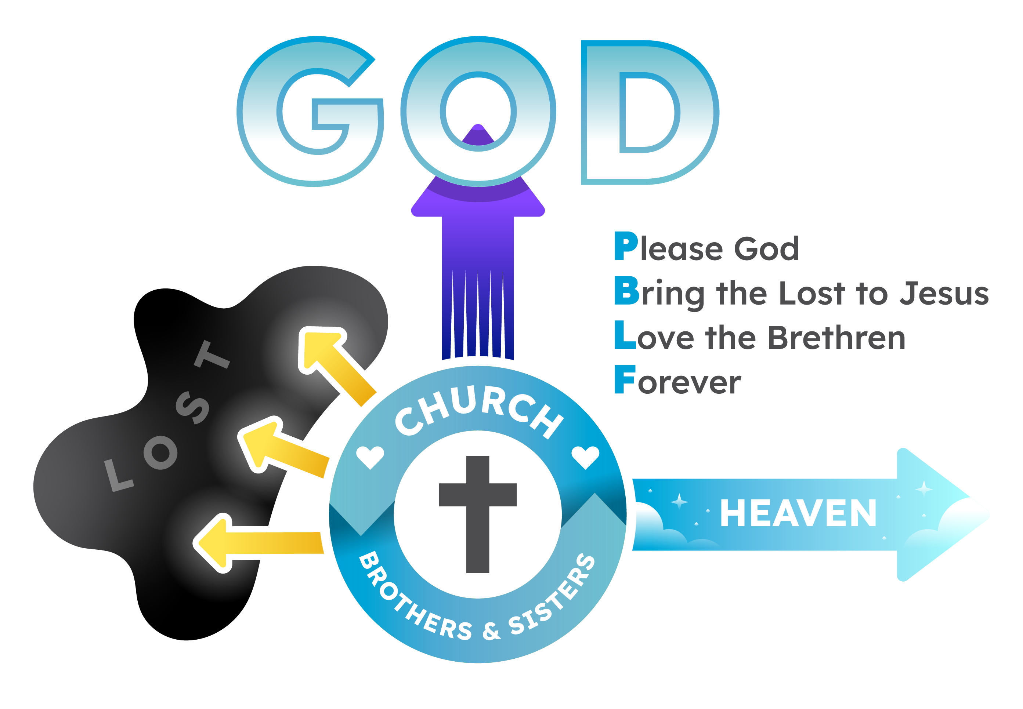

Slide 5



Slide 6



Slide 8
Every Servant of God Has Something to Do (Matt. 25:14-15).
Every Servant of God Is Part of PBL Forever (Mark 12:26-34).
Every Servant of God Can Find Plenty to Do for the Lord (1 Cor. 15:58).
  Sometimes we think we have to wait:
    To be asked to do something
    For the church to express a need
    For a program to be created
  Does “always abounding” (1 Cor. 15:58) rhyme with “waiting”?
    “Blessed is that servant whom his master will find so DOING” (Luke 12:43)
    And WHY wouldn’t YOU find plenty to do for the Lord?
    WHY wouldn’t EVERY Christian?
    WHY wouldn’t EVERY part endeavor to do its share (Eph. 4:16)?

Slide 9
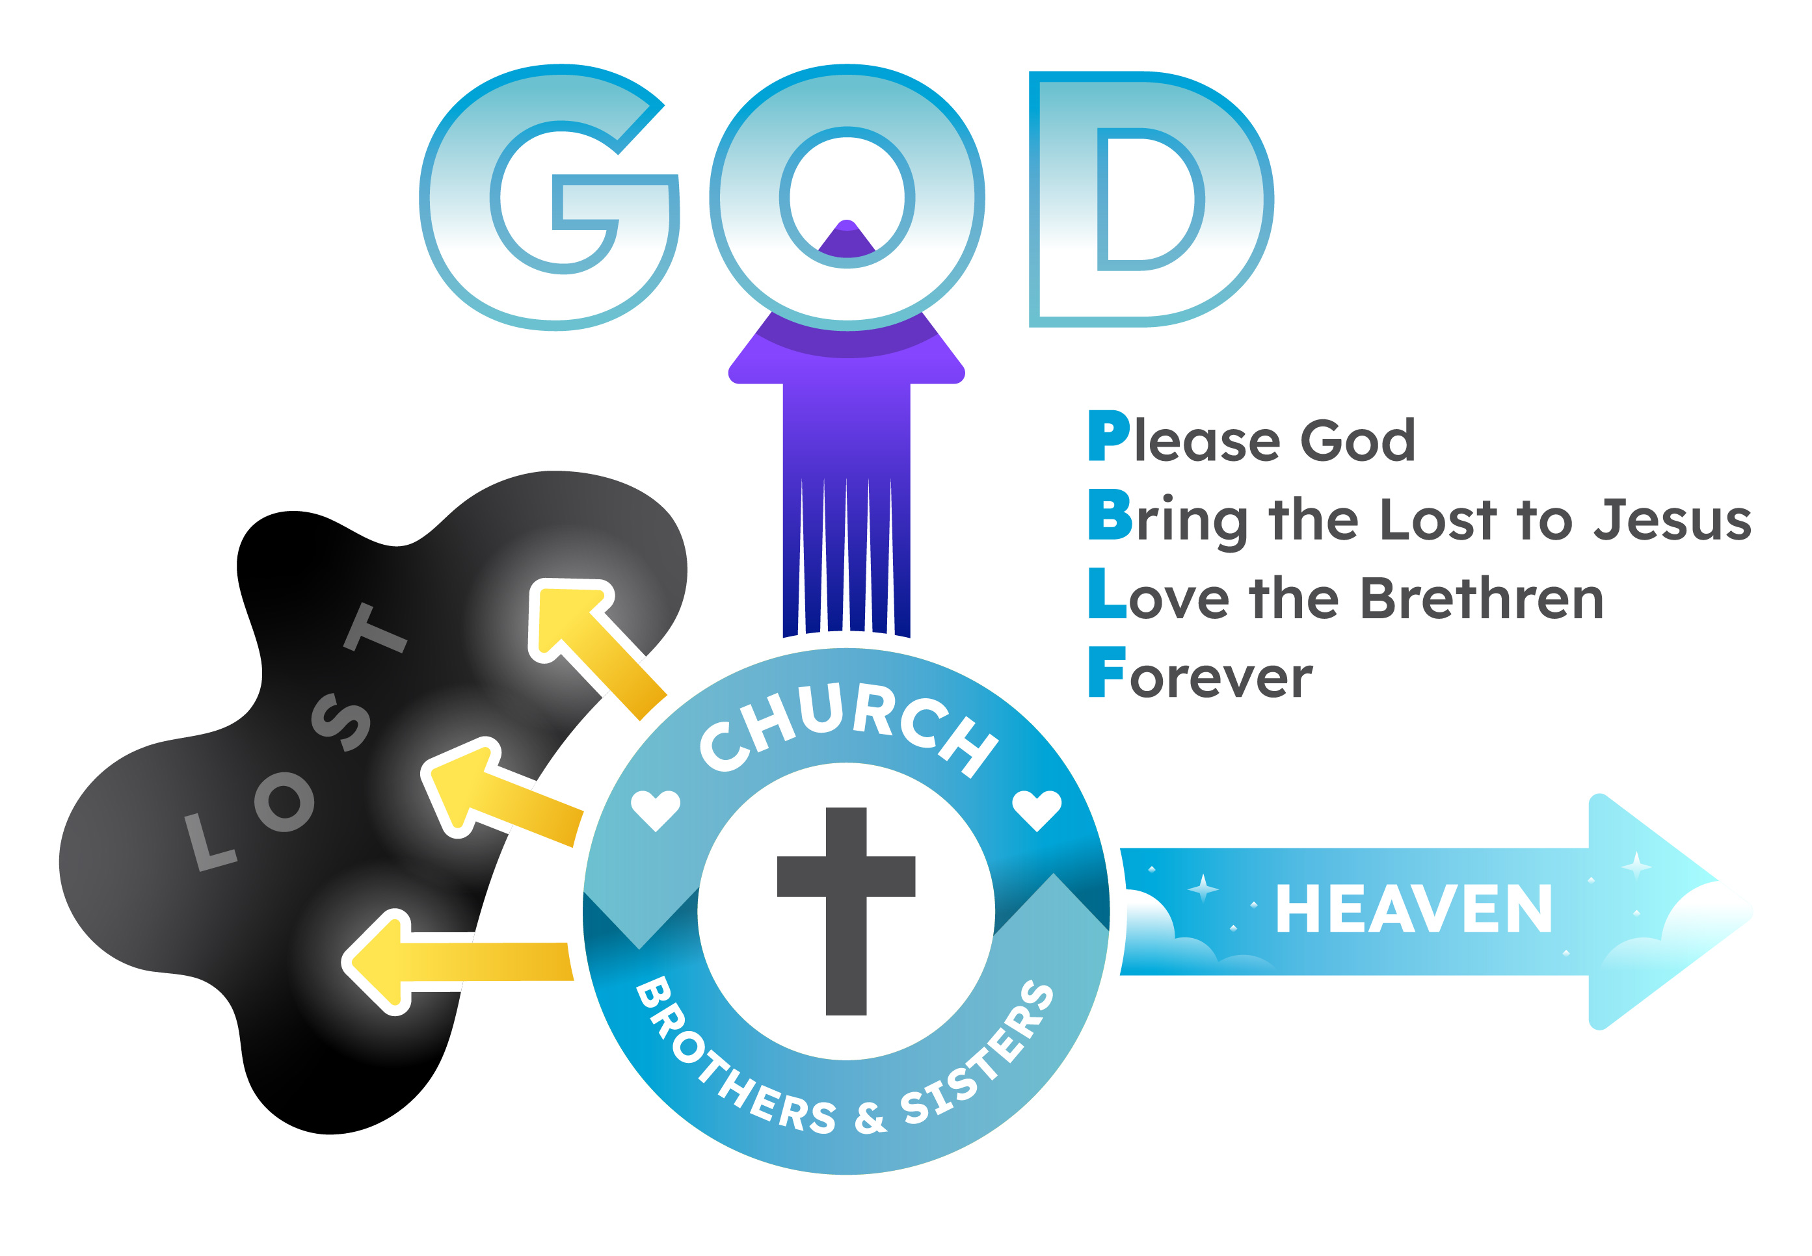

Share the Gospel & Invite to Worship
Greet Guests & Make Them Feel at Home
Follow Up with Guests After Worship
Teach & Convert Guests to Christ
Maintain Church Property
Incorporate New Members into PBL
Prepare for & Serve in Worship
Teach
Children and Adults
Fellowship
with the Brethren
Serve & Encourage the Brethren

Slide 10
Questions to Ask at the End of Every GOD-Given Day.
  Did I use my GOD-given EYES for HIM today?
    To look for opportunities (Gal. 6:10), for souls needing the gospel (John 4:35), etc.?
  Did I use my GOD-given EARS for HIM today?
    To hear needs (Rom. 12:15), to listen cries for help (Acts 16:9), etc.?
  Did I use my GOD-given TONGUE for HIM today?
    To talk about Jesus (Mark 16:15), to encourage (Heb. 3:13), etc.?
  Did I use my GOD-given SHOULDERS for HIM today?
    To bear burdens (Gal. 6:2), to help the weak (Rom. 15:1), etc.?
  Did I use my GOD-given HANDS for HIM today?
    To write (3 John 11), to comfort (2 Cor. 1:3-5), etc.?
  Did I use my GOD-given FEET for HIM today?
    To visit (Jas. 1:26), to teach (Acts 8:4), etc.?

