Slide 2

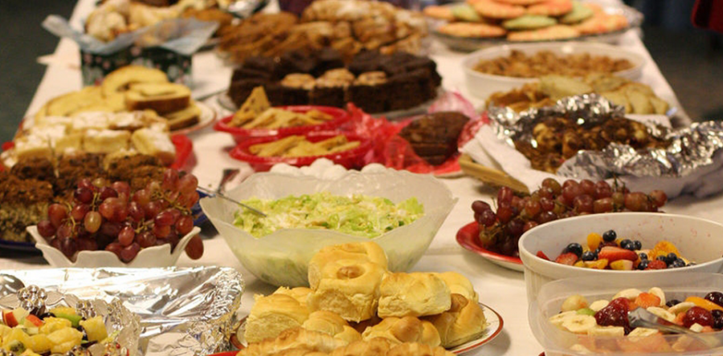
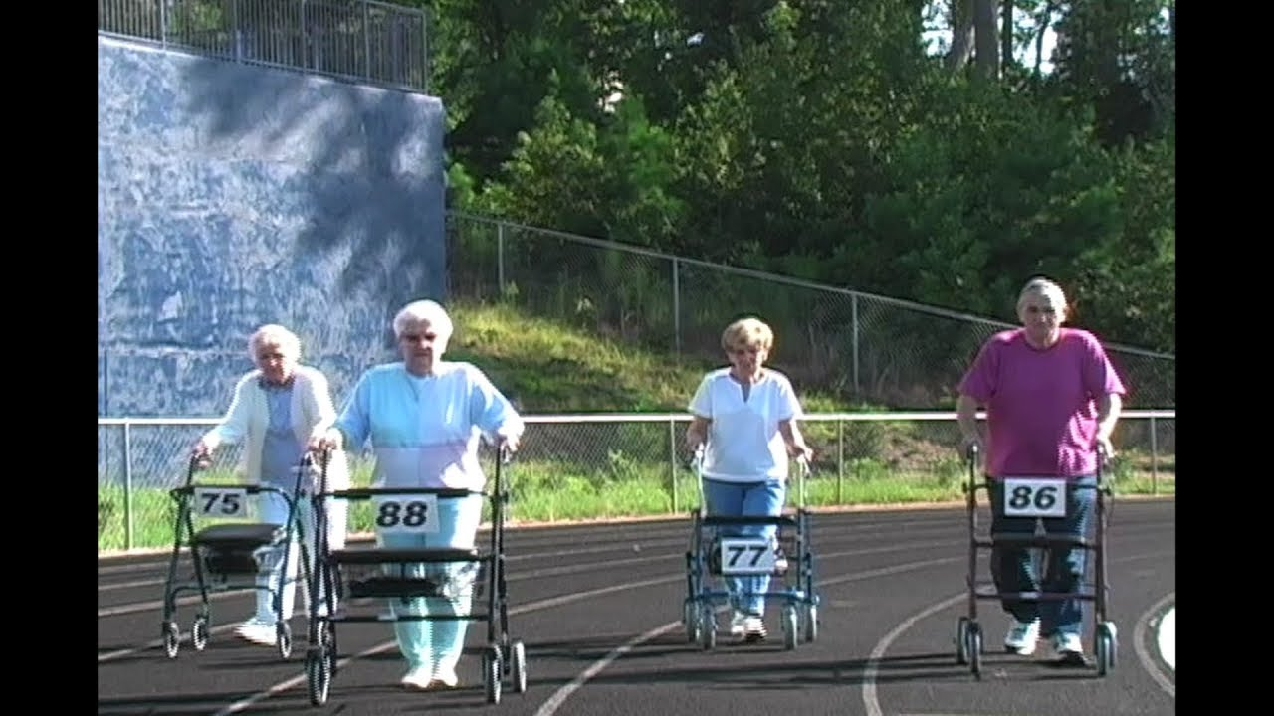




Slide 3
In man’s eyes, those who serve are looked down upon (Luke 22:27; Mark 10:42)
In God’s eyes, those who serve are “great” and “first” (Mark 9:35; 10:43-44)
Servants of the church are recognized and honored by God (Rom. 16:1; John 12:26)
Servants of the church get to minister to each other (Heb. 6:10)
Servants of the church can addict themselves to serving (1 Cor. 16:15)
Servants of the church look like Jesus (Matt. 20:28; Mark 10:45; Luke 22:27)
Servants of the church are actually serving Jesus (Matt. 25:40, 44, 45; Col. 3:23-24)
Servants of the church serve as God has blessed and to God’s glory (1 Pet. 4:10-11)
THE CHURCH NEEDS MORE!

Slide 4
Being a preacher is not a job where it’s all about you (1 Cor. 3:5-7)
Being a preacher, like Jesus, is about being a minister/servant (1 Tim. 4:6)
You get to be a minister of the Word (Acts 6:4)
You get to be a minister of the gospel (Col. 1:23)
You get to be a minister of reconciliation (2 Cor. 5:18)
You get to be a minister of (and to and for) the church (Col. 1:24-25)
You get to be a fellow laborer with ministers around the world (1 Thess. 3:2)
You get to serve the Lord and serve His church with joy (Acts 20:24)
Your boss is…God (2 Cor. 6:4; 1 Thess. 3:2), Jesus Christ (1 Tim. 4:6; Phil. 1:1)
THE CHURCH NEEDS MORE!

Slide 5
Deacons are special servants in the church who get to do special tasks designated by the elders
A deacon must “first be tested,” proved to be a willing servant (1 Tim. 3:10)
A deacon must meet the God-given qualifications (1 Tim. 3:8-13)
A deacon’s wife must meet the God-given qualifications (1 Tim. 3:11)
A deacon must serve and minister well (1 Tim. 3:13)
A deacon is an example to whom others look and follow (Acts 6:3)
THE CHURCH NEEDS MORE!

Slide 6
Believe that Jesus is the Son of God – John 8:24
Repent of your sins and turn toward God – Acts 17:30
Confess your faith in Jesus Christ – Romans 10:9
Be immersed into Christ – Acts 22:16
  God will forgive all of your sins – Acts 2:38
  God will add you to His church – Acts 2:47
  God will register you in heaven – Hebrews 12:23
Serve the Lord faithfully – Matthew 25:23

