Slide 1
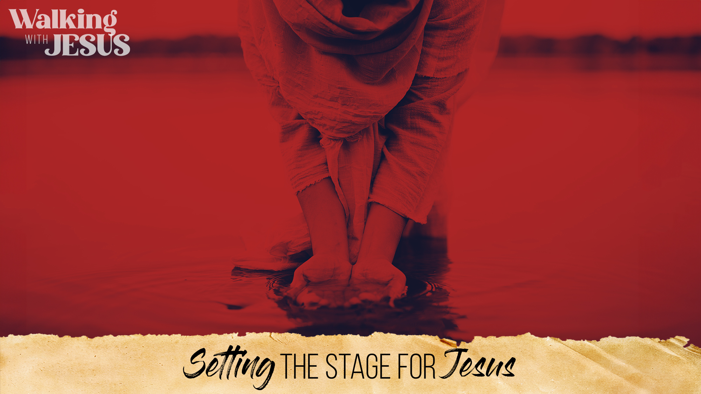
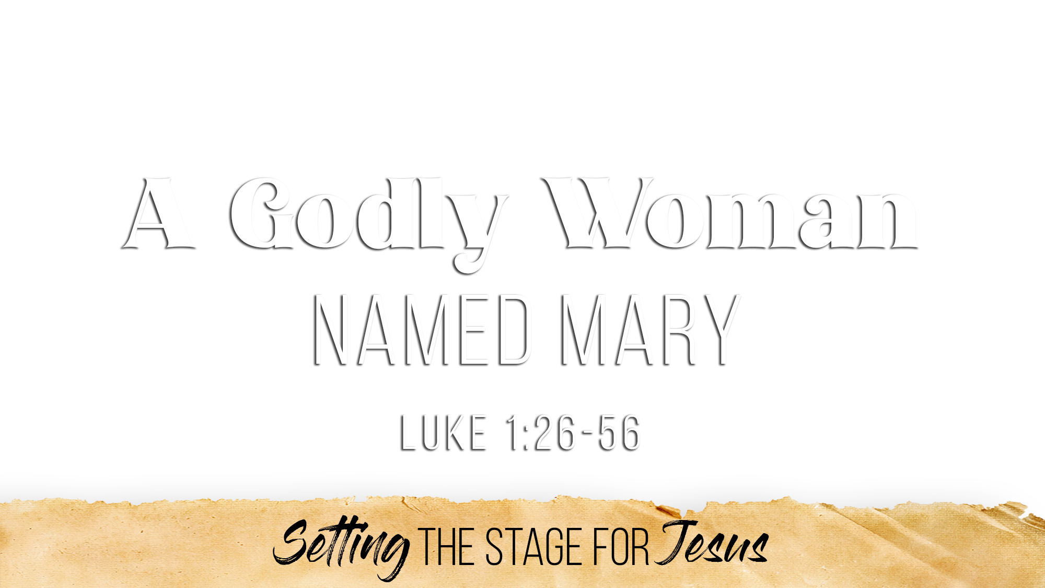

Slide 2
Before her name is recorded, twice she is called a “virgin” (1:27)
She readily revealed that she “is not knowing a man” (1:34)
A godly woman must make choices (even hard ones) to remain pure
  She needs to guard who she spends time with (1 Cor. 15:33; Rom. 12:2)
  She needs to guard the places that she goes (Prov. 1:10-15; 4:14-15)
  She needs to guard her modesty and her body (1 Tim. 2:9-10; 1 Pet. 3:2-4; 1 Cor. 6:20)
  She needs to guard her interactions with others (Prov. 11:5, 20; 13:6; 2 Cor. 8:21)
  She needs to guard against being alone with a man and guard her influence (Eph 4:27; Jas. 4:7; 1 Pet. 2:11-12)
  She needs to guard her heart, desires, emotions, passions (Prov. 4:23; Jas. 1:14-15; Matt. 5:8; 2 Tim. 2:22)

Slide 3
The first words spoken to her reveal God’s “favor” for her (1:28, 30)
She cared about her relationship with the Lord and finding “favor” in His sight
“God gives grace/favor to the humble” (Prov. 3:34; Jas. 4:6; 1 Pet. 5:5)
A godly woman must be clothed with humility (1 Pet. 5:5)
  She puts God first, above herself (Matt. 22:37)
  She puts others first, above herself (Phil. 2:3-5)
  She does not think of herself more highly than she should (Rom. 12:3)
  She sees Christ as the reason she is anything in eyes of God (1 Cor. 15:8; 1 Tim. 1:12-15)

Slide 4
She willingly submitted herself to the will of God (1:38)
She wholeheartedly put her faith in God, that He would and could fulfill His Word (1:45)
A godly woman must have a deep faith and trust in God
  She spends much time in reading and learning God’s will for her (Psa. 1:2)
  She does not question or doubt God (Jas. 1:5-8; Acts 10:20; 27:25)
  She does not hold herself back from God in any way (Rom. 12:1; 6:13)
  She believes in the power of God (1:37; John 2:5; Eph. 3:20)
  She allows and desires her will and her life to be lost in Christ (Col. 3:3)

Slide 5
She magnified the Lord for what He had done for her (1:46-49)
She magnified the Lord for what He had done for all people (1:50-53)
She magnified the Lord for what He had done for Israel (1:54-55)
A godly woman praises her God for all that “He has” done (1:46-47)
  She knows her God and His Word personally (1:48-49; Psa. 119:92-94)
  She realizes that without Him, she would be nothing (1:48; John 15:5)
  She sees all of His “great/good things, mercy” (1:49, 50, 53, 54; Psa. 145:8)
  She appreciates the holiness of her God (1:49; 1 Sam. 2:2)
  She has and manifests deep love and respect for God (1:50; Ecc. 12:13)

Slide 6
Believe that Jesus is the Son of God – Acts 16:31
Repent of your sins and turn toward God – Acts 3:19
Confess your faith in Jesus Christ – Acts 8:36-38
Be immersed into Christ – Mark 16:16
  God will forgive all of your sins – Acts 2:38
  God will add you to His church – Acts 2:47
  God will register you in heaven – Hebrews 12:23
Be a faithful child of God – Revelation 2:10

