Slide 1


Slide 2
LESSONS FROM THE MIRACLES OF JESUS

Slide 3
LESSONS FROM THE MIRACLES OF JESUS
The purpose of miracles was to confirm God’s Word.
The purpose of the Gospel of John is to confirm Jesus as God’s Son
Disciples, Pharisees, Gentiles
Genesis 12:3
I will bless those who bless you (Abraham), and I will curse him who curses you; and in you ALL the families of the earth shall be blessed.

Slide 4
LESSONS FROM THE MIRACLES OF JESUS
John Chapter 11 – Raising Lazarus from the dead
2 other instances of raising the dead are recorded
The widow of Nain’s son (Luke 7:11-17)
Jairus’ daughter (Mark 5:22-24, 35-43)

Slide 5
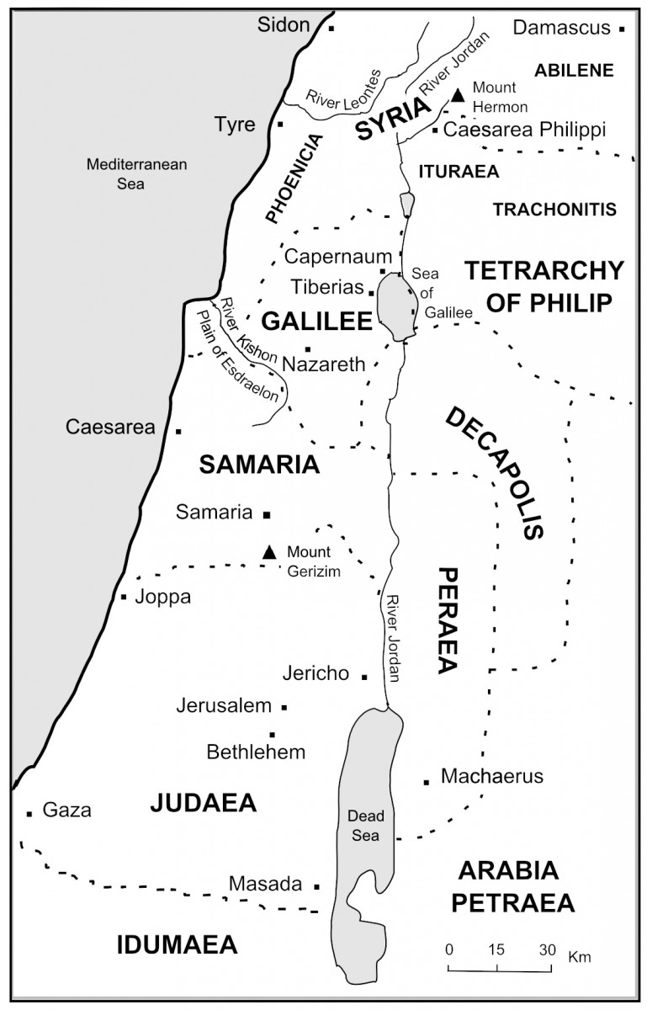
Lazarus raised from the dead
John Chapter 11 life and death
Bethany

Slide 6
Lazarus Raised from the Dead, John chapter 11
Life and Death
Therefore #1 (verse 16) Thomas voices the disciples’ approval that they will accompany Jesus to Bethany even in the face of death.
We need to be ready to follow Jesus into the breach of a sinful world
Therefore #2 (verse 20) Martha leaves the house to meet Jesus on the road and before He makes it to the house. Martha remembered the lesson previously taught to her by Jesus and focused her attention on Jesus.
Martha knows what we need to know – In difficult times, trust in the Lord

Slide 7
Lazarus Raised from the Dead, John chapter 11
Life and Death
Therefore #3 (verse 32) Mary leaves the house to respond to Jesus and fell at His feet.
Therefore #4 (verse 33) When Jesus saw Mary’s pain, He was deeply moved in the spirit and was troubled
Jesus can sympathize with our weakness – He is our brother AND our High Priest (Hebrews 4:15)

Slide 8
Lazarus Raised from the Dead, John chapter 11
Life and Death
Therefore #5 (verse 45) Many of the Jews who came to Mary, and saw, also believed
The miracle that sealed Jesus’ fate.
This is what Jesus knew He was walking into when he steadfastly set his face to go to Jerusalem (Luke 9:51). This is the Lord and Savior that we serve.

