Slide 1

Thinking Right About…
LIFE,
DEATH,
& ETERNITY

Slide 2
CAN GOD RIGHTLY TAKE LIFE?

Slide 3
CAN GOD RIGHTLY TAKE LIFE?
YES

Slide 4
CAN GOD RIGHTLY TAKE LIFE?
YES
He created it. He owns it. He has the authority over it.

Slide 5
CAN GOD RIGHTLY TAKE LIFE?
YES
He created it. He owns it. He has the authority over it.
-Job 41:11; 1:21

Slide 6
CAN GOD RIGHTLY TAKE LIFE?
YES
He created it. He owns it. He has the authority over it.
-Job 41:11; 1:21
-Psa. 24:1; 100:3

Slide 7
CAN GOD RIGHTLY TAKE LIFE?
YES
He created it. He owns it. He has the authority over it.
-Job 41:11; 1:21
-Psa. 24:1; 100:3
-John 21:18-22

Slide 8
CAN GOD RIGHTLY TAKE LIFE?
YES
He created it. He owns it. He has the authority over it.
-Job 41:11; 1:21
-Psa. 24:1; 100:3
-John 21:18-22
-Acts 12:1-11

Slide 9
CAN GOD RIGHTLY TAKE LIFE?
YES
He created it. He owns it. He has the authority over it.
As judgment upon the wicked.

Slide 10

On what basis can atheists say that killing a child is wrong or evil?

Slide 11
Atheism logically implies, “Everything is permitted,” including murder.
*Jean-Paul Sartre (1989), “Existentialism is Humanism,” in Existentialism from Dostoyevsky to Sartre, ed. Walter Kaufman, trans. Philip Mairet (Meridian Publishing Company), http://www.Marxists.org/reference/archive/sartre/works/exist/sartre.htm.

Slide 12
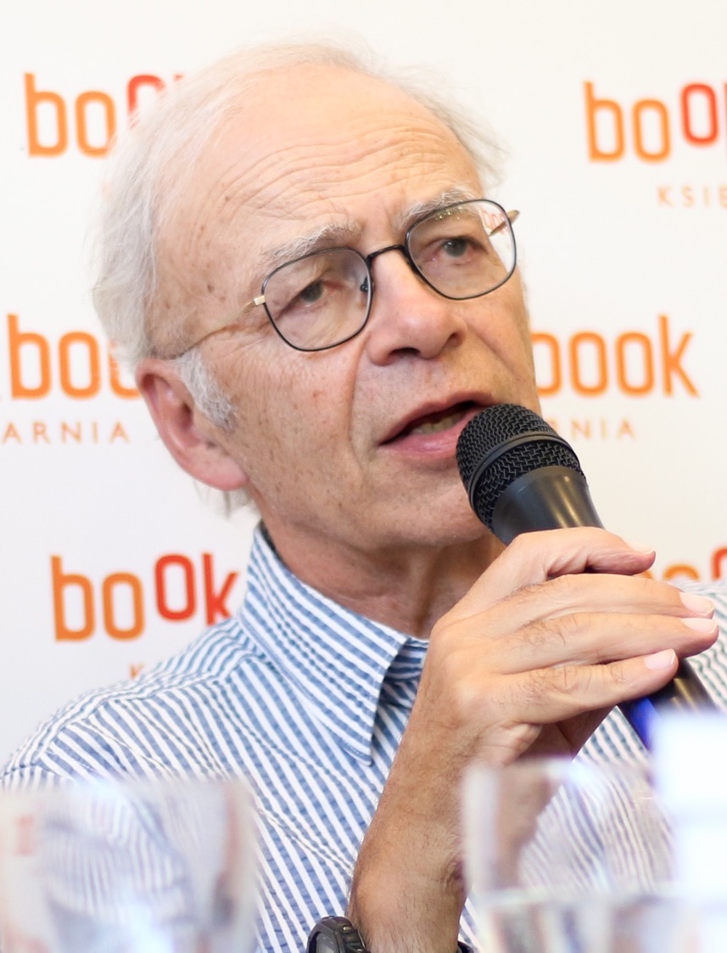
Peter Singer:
“[K]illing a disabled infant is not morally equivalent to killing a person. Very often it is not wrong at all.”
Peter Singer (2000), Writings on an Ethical Life (New York: Harper Collins), p. 193, emp. added.
www.Wikimedia.org—Ula Zarosa—2017—CC-by-SA-2.0

Slide 13
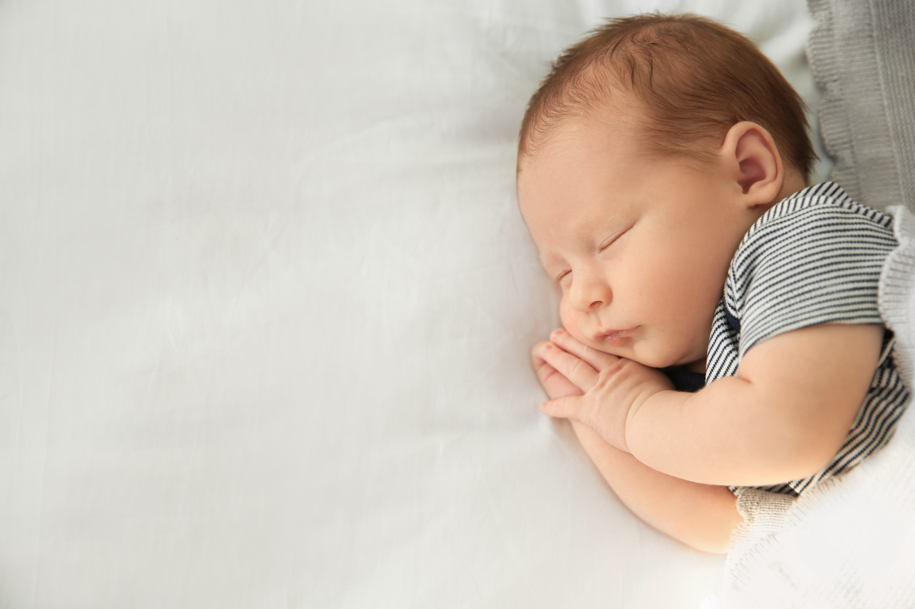
Secular bioethicists Alberto Giubilini and Francesca Minerva argued “that what we call ‘after-birth abortion’ (killing a newborn) should be permissible in all the cases where abortion is, including cases where the newborn is not disabled.”
Alberto Giubilini and Francesca Minerva (2013), Featured Article: “After-Birth Abortion: Why Should the Baby Live?” Journal of Medical Ethics, 39[5]:261, emp. added, https://jme.bmj.com/content/39/5/261.

Slide 14
CAN GOD RIGHTLY TAKE LIFE?
YES
He created it. He owns it. He has the authority over it.
As judgment upon the wicked.
As mercy upon the righteous. cf. Isa. 57:1-2; Psa. 116:15

Slide 15
CAN GOD RIGHTLY TAKE LIFE?
YES
He created it. He owns it. He has the authority over it.
As judgment upon the wicked.
As mercy upon the righteous.
Was it right for God to take Enoch and Elijah?

Slide 16
CAN GOD RIGHTLY TAKE LIFE?
YES
He created it. He owns it. He has the authority over it.
As judgment upon the wicked.
As mercy upon the righteous.
Was it right for God to take Enoch and Elijah?
Will it be fair for Jesus to return, end time, and judge mankind?

Slide 17
Thinking Right About…
LIFE,
DEATH,
& ETERNITY

Slide 18
PHYSICAL LIFE IS PRECIOUS

Slide 19
HARD-WIRED WITH A DESIRE TO LIVE

Slide 20
THE BLESSING OF LONG LIFE
Gen. 15:15; Ex.20:12;
Deut. 5:33; Psa. 91:16; Prov. 3:2; Eph. 6:1-3

Slide 21
Do Not Confuse a Godly Desire for a Long Life with Being Scared to Die

Slide 22
MOST PEOPLE ARE AFRAID OF DEATH BECAUSE...

Slide 23
Christians Desire to Live…

Slide 24
Christians Desire to Live…
Not out of fear of death

Slide 25
“O death, where is your sting?... Death is swallowed up in victory…” (1 Cor. 15:55,54,57-58).

Slide 26
“O death, where is your sting?... Death is swallowed up in victory…” (1 Cor. 15:55,54,57-58).
“I am the resurrection and the life. Whoever believes in me, though he die, yet shall he live” (John 11:25).

Slide 27
“O death, where is your sting?... Death is swallowed up in victory…” (1 Cor. 15:55,54,57-58).
“I am the resurrection and the life. Whoever believes in me, though he die, yet shall he live” (John 11:25).
“Jesus…abolished death and brought life and immortality to light through the Gospel” (2 Tim. 1:10).

Slide 28
“O death, where is your sting?... Death is swallowed up in victory…” (1 Cor. 15:55,54,57-58).
“I am the resurrection and the life. Whoever believes in me, though he die, yet shall he live” (John 11:25).
“Jesus…abolished death and brought life and immortality to light through the Gospel” (2 Tim. 1:10).
“Precious in the sight of the Lord is the death of His saints” (Psa. 116:15).

Slide 29
Christians Desire to Live…
Not out of fear of death
Not fearing the unknown

Slide 30
Christians Desire to Live…
Not out of fear of death
Not fearing the unknown
Not for earthly gain
Not for earthly pleasures

Slide 31
Christians Desire to Live…
Not out of fear of death
Not fearing the unknown
Not for earthly gain
Not for earthly pleasures
For Christ
To Love
To Serve
To Sacrifice
To Show (the Way)
To Teach Others

Slide 32
But isn’t it better for me to die?
To have no more pain and suffering
To have no more sorrow
To be in comfort in Paradise
To be with the Lord
To forever enjoy eternal life
No more sin
No more funerals

Slide 33
But isn’t it better for me to die?
God hasn’t given us the authority to make/take that decision.

Slide 34
But isn’t it better for me to die?
God hasn’t given us the authority to make/take that decision.
We have no idea of the ramifications of such a decision.

Slide 35
But isn’t it better for me to die?
God hasn’t given us the authority to make/take that decision.
We have no idea of the ramifications of such a decision.
God has given us the task of doing good in His name with whatever time we have left.

Slide 36
Let’s live like our days on Earth are numbered—Psa. 90:12; James 4:14.

Slide 37
Let’s live like our days on Earth are numbered—Psa. 90:12; James 4:14.
Let’s live daily like we’re dying—like we have very little time left.

Slide 38
Let’s live like our days on Earth are numbered—Psa. 90:12; James 4:14.
Let’s live daily like we’re dying—like we have very little time left.
Let’s live…like going and being with the Lord means EVERYTHING to us.

Slide 39
Let’s live like our days on Earth are numbered—Psa. 90:12; James 4:14.
Let’s live daily like we’re dying—like we have very little time left.
Let’s live…like going and being with the Lord means EVERYTHING to us.
Let’s live like we really believe what the Bible really teaches about life, death, and eternity.

Slide 40
Let’s live daily like this world is not our home… and we’re just traveling to our MUCH better life.

Slide 41
Thinking Right About…
LIFE,
DEATH,
& ETERNITY

