Slide 1



Slide 2
As Light, Jesus constantly shines in darkness (1:5)
  His light exposes darkness (John 3:19-21)
  His light dispels darkness (1 John 1:5; 2:8; cf. 2 Cor. 6:14)
As Light, Jesus constantly gives light to every man (1:9)
  His light longs to reach every person (1 Tim. 2:4; 2 Pet. 3:9)
  His light does not show partiality (Rom. 2:11; Acts 10:34)
No matter how powerful the evil, it cannot overcome the light (1:5)

Slide 3
Am I like Jesus?
  Is my light constantly shining (Matt. 5:16)?
  Is my light constantly giving light to every man (Phil. 2:15)?
  Do I allow darkness to overcome me (Eph. 5:8-11)?
Am I like John?
  Do I know that my task is to “bear witness to the Light” (1:7, 8)?
  Do I know that my purpose is “that all might believe” (1:7)?
  Do I realize my efforts are not about me, but about the True Light (1:8)?

Slide 4

January 26
Every dollar given on Mission Sunday
goes toward mission work.

Slide 5
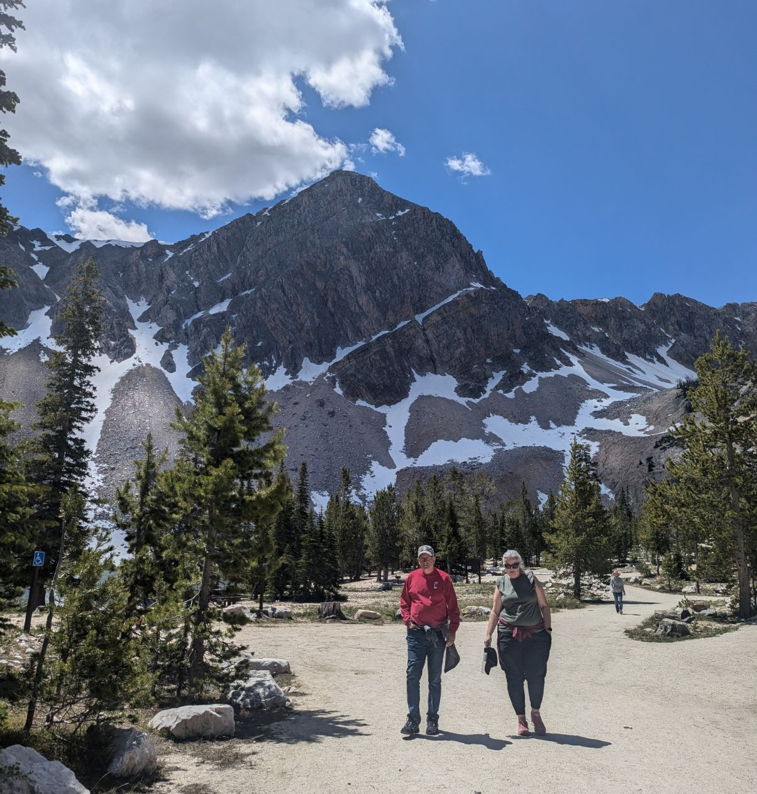

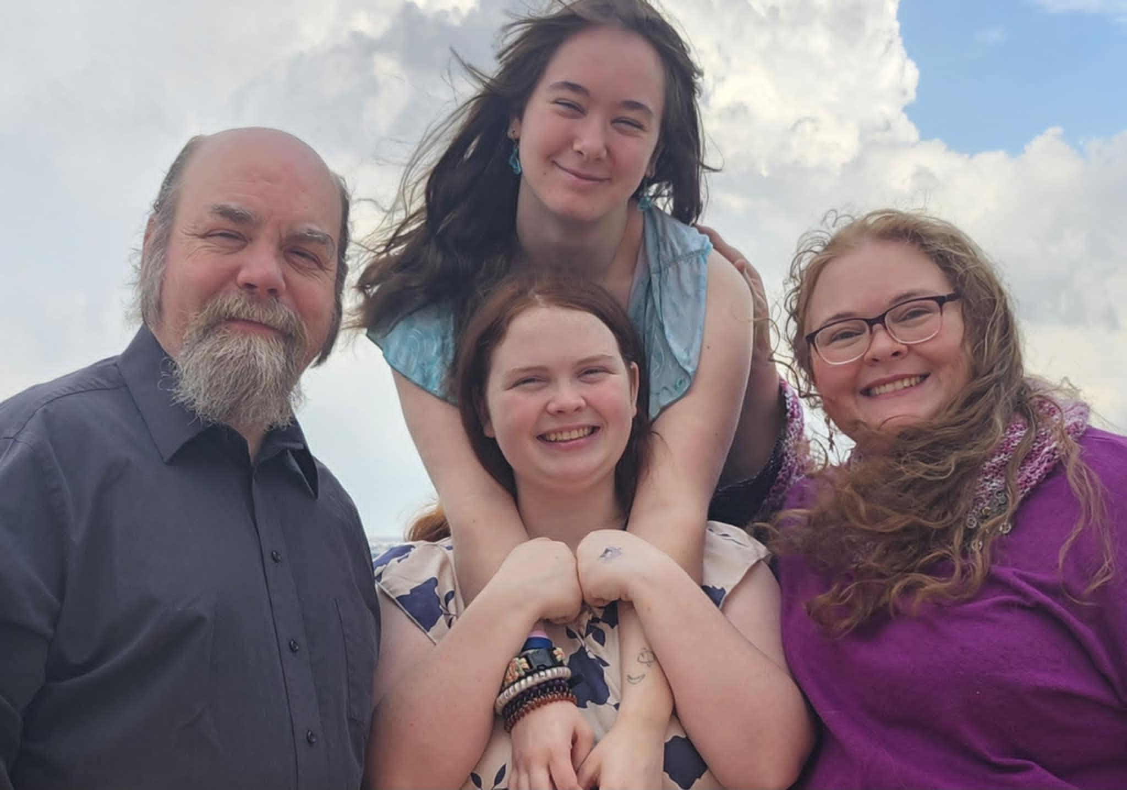
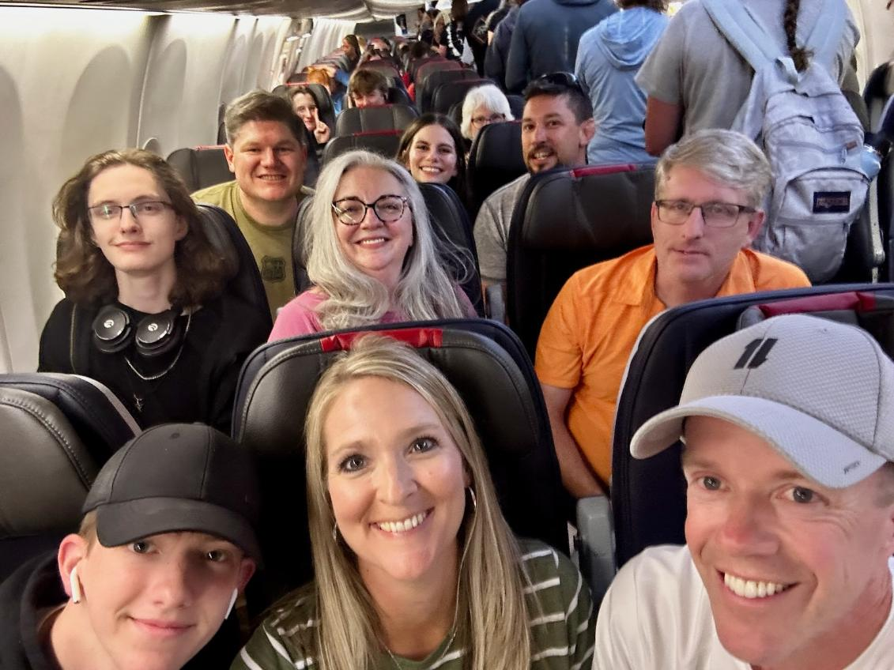
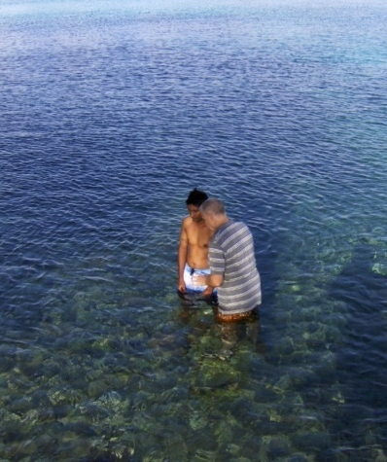

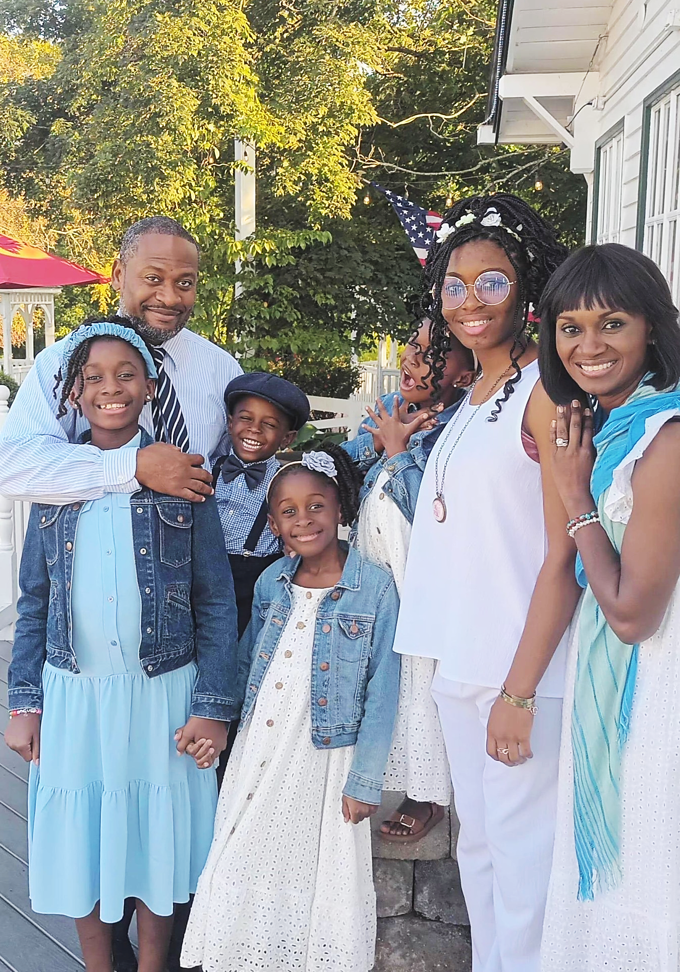
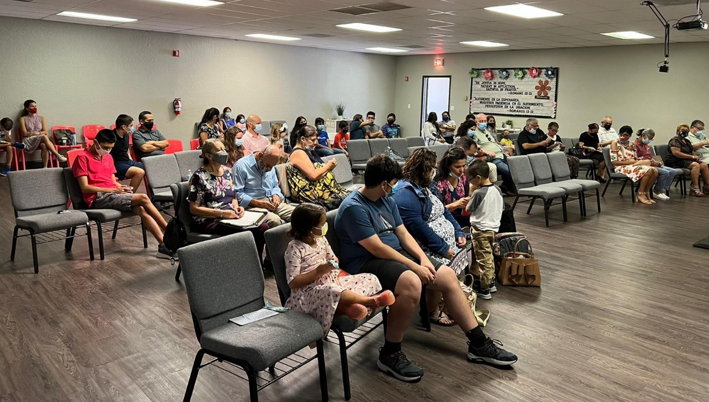
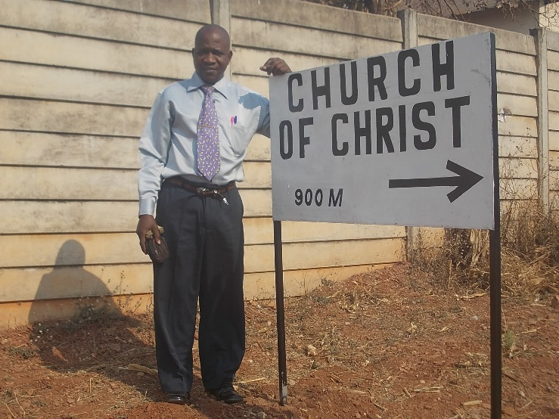
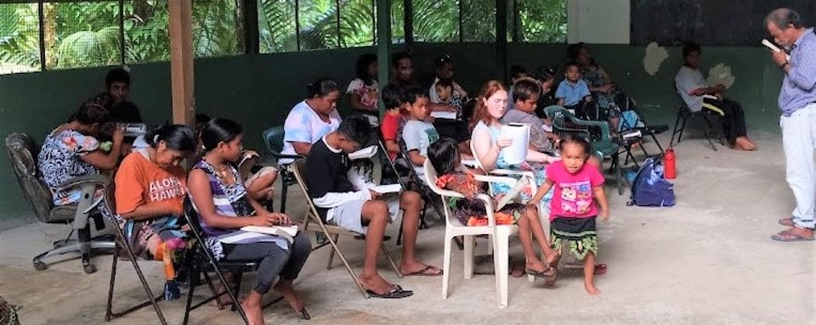
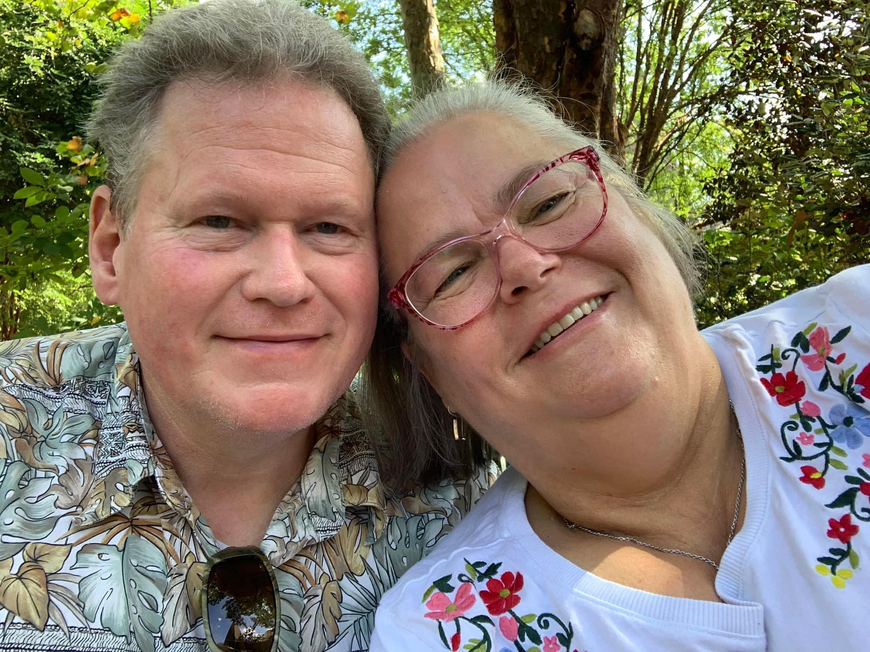
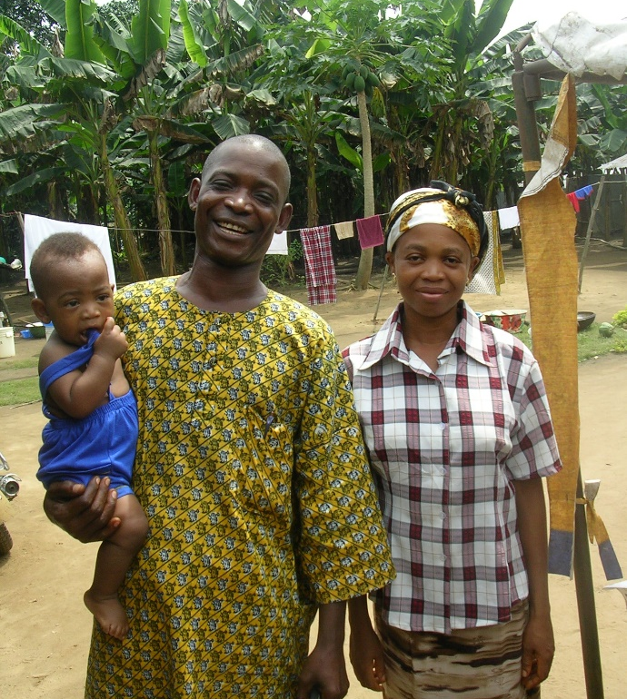
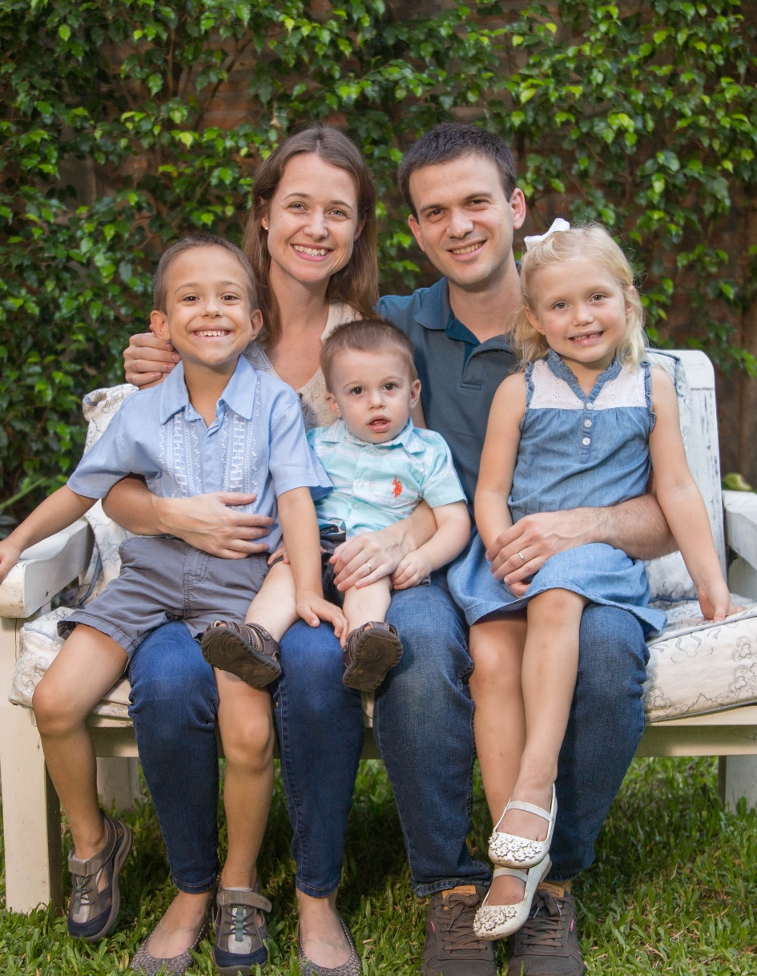
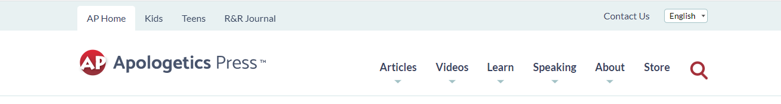
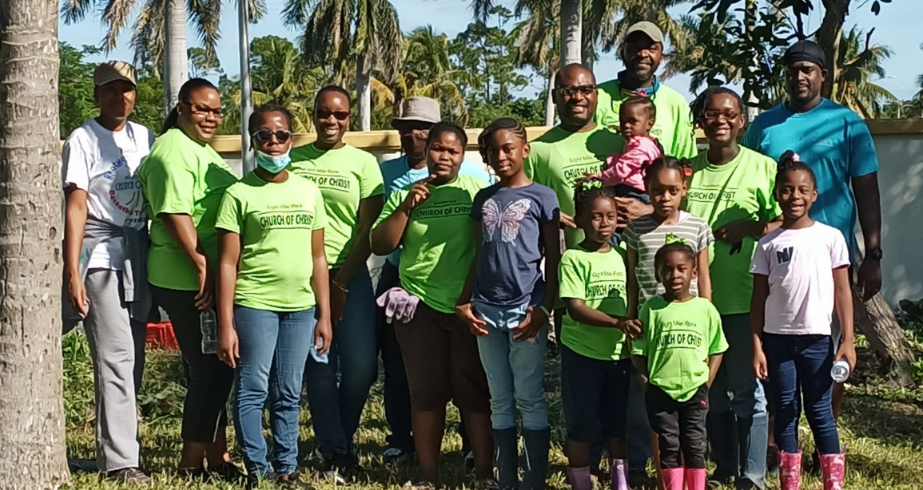
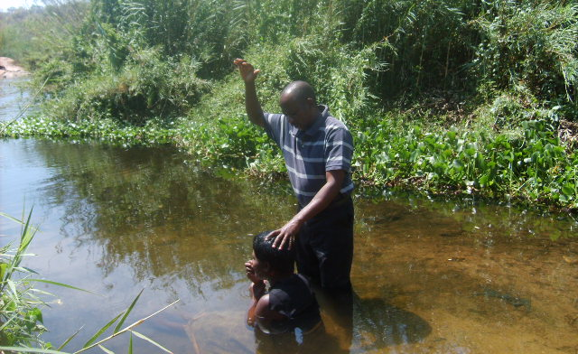
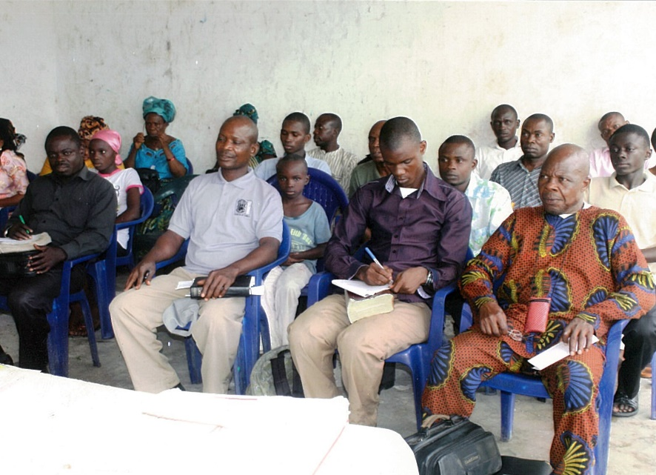
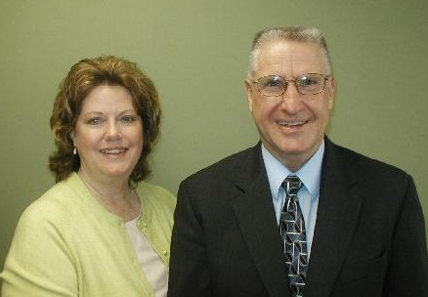
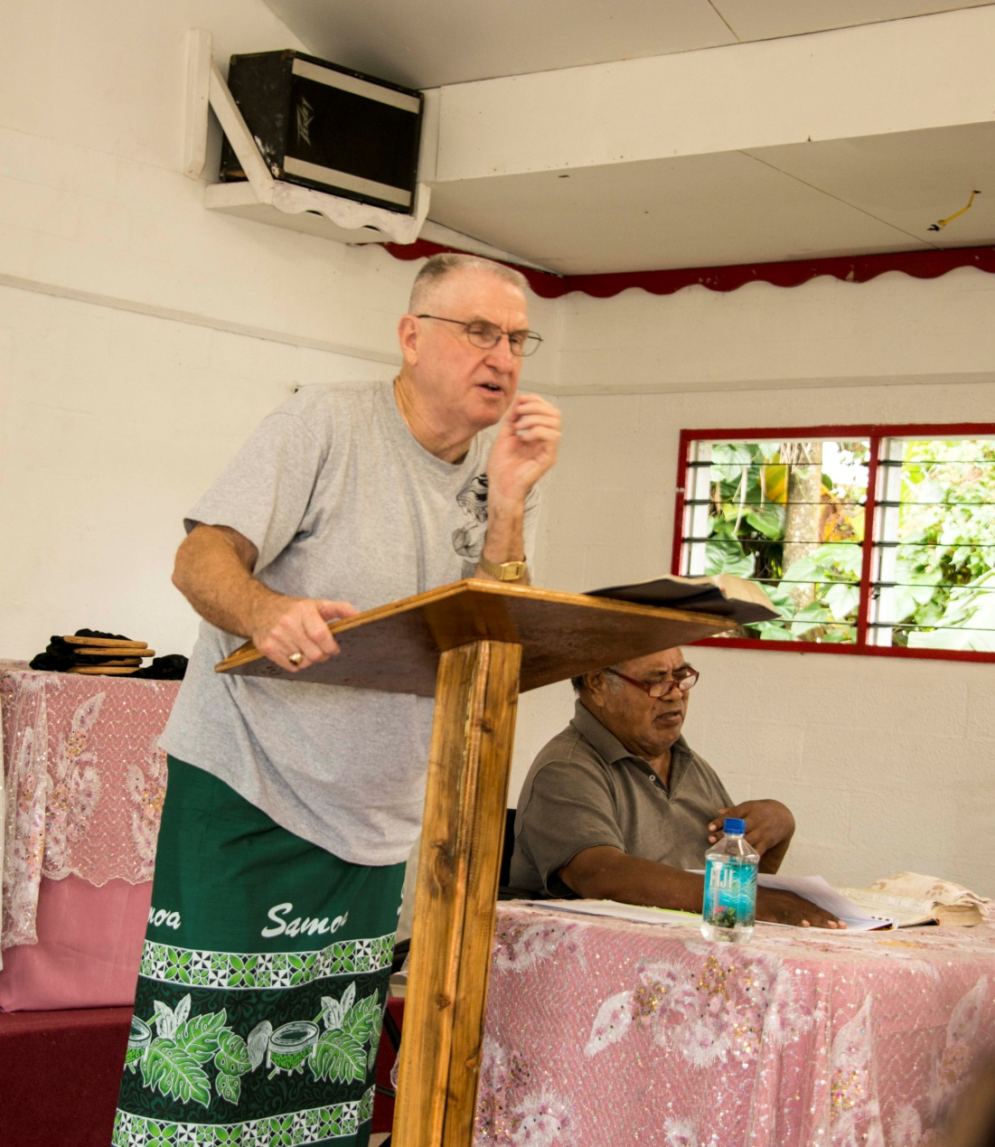
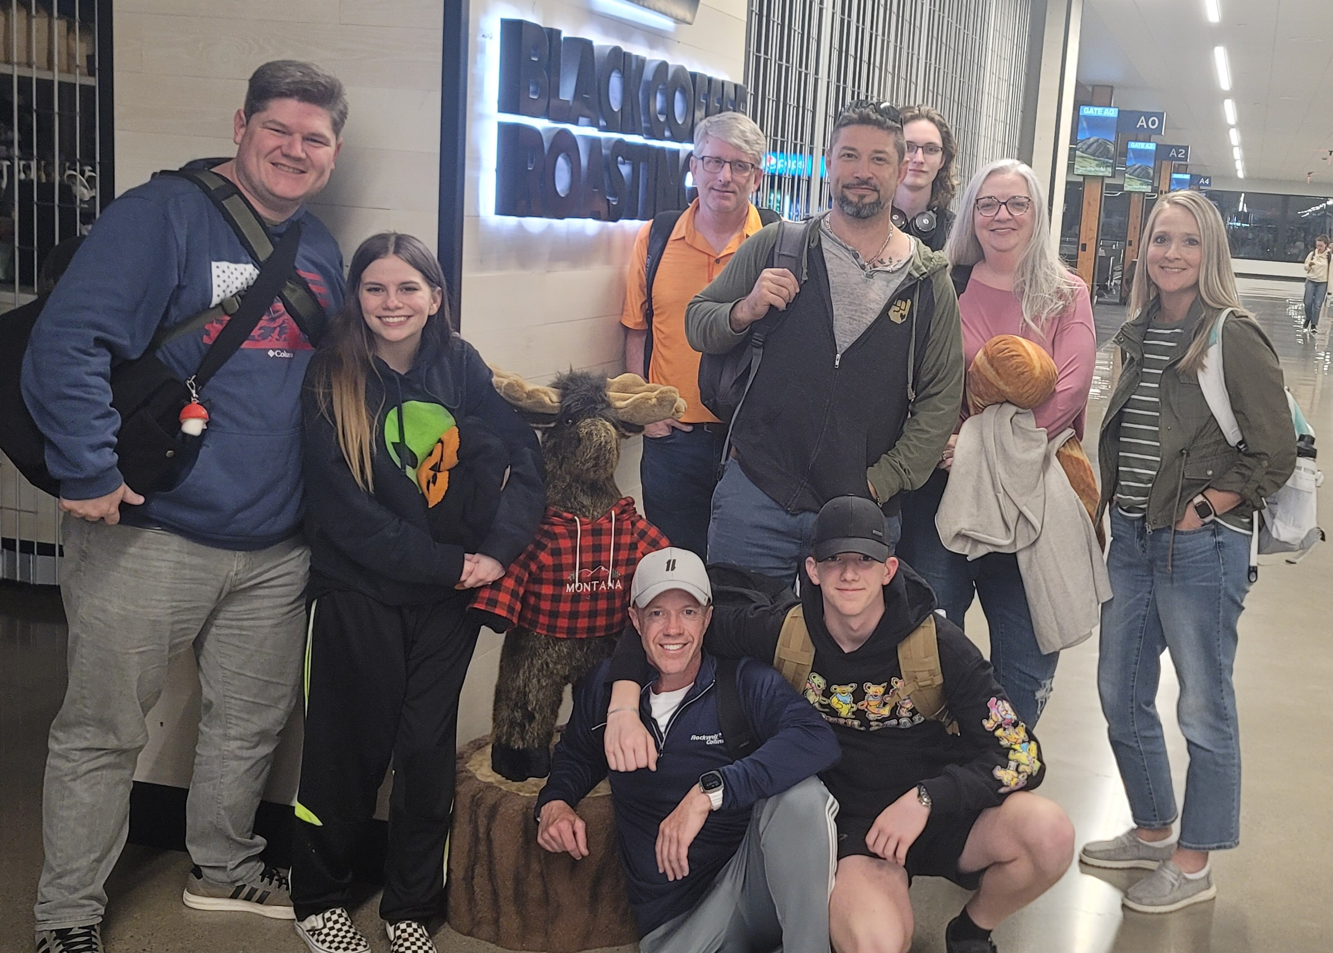
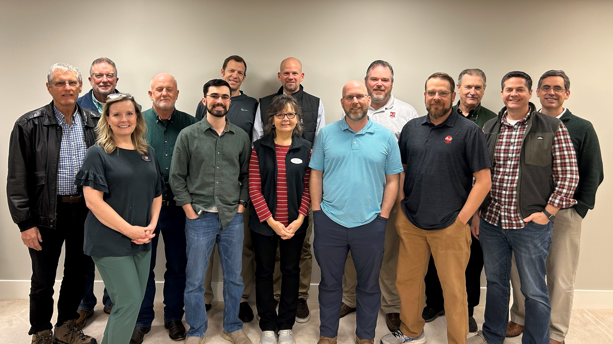
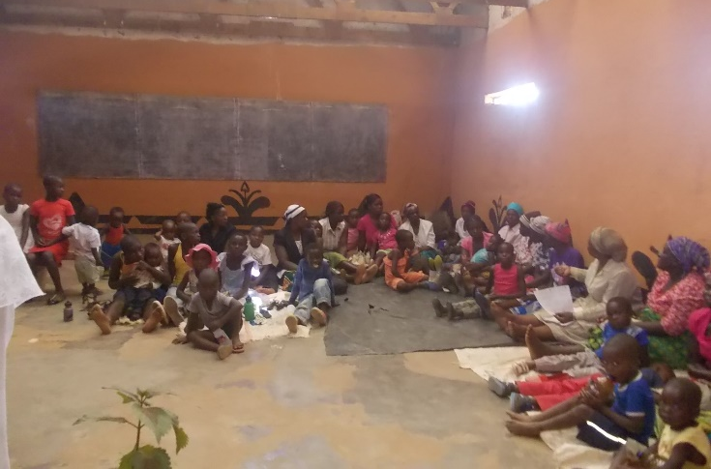

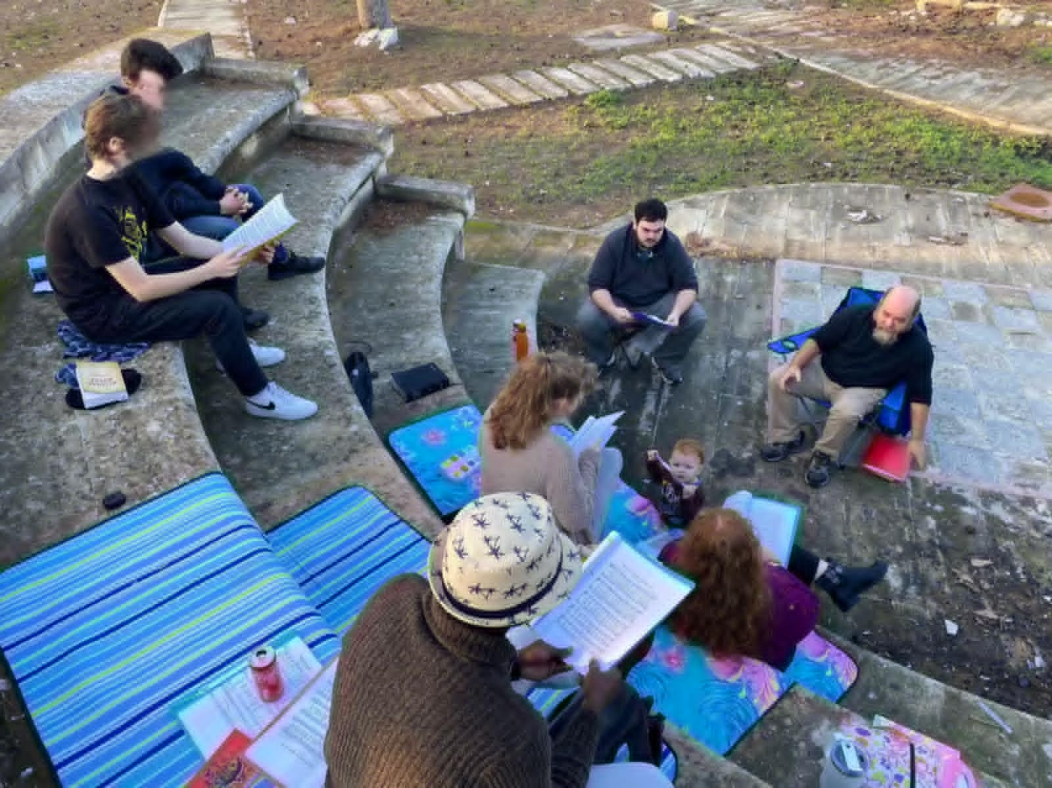



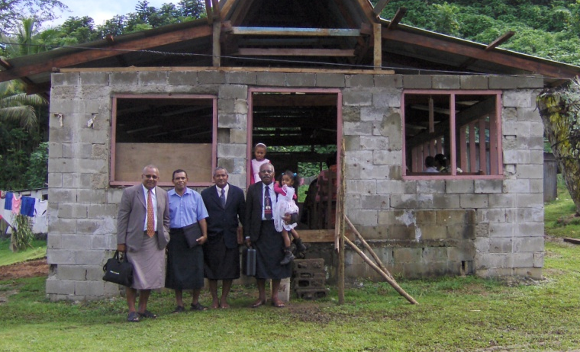
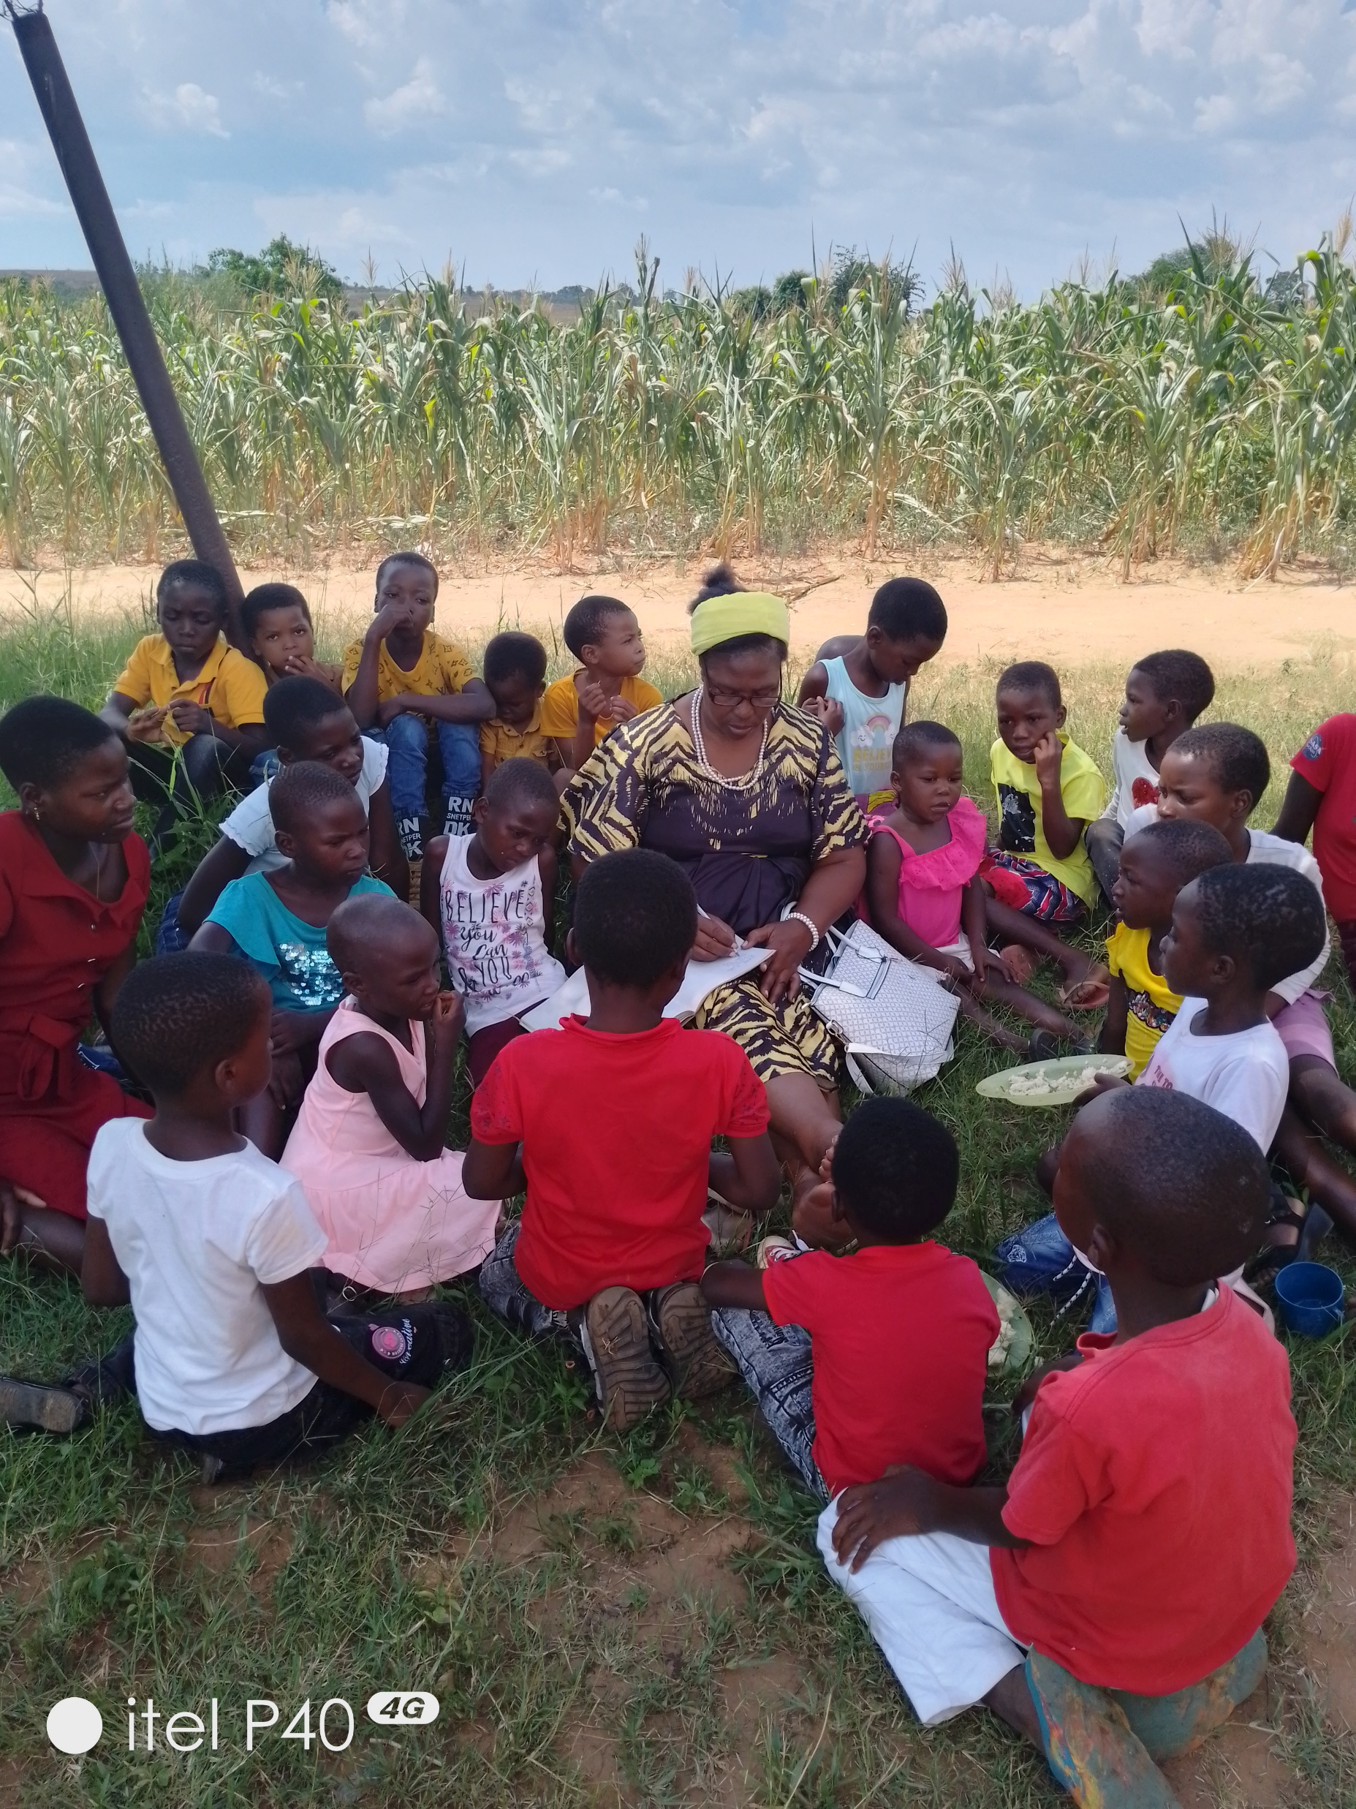
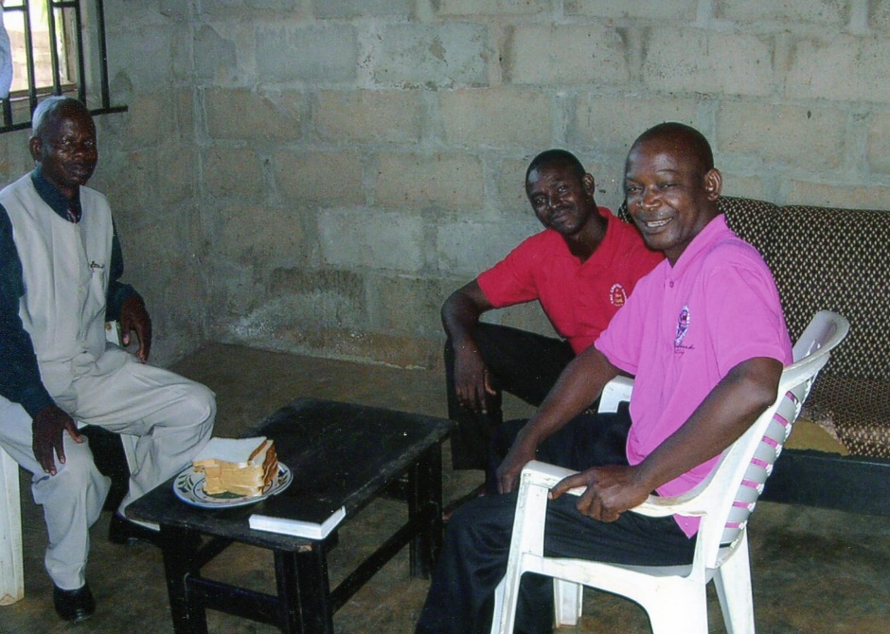
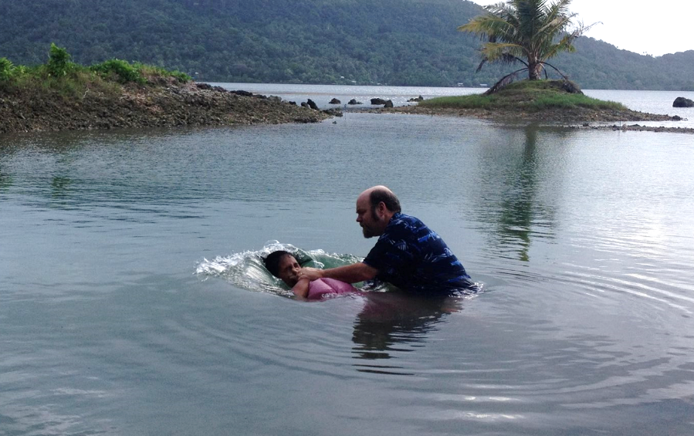
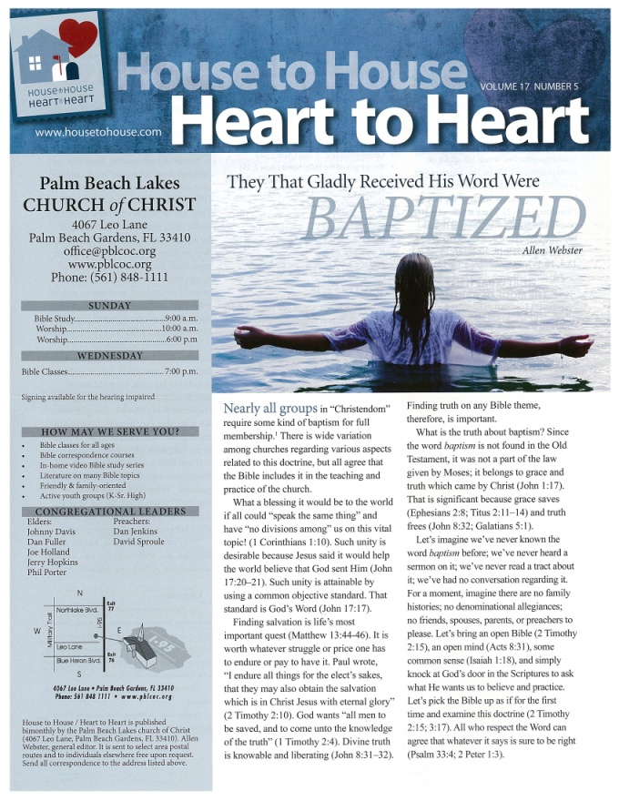
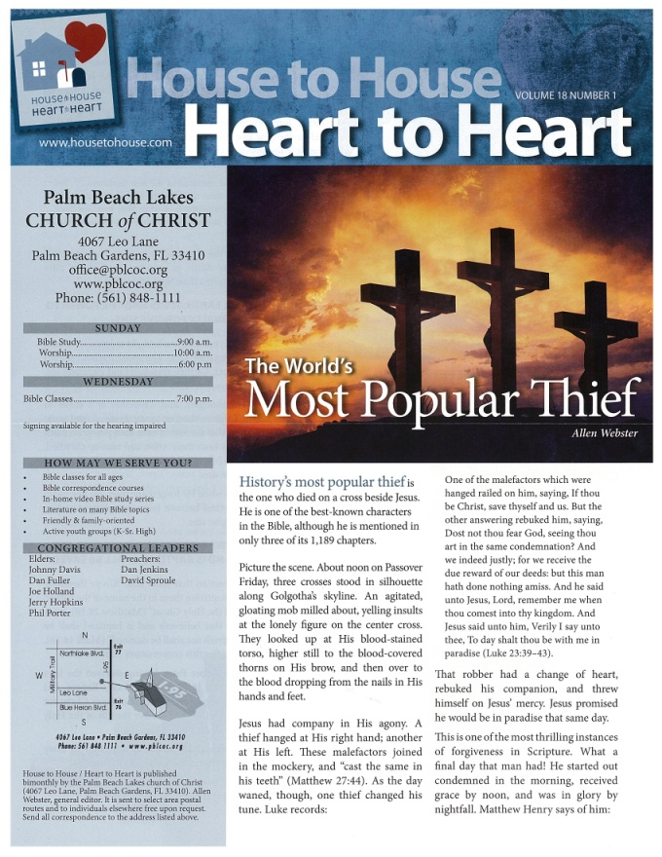
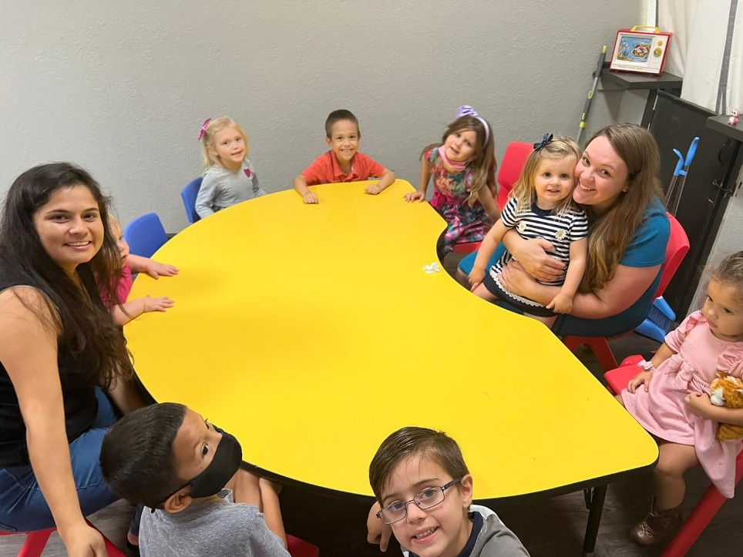
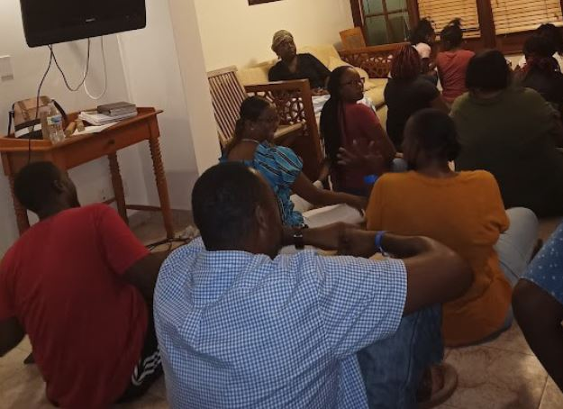
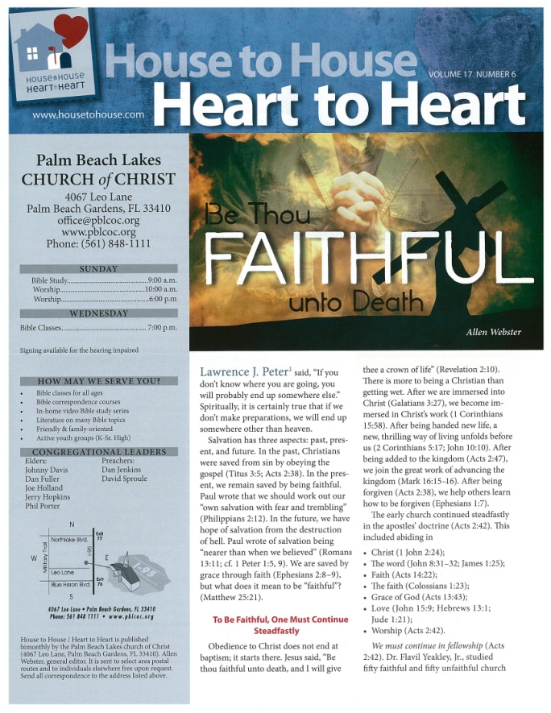
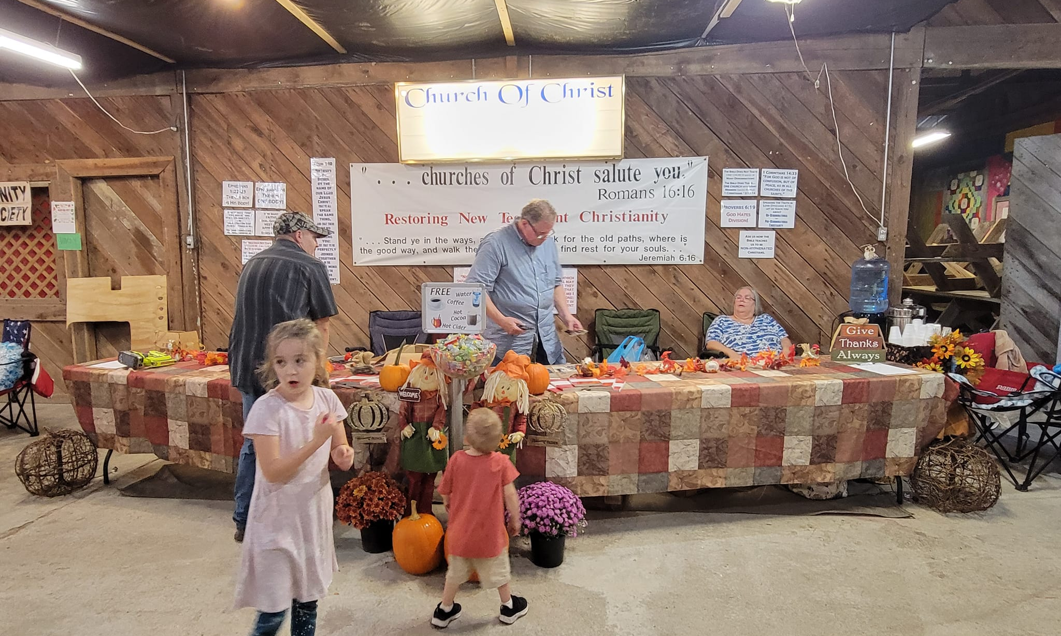
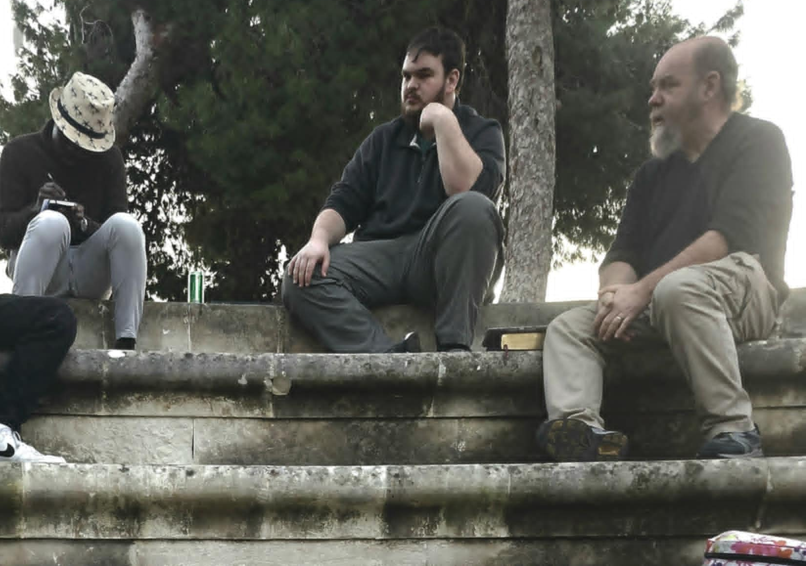
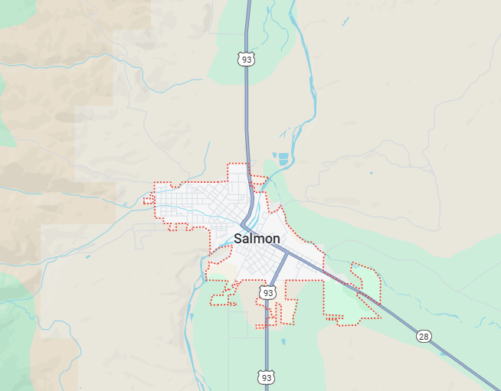
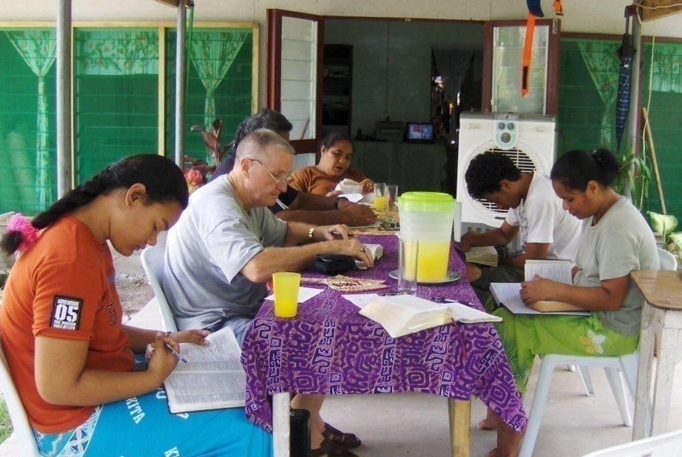
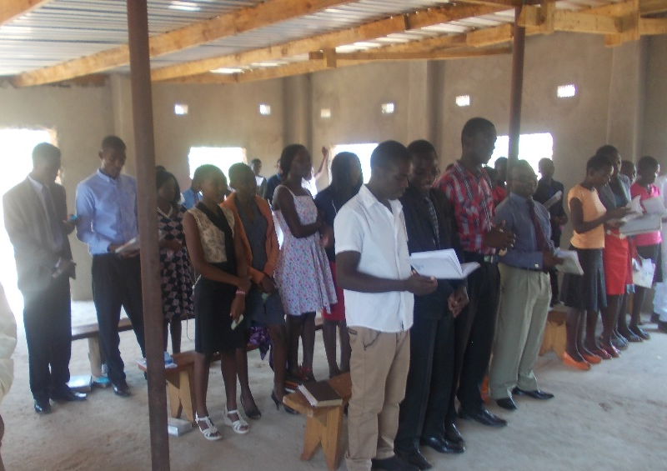
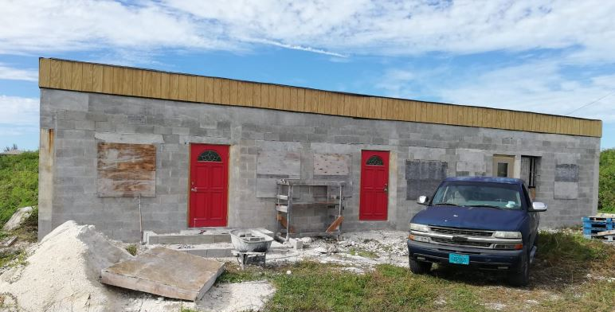
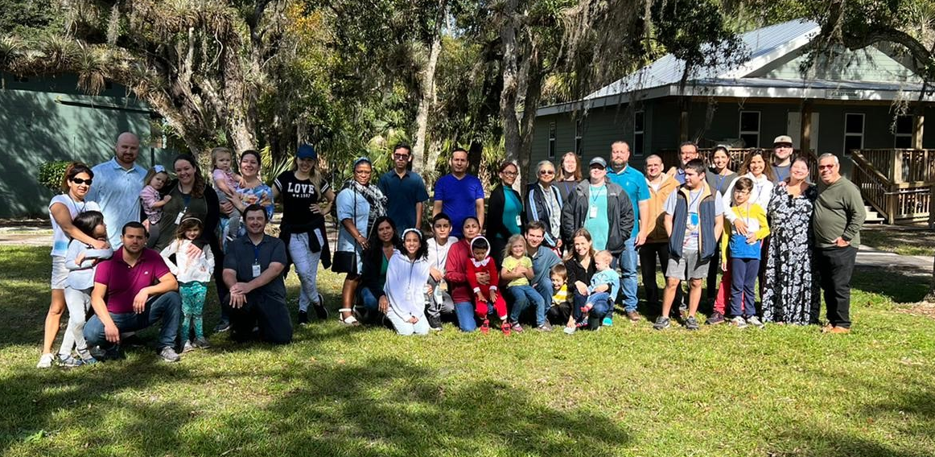

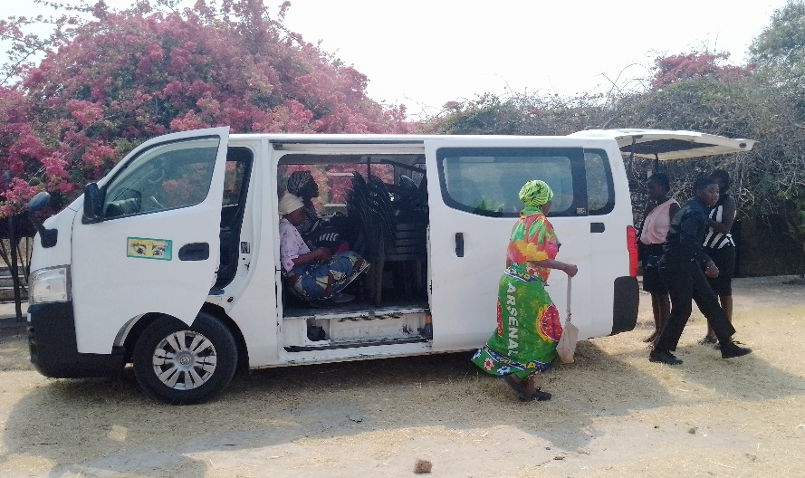
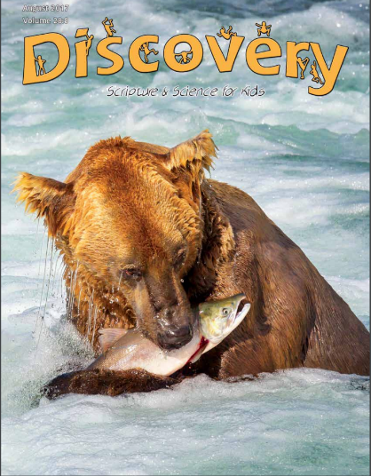
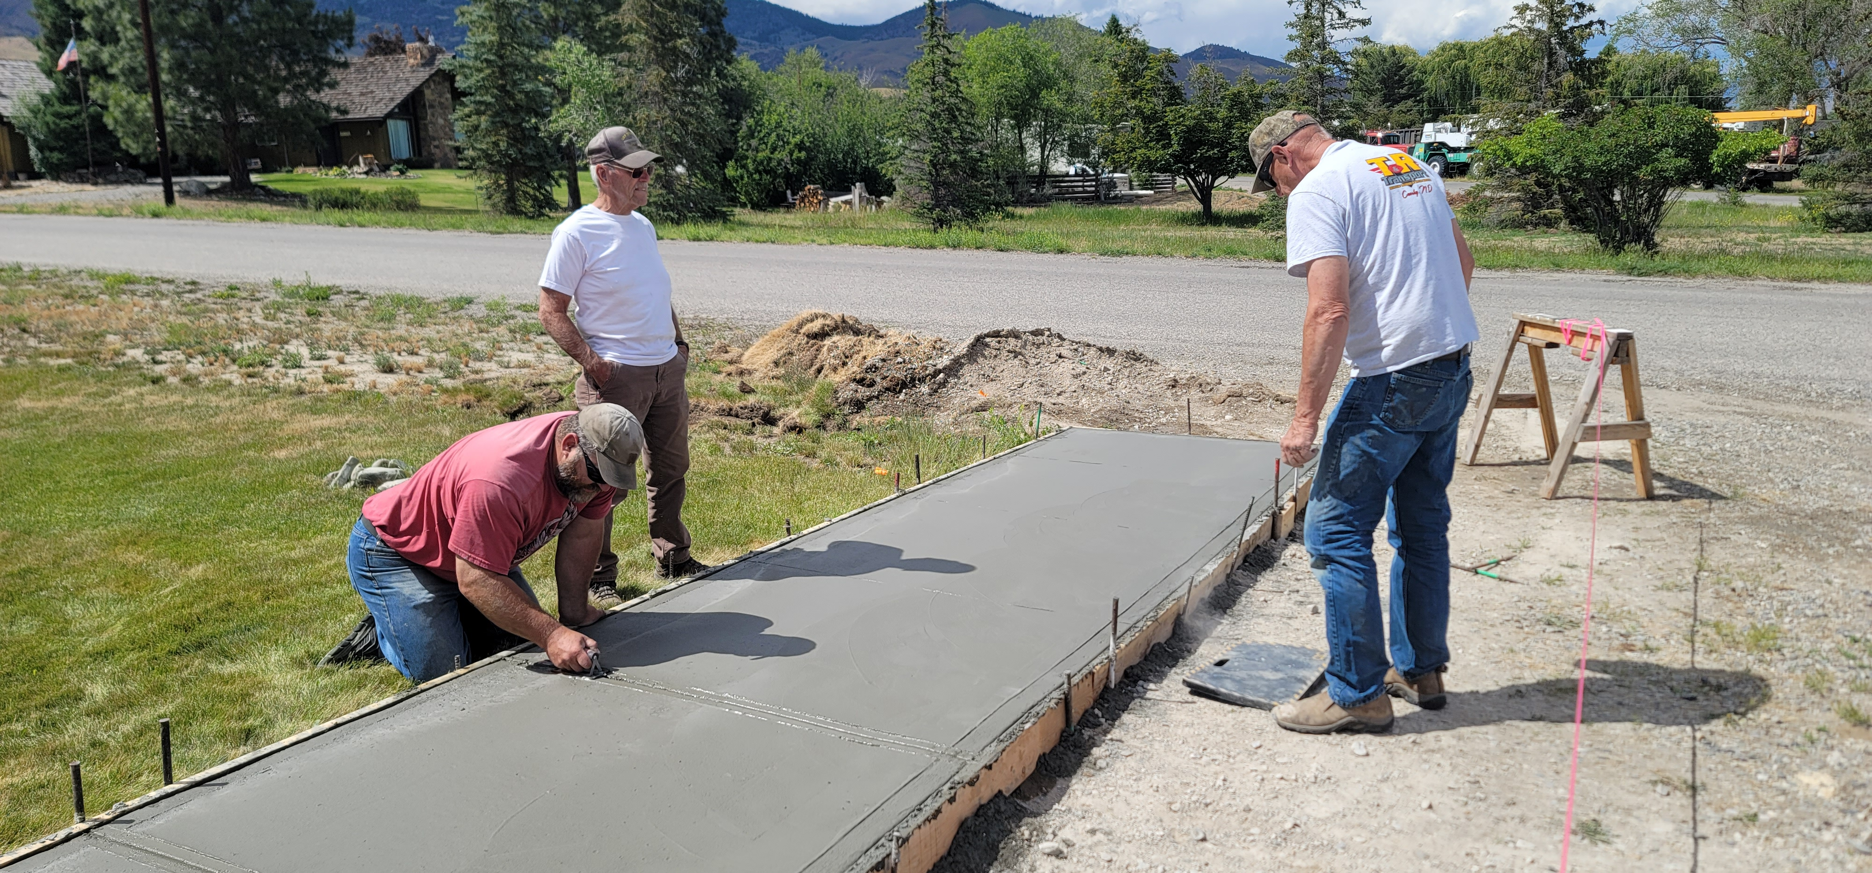

1,800 homes
EVERY month
Rotating Routes
Nnanna
Tamuka
Robert
Wayne
Tavaro
Mauricio
Robert C.
AP
Sr. High
H2H
AMC
Easter
Answering Macedonian Calls
Sr. High & Adult Mission Trip
House to House/Heart to Heart
$139,500
Apologetics Press
Robert C. Lupo (Sneedville, TN)
Tavaro Hanna (Bahamas)
Mauricio Yegros (Coral Springs)
Robert Martin (Pacific)
Wayne Parker (Pacific, Cyprus)
Nnanna Aforji (Nigeria)
Tamuka Arunashe (Zimbabwe)

Slide 6

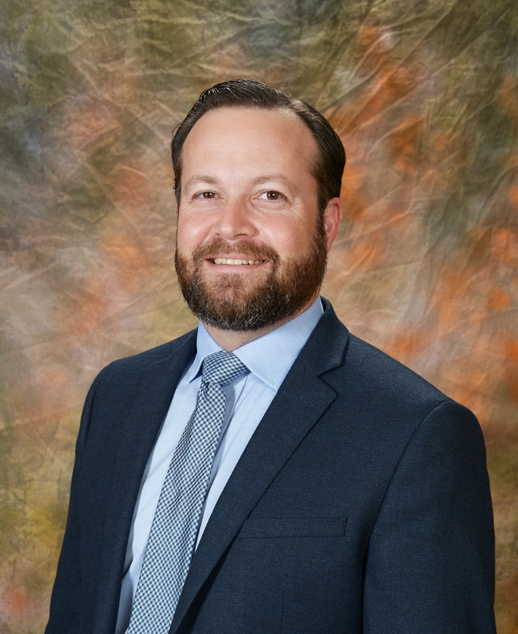
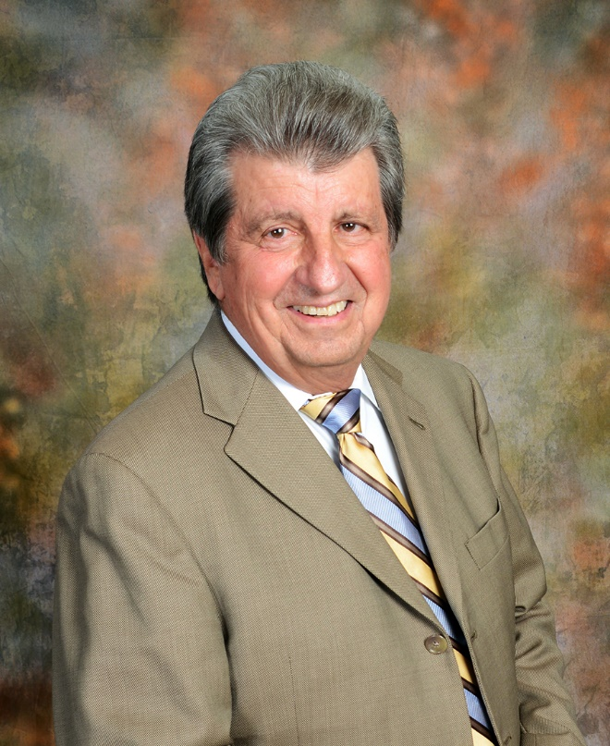
Josh Blackmer
Dan Jenkins
Mission Statement: Our mission is to labor with existing congregations and new works of the Lord’s church in evangelizing, edifying, and equipping the saints for greater service in domestic and foreign fields.
Assisting congregations around the United States
Assisting mission works on foreign soils

Slide 7
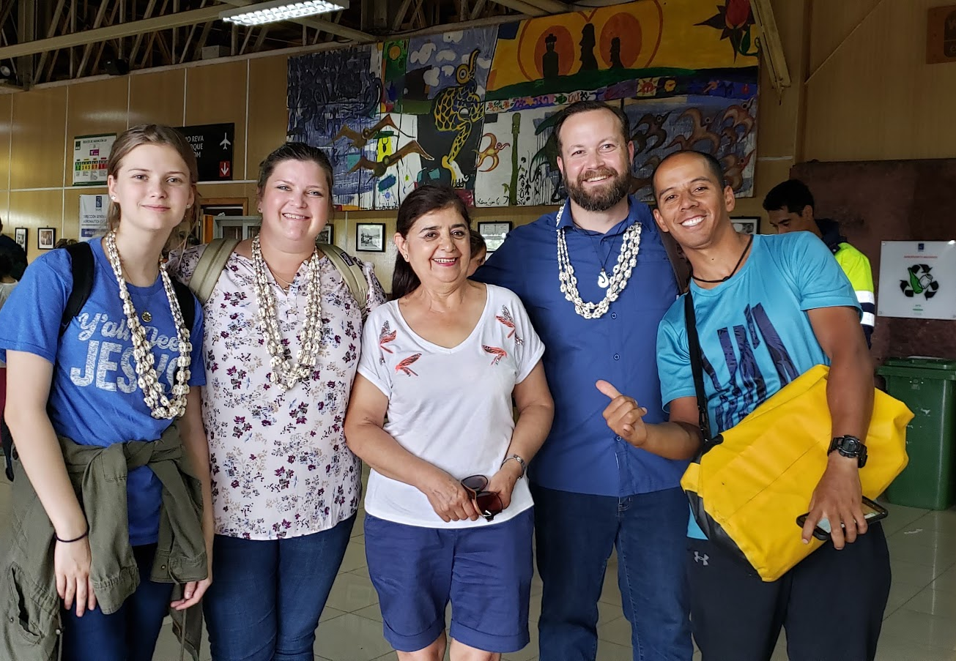
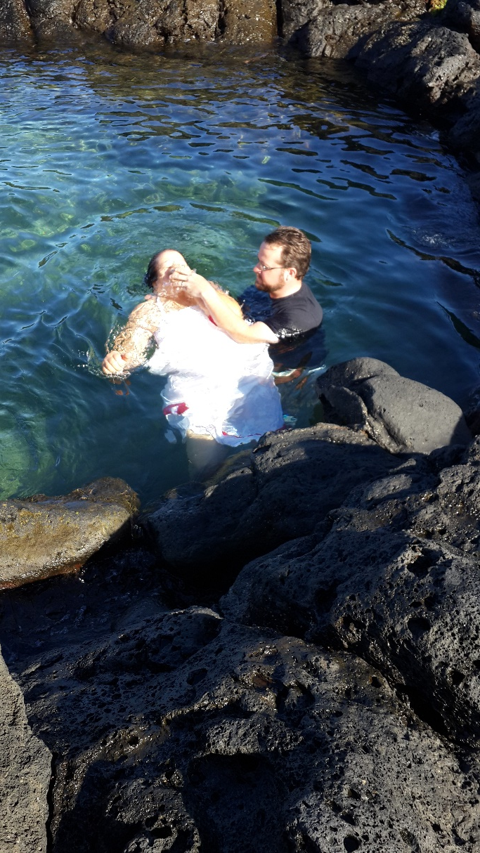
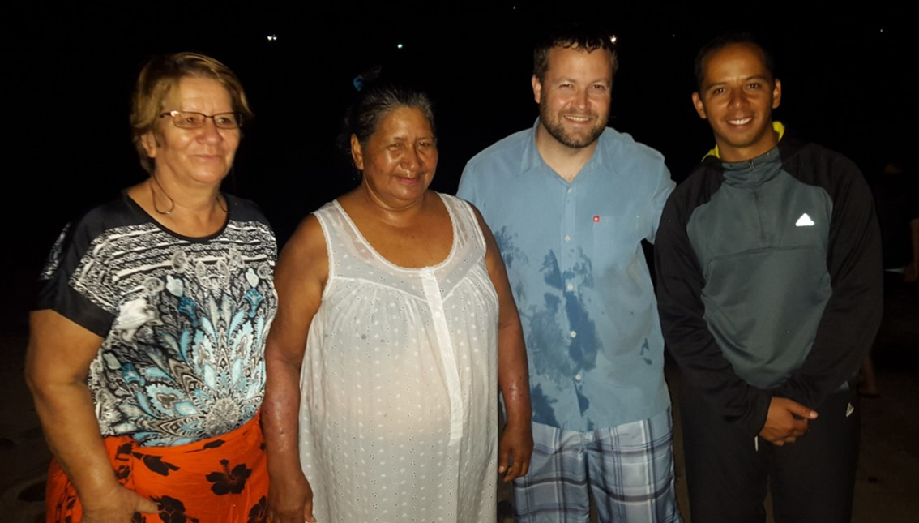
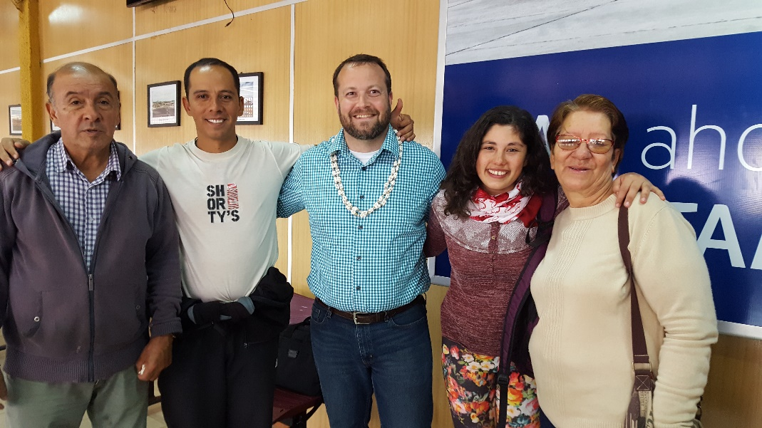
Nnanna
Tamuka
Robert
Wayne
Tavaro
Mauricio
Robert C.
AP
Sr. High
H2H
AMC
Easter
Answering Macedonian Calls
Easter Island
Sr. High & Adult Mission Trip
House to House/Heart to Heart
$139,500
Apologetics Press
Robert C. Lupo (Sneedville, TN)
Tavaro Hanna (Bahamas)
Mauricio Yegros (Coral Springs)
Robert Martin (Pacific)
Wayne Parker (Pacific, Cyprus)
Nnanna Aforji (Nigeria)
Tamuka Arunashe (Zimbabwe)

Slide 8
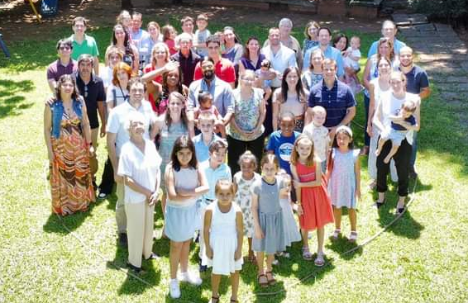
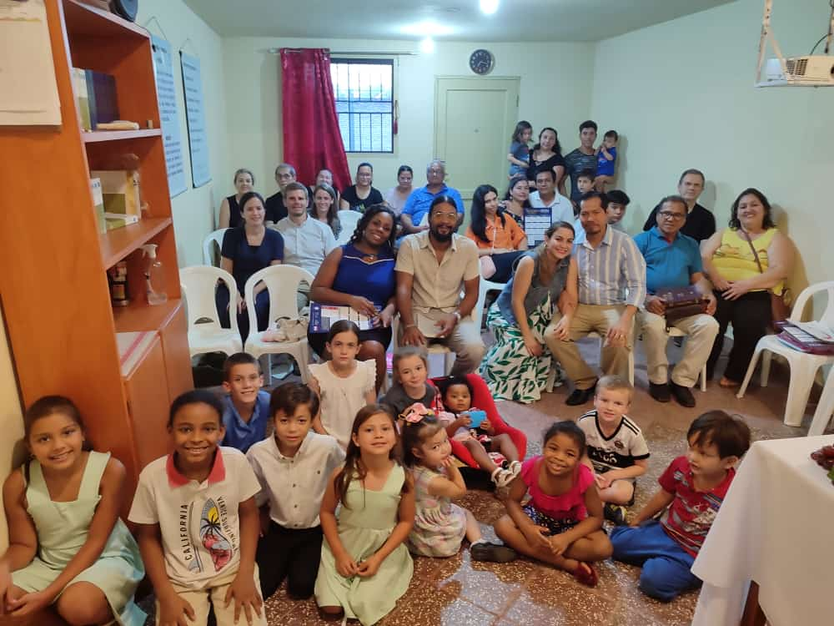
$151,000
Special Requests for
Mission Trips
Answering Macedonian Calls Trip to Paraguay
Answering Macedonian Calls
Easter Island
Sr. High & Adult Mission Trip
House to House/Heart to Heart
$139,500
Apologetics Press
Robert C. Lupo (Sneedville, TN)
Tavaro Hanna (Bahamas)
Mauricio Yegros (Coral Springs)
Robert Martin (Pacific)
Wayne Parker (Pacific, Cyprus)
Nnanna Aforji (Nigeria)
Tamuka Arunashe (Zimbabwe)

Slide 9
$162,000
PIBC Teacher’s
Travel to Pacific
$151,000
Special Requests for
Mission Trips
Answering Macedonian Calls Trip to Paraguay
Answering Macedonian Calls
Easter Island
Sr. High & Adult Mission Trip
House to House/Heart to Heart
$139,500
Apologetics Press
Robert C. Lupo (Sneedville, TN)
Tavaro Hanna (Bahamas)
Mauricio Yegros (Coral Springs)
Robert Martin (Pacific)
Wayne Parker (Pacific, Cyprus)
Nnanna Aforji (Nigeria)
Tamuka Arunashe (Zimbabwe)

Slide 10

Training Christians for 30 years
Taking the school directly to the students
Our part: Assisting with travel expenses of teachers

Slide 11
$162,000
PIBC Teacher’s
Travel to Pacific
AP Evangelism Bibles
to Area Congregations
$151,000
Special Requests for
Mission Trips
Answering Macedonian Calls Trip to Paraguay
Answering Macedonian Calls
Easter Island
Sr. High & Adult Mission Trip
House to House/Heart to Heart
$139,500
Apologetics Press
Robert C. Lupo (Sneedville, TN)
Tavaro Hanna (Bahamas)
Mauricio Yegros (Coral Springs)
Robert Martin (Pacific)
Wayne Parker (Pacific, Cyprus)
Nnanna Aforji (Nigeria)
Tamuka Arunashe (Zimbabwe)

Slide 12

AP Evangelism Bibles
for Area Congregations
Great resource for reaching lost souls
Special sections with answers to some of the most fundamental questions
Supply these for a few congregations in South Florida to use in evangelism

Slide 13
$167,000
“In Search of the Lord’s Way” TV
$162,000
PIBC Teacher’s
Travel to Pacific
AP Evangelism Bibles
to Area Congregations
$151,000
Special Requests for
Mission Trips
Answering Macedonian Calls Trip to Paraguay
Answering Macedonian Calls
Easter Island
Sr. High & Adult Mission Trip
House to House/Heart to Heart
$139,500
Apologetics Press
Robert C. Lupo (Sneedville, TN)
Tavaro Hanna (Bahamas)
Mauricio Yegros (Coral Springs)
Robert Martin (Pacific)
Wayne Parker (Pacific, Cyprus)
Nnanna Aforji (Nigeria)
Tamuka Arunashe (Zimbabwe)

Slide 14

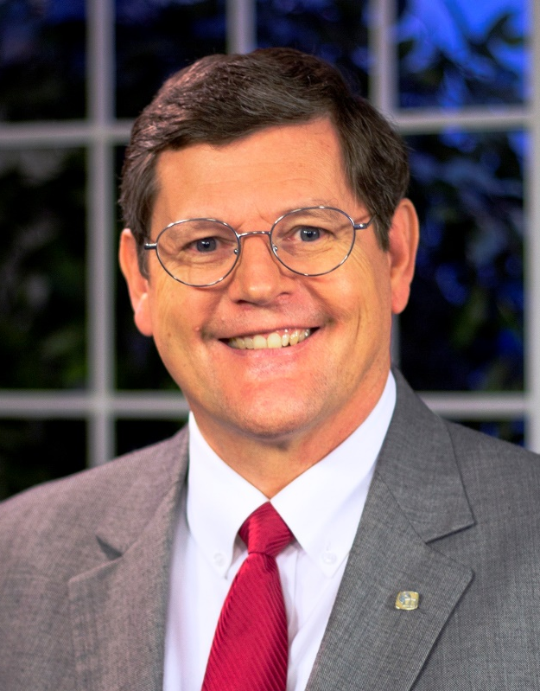

Sunday Mornings
at 7:00 a.m.
Reaching 100 million homes in America every week
Phil Sanders

Slide 15
$167,000
“In Search of the Lord’s Way” TV
Truth for Today
Bible School
$162,000
PIBC Teacher’s
Travel to Pacific
AP Evangelism Bibles
to Area Congregations
$151,000
Special Requests for
Mission Trips
Answering Macedonian Calls Trip to Paraguay
Answering Macedonian Calls
Easter Island
Sr. High & Adult Mission Trip
House to House/Heart to Heart
$139,500
Apologetics Press
Robert C. Lupo (Sneedville, TN)
Tavaro Hanna (Bahamas)
Mauricio Yegros (Coral Springs)
Robert Martin (Pacific)
Wayne Parker (Pacific, Cyprus)
Nnanna Aforji (Nigeria)
Tamuka Arunashe (Zimbabwe)

Slide 16

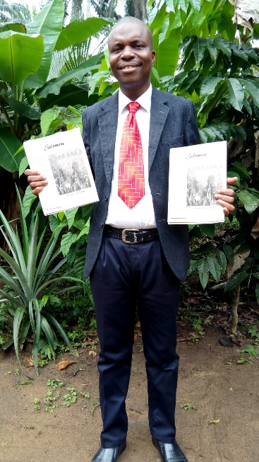









Slide 17
$175,500
Expand H2H/H2H
$167,000
“In Search of the Lord’s Way” TV
Truth for Today
Bible School
$162,000
PIBC Teacher’s
Travel to Pacific
AP Evangelism Bibles
to Area Congregations
$151,000
Special Requests for
Mission Trips
Answering Macedonian Calls Trip to Paraguay
Answering Macedonian Calls
Easter Island
Sr. High & Adult Mission Trip
House to House/Heart to Heart
$139,500
Apologetics Press
Robert C. Lupo (Sneedville, TN)
Tavaro Hanna (Bahamas)
Mauricio Yegros (Coral Springs)
Robert Martin (Pacific)
Wayne Parker (Pacific, Cyprus)
Nnanna Aforji (Nigeria)
Tamuka Arunashe (Zimbabwe)

Slide 18
Expand House to House/Heart to Heart
to More Local Neighbors
There are 15,000+ homes within about 1-mile radius of our church building
What if they could all receive one issue of House to House/Heart to Heart?
“Look on the fields, they are white for harvest!”

Slide 19
$175,500
Expand H2H/H2H
PIBC
Travel
$167,000
“In Search of the Lord’s Way” TV
Truth for Today
Bible School
$162,000
PIBC Teacher’s
Travel to Pacific
AP Evangelism Bibles
to Area Congregations
$151,000
Special Requests for
Mission Trips
Answering Macedonian Calls Trip to Paraguay
Answering Macedonian Calls
Easter Island
Sr. High & Adult Mission Trip
House to House/Heart to Heart
$139,500
Apologetics Press
Robert C. Lupo (Sneedville, TN)
Tavaro Hanna (Bahamas)
Mauricio Yegros (Coral Springs)
Robert Martin (Pacific)
Wayne Parker (Pacific, Cyprus)
Nnanna Aforji (Nigeria)
Tamuka Arunashe (Zimbabwe)

Slide 20
$+++,+++
+
+
+
$175,500
Expand H2H/H2H
PIBC
Travel
$167,000
“In Search of the Lord’s Way” TV
Truth for Today
Bible School
$162,000
PIBC Teacher’s
Travel to Pacific
AP Evangelism Bibles
to Area Congregations
$151,000
Special Requests for
Mission Trips
Answering Macedonian Calls Trip to Paraguay
Answering Macedonian Calls
Easter Island
Sr. High & Adult Mission Trip
House to House/Heart to Heart
$139,500
Apologetics Press
Robert C. Lupo (Sneedville, TN)
Tavaro Hanna (Bahamas)
Mauricio Yegros (Coral Springs)
Robert Martin (Pacific)
Wayne Parker (Pacific, Cyprus)
Nnanna Aforji (Nigeria)
Tamuka Arunashe (Zimbabwe)

Slide 21
Believe that Jesus is the Son of God – Acts 16:31
Repent of your sins and turn toward God – Acts 17:30
Confess your faith in Jesus Christ – Acts 8:37
Be immersed into Christ – Acts 22:16
  God will forgive all of your sins – Acts 2:38
  God will add you to His church – Acts 2:47
  God will register you in heaven – Hebrews 12:23
Walk in the light with the Light – 1 John 1:7

