Slide 1

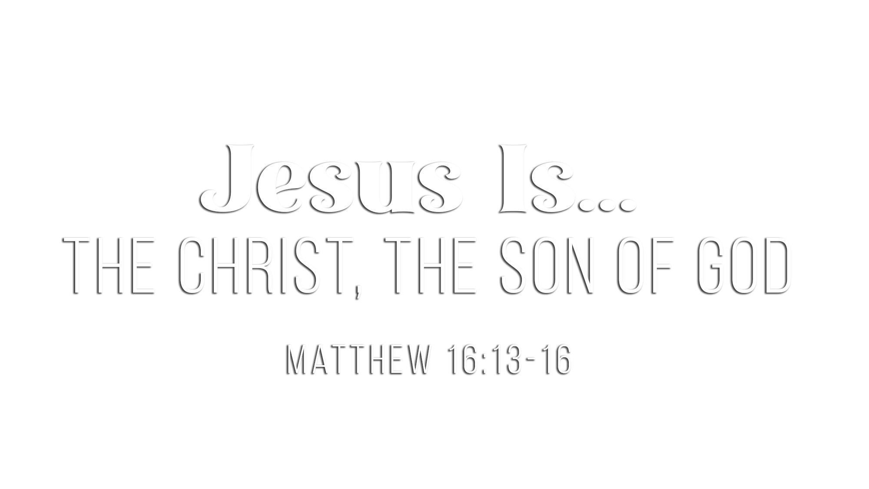

Slide 2
These are accepted criteria for proving any predictive prophecy to be “valid”:
It must be a specific, detailed declaration
There must be sufficient time between prophecy and its fulfillment
It must be stated in clear, understandable terms
It must not have historical overtones
A clear, understandable, exact prophecy must have a clear, understandable, exact fulfillment

Slide 3
Messianic prophecies were very specific
PROPHECY | FULFILLMENT
Of the tribe of Judah (Gen. 49:10) | Matt. 1:1-2
Called out of Egypt (Hos. 11:1) | Matt. 2:15
Priest like Melchizedek (Psa. 110:4) | Heb. 5:6
Ride into Jerusalem on donkey (Zech. 9:9) | Luke 19:35-37
Betrayed for 30 pieces of silver (Zech. 11:12) | Matt. 26:15
Spit upon (Isa. 50:6) | Matt. 26:67
Buried with the rich (Isa. 53:9) | Matt. 27:57-60

Slide 4
Messianic prophecies were made centuries before their fulfillment
PROPHECY | FULFILLMENT
Seed of woman (Gen. 3:15) | 4,000+ years later (Gal. 4:4)
Seed of Abraham (Gen. 22:18) | ~2,000 years later (Matt. 1:1)
Prophet like Moses (Deut. 18:15) | ~1,400 years later (Acts 3:22)
Seed of David (2 Sam. 7:14) | ~1,000 years later (Matt. 1:1-6)
Silent when accused (Isa. 53:7) | ~750 years later (Matt. 27:12)
Price for potter’s field (Zech. 11:13) | ~520 years later (Matt. 27:7)
Messenger to prepare (Mal. 3:1) | ~440 years later (Matt. 11:10)

Slide 5
Many of the prophecies were beyond human control to fulfill
PROPHECY | FULFILLMENT
Born in Bethlehem (Mic. 5:2) | Matt. 2:1
Born of a virgin (Isa. 7:14) | Matt. 1:18-25
Murder of children (Jer. 31:15) | Matt. 2:16
Betrayed by a friend (Psa. 41:9) | Matt. 26:47-50
Death by crucifixion (Psa. 22:16) | Mark 15:25
Numbered with transgressors (Isa. 53:12) | Matt. 27:38
Garments parted and cast lots (Psa. 22:18) | John 19:23-24

Slide 6
To understand the improbability of any one man fulfilling all 332, consider these odds:
Odds of being struck by lightning: 1 in 1,600,000
Odds of being attacked by a shark: 1 in 11,500,000
Odds of winning Powerball with one ticket: 1 in 292,000,000
Odds of winning $1 million in McDonald’s Monopoly: 1 in 450,000,000
Odds of being killed by a meteorite: 1 in 840,000,000
Odds of one man fulfilling just 8 Messianic prophecies: 1 in 100 quadrillion
(1 in 10¹⁷, or 1 in 100,000,000,000,000,000)

Slide 7
“The following probabilities are taken from Peter Stoner in Science Speaks to show that coincidence is ruled out by the science of probability. Stoner says that by using the modern science of probability in reference to eight prophecies, ‘We find that the chance that any man might have lived down to the present time and fulfilled all eight prophecies is 1 in 10¹⁷.’ That would be 1 in 100,000,000,000,000,000.
“In order to help us comprehend this staggering probability, Stoner illustrates it by supposing that ‘we take 10¹⁷ silver dollars and lay them on the face of Texas. They will cover all of the state two feet deep. Now mark one of these silver dollars and stir the whole mass thoroughly, all over the state. Blindfold a man and tell him that he can travel as far as he wishes, but he must pick up one silver dollar and say that this is the right one. What chance would he have of getting the right one? Just the same chance that the prophets would have had of writing these eight prophecies and having them all come true in any one man…but they all came true in Christ.’
From Josh McDowell,
Evidence That Demands a Verdict, p. 167

Slide 8
“Stoner considers 48 prophecies and says, ‘We find the chance that any one man fulfilled all 48 prophecies to be 1 in 10¹⁵⁷.
“‘This is a really large number and it represents an extremely small chance. Let us try to visualize it. The silver dollar, which we have been using, is entirely too large. We must select a smaller object. The electron is about as small as an object as we know of. It is so small that it will take 2.5 times 10¹⁵ of them laid side by side to make a line, single file, one inch long. If we were going to count the electrons in this line one inch long, and counted 250 each minute, and if we counted day and night, it would take us 19,000,000 years to count just the one-inch line of electrons. If we had a cubic inch of these electrons and we tried to count them it would take us, counting steadily 250 each minute, 19,000,000 times 19,000,000 times 19,000,000 years or 6.9 times 10²¹ years.
“‘With this introduction, let us go back to our chance in 10¹⁵⁷. Let us suppose that we are taking this number of electrons, marking one, and thoroughly stirring it into the whole mass, then blindfolding a man and letting him try to find the right one. What chance has he of finding the right one? What kind of pile will this number of electrons make? They make an inconceivably large volume.’
“Such is the chance of any one man fulfilling 48 prophecies.”
From Josh McDowell,
Evidence That Demands a Verdict, p. 167

Slide 9
“The Law of Probability. If only fifty prophecies about Jesus had been made, assuming an equal chance for their happening or not happening, the law of probability against all fifty’s being fulfilled ‘is that of the fiftieth power of two to unity; that is the probability is greater than eleven hundred and twenty-five millions to one that all of these circumstances do turn up.’ Then to assume that the fifty events would happen contemporaneously surpasses the power of numbers to express correctly the immense improbability of its taking place.
“The previous paragraph deals with the law of probability as regards inanimate objects. It does not consider the will and acts of free agents for and against God, namely: ‘passions of multitudes, the ambition of princes, the studies of the wise, the craft of the wicked, the wars, the revolutions, and the varied destinies of nations.’
“If only one hundred prophecies had been made, the chance that they would happen to one man is less than all the drops of water if the world were completely water. But not fifty, nor one hundred, but three hundred thirty-two prophecies of Christ had been counted.”
From Hugo McCord,
From Heaven or From Men?, p. 47-48

Slide 10
The conclusion is inescapable:
Jesus of Nazareth is
the predicted Messiah of the Old Testament!
Jesus is the Son of God!
“Then He said to them, ‘These are the words which I spoke to you while I was still with you, that all things must be fulfilled which were written in the Law of Moses and the Prophets and the Psalms concerning Me’” (Luke 24:44).

Slide 11
What does that have to do with me?
I can confess with absolute certainty: “I believe Jesus is the Son of God”
(Acts 2:36-41; Matt. 16:16; Acts 8:36-38)
I can know that my faith is built on solid evidence (1 Cor. 15:1-20; Acts 1:3)
I can know that I have absolutely no reason to be ashamed (Phil. 1:20; 2 Tim. 1:12)
I can know that my labor for Him is not in vain (1 Cor. 15:58)
I can know that walking by faith in Christ is better than walking by sight (2 Cor. 5:7)
I can gladly submit to His authority in my life (Matt. 28:18; Col. 3:17)
I can know that it is always right to do right (Deut. 6:18; 12:25; 13:18; Matt. 4:4; 7:21)
I can know personally the One whom I worship (Acts 17:23; Matt. 4:10)
I can know that my dead body will be raised to life (2 Cor. 4:14; 1 Thess. 4:13-17)
I can know that there IS a heavenly reward awaiting me (2 Tim. 4:6-8; Heb. 10:34)

Slide 12
Believe that Jesus is the Son of God – John 5:24
Repent of your sins and turn toward God – Romans 2:4
Confess your faith in Jesus Christ – Matthew 10:32
Be immersed into Christ – 1 Peter 3:21
  God will forgive all of your sins – Acts 2:38
  God will add you to His church – Acts 2:47
  God will register you in heaven – Hebrews 12:23
Walk faithfully with Him – 1 John 1:7

