Slide 2
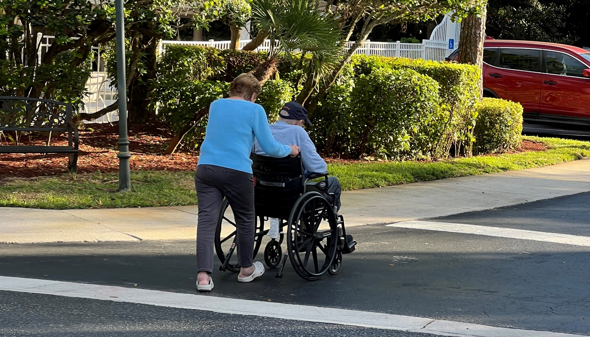

Slide 4
Jesus lifts His hand of invitation toward you
  Luke 19:10; 1 Tim. 1:15; John 12:46
Jesus loves you, having loved you first
  Gal. 2:20; 1 John 3:16; 4:19; Eph. 5:2
Jesus lived on this earth for you
  2 Cor. 9:8; Phil. 2:5-11; Heb. 2:17-18; 1 Pet. 1:20
Jesus laid down His life to liberate you from sin
  John 10:11-18; 15:13; Tit. 2:14; Gal. 1:4; 1 John 3:16
Jesus left His will for you in His Scripture
  2 Tim. 3:15-17; Luke 6:46; John 12:48
Jesus longs for you to walk with Him now
  Matt. 11:28-30; John 10:10; 1 John 1:7; Col. 2:6
Jesus looks eagerly for you to live with Him eternally
  John 14:1-6; 1 Pet. 1:3-4; Matt. 24:46

Slide 5
Love Jesus, as your first love
  John 14:15, 21, 23; 21:15-17; Eph. 6:24; Rev. 2:4
Listen to Jesus in His Scripture
  Matt. 7:24; 17:5; 24:35; John 12:48; 15:7; Rev. 3:20
Let Jesus have His way and humbly obey Him
  Luke 9:23; Jas. 4:10, 15; Gal. 2:20; Heb. 5:9
Lean on Jesus and rely on Him
  John 6:68; 15:5; Phil. 4:4-13; 2 Tim. 4:17; 2 Cor. 12:9-10
Look like Jesus for others to see
  2 Cor. 3:18; Gal. 2:20; Matt. 5:16; 1 Pet. 2:21
Lead people to Jesus
  John 1:42; 4:29; Matt. 28:19; Acts 8:35
Long earnestly for your eternity with Jesus
  Phil. 3:20-21; Col. 3:1-4; 2 Tim. 4:8; Tit. 2:13

Slide 6



Slide 7







Slide 8


Sermon &
Bible Class
Notebook

Slide 9

2025
Calendars

Slide 10
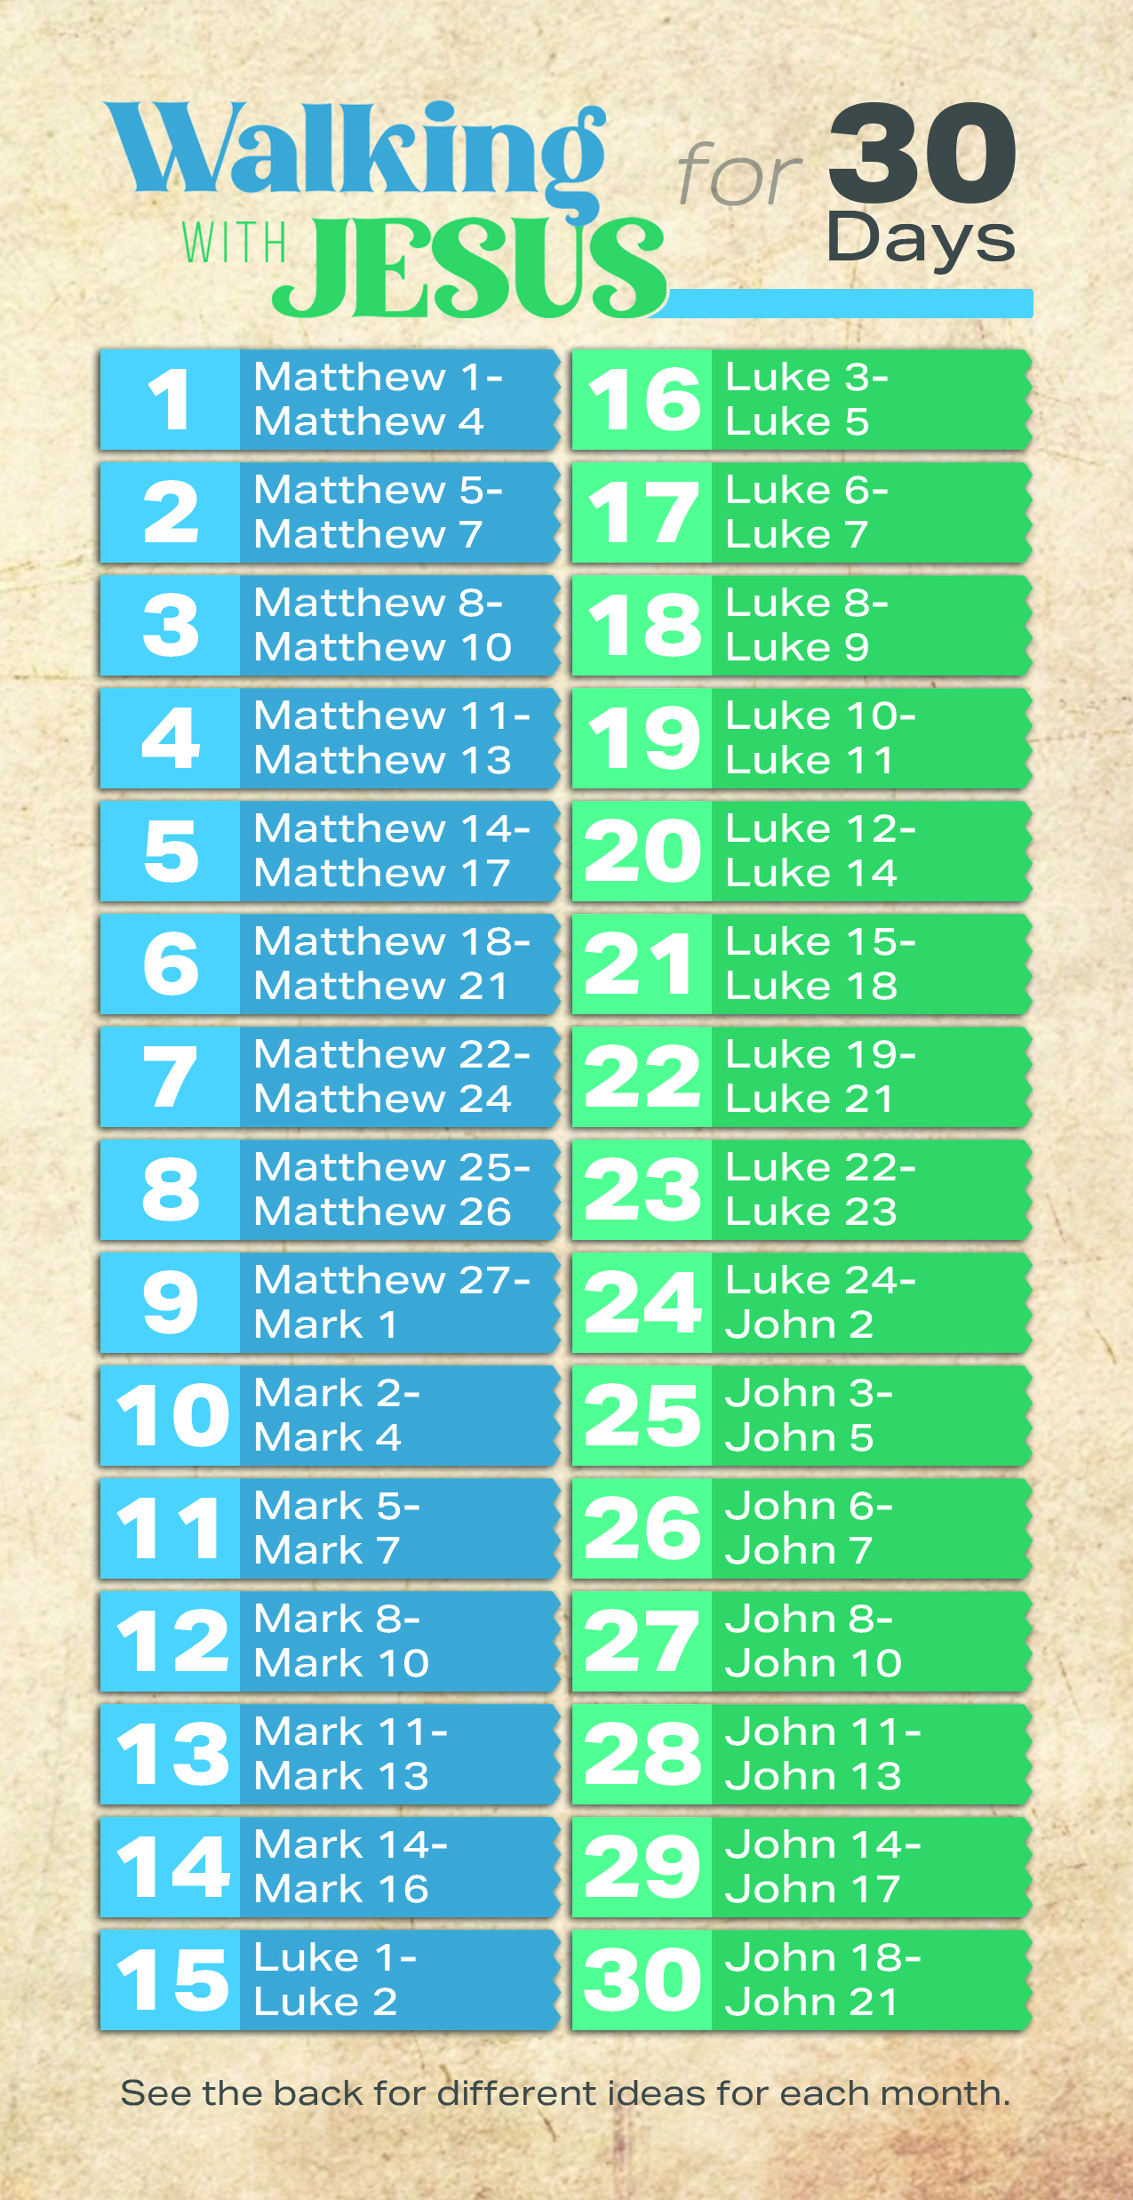
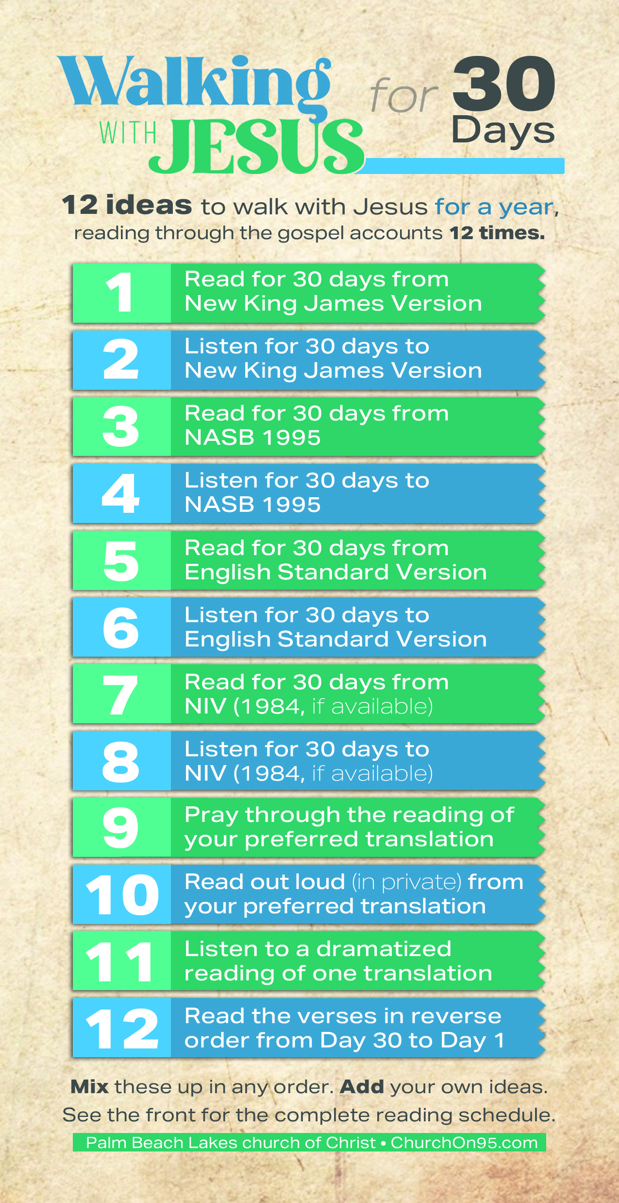
Bible Reading Schedule

Slide 11


Daily Bible Study

Slide 12
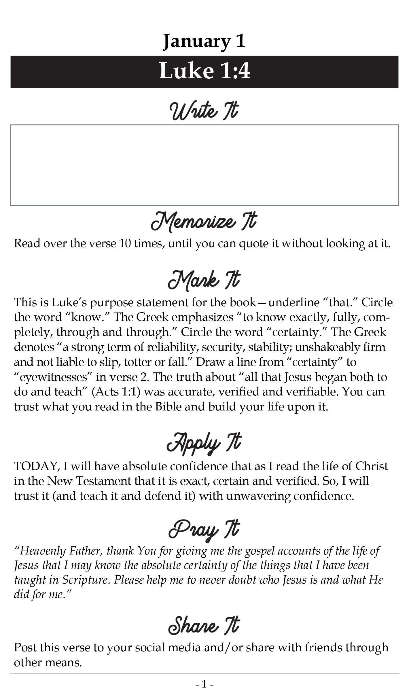

Slide 13

Daily Bible Study
in 2026

Slide 16
Believe Jesus is the Son of God – John 1:12
Repent of your sins and turn toward God – Luke 13:3
Confess your faith in Jesus Christ – Romans 10:9
Put Christ on in baptism – Galatians 3:27
  God will forgive all of your sins – Acts 2:38
  God will add you to His church – Acts 2:47
  God will enroll you in heaven – Hebrews 12:23
Walk faithfully with the Lord – 1 John 1:7

