Slide 1
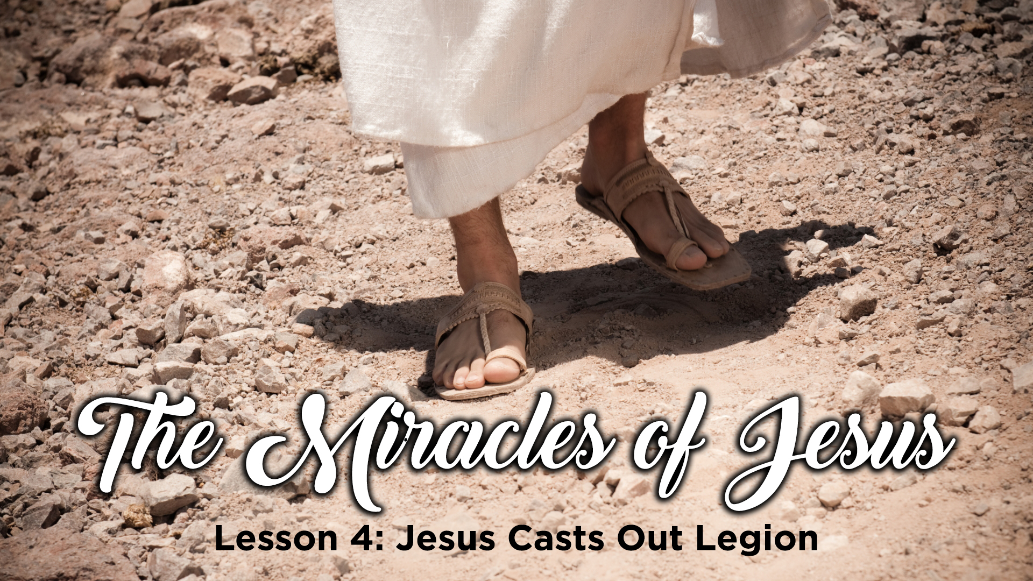

Slide 2
LESSONS FROM THE MIRACLES OF JESUS

Slide 3
Jesus casts out legion
Matthew 8:28-34 mark 5:1-20
Luke 8:26-39

Slide 4
Miracles in the 1st Century
Jesus performed them (John 3:34; Acts 2:22)
Jesus promised the 12 that they would have the Holy Spirit to help them in their ministry (Luke 24:49; Acts 1:2-5,8)
The apostles were able to transfer to others the power to perform miracles (Acts 6:8; Acts 8:13)
Those who were able to perform miracles (outside of the Apostles) were not able to pass the power to anyone else (Acts 8:14-17)

Slide 5
Codex book form
Early AD 100’s
Papias, AD 110 references Matthew and Mark
Justin Martyr, AD 150 references “the memoirs of the apostles and the writings of the prophets”
Jesus performed miracles
AD 30-33
The apostles and others to whom the ability was given performed miracles
AD 33-100 ish
The New Testament is written
AD 45-96
The life span of the apostles and others comes to an end
AD 44 -100 ish

Slide 6
Jesus Casts Demons into the Herd of Pigs
Matthew 8:28-33
Mark 5:1-20
Luke 8:26-39
The context
Still Jesus’ busy day, after the calming the seas, and arriving at the opposite side of the Sea of Galilee

Slide 7
Reasons to NOT help the Demon Possessed Man
I am too tired, and it has been a long hard day
This is not my responsibility – this man has family who should be helping
This man is not a good candidate for conversion
This man carries too much risk – help will not be accepted, and I just will make others mad

Slide 8
Jesus’ Motivation to Help the Demon Possessed Man
Jesus was sensitive to people’s needs
Jesus started where the man was, not where he wished him to be
The man talked and Jesus listened
Jesus trusted His Father’s Power

Slide 9
The Results
1) A man was touched
2) Others were not touched, Jesus never forced himself on the non-responsive
3) An entire area was taught

Slide 10
Conclusion
Don’t miss Heaven because we don’t let our mind communicate to our heart

Slide 11

Next WEEK
Jesus feeds 5,000
MATTHEW 14:13-21
MARK 6:30-44
LUKE 9:10-17 john 6:1-15

