Slide 1
LESSONS FROM THE MIRACLES OF JESUS

Slide 2
Jesus calms the storm
Matthew 8:23-27 mark 4:35-41
Luke 8:22-25

Slide 3

Miracles are works of a supernatural origin and character, such as cannot be produced by natural agents and means
Miracles confirm the word and the speaker
During Jesus’ public ministry, the Gentiles didn’t know him and the Jews needed to come to the belief that He was the Messiah
The miraculous is not to be confused with the providential, where God operates within the usual course of nature

Slide 4
True or False – miracles were performed in the 1st century and we read about them in the Bible
True or False – miracles are performed today
When / why did miracles cease?
2 Peter 1:3
How did people of the 1st century know Jesus?
Can we know Jesus today the same way a 1st century person knew Jesus? How?

Slide 5
2 Timothy 3:16
Could 2 Timothy 3:16 be true if the word was incomplete?
If we insist that we need a miracle today to believe in Jesus, then we are saying that we do not believe that God’s word is complete and without error
1 Corinthians chapters 12, 13 and 14
1 Corinthians 13:8-10
Ephesians 4:8,13

Slide 6
Jesus calms the storm
Matthew 8:23-27
Mark 4:35-41
Luke 8:22-25
The context
Jesus’ busy day
A boat trip to get away from the crowd

Slide 7
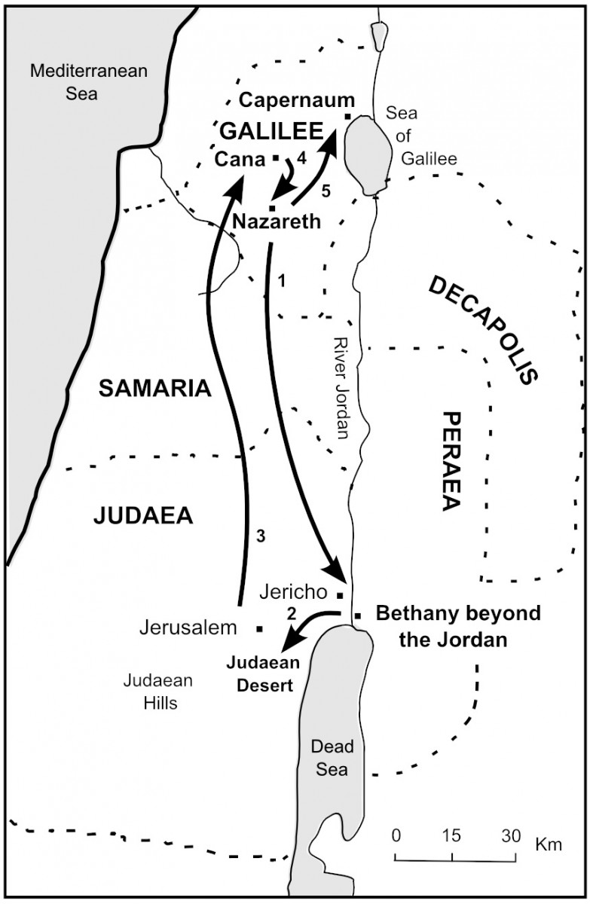
Jesus’ home base was in Capernaum. During His ministry, He made multiple trips across the lake to the eastern shore
Land of the Gadarenes
Land of the Gerasenes
City of Gerasa
City of Gergesa
City of Kherasa
Ruled by the city of Gadara (SE of the lake -
X marks Gadara)

Slide 8
Jesus calms the storm
Matthew 8:23-27; Mark 4:35-41; Luke 8:22-25
Jesus was fully God AND He was fully man
We need to have faith like Jesus had faith
Faith is not a function of physical proximity to Jesus
We can be assured that Jesus is the Son of God

Slide 9
Jesus calms the storm
Matthew 8:23-27; Mark 4:35-41; Luke 8:22-25
Who is this man? (Matthew 8:27; Mark 4:41; Luke 8:25) that the wind and the waves obey him
Who is this man? (Luke 5:21) who blasphemes
Who is this man? (Luke 7:49) who forgives sin of the woman who washes his feet
Who is this man? (Luke 9:9) about whom Herod hears
Who is this man? (Matthew 21:10) who made a triumphal entry into Jerusalem

Slide 10
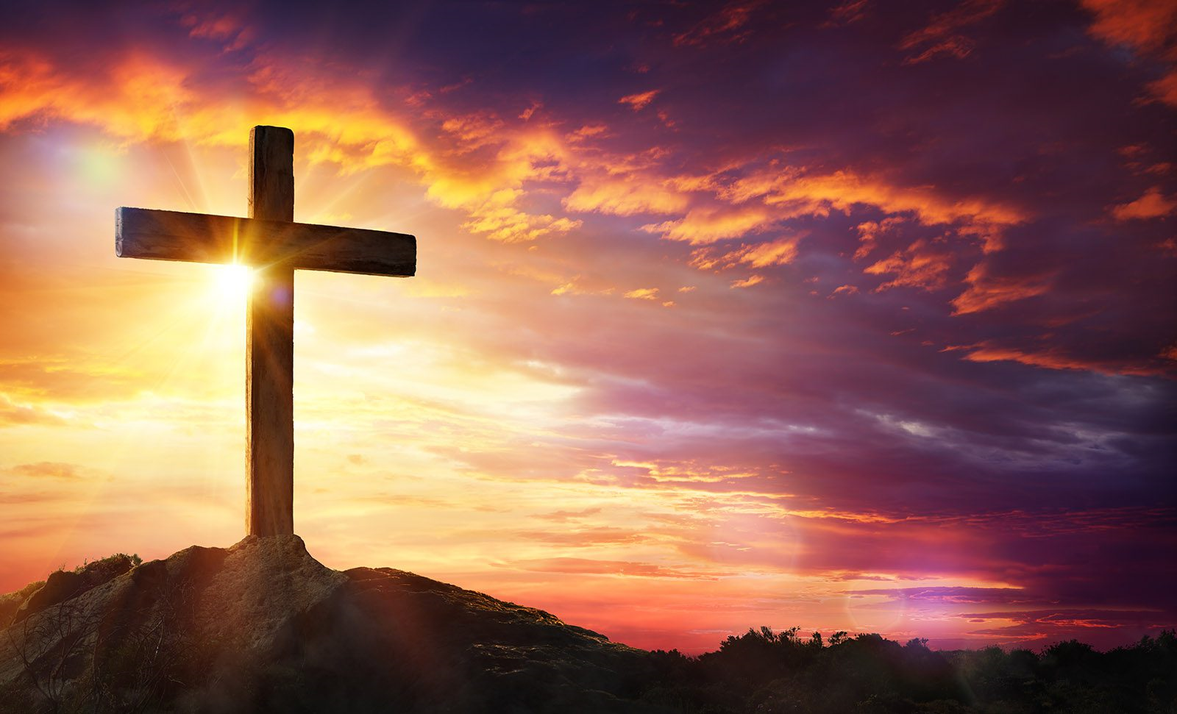
Jesus calms the storm
Who is this man?
1 John 3:1-8

Slide 11

Next WEEK pigs soooiee
MATTHEW 8:23-27
MARK 4:35-41
LUKE 8:26-39

