Slide 1




Slide 2
It DOES
  “Each” Christian is responsible to plant and water (1 Cor. 3:5, 8)
  The church cannot and will not grow without God’s Word being planted and watered
  God has NO other plan – for churches do NOT grow automatically on their own
It DOESN’T
  While we must plant and water the seed, GOD GIVES THE INCREASE (3:6-7)
  God is the one who “adds” to His church (Acts 2:41, 47)
  But God cannot and will not add where there is no planting and watering

Slide 3
We see this in the book of Acts
  There is often a focus on crowds and multitudes
  (Acts 2; 3; 7; 8:5-12; 13-14; 17; 18; 19; 22-23; 24-26)
  But, there is often a focus on an individual
  (Acts 8:9-13, 26-40; 9:1-22; 10:1-48; 16:1-3, 14-15, 25-40; 17:34; 18:8, 24-28)
We need to see this in our lives
  There is often a focus on crowds and multitudes today
  But, there needs to be a focus on the individual = one person at a time
  We want the church to grow by crowds and multitudes (and it can, but don’t sit back)
  BUT, the church most often (for 2,000 years) grows by one person at a time

Slide 4



Jesus still says, “Go” (Matt. 28:19; Mark 16:15)
  You cannot NOT GO and still think you’re following Jesus (Luke 6:46)
See the soul: Distracted, Desperate, Dying souls need what YOU have!
Break the ice: Pass out easy cards,
inviting to church and our website

Slide 5
Jesus still says, “Go” (Matt. 28:19; Mark 16:15)
  You cannot NOT GO and still think you’re following Jesus (Luke 6:46)
See the soul: Distracted, Desperate, Dying souls need what YOU have!
Break the ice: Pass out easy cards, inviting to church and our website
Pop the question: “Would you come to church? Would you like a Bible study?”
Teach the gospel: Watch a video. Conduct it yourself. Or ask for help.

Slide 6




Slide 7
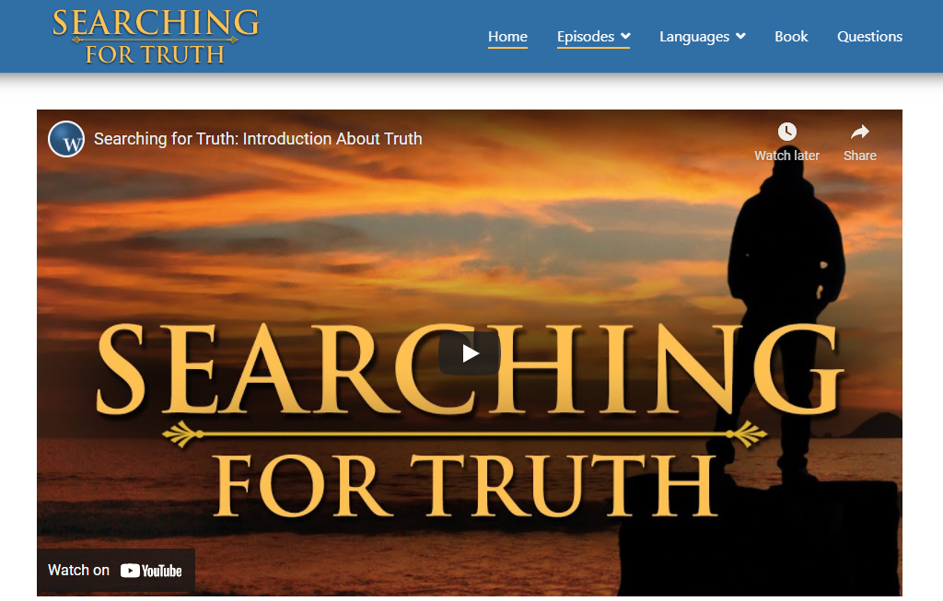
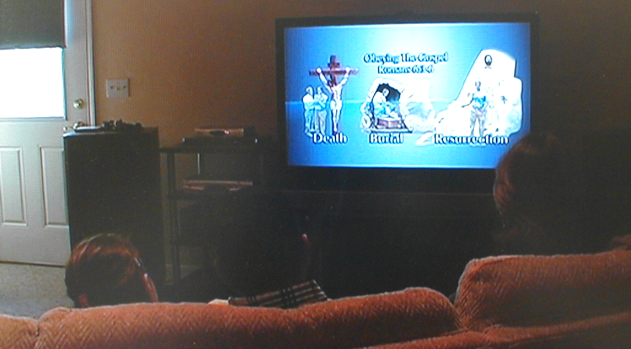

Slide 8


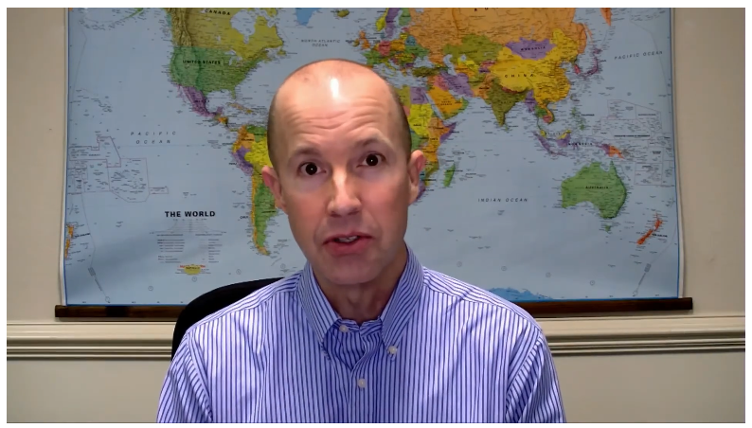

Slide 9



“Let’s Go Back to the Bible”

Slide 10
Jesus still says, “Go” (Matt. 28:19; Mark 16:15)
  You cannot NOT GO and still think you’re following Jesus (Luke 6:46)
See the soul: Distracted, Desperate, Dying souls need what YOU have!
Break the ice: Pass out easy cards, inviting to church and our website
Pop the question: “Would you come to church? Would you like a Bible study?”
Teach the gospel: Watch a video. Conduct it yourself. Or ask for help.
The church will never be larger than the gospel will make it
The church should never be larger than the gospel will make it
But if the church is not spreading the gospel, it will NOT grow

Slide 11

Jesus still says, “Go”
  Are YOU following Jesus (Luke 6:46)?
See the soul
Break the ice
Pop the question
Teach the gospel
The church will never be larger than the gospel will make it
The church should never be larger than the gospel will make it
But if the church is not spreading the gospel, it will NOT grow

Slide 12
Believe Jesus is the Son of God – John 8:24
Repent of your sins and turn toward God – Acts 17:30
Confess your faith in Jesus Christ – Romans 10:9
Be immersed into Christ – Galatians 3:27
  God will forgive all of your sins – Acts 2:38
  God will add you to His church – Acts 2:47
  God will register you in heaven – Hebrews 12:23
Serve the Lord faithfully – 1 Corinthians 3:8

