Slide 2
The Cause of the Gap
  Our own trespasses and sins (2:1, 5)
  From walking with Satan (2:2)
  From indulging our own fleshly desires (2:3)
The Severity of the Gap
  Spiritual death (2:1, 5)
  Separated from Christ and God, out in the world (2:12)
  Separated from fellowship with the people of God (2:14)
  Having no hope (2:12)

Slide 3
God could have left the gap in place – “But God” did not do that (2:4)
God’s grace could not sit idly by
  His grace was motivated by His love (2:4)
  His grace was moved by His mercy (2:4)
  His grace was manifested in His kindness (2:7)
God’s grace sent Jesus to “the cross” for us (2:16)
God’s grace shed “the blood of Christ” for us (2:13)

Slide 4
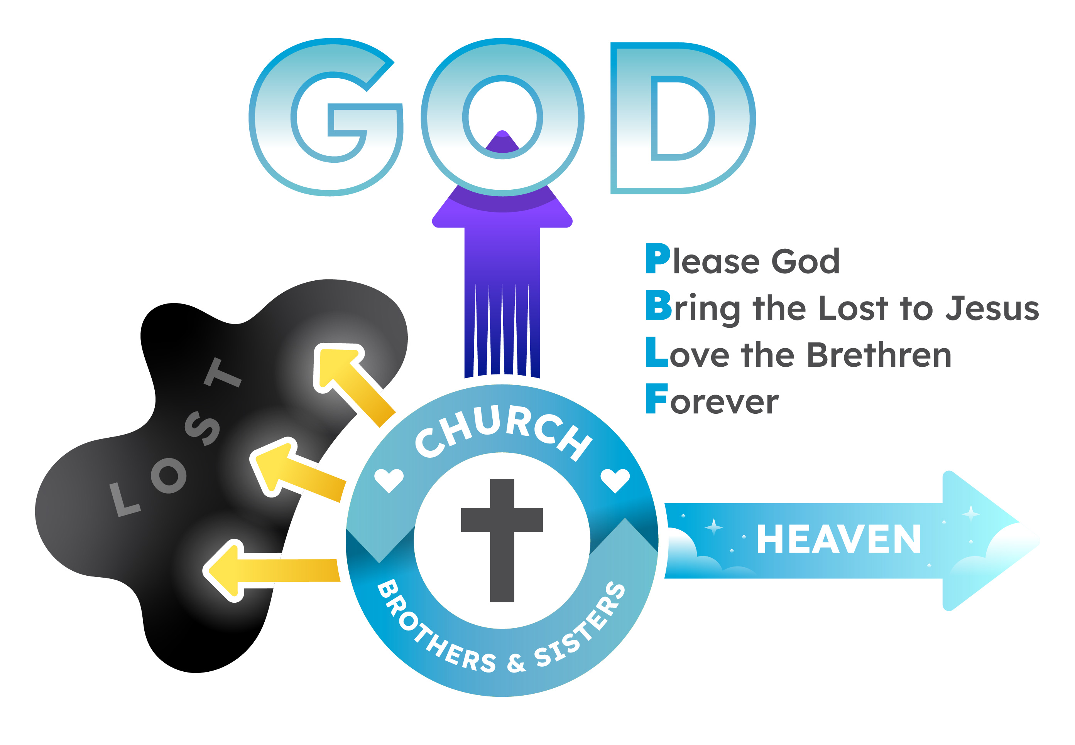
We have been reconciled to God (2:16)
  Brought near (2:13)
We have been saved from our sins (2:5, 8)
  Made alive from the dead (2:5)
We have been granted true peace (2:14, 17)
  No longer at enmity with God or His people (2:16)
We have been granted unhindered access to God (2:18)
  Into His family, into His throne-room, into His presence through worship (2:19-22)
We have been given true purpose (2:10)
  To stand in the gap and help others to also be reconciled to God (2 Cor. 5:14-21)
  To stand in the gap and help brethren to stay reconciled to God (Gal. 6:1-10)

Slide 5
Believe Jesus is the Son of God – John 1:12
Repent of your sins and turn toward God – Luke 13:3
Confess your faith in Jesus Christ – Romans 10:9
Be immersed into Christ – Romans 6:3
  God will forgive all of your sins – Acts 2:38
  God will add you to His church – Acts 2:47
  God will enroll you in heaven – Hebrews 12:23
Walk faithfully with the Lord – 1 John 1:7

