Slide 1


Slide 2


Slide 3


Slide 4


Slide 5


Slide 6


Slide 7


Slide 8


Slide 9


Slide 10


Slide 11


Slide 19



The “Law of Cause and Effect”
  “Every material effect must have an adequate cause that existed before the effect”
The “Law of Cause and Effect”
  “Every material effect must have an adequate cause that existed before the effect”

Slide 20
The “Law of Cause and Effect”
  “Every material effect must have an adequate cause that existed before the effect”
The “Law of Rationality”
  “One must only draw and accept conclusions that are warranted by clear evidence”
  If there is design, that demands the conclusion there is a designer

Slide 21


Slide 22


Slide 23


Slide 24


Slide 25


Slide 27


Slide 28

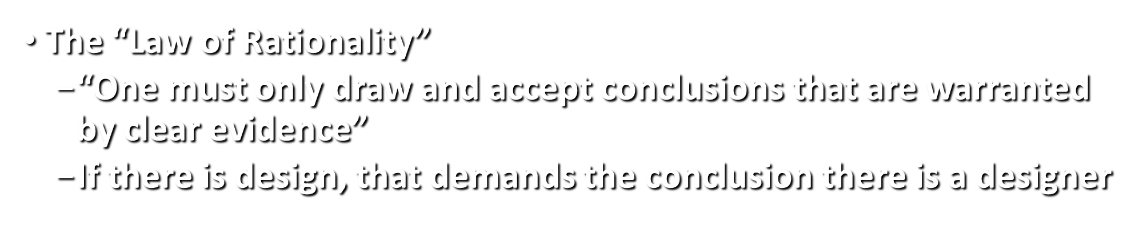

Slide 29

“The World’s First Artificial Stomach” (2006)
Built by British scientists at the Institute of Food Research
Dr. Martin Wickham was the “chief designer”
Simulates/Mimics human digestion, both the physical and chemical parts, including the stomach contractions that break up food and move it along the alimentary canal
Constructed from sophisticated plastics and metals able to withstand the corrosive acids and enzymes found in the human gut
Two-part model, slightly larger than a desktop computer
  Top: a funnel in which food, stomach acids and
  digestive enzymes are mixed
  Bottom: Once the hydration process is finished, the
  food gets crunched by a small metal tube that grinds it down before it would be absorbed by the human body
Computer software is used to set parameters: controls
how long food remains in a particular part of the stomach, predicts hormone responses at various stages, releases
gut secretions, adjusts for an infant or adult gut
Has a capacity of half the size of an actual stomach
Cost the British government $1,800,000

Slide 30

“The World’s First Artificial Stomach” (2006)
The “chief designer,” Dr. Martin Wickham said, “Our knowledge of what actually happens in the gut is still very rudimentary, but we hope that this model can help fill in some of the blanks.”
Dr. Stephen Bloom, the head of metabolic medicine at Imperial Collage in London, admitted, “The stomach is an extraordinarily complex organ, so you cannot create a model that will undertake all of these functions.”
“One very important point needs to be noted about this artificial stomach: it is complex, expensive, and took hundreds or thousands of hours to design and build. But it still cannot accomplish all the processes of a real human stomach. Yet we are to believe that the human stomach evolved over millions of years by random, chance processes with no intelligent agent responsible for any of its construction.” (Kyle Butt, ApologeticsPress.org)
So where did the human stomach originate???
The only sensible and rational conclusion is that it, like the artificial stomach, was designed and created by a Creator much wiser and more powerful than any human (Psa. 139)

Slide 31
Psalm 19:1 – “The heavens are telling of the glory of God; and their expanse is declaring the work of His hands.”
Hebrews 3:4 – “Every house is built by someone, but He who built all things is God.”
Romans 1:20 – “For since the creation of the world His invisible attributes are clearly seen, being understood by the things that are made, even His eternal power and Godhead, so that they are without excuse.”
Psalm 8 – “O Lord, our Lord, How excellent is Your name in all the earth!”
Isaiah 6:3 – “Holy, holy, holy is the Lord of hosts; The whole earth is full of His glory!”

Slide 32
Stand in awe of God (Psa. 33:8; 96:4)
Worship God (Psa. 96:7-9)
Tell others about God (Psa. 96:2-4)

