Slide 1


Slide 2


Slide 3
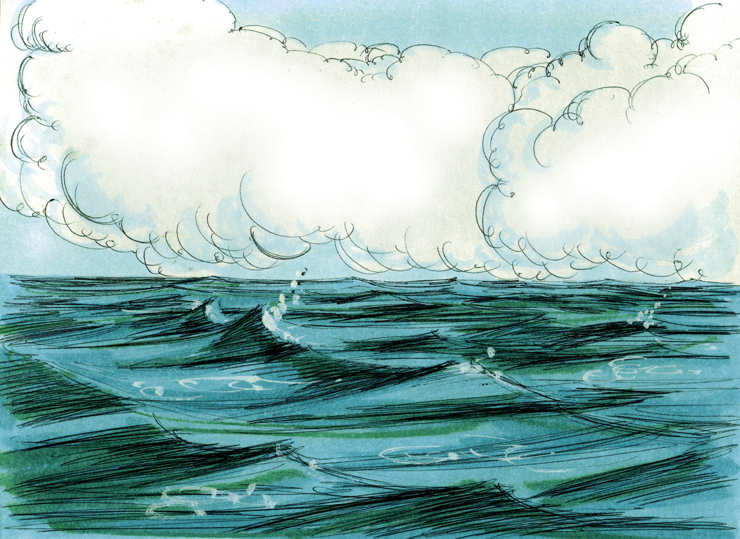

Slide 4
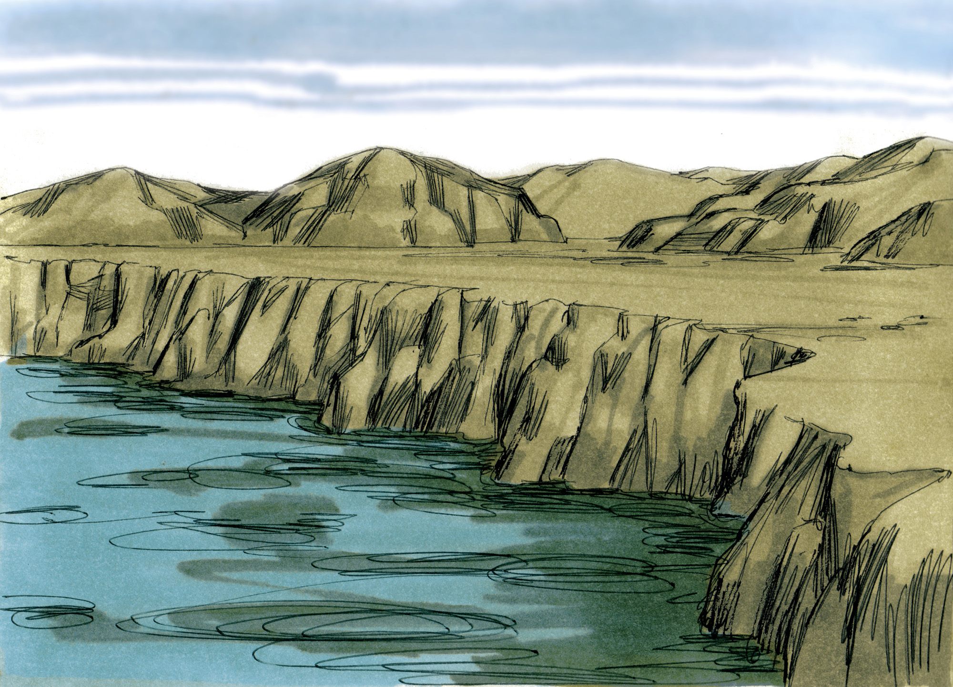

Slide 5
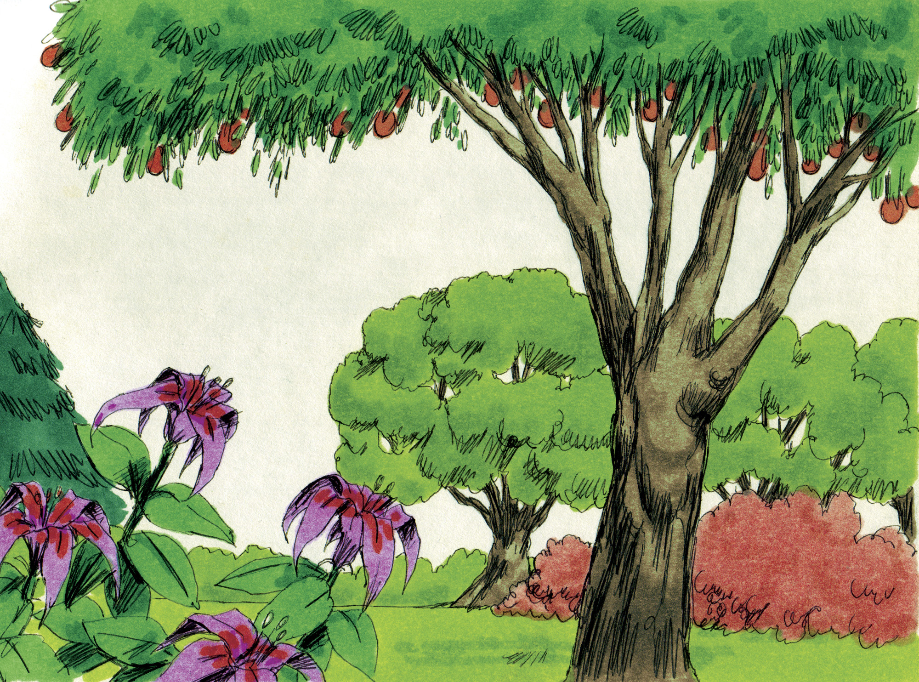

Slide 6
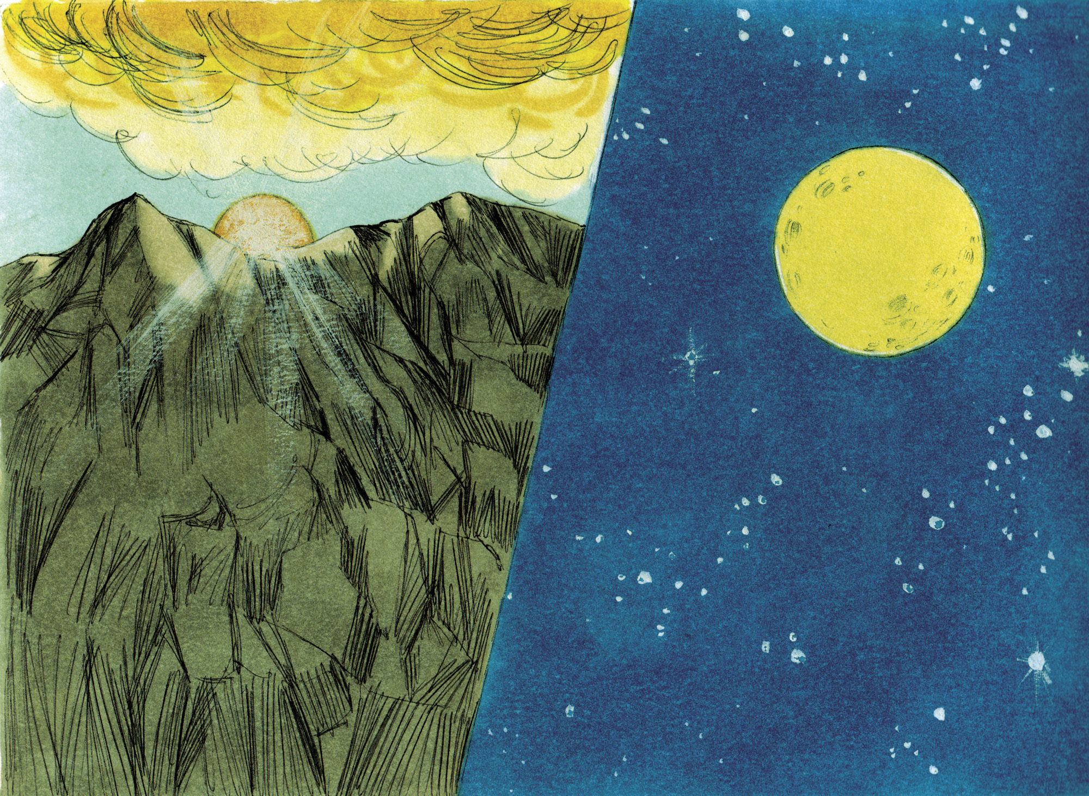

Slide 7
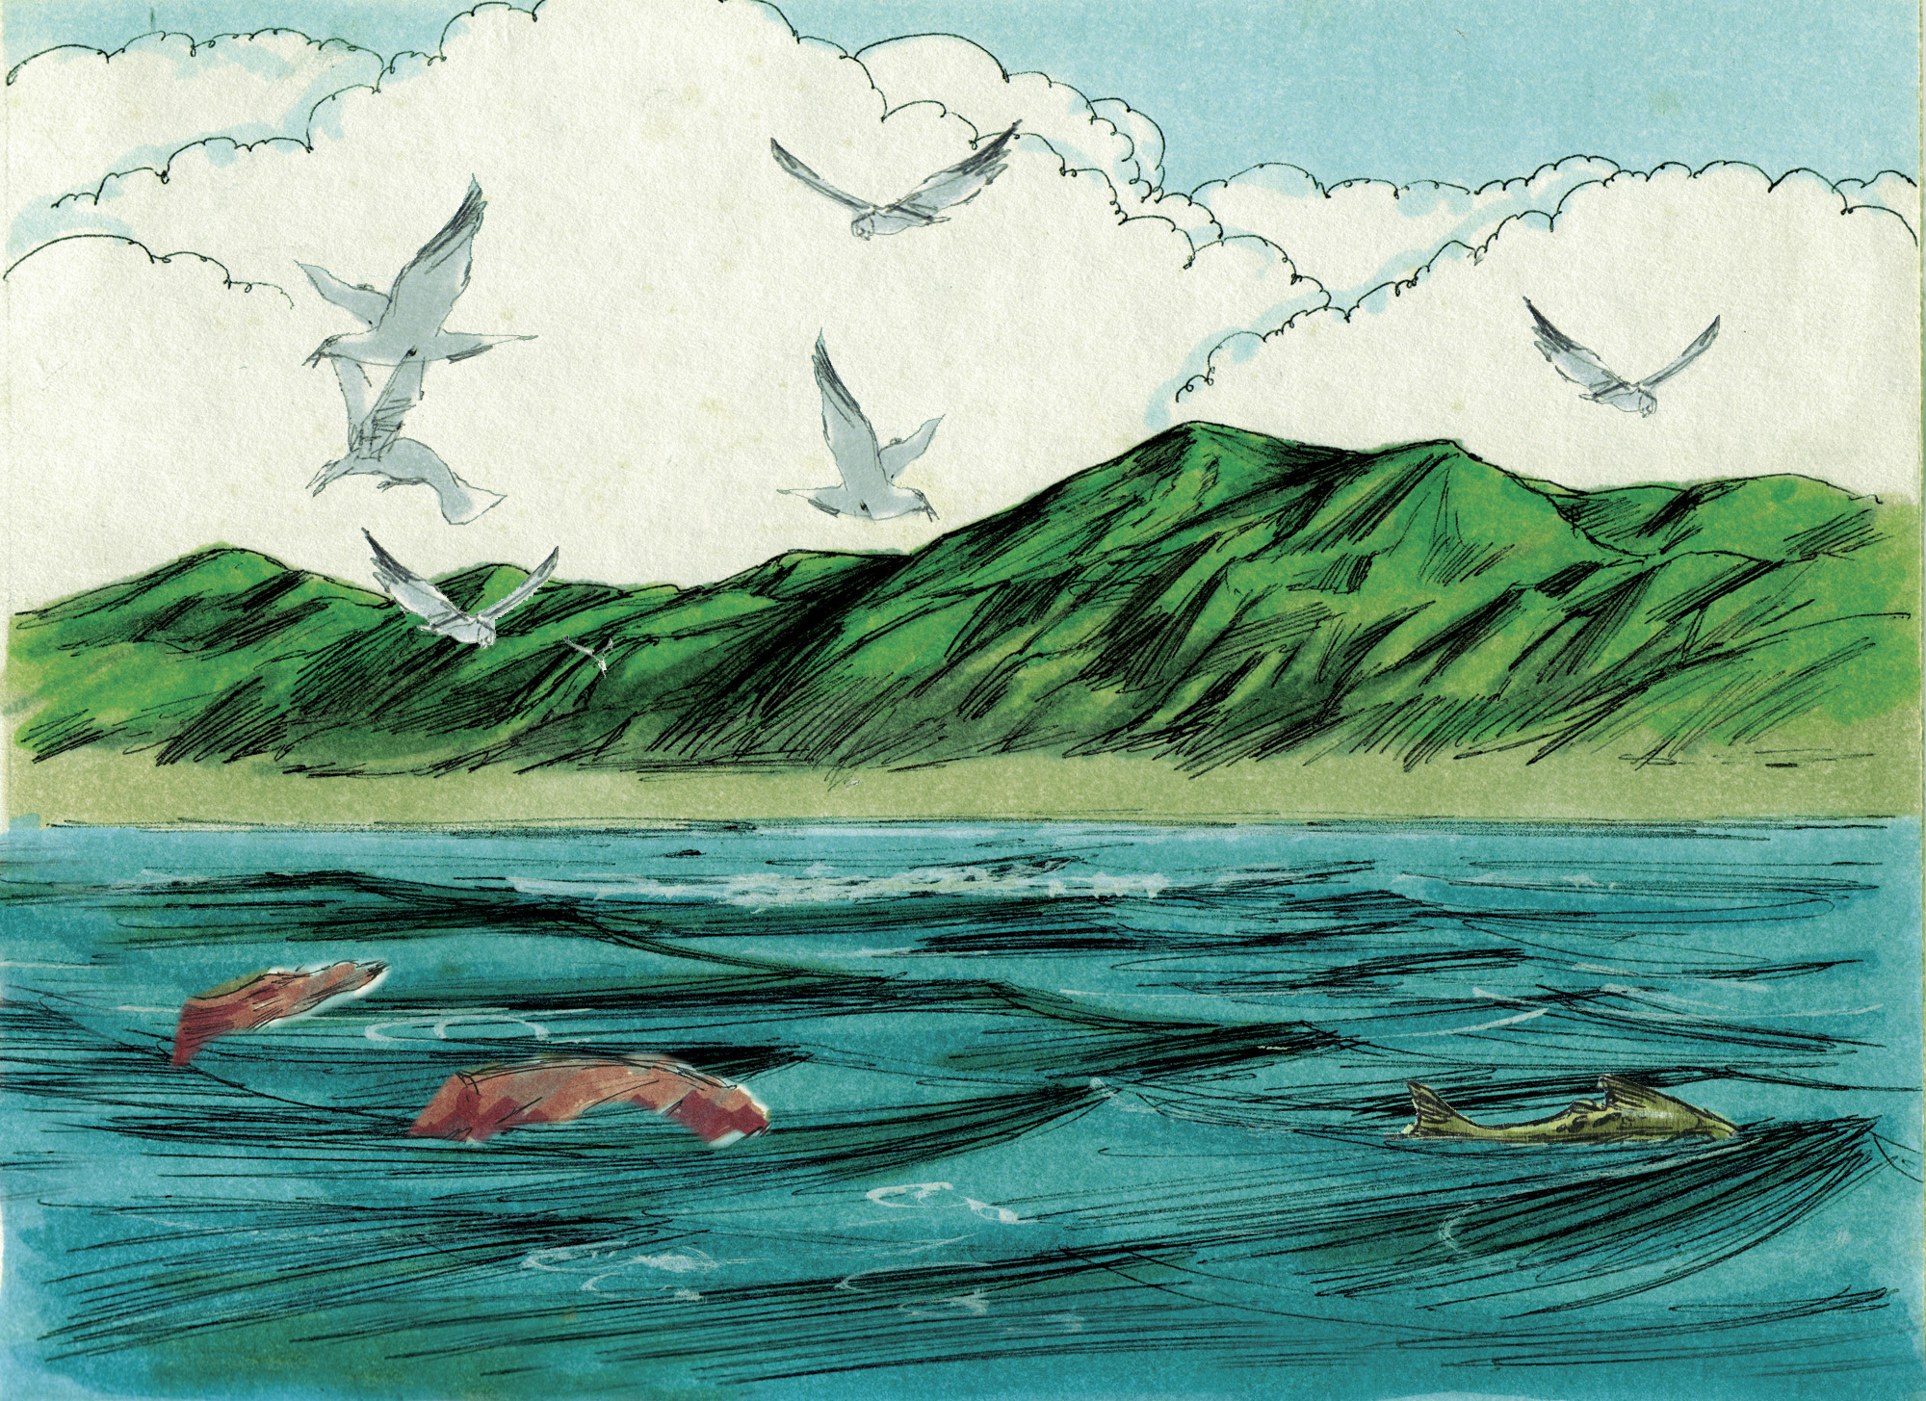

Slide 8
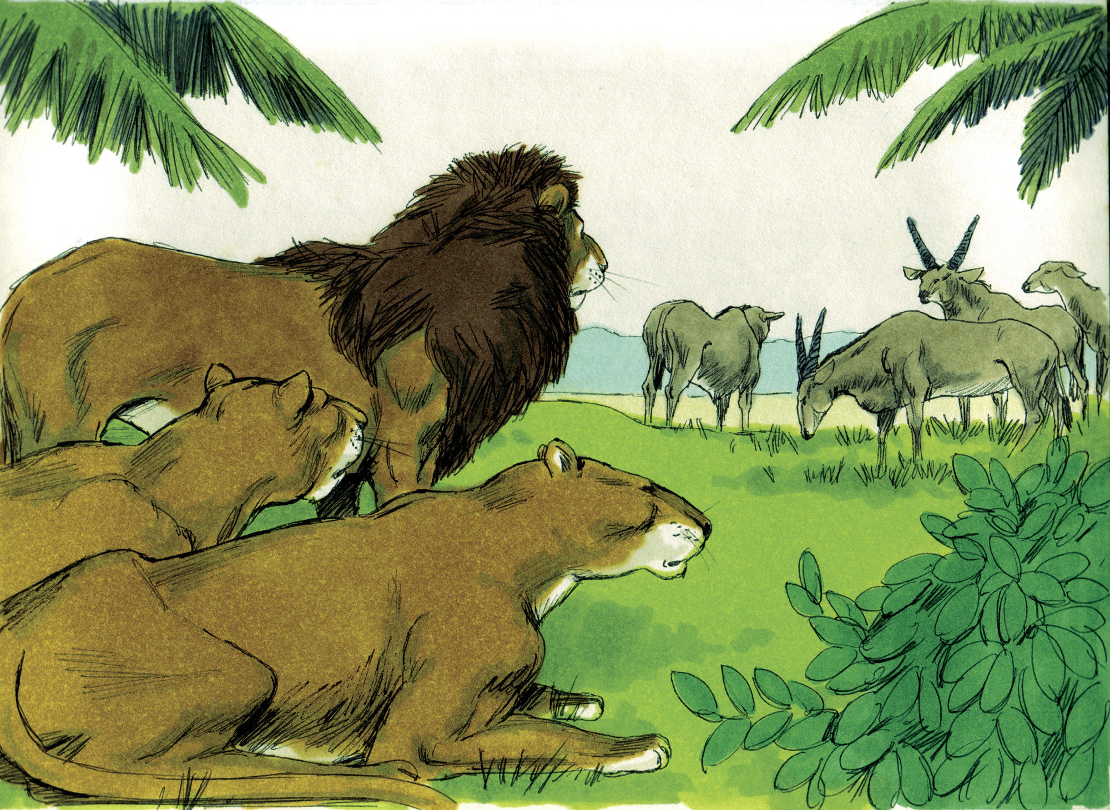

Slide 9
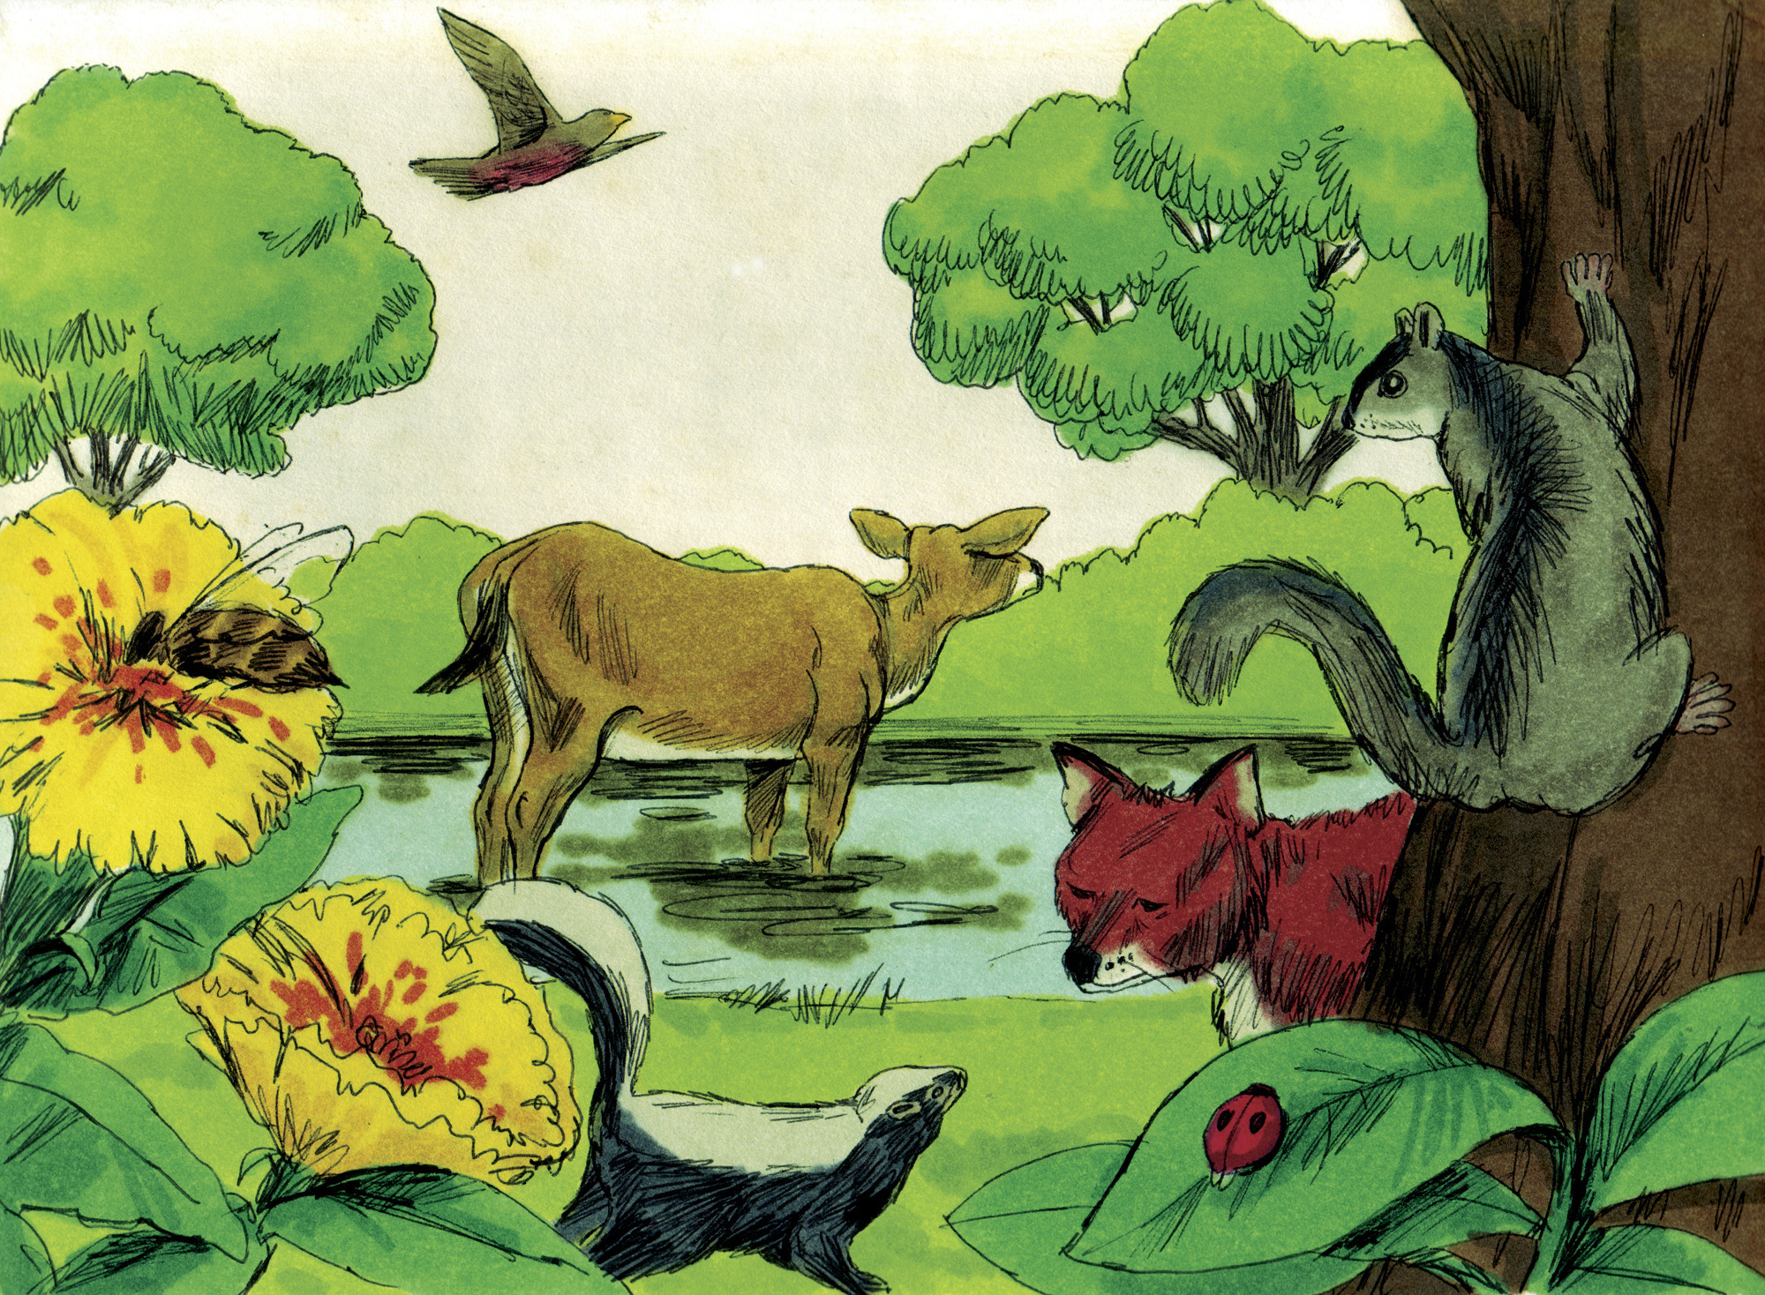

Slide 10
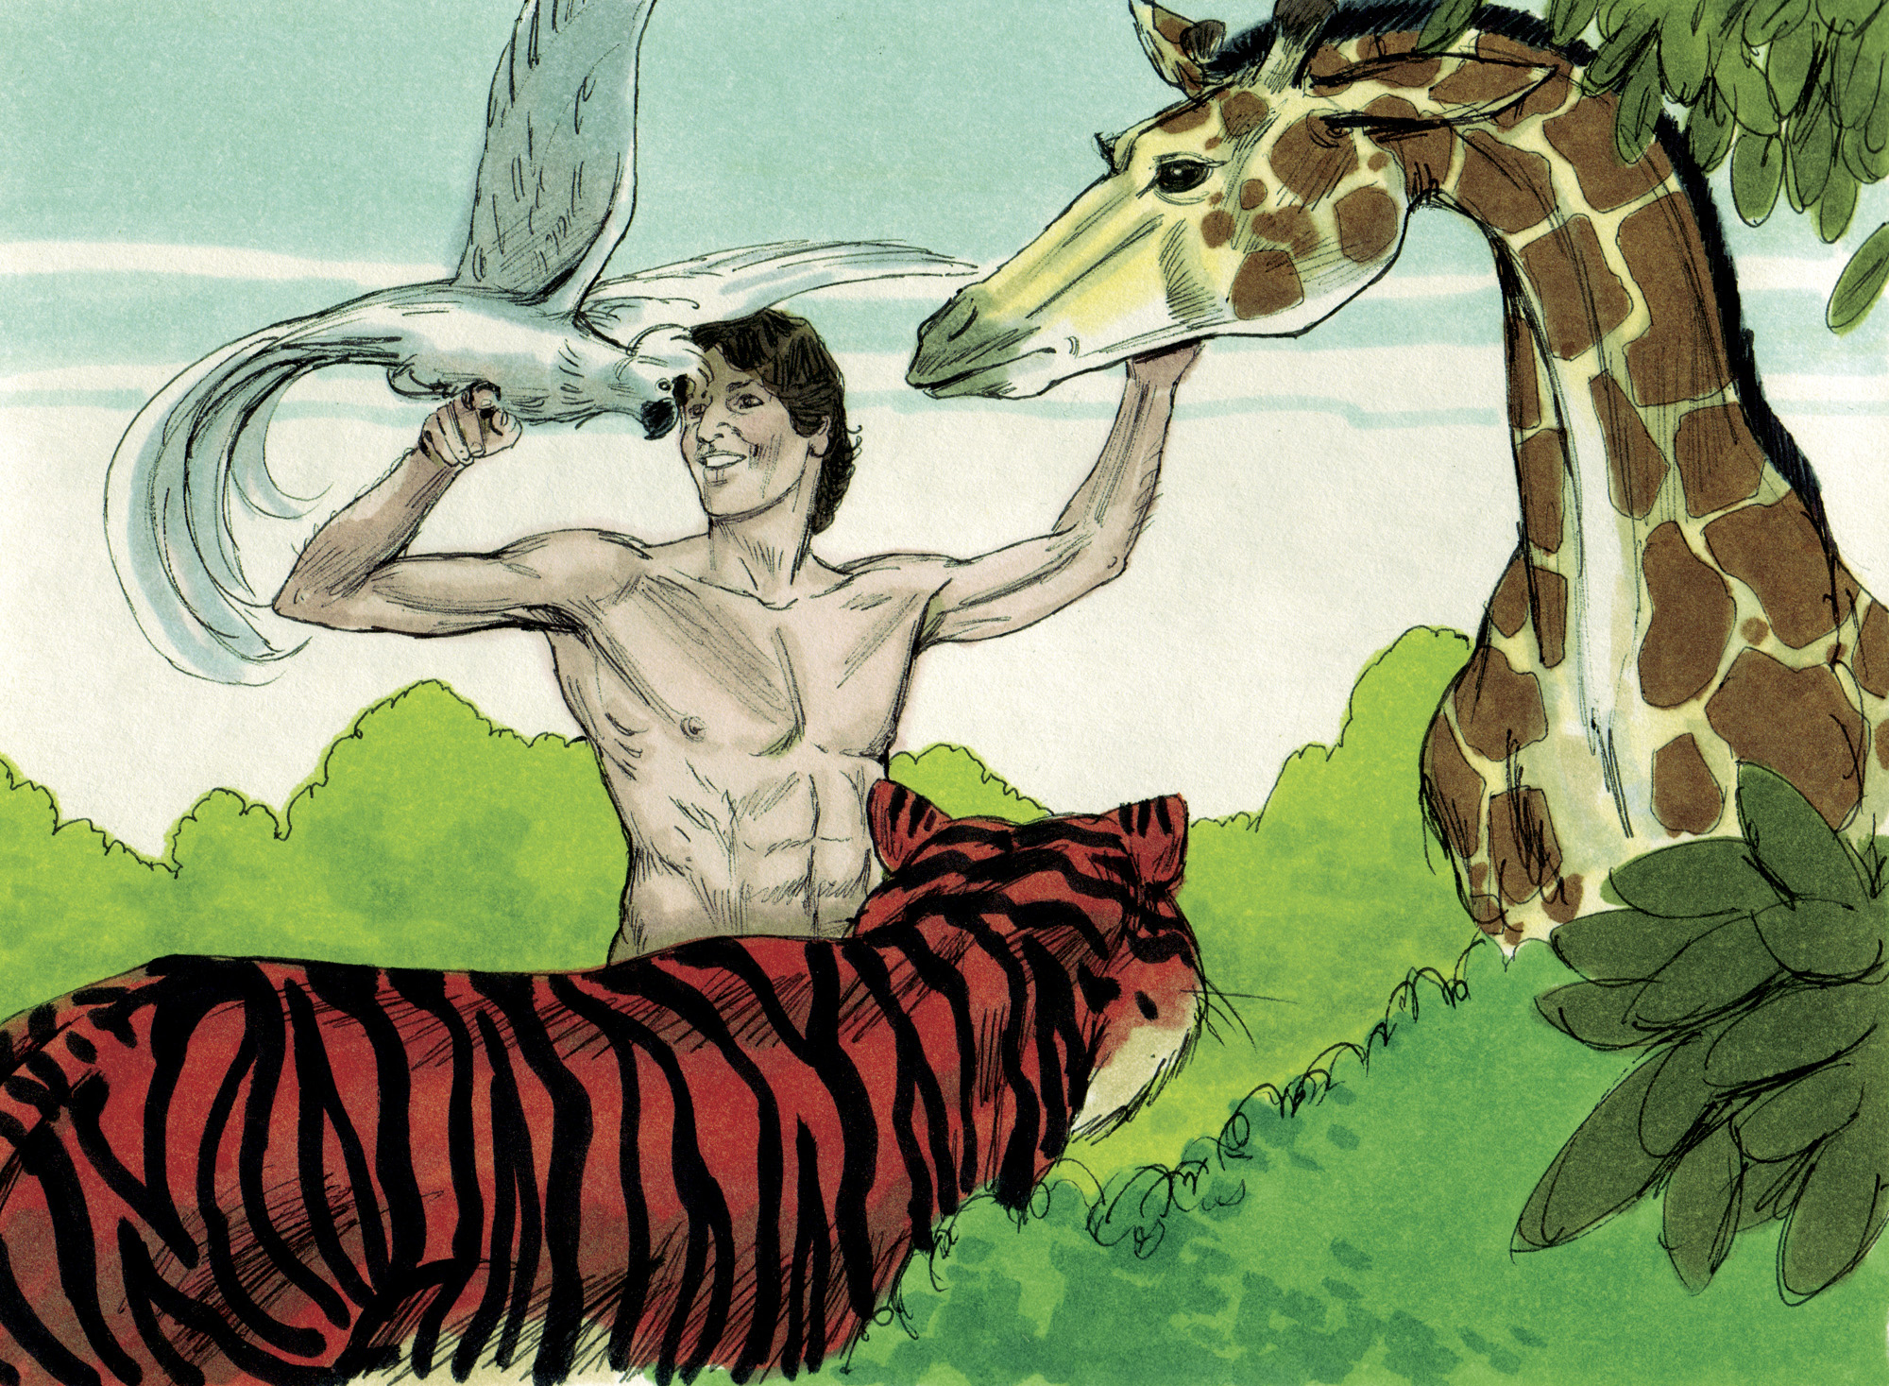

Slide 11
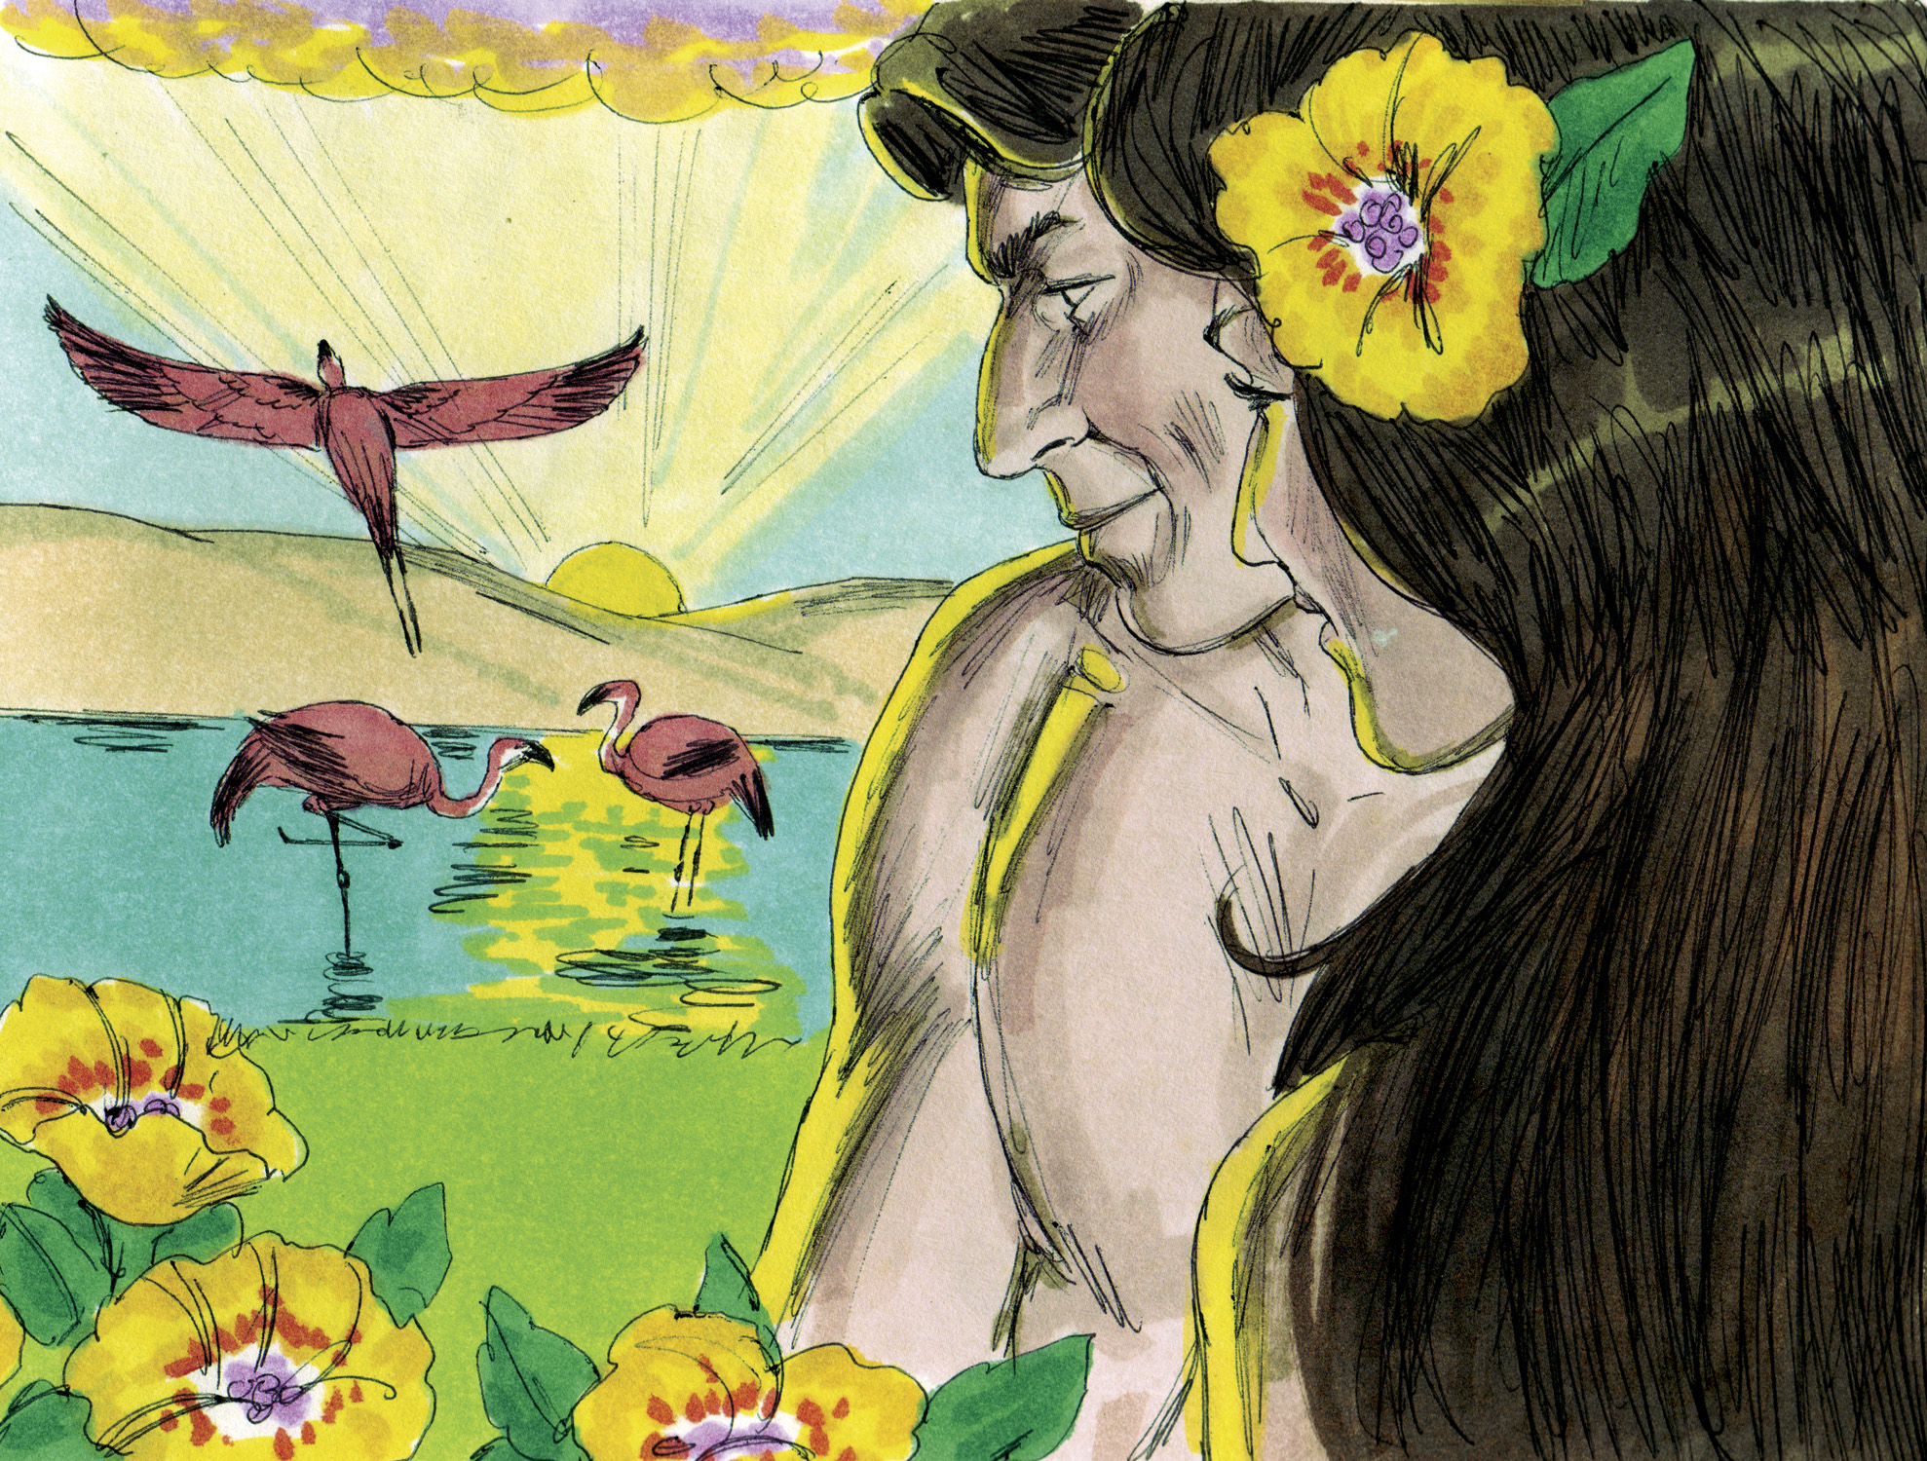

Slide 12


Slide 13
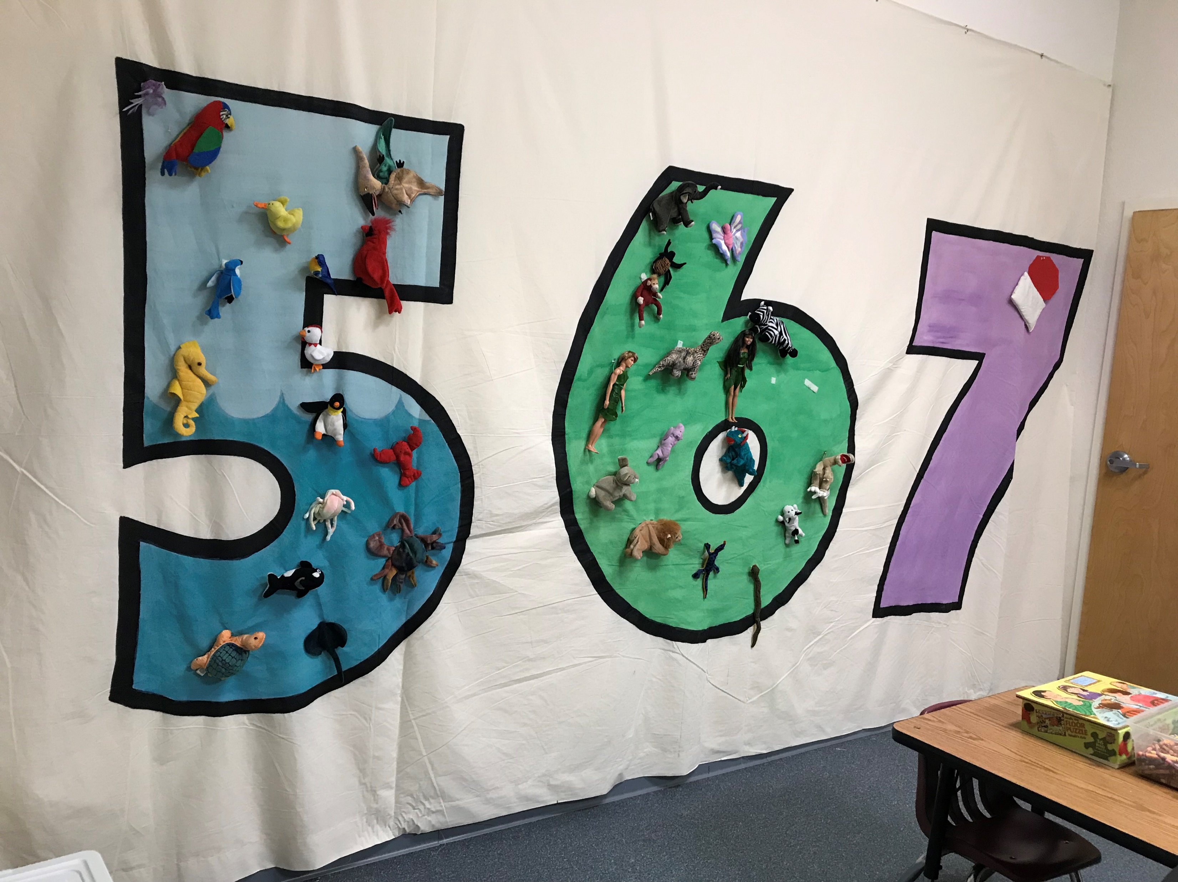

Slide 15
The word “God” is found 32 times in 31 verses
The word designates One who has great power (cf. Eph. 3:20-21)
The NT teaches that Jesus created all things (John 1:1-3; Col. 1:16)

Slide 16
Used in Scripture only of divine activity
– bringing something new into existence (1:1, 21, 27)
God “made” (1:7, 16, 25, 31; cf. Ex. 20:11)

Slide 17
He merely expressed His will and it was done
(1:3, 6, 9, 11, 14, 20, 24, 26, 28, 29)
His word had tremendous creating power (Psa. 33:6, 9)
His word has tremendous saving power (Jas. 1:21; Rom. 1:16)
His word has tremendous penetrating power (Heb. 4:12)
His word has tremendous transforming power (2 Cor. 3:18)
His word has tremendous calming power (Psa. 119:113-117)
How should we respond to “God said”?

Slide 18
Divine approval of His created world
(1:4, 10, 12, 18, 21, 25, 31)
Everything that God does is “good”
(Gen. 50:20; 1 Sam. 3:18; Rom. 8:28; Jas. 1:17)
The very nature of God is “good”
(Psa. 34:8; 100:5; 106:1; 107:1; 118:1, 29; 135:3)
Do we trust (1) God’s definition of “good” & (2) God to do what is “good”?
  Do we seek to “hold fast to that which is good” (1 Thess. 5:21)?
  Do we seek to “do what is good and right in the sight of the Lord” (Deut. 12:28)?
  Do we seek to “imitate what is…good” (3 John 11)?

Slide 19
God numbered the days = 6
(1:5, 8, 13, 19, 23, 31)
God defined the day = “the evening and the morning”
(1:5, 8, 13, 19, 23, 31)
God made a difference between days and years (1:14)
God created “all” things in SIX, 24-hour “days” (Ex. 20:8-11)

Slide 20
God created all living things
  The law of biogenesis teaches that life always comes from life
  If there is life on this earth, it had to come from Life
  Life NEVER comes from something NON-living (like evolution teaches)
God created all living things mature and able to produce seed for reproduction and conservation
The seed would produce “according to its kind” (1:11, 12, 21, 24, 25)
  The law of biogenesis teaches that life always produces after its kind
  Animal→Same animal. Plant→Same plant. Tree→Same tree. Human→Human.

Slide 21
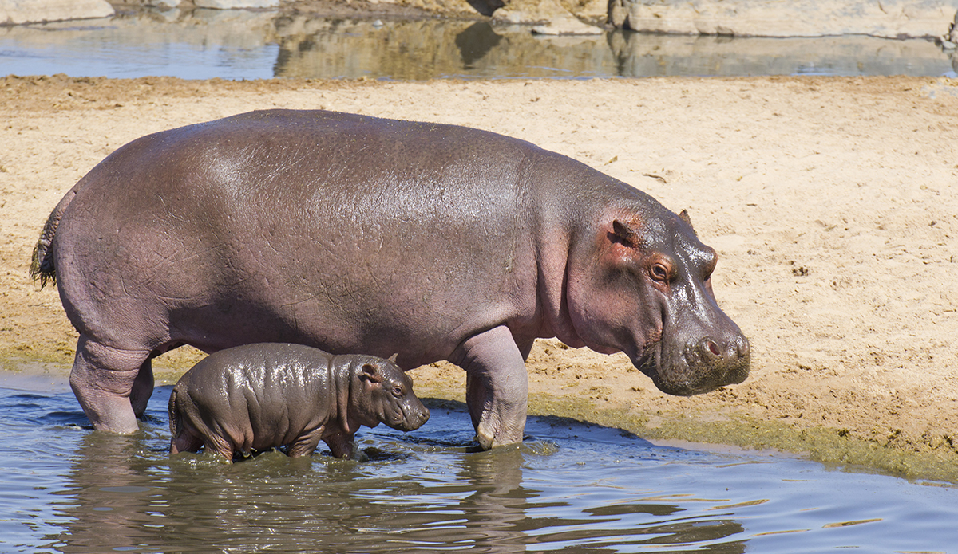
The Law of Biogenesis

Slide 22

The Law of Biogenesis

Slide 23
God created all living things
  The law of biogenesis teaches that life always comes from life
  If there is life on this earth, it had to come from Life
  Life NEVER comes from something NON-living (like evolution teaches)
God created all living things mature and able to produce seed for reproduction and conservation
The seed would produce “according to its kind” (1:11, 12, 21, 24, 25)
  The law of biogenesis teaches that life always produces after its kind
  Animal→Same animal. Plant→Same plant. Tree→Same tree. Human→Human.
Man was created “according to” God’s likeness (1:26)
  “Image” and “likeness” = spiritually, man is a rational and morally responsible personality (Eph. 4:24; Col. 3:10)
  Life (man) comes from Life (God)
  Man’s spirit (his soul) is according to God’s likeness (like no other created thing on earth)

