Slide 1
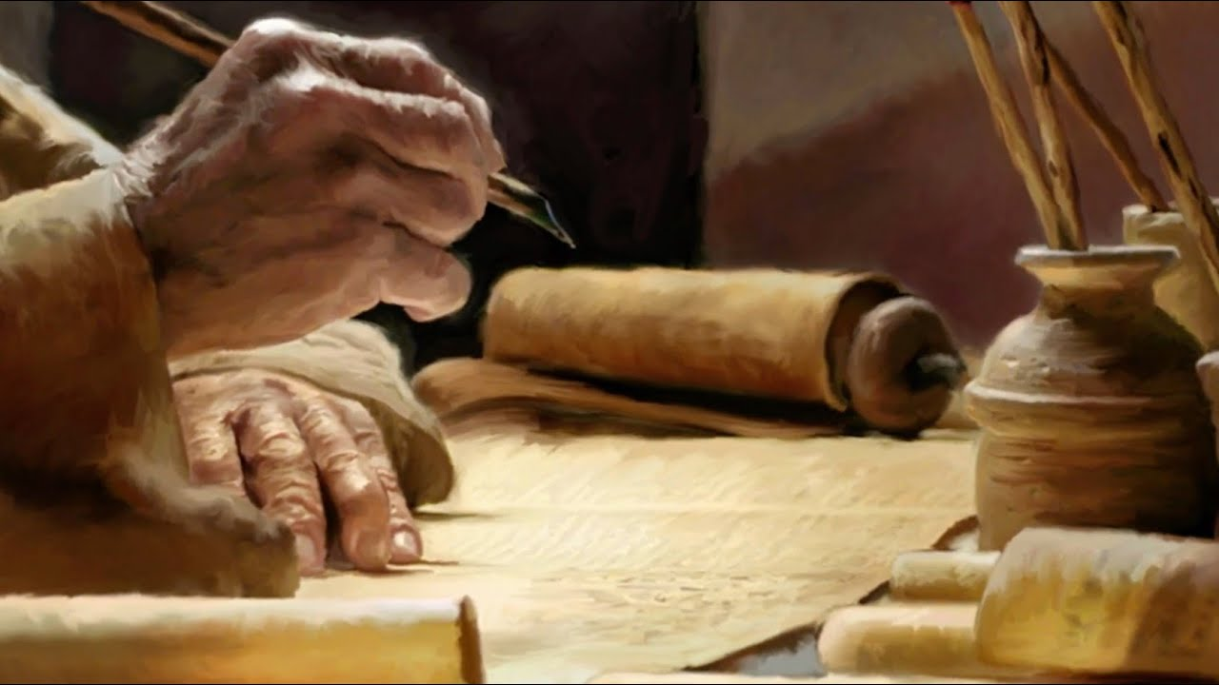
Ezekiel
The Watchman of Israel

Slide 2

Ezekiel: Outline
Judgement on Judah and Jerusalem (1-24)
Oracles against foreign nations (25-32)
Blessing for Judah and Jerusalem (33-48)

Slide 3
Judgement on Judah and Jerusalem (1-24)
Chapter 13
1-7: Accusation against the prophets
8-16: “I am against you,” declares the Lord
17-19: Accusation against false prophetesses
20-23: God is against the influence of these prophets

Slide 4
Judgement on Judah and Jerusalem (1-24)
Chapter 14
1-11: The elders inquire of Ezekiel
12-20: The city is not saved by the righteous
21-23: The righteous saved in captivity

Slide 5
Judgement on Judah and Jerusalem (1-24)
Chapter 15
1-5: The uselessness of the vine
6-8: The inhabitants of Jerusalem are the vine

Slide 6
Judgement on Judah and Jerusalem (1-24)
Chapter 16
1-14: Israel's origin story
15-34: Israel’s harlotry
35-59: God’s judgement against Jerusalem
60-63: “I will remember My covenant”

Slide 7
Judgement on Judah and Jerusalem (1-24)
Chapter 17
1-11: The Parable of the two eagles
12-21: The meaning of the parable
21-24: Messianic parable

Slide 8
Judgement on Judah and Jerusalem (1-24)
Chapter 18
1-4: The false proverb
5-18: Three generations
19-20: “But why?”
21-23: If the wicked repent
24-29: Righteous turn to evil
30-32: God’s call to repentance

Slide 9
Judgement on Judah and Jerusalem (1-24)
Chapter 19
1-4: First Lion-Jehoahaz
5-9: Second Lion-Jehoiachin
10-11: The great vine-Judah
12-14: The fate of the great vine-Zedekiah

