Slide 1
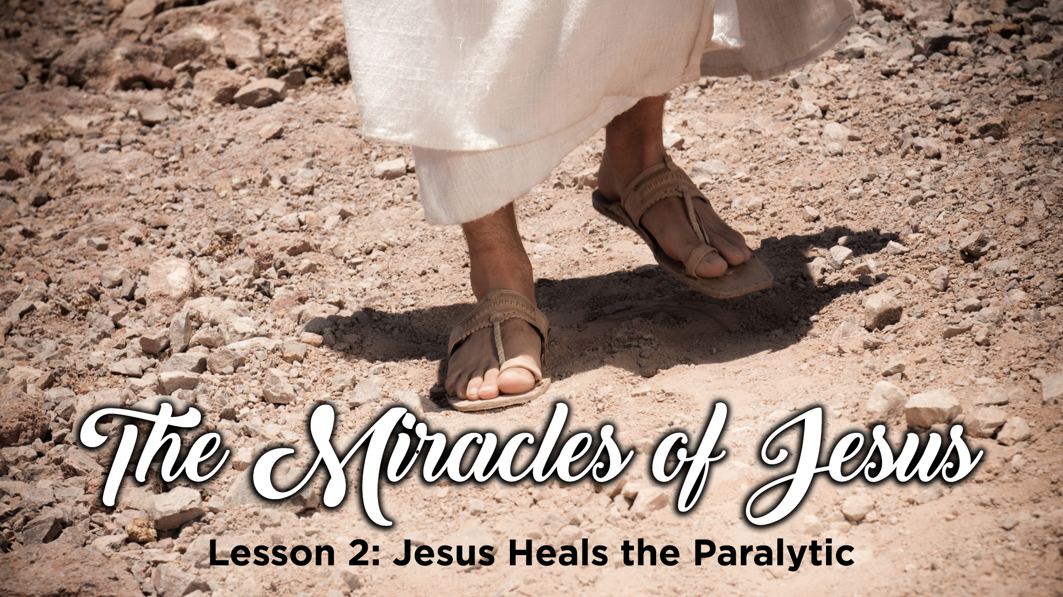
LESSONS FROM THE MIRACLES OF JESUS

Slide 2
LESSONS FROM THE MIRACLES OF JESUS

Slide 3
Jesus heals the paralytic
Matthew 9:2-8 mark 2:1-12
Luke 5:17-26

Slide 4

Miracles are works of a supernatural origin and character, such as cannot be produced by natural agents and means

Slide 5
Miracles confirm the word and the speaker
During Jesus’ public ministry, the Gentiles didn’t know him and the Jews needed to come to the belief that He was the Messiah
Mark 16:15-20; Hebrews 2:3-4; 1 Thessalonians 1:5; John 3:2-3; Exodus 4:8,15, 30, 8:19

Slide 6
Mark 16:15-20
Message
16:15 And He said to them, "Go into all the world and preach the gospel to every creature.
Confirmation
16:20 ... the Lord working with them and confirming the word through the accompanying signs.
Response
16:16 He who believes and is baptized will be saved

Slide 7
Hebrews 2:3-4
Message
2:3 ... so great a salvation, which at the first began to be spoken by the Lord,
Confirmation
2:4 God also bearing witness both with signs and wonders, with various miracles, and gifts of the Holy Spirit.
Response
2:1 ... we must give the more earnest heed to the things we have heard, lest we drift away.

Slide 8
1 Thessalonians 1:5-6
Message
1:5 For our gospel did not come to you in word only,
Confirmation
1:5 but also in power, and in the Holy Spirit and in much assurance,
Response
1:6 And you became followers of us and of the Lord

Slide 9
John 3:2-3
Message
3:3 “... unless one is born again, he cannot see the kingdom of God.“
Confirmation
3:2 “... no one can do these signs that You do unless God is with him.“
Response
3:2 “... we know that You are a teacher come from God;

Slide 10
Exodus 4:8, 15, 30; 8:19(a)
Message
4:15 “... I will be with your mouth ... and I will teach you what you shall do.
Confirmation
4:30 And Aaron spoke all the words which the LORD had spoken to Moses. Then he did the signs in the sight of the people.
Response
4:8 ...that they (the Israelites) may believe the message ...
8:19(a) Then the magicians said to Pharaoh, "This is the finger of God."

Slide 11
1 Kings 17:24
Elijah and the widow of Zarephath
Then the woman said to Elijah, "Now by this I know that you are a man of God, and that the word of the LORD in your mouth is the truth."

Slide 12
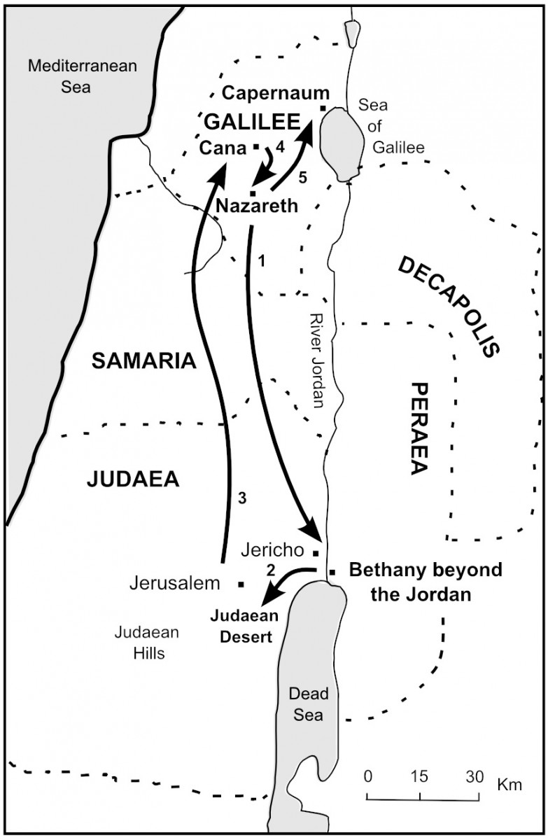
Jesus’ public ministry started in Judea
Jesus moved his ministry to Galilee
Jesus made Capernaum His home base in Galilee

Slide 13
Jesus heals a paralytic
Matthew 9:2-8; Mark 2:1-12; Luke 5:17-26)
And again He entered Capernaum after some days, and it was heard that He was in the house. Immediately many gathered together, so that there was no longer room to receive them, not even near the door. And He preached the word to them. Then they came to Him, bringing a paralytic who was carried by four men. And when they could not come near Him because of the crowd, they uncovered the roof where He was. So when they had broken through, they let down the bed on which the paralytic was lying. When Jesus saw their faith, He said to the paralytic, "Son, your sins are forgiven you." And some of the scribes were sitting there and reasoning in their hearts, "Why does this Man speak blasphemies like this? Who can forgive sins but God alone?" But immediately, when Jesus perceived in His spirit that they reasoned thus within themselves, He said to them, "Why do you reason about these things in your hearts? Which is easier, to say to the paralytic, 'Your sins are forgiven you,' or to say, 'Arise, take up your bed and walk'? But that you may know that the Son of Man has power on earth to forgive sins"—He said to the paralytic, "I say to you, arise, take up your bed, and go to your house." Immediately he arose, took up the bed, and went out in the presence of them all, so that all were amazed and glorified God, saying, "We never saw anything like this!"

Slide 14
Jesus heals a paralytic
Matthew 9:2-8; Mark 2:1-12; Luke 5:17-26)
The 3 steps of reasoning by the Scribes and Pharisees
Only God can forgive sins
This man is NOT God
Therefore, he is guilty of blasphemy
The 3 steps that the scribes and Pharisees should have reasoned
Only God can forgive sins
This man can forgive sins
Therefore, this man must be God

Slide 15
THE REASONABLENESS OF JESUS’ MIRACLES
I believe this to be true because I believe in God (Mark10:27)
I believe this to be true because I believe the Bible (2 Timothy 3:16)
I believe this to be true because the miracles of Jesus are recorded by trustworthy witnesses
I believe this to be true because the miracles of Jesus are consistent with who He claimed to be

Slide 16
The reality of Jesus’ miracles
Jesus was not limited in his miracles
(John 3:34; Matthew 4:23)
Jesus was not limited by the faith of others
Jesus’ healing was immediate (Matthew 8:3)
Jesus’ healing was complete (Mark 2:12)
Jesus’ primary focus was spiritual not physical (Luke 4:43)

Slide 17
The results of Jesus’ miracles
The people were amazed (Mark 2:1-12)
The people were astonished (Luke 5:26)
The people were filled with awe (Matthew 9:8)
Jesus’ miracles always glorified the Father
(Matthew 9:8; Mark 2:12; Luke 5:25-26)

Slide 18
The results of Jesus’ miracles
Jesus’ miracles show that He is the son of God
Jesus’ miracles show that He is concerned for us
Jesus’ miracles show that he is moved with compassion for us
We can therefore know without a doubt that we can be saved from our sins

Slide 19

Next WEEK calming the storm
MATTHEW 8:23-27
MARK 4:35-41
LUKE 8:26-39

