Slide 1
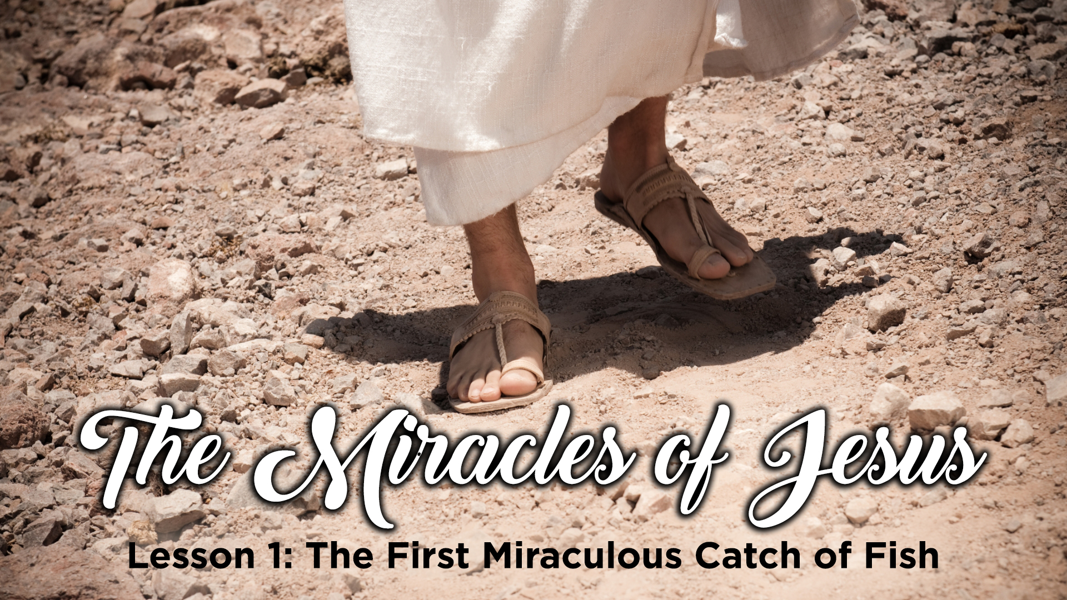

Slide 2
The first miraculous catch of fish
Lessons from select miracles of Jesus and a study of what miracles are (and are not)

Slide 3
G1411 - dunamis, doo'-nam-is –(MIRACLE) From G1410; force (literally or figuratively); specifically miraculous power (usually by implication a miracle itself):
G5059 – teras, ter'-as – (WONDER) a prodigy or omen: - wonder.
G4592 - sēmeion, say-mi'-on – (SIGN) an indication, especially ceremonially or supernaturally
Also watch for the words “work(s)” and “mighty Deeds” – these also typically refer to a miraculous event

Slide 4

Works of a supernatural origin and character, such as cannot be produced by natural agents and means
The miraculous is not to be confused with the providential, where God operates within the usual course of nature

Slide 5
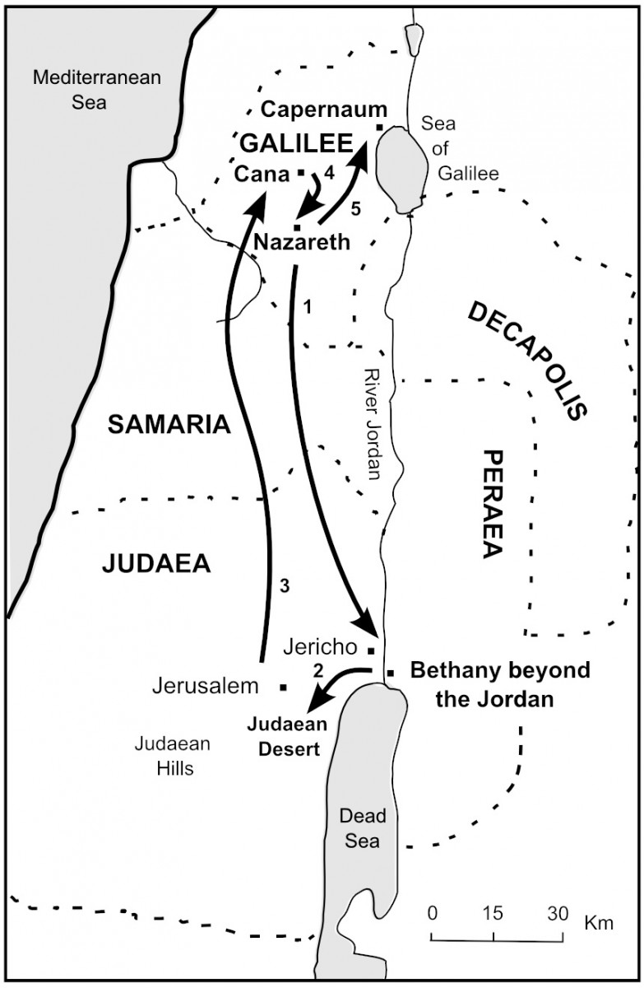
The call to discipleship and the miraculous catch of fish (Luke 5:1-11)
Jesus’ public ministry started in Judea
John 1:35-42
John 4:1-3
Mark 1:14
Jesus moved his ministry to Galilee
Matthew 4:18-22
Mark 1:16-20
Luke 5:1-11

Slide 6
The call to discipleship and the miraculous catch of fish (Luke 5:1-11)
All three accounts take place at the Sea of Galilee
All three accounts mention 3 of the same people – Peter, James & John *
All three accounts refer to the same activity – fishing / cleaning and mending of nets
All three accounts record the same call to action – to make fishers of men
All three accounts record the same response – jobs were left behind and Jesus was followed full time

Slide 7
The call to discipleship (Luke 5:1-11)
We must learn something – Luke 5:1-3
We must understand something - Luke 5:3-8
We must acknowledge something – Luke 5:8-10a
We must change something – Luke 5:10b
We must give up something (sacrifice) – Luke 5:11
We must do something – Luke 5:11

Slide 8

Next WEEK
THROUGH THE ROOF
MATTHEW 9:1-8
MARK 2:1-12
LUKE 5:17-26

