Slide 1
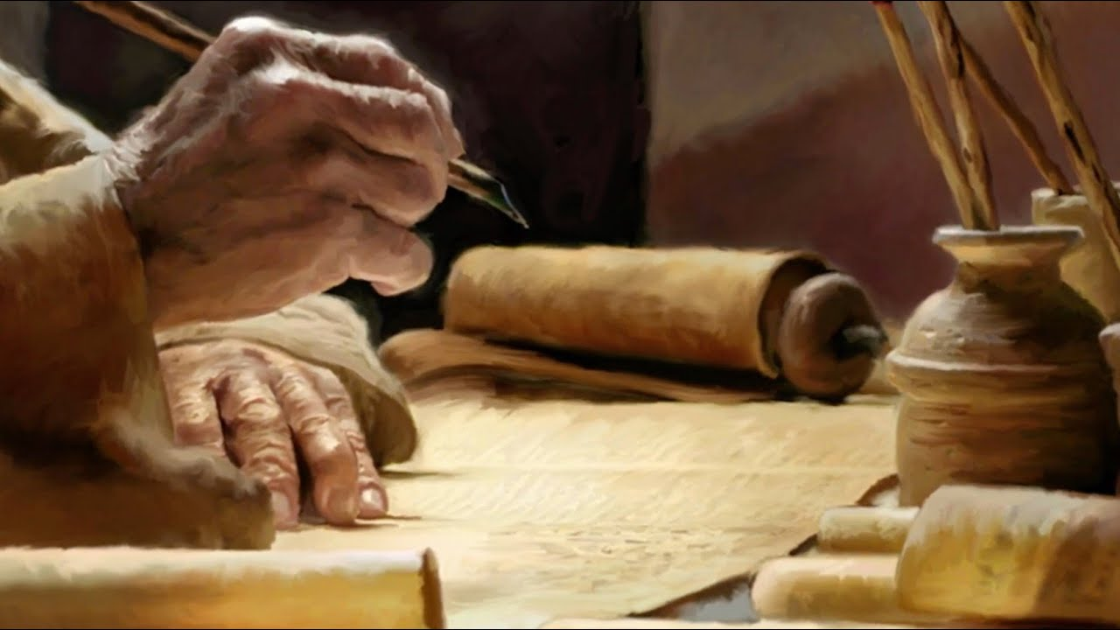
Ezekiel
The Watchman of Israel

Slide 2

Ezekiel: The Prophet
His name means God Strengthens.
He was the son of Buzi, a priest.
Being 30 years old at the 5th year of the exile of Jehoiachin he would’ve been born in 623-622 BC, a year or two before the book of the law was discovered in the temple.
He would’ve been 14 when King Josiah died and wouldn’t have been old enough to have served as a priest before the captivity (Num 4:3).
He may have heard the preaching of Jeremiah and known about Habakkuk and Zephaniah.

Slide 3
Ezekiel: The Prophet
He would’ve been around during much political instability.
  Pharaoh Neco deposed Josiah’s successor, Jehoahaz and installed Jehoiakim as an Egyptian puppet.
  When Egypt was defeated at the battle of Carchemish in 604, Jehoiakim shifted his allegiance to Nebuchadnezzar, only to later rebel and align with Egypt again.
  Jehoiakim died and left Jehoiachin in his place to face Babylonian retribution.
  He was among those lead into captivity with Jehoiachin in 2 Kings 24:14 with the rest of the wealthy and ruling class.
  He lived with his wife along a large irrigation canal, River Kebar, in a community of exiles.
  At the opening of the book Jerusalem was not yet destroyed.

Slide 4
Ezekiel: The Prophet
Critics have called his mental health into question saying he was pathological.
  He lies motionless for long periods of time (4:4-7)
  Is dumb or mute (3:24-27; 24:25-27; 33:22)
  Does not mourn the death of his wife (24:15-27)
  Visionary transports (8:1-4)
  Reports extraordinary stories and visions (1-2; 8-11; 15-18; 21; 23-24; 37-48)
  Engages in bizarre conduct (4:12; 5:1-4; 12:3-5)

Slide 5
Ezekiel: Chronological Dates
Reference | Yr/Mon/Dy | Julian Calendar | Event
1:1 | 30/4/5 | July 31, 593 | Call narrative
1:2 | 5/4/5 | July 31, 593 | Call narrative
8:1 | 6/6/5 | Sept. 17, 592 | Vision of Events in Jerusalem
20:1 | 7/5/10 | Aug. 14, 591 | Elders come to inquire
24:1 | 9/10/10 | Jan. 15, 588 | Siege of Jerusalem begins
26:1 | 11/-/1 | Between Apr. 587 and Apr. 586 | Oracle against Tyre
29:1 | 10/10/12 | Jan. 7, 587 | Oracle against Egypt
29:17 | 27/1/1 | Apr. 26, 571 | Egypt instead of Tyre
30:20 | 11/1/7 | Apr. 29, 587 | Oracle against Pharaoh
31:1 | 11/3/1 | June 21, 587 | Oracle against Pharaoh
32:1 | 12/12/1 | Mar. 3, 585 | Oracle against Pharaoh
32:17 | 12/-/15 | Between Apr. 586 and Apr. 585 | Oracle against Egypt
33:21 | 12/10/5 | Jan. 8, 585 | Escapee from Jerusalem arrives
40:1 | 25/1/10 | Apr. 28, 573 | Vision of Restored Jerusalem

Slide 6
Ezekiel: Outline
Judgement on Judah and Jerusalem (1-24)
Oracles against foreign nations (25-32)
Blessing for Judah and Jerusalem (33-48)

Slide 7
Ezekiel: Important Passages
“Son of man, I have appointed you a watchman to the house of Israel; whenever you hear a word from My mouth, warn them from Me.” (3:17)

Slide 8
Ezekiel: Important Passages
“The person who sins will die. The son will not bear the punishment for the father's iniquity, nor will the father bear the punishment for the son's iniquity; the righteousness of the righteous will be upon himself, and the wickedness of the wicked will be upon himself.” (18:20)

Slide 9
Ezekiel: Important Passages
“Say to them, 'As I live!' declares the Lord GOD, 'I take no pleasure in the death of the wicked, but rather that the wicked turn from his way and live. Turn back, turn back from your evil ways! Why then will you die, O house of Israel?” (33:11)

Slide 10
Ezekiel: Important Passages
“I will make them and the places around My hill a blessing. And I will cause showers to come down in their season; they will be showers of blessing.” (34:26)

Slide 11
Ezekiel: Important Passages
“Moreover, I will give you a new heart and put a new spirit within you; and I will remove the heart of stone from your flesh and give you a heart of flesh.” (36:26)

Slide 12
Ezekiel: Important Passages
“My servant David will be king over them, and they will all have one shepherd; and they will walk in My ordinances and keep My statutes and observe them.” (37:24)

Slide 13
Judgement on Judah and Jerusalem (1-24)
Chapter 1:
1-3: Date time and place
4-28: The Glory of the Lord
4: Great cloud and flashing light
5-14: Living beings
15-24: Wheels moving with the living beings
25-28: The expanse and the glory of God

Slide 14
Judgement on Judah and Jerusalem (1-24)
Chapter 2:
1-2: The Call
3-7: The Mission
8-10: The Scroll

Slide 15
Judgement on Judah and Jerusalem (1-24)
Chapter 3:
1-3: The Scroll Continued
4-7: The condition of the house of Israel
8-15: Preparation of Ezekiel
16-27: Ezekiel the Watchman

Slide 16
Judgement on Judah and Jerusalem (1-24)
Chapter 4:
1-8: Symbolism of sieged Jerusalem
9-13: The food of sieged Jerusalem
14-17: Objection and meaning of the food

Slide 17
Judgement on Judah and Jerusalem (1-24)
Chapter 6:
1-7: Calamity for idol worship
8-9: A remnant
10-14: Sword, famine, and plague!

