Slide 1
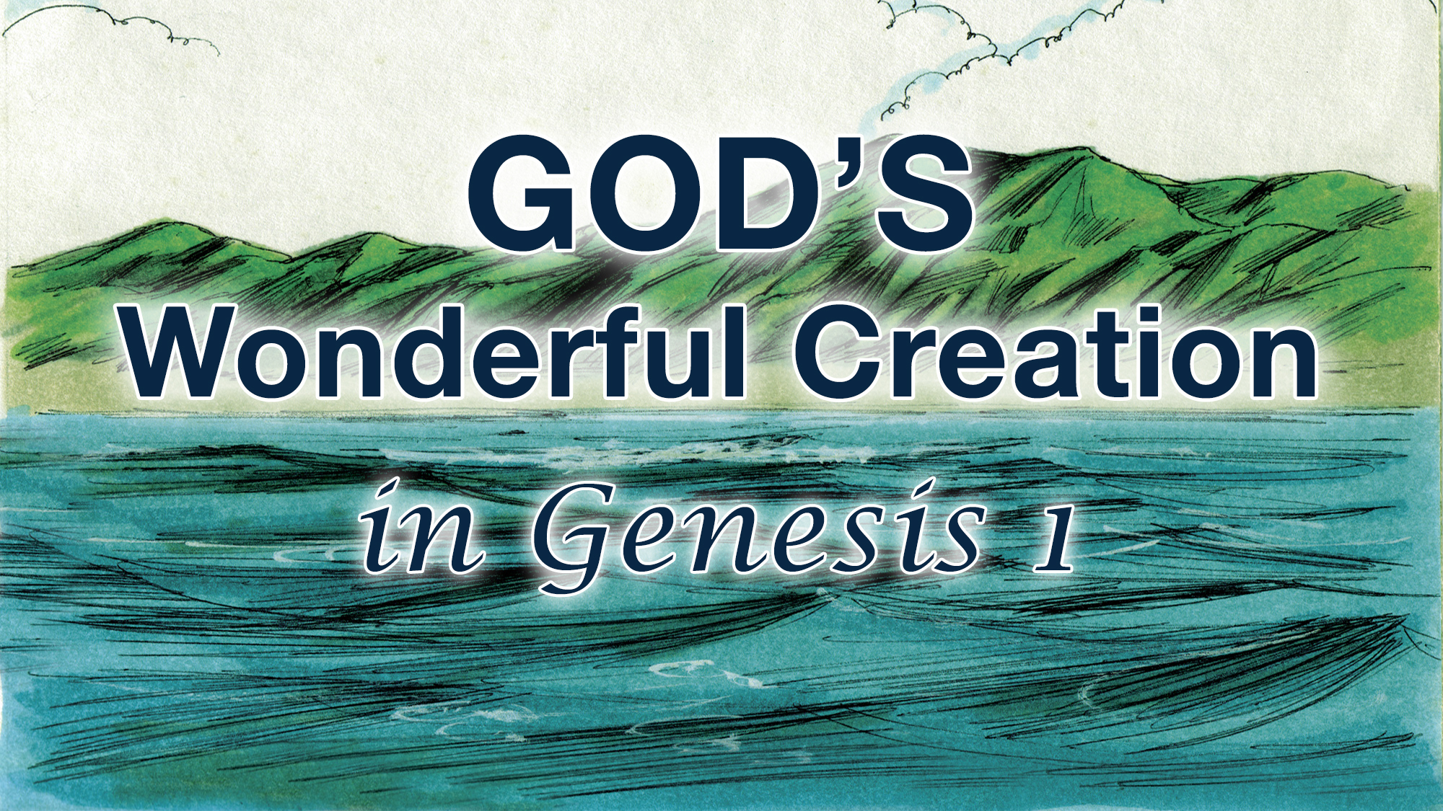

Slide 2


Slide 3
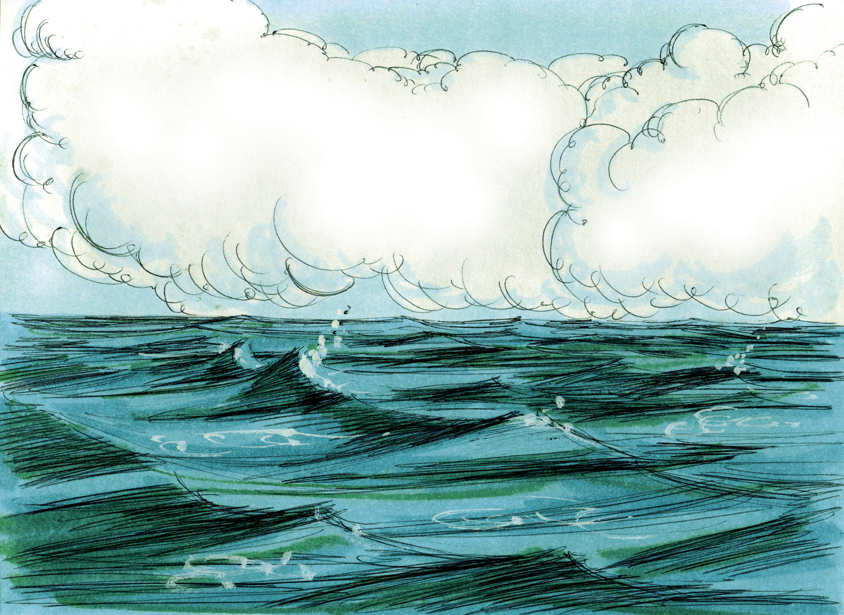

Slide 4
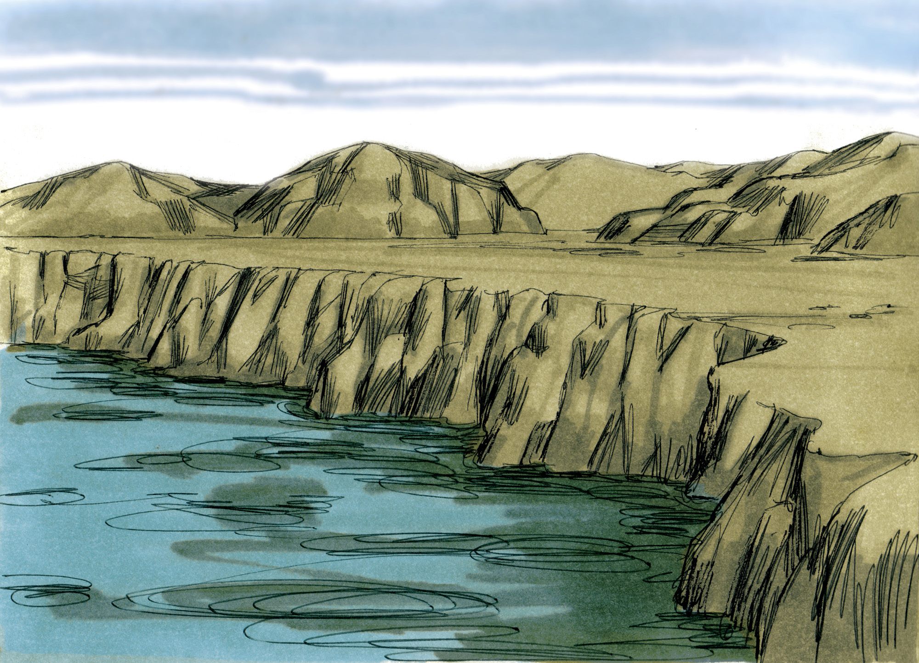

Slide 5


Slide 6
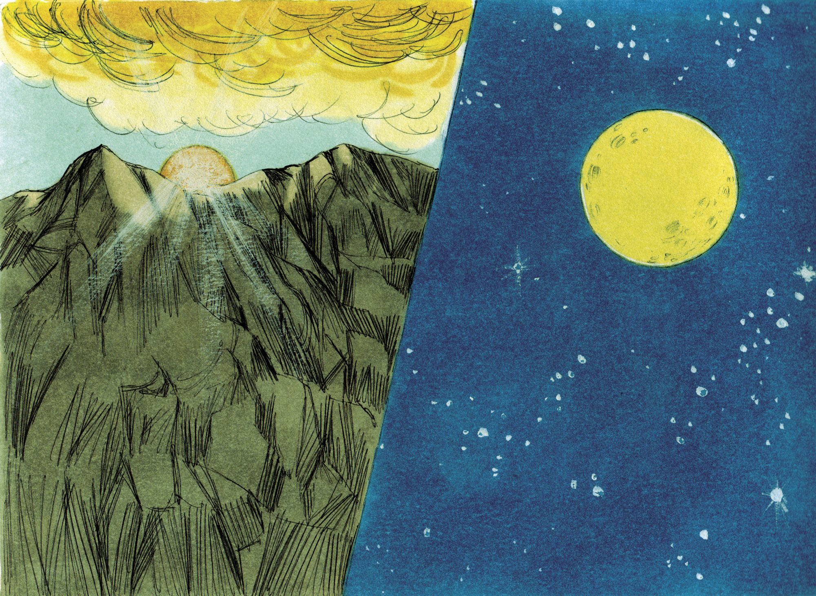

Slide 7


Slide 8
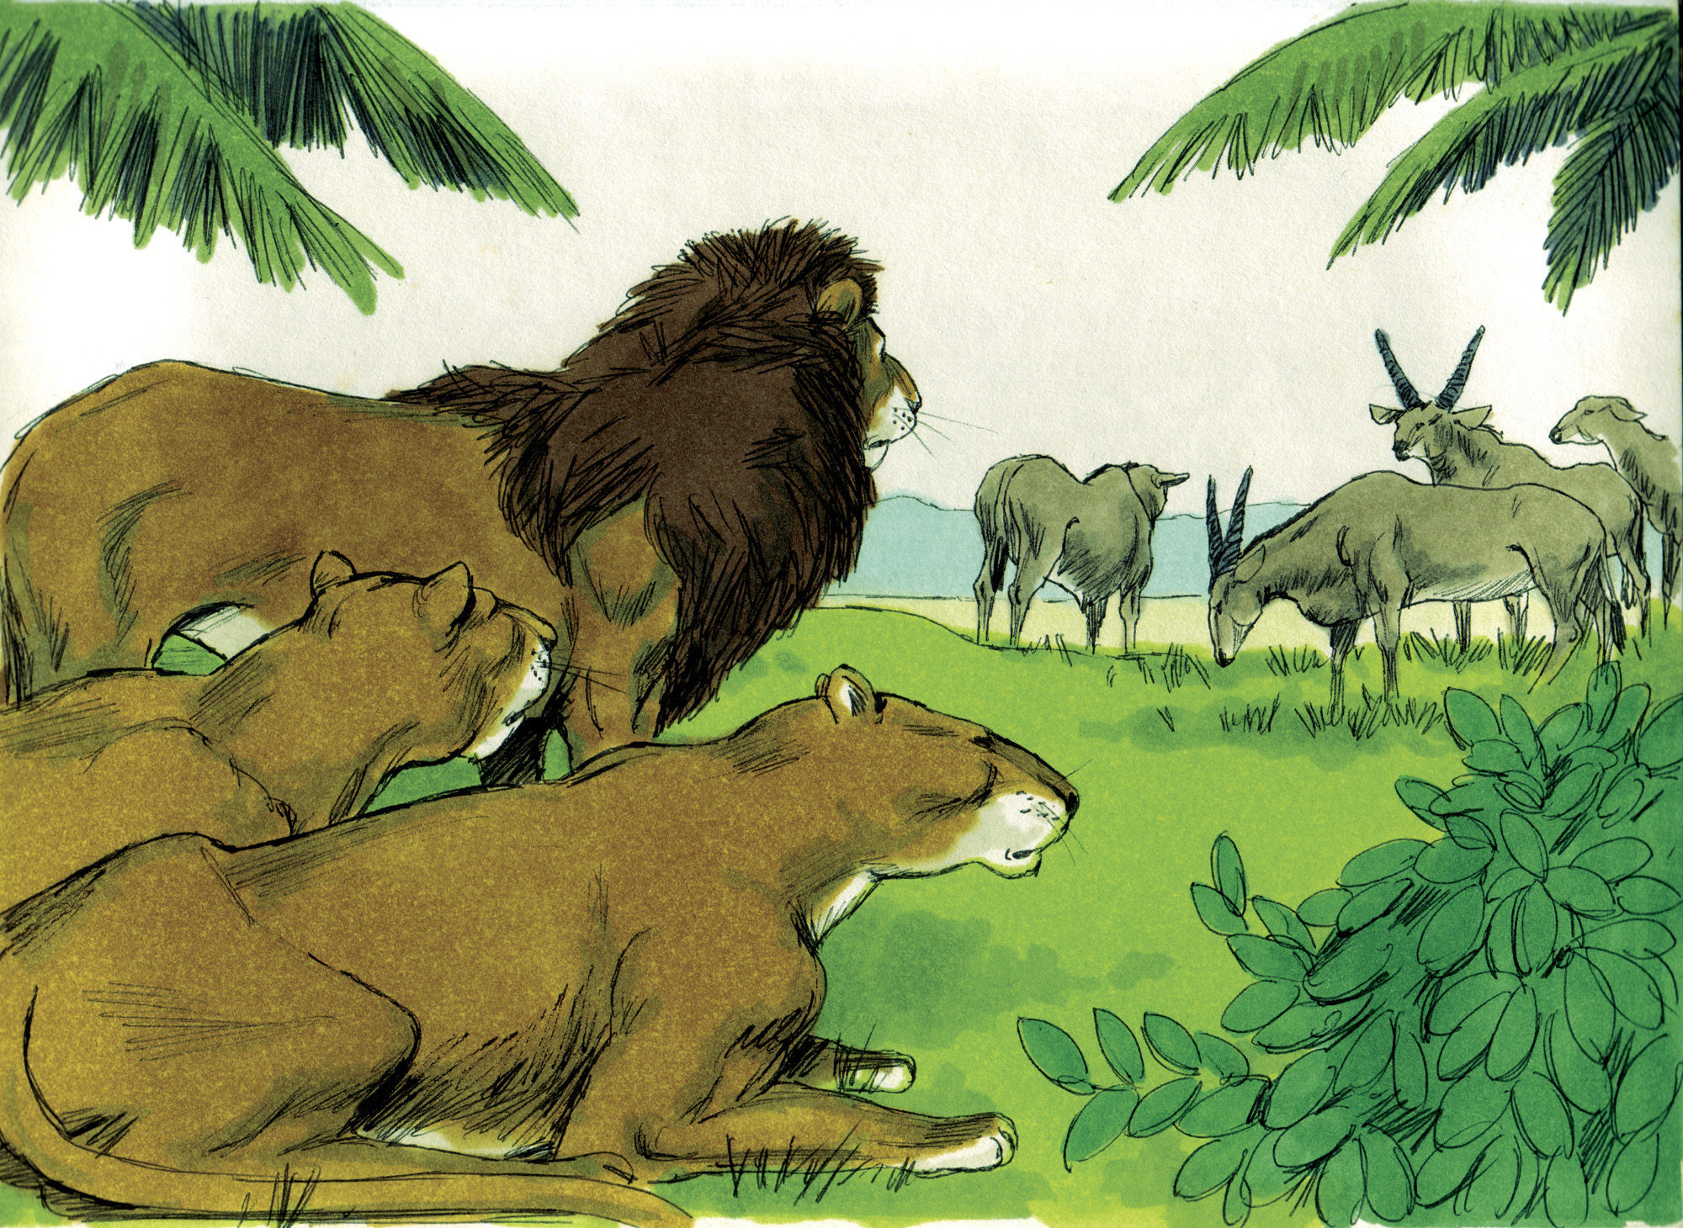

Slide 9
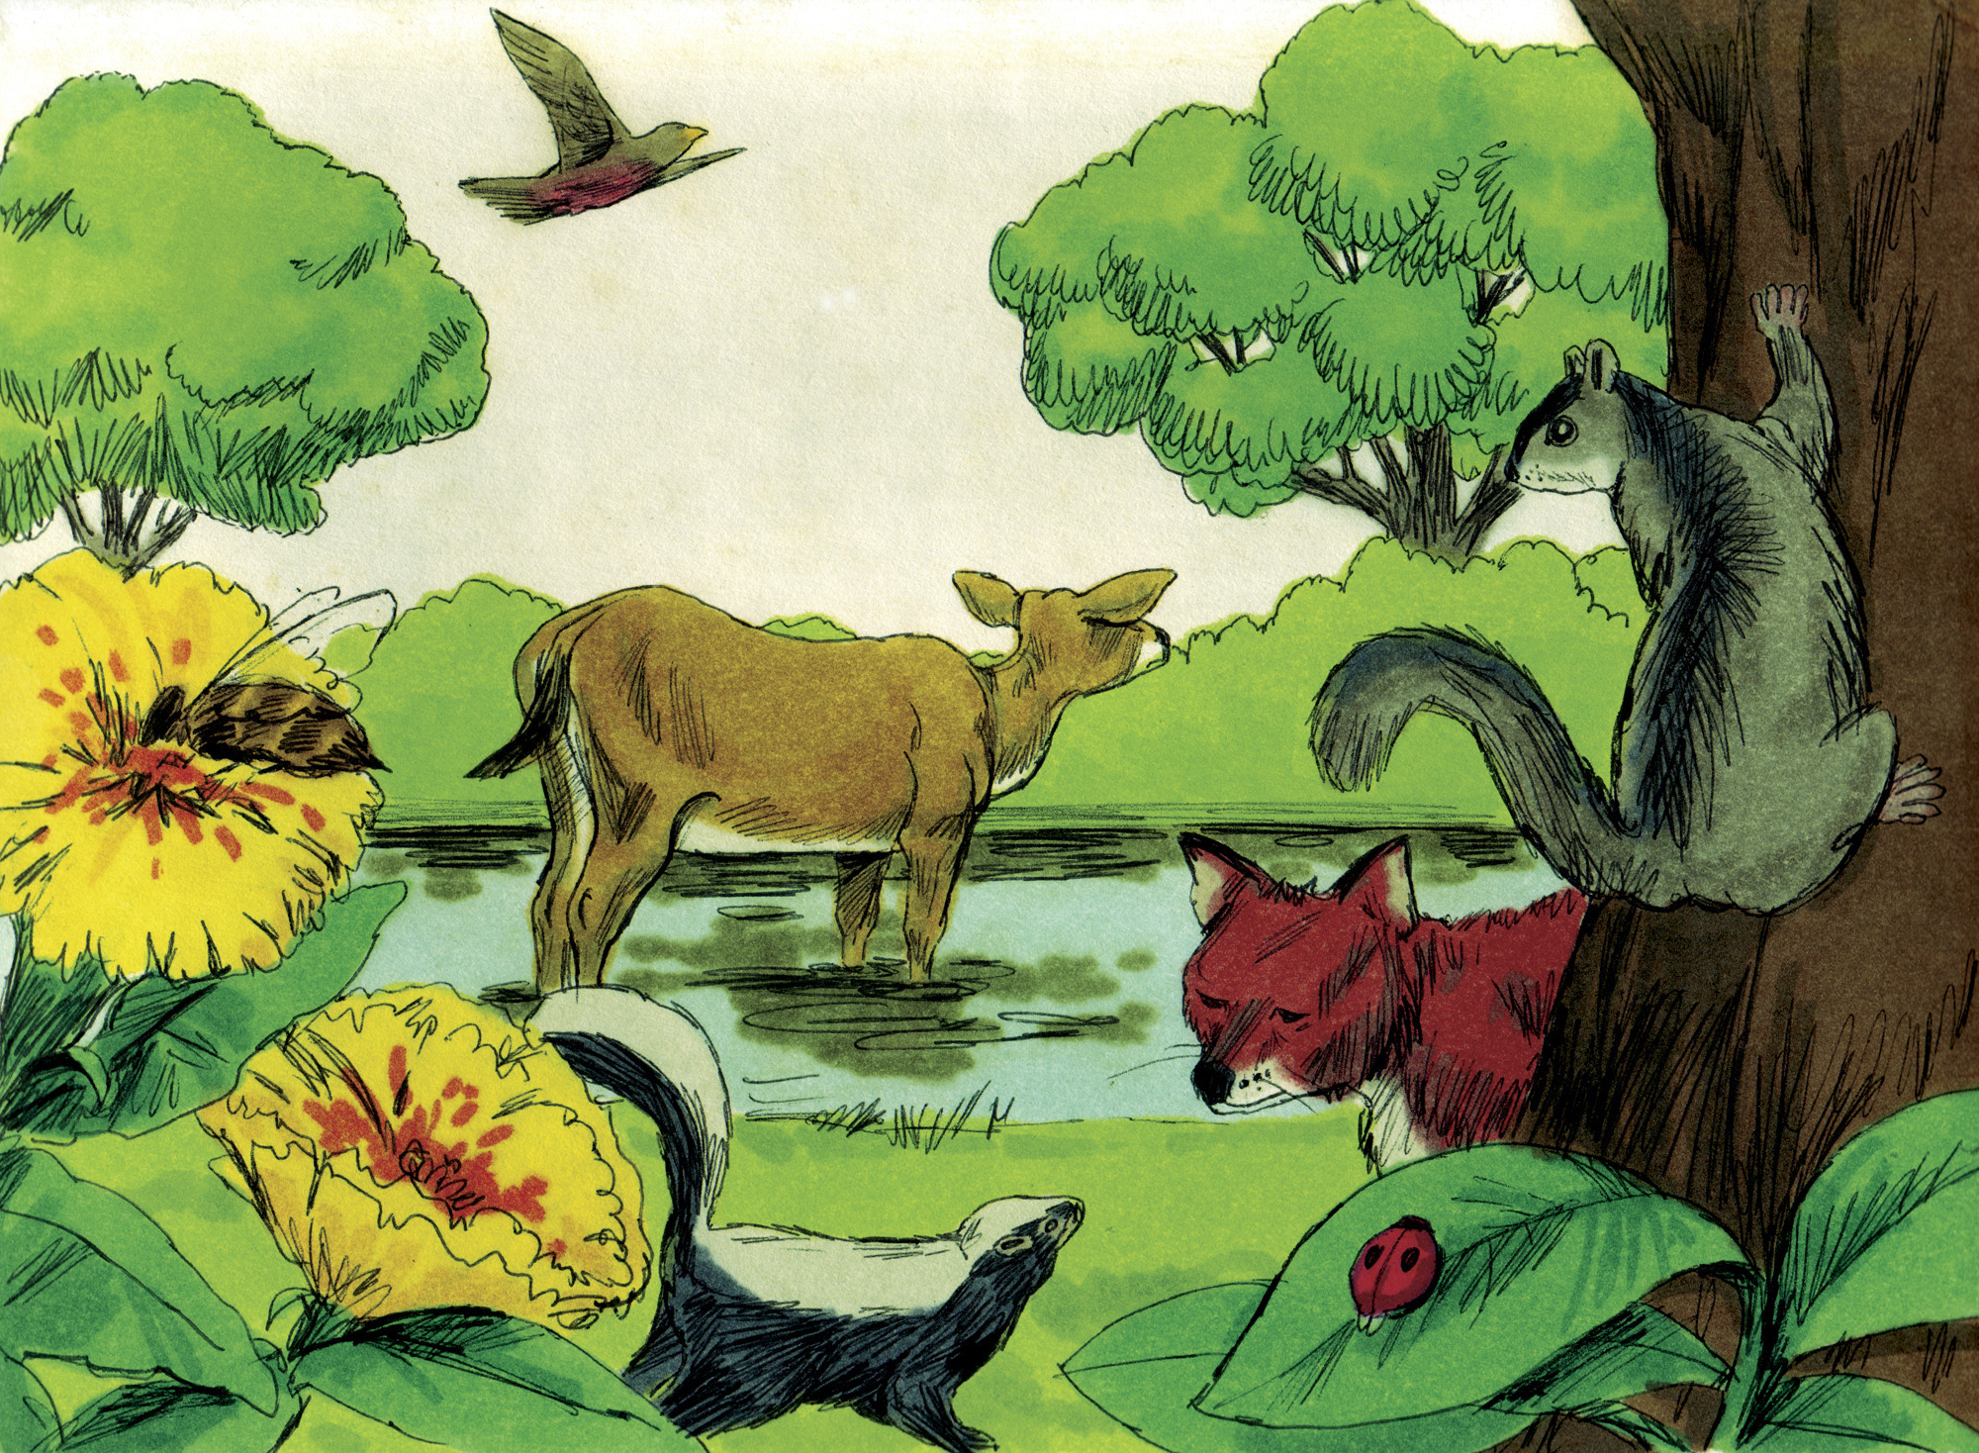

Slide 10


Slide 11


Slide 13
The word “God” is found 32 times in 31 verses
The word designates One who has great power (cf. Eph. 3:20-21)
“God” in verse 1 is actually plural
“Us…Our” (1:26-27) – plurality in unity
  One God with a triune nature (Matt. 28:19; 2 Cor. 13:14)
The NT teaches that Jesus created all things (John 1:1-3; Col. 1:16)

Slide 14
Used in Scripture only of divine activity
– bringing something new into existence (1:1, 21, 27)
God “made” (1:7, 16, 25, 31; cf. Ex. 20:11)

