Slide 1
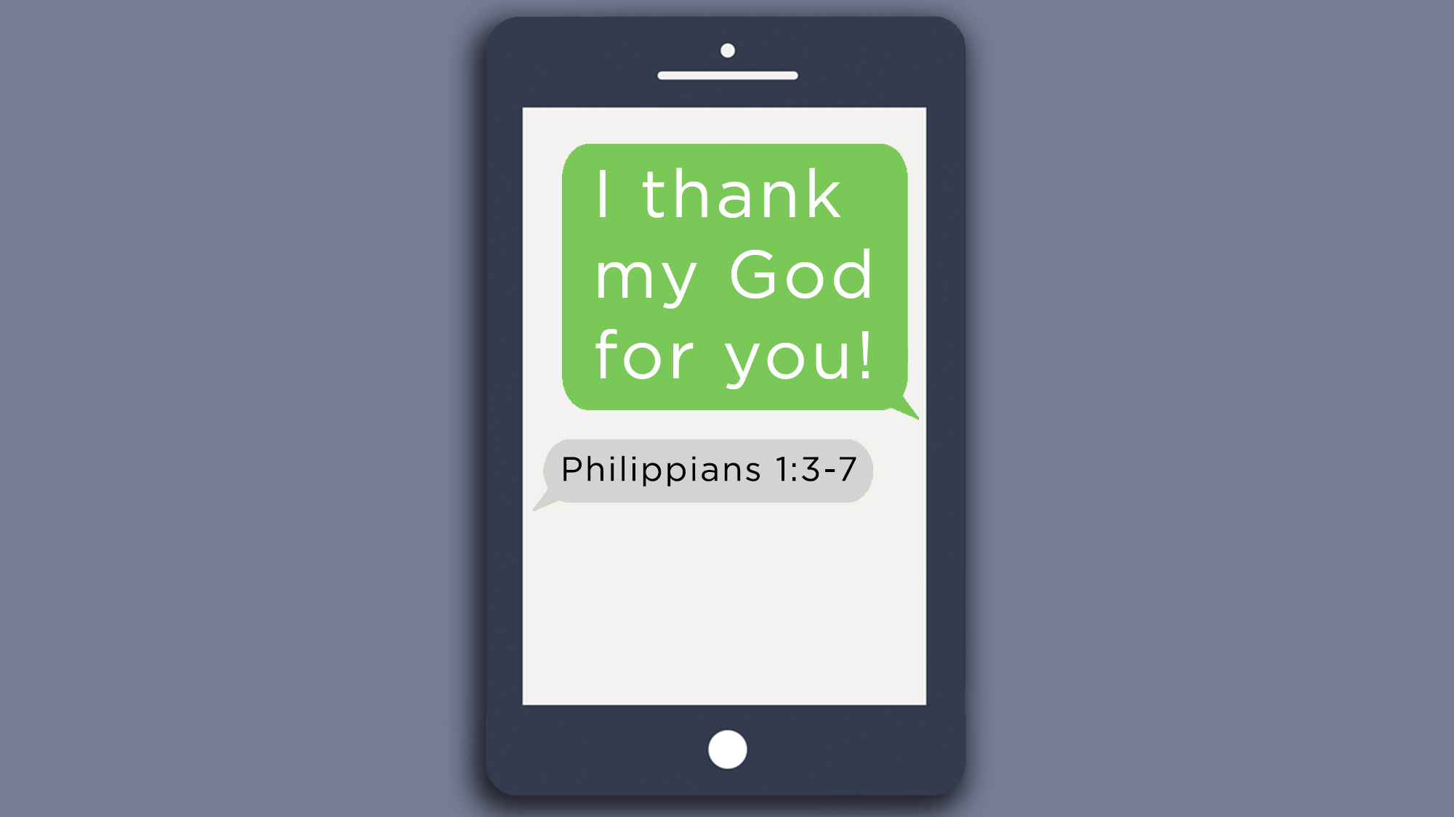

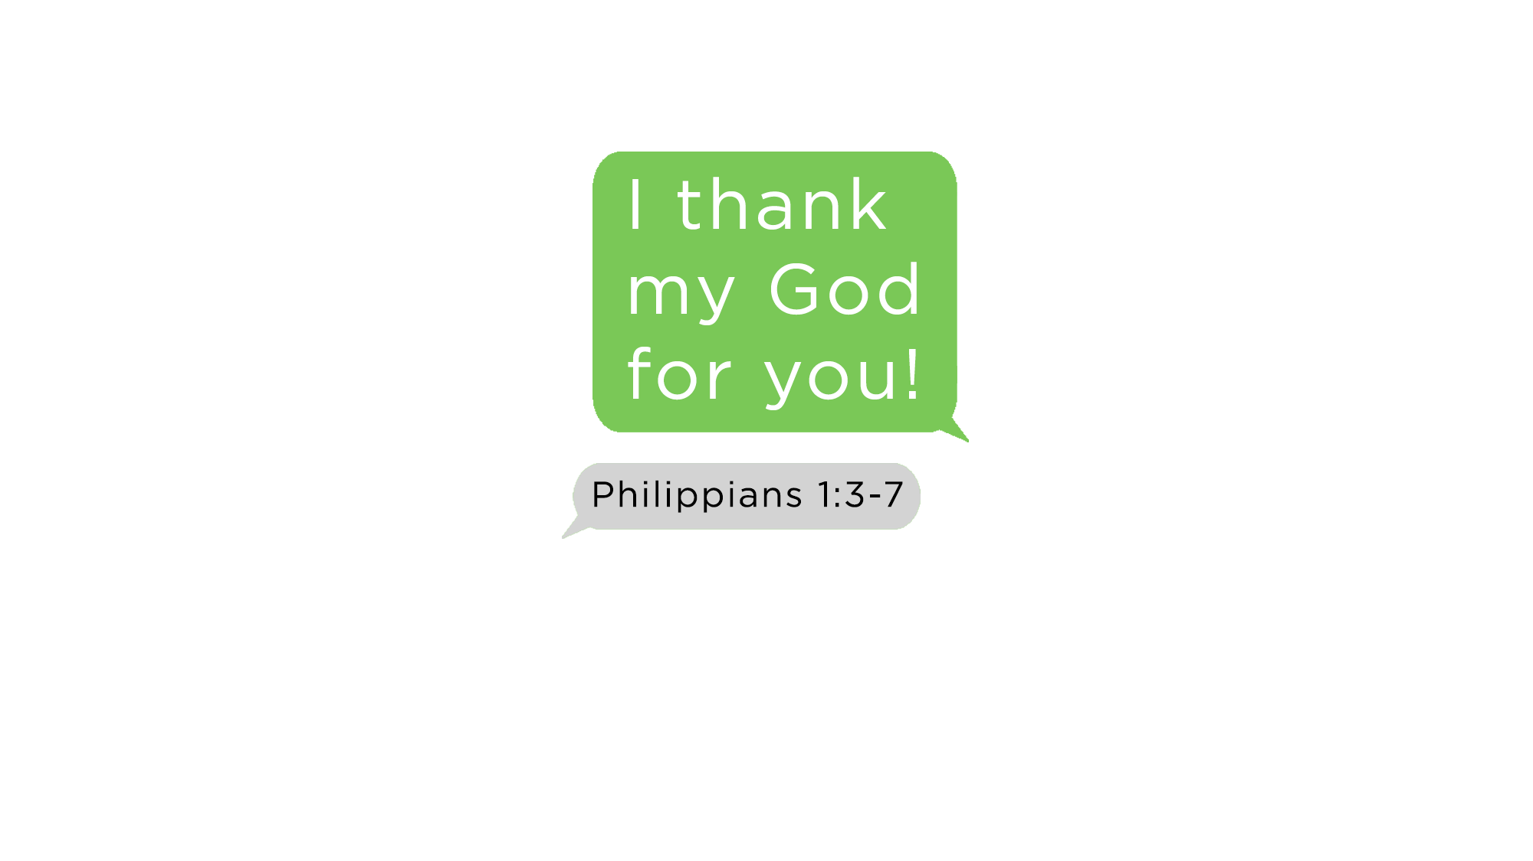

Slide 2
What is something simple
that you can do to
strengthen every relationship?

Slide 3
“First, I thank my God through Jesus Christ for you all.”
(Rom. 1:8)

Slide 4
“I thank my God always
concerning you.”
(1 Cor. 1:4)

Slide 5
“I do not cease to give thanks for you, making mention of you
in my prayers.”
(Eph. 1:16)

Slide 6
“I thank my God upon every remembrance of you.”
(Phil. 1:3)

Slide 7
“We give thanks to the God and Father of our Lord Jesus Christ, praying always for you.”
(Col. 1:3)

Slide 8
“We give thanks to God always for you all, making mention of you
in our prayers.”
(1 Thess. 1:2)

Slide 9
“For what thanks can we render to God for you, for all the joy with which we rejoice for your sake before our God.”
(1 Thess. 3:9)

Slide 10
“We are bound to thank God always for you, brethren.”
(2 Thess. 1:3)

Slide 11
“But we are bound to give thanks to God always for you, brethren.”
(2 Thess. 2:13)

Slide 12
“I thank God…as without ceasing
I remember you in my prayers night and day.”
(2 Tim. 1:3)

Slide 13
“I thank my God, making mention of you always in my prayers.”
(Phile. 4)

Slide 15

Gratitude is a choice and does not have to be determined by circumstances
(Gal. 5:22-23; Phil. 4:4; Col. 3:15)
Perspective is powerful
(Col. 3:1-2; 2 Cor. 4:18; Phil. 4:8)
Actively look for everyday blessings
(Jas. 1:17; Matt. 6:26)
Keep a “Gratitude List” or “Gratitude Journal”
  Write down 3 things every day – simple, small things
Memorize and meditate on Bible verses about thanksgiving (Psa. 136:1-3; Prov. 23:7)
  Fill your heart with God’s Word (Col. 3:16; Psa. 119:11)

Slide 16

Make a habit to thank God:
For everything you see (Eph. 5:20)
For every person on earth (1 Tim. 2:1)
For everything that happens (1 Thess. 5:18)
For everything He has done, is doing and will do (1 Cor. 15:57; 2 Cor. 2:14; 9:15; Col. 1:12; 1 Tim. 1:12; 4:3-4)
In everything that you get to do and say for Him (Col. 3:17)
In every prayer (Phil. 4:6; Col. 4:2)
Even when it’s hard and you don’t feel like it (Acts 27:35; Phil. 4:6)

Slide 17

Paul wrote how he gave thanks to God for His brethren (Rom. 1:8; 1 Cor. 1:4; Eph. 1:16; Phil. 1:3; Col. 1:3; 1 Thess. 1:2; 3:9; 2 Thess. 1:3; 2:13; 2 Tim. 1:3; Phile. 4)
But in writing that, Paul was expressing his gratitude directly to his brethren
Make a habit of telling people, “Thank you!”
  For big and especially for small deeds and favors
  To the often overlooked and underappreciated folks
  To friends and family, and to strangers
  To church members and to children at church
  In person, in text, in hand-written notes
Expressing gratitude benefits both the recipient and the expresser
Expressing gratitude is contagious (and it’s fun)

Slide 18
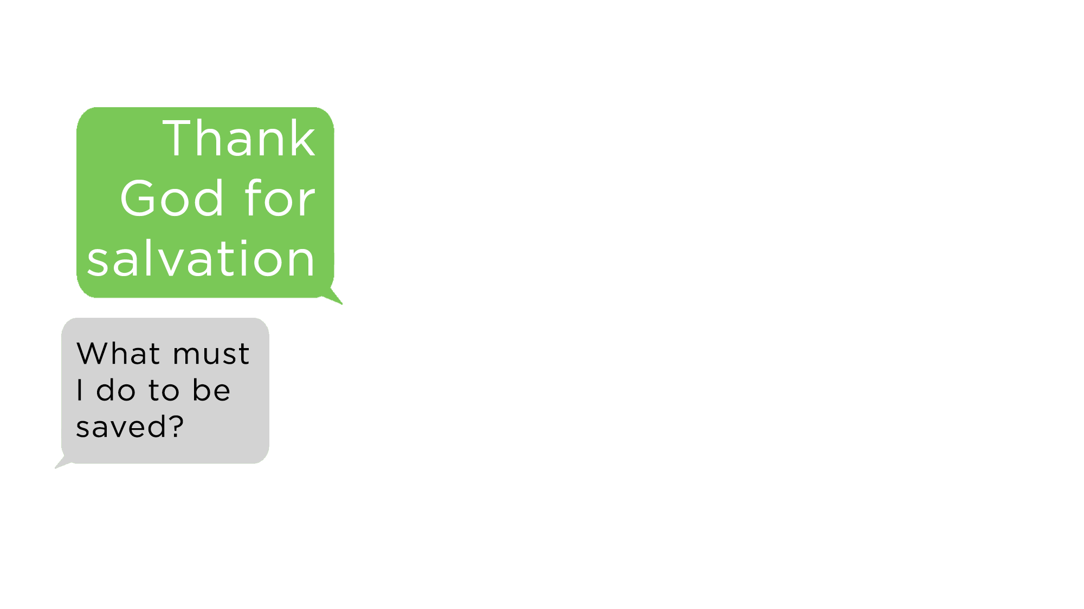
Believe Jesus is God’s Son – Mark 16:16
Repent of your sins – Acts 17:30
Confess your faith – Romans 10:9
Be baptized into Christ – Acts 22:16
  God will forgive all of your sins – Acts 2:38
  God will add you to His church – Acts 2:47
  God will enroll you in heaven – Hebrews 12:23
Serve Him faithfully – 1 Corinthians 15:58

