Slide 1
Samuel
A Child Used By God

Slide 2
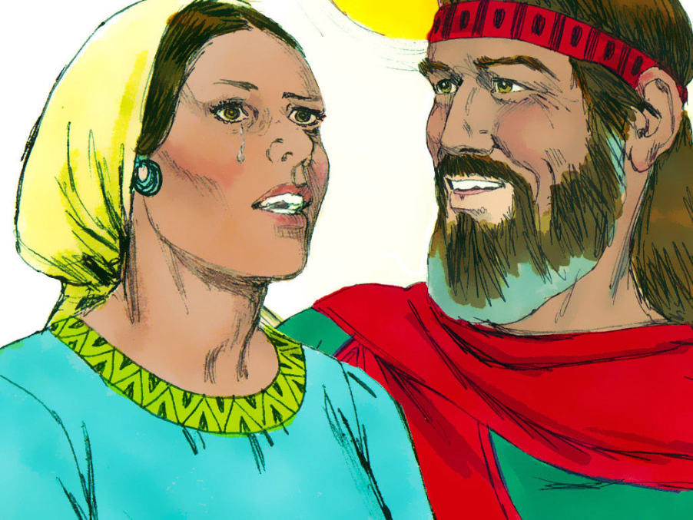

Slide 3
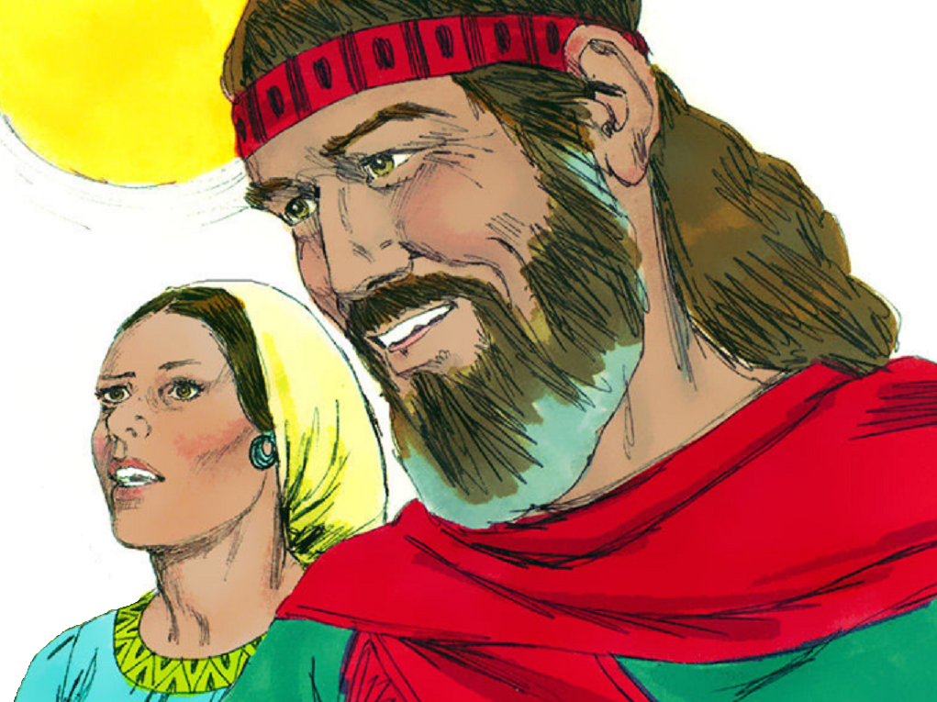

Slide 4
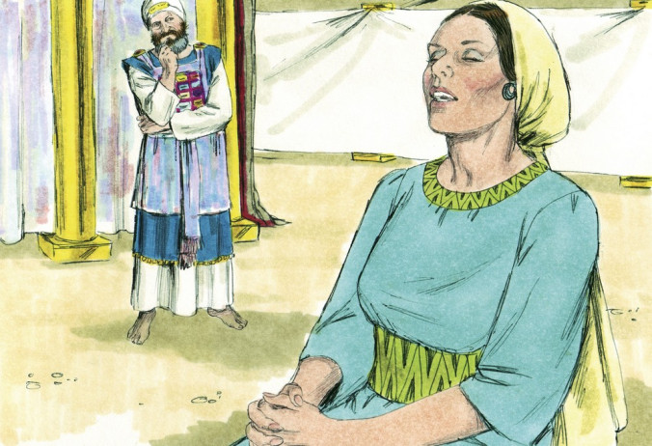

Slide 5
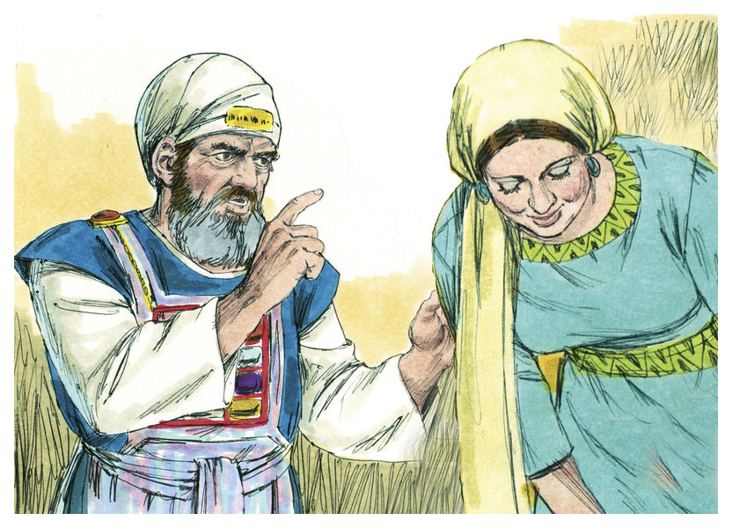

Slide 6
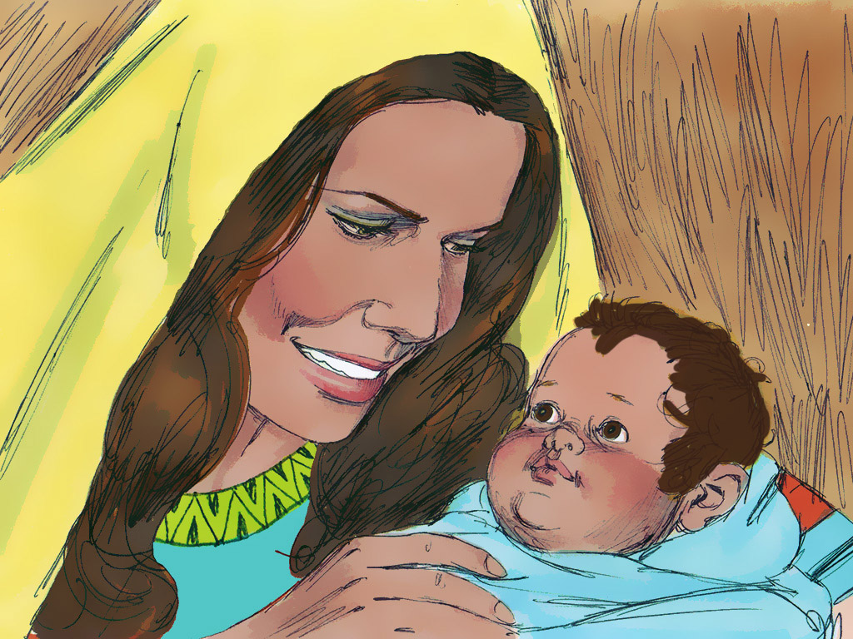

Slide 7
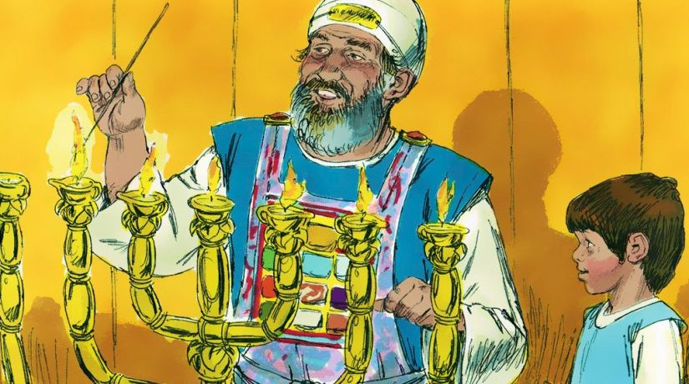

Slide 8
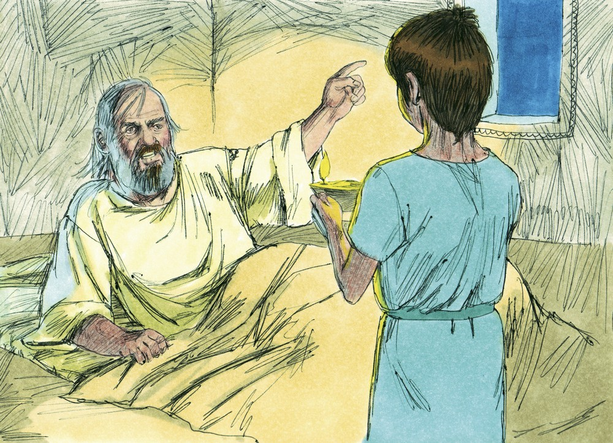

Slide 9
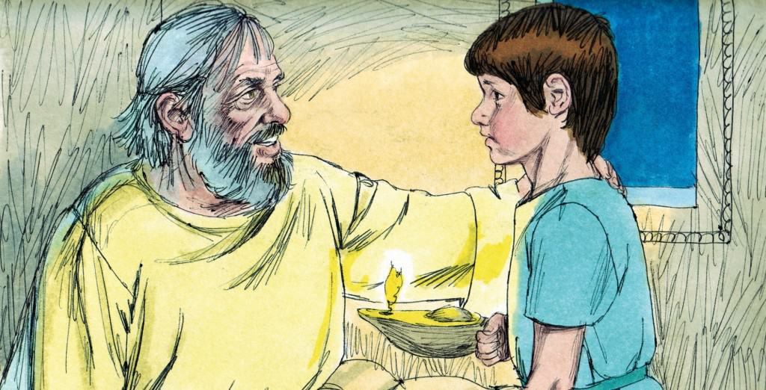

Slide 10
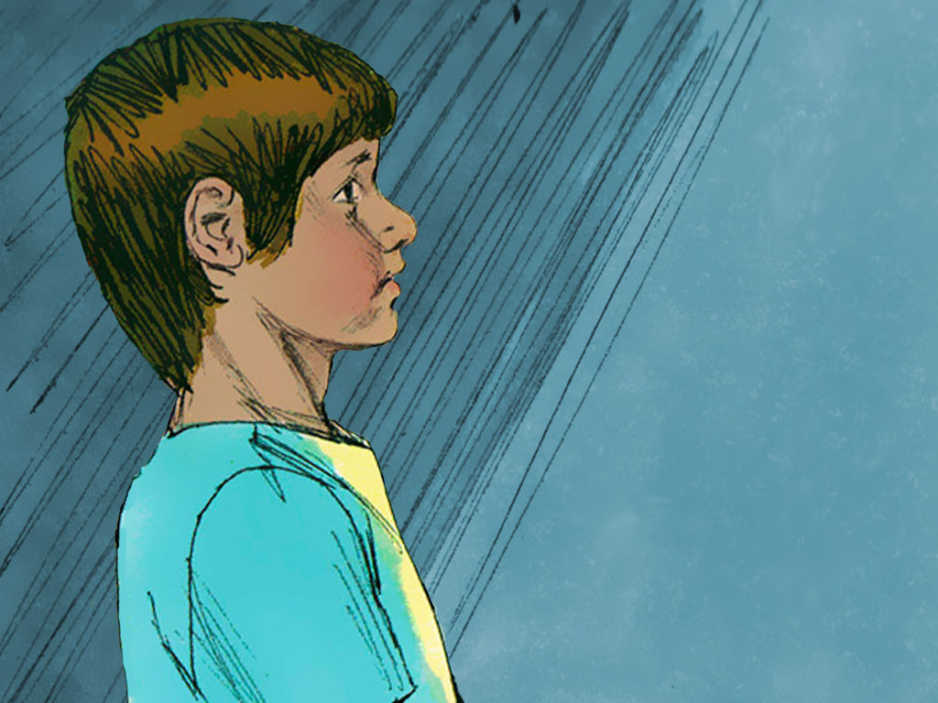

Slide 11
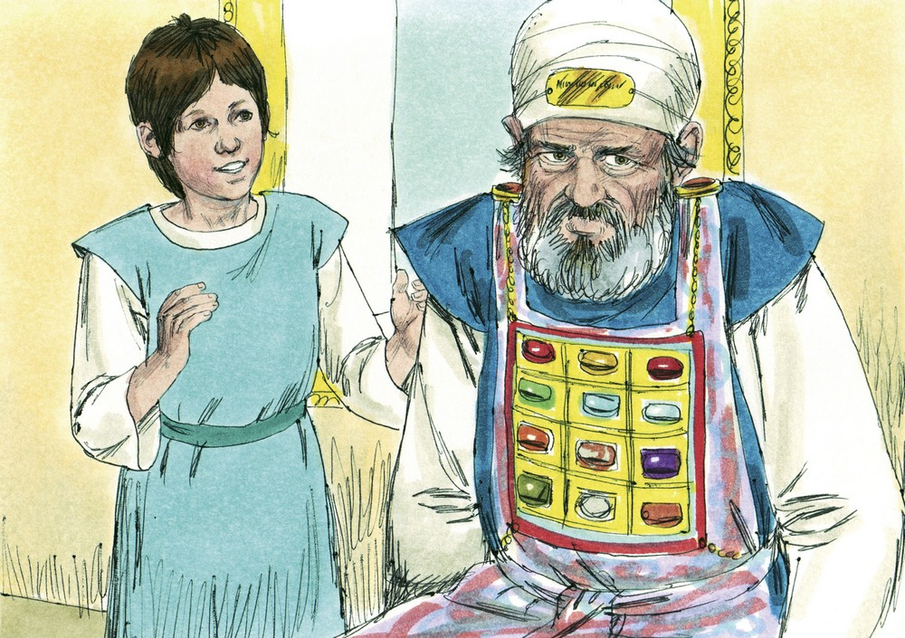

Slide 12
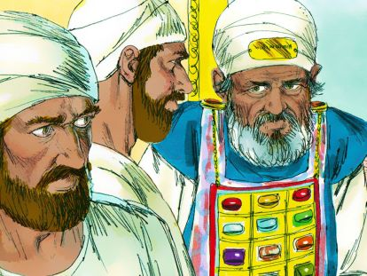

Slide 13
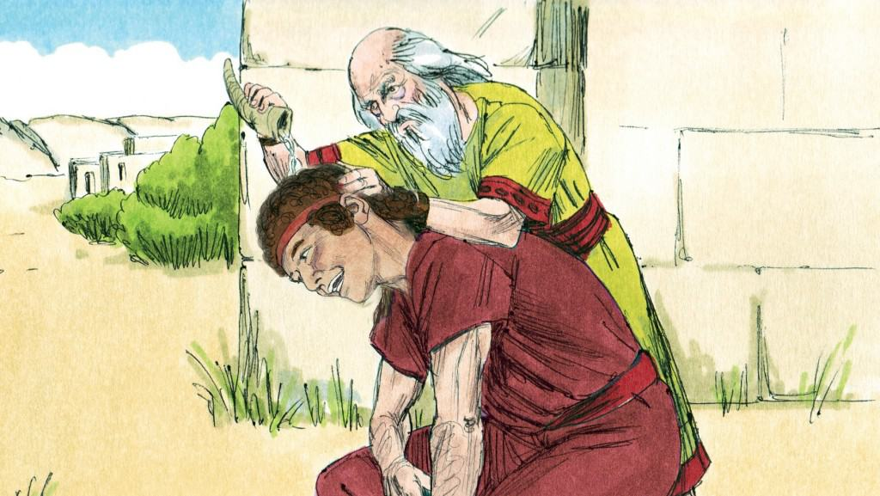

Slide 14
What can we learn from Samuel?
The importance of the faith of parents.
Some times discussions are made for us, for our good.
We need to focus on our spiritual growth as much as our physical.
There should be people in our lives that help us grow in our faith.
We can be a messenger for God no matter our age.
We shouldn’t underestimate the work of youth for God.
Some times we have to say hard things, even to people we care about.

