Slide 1
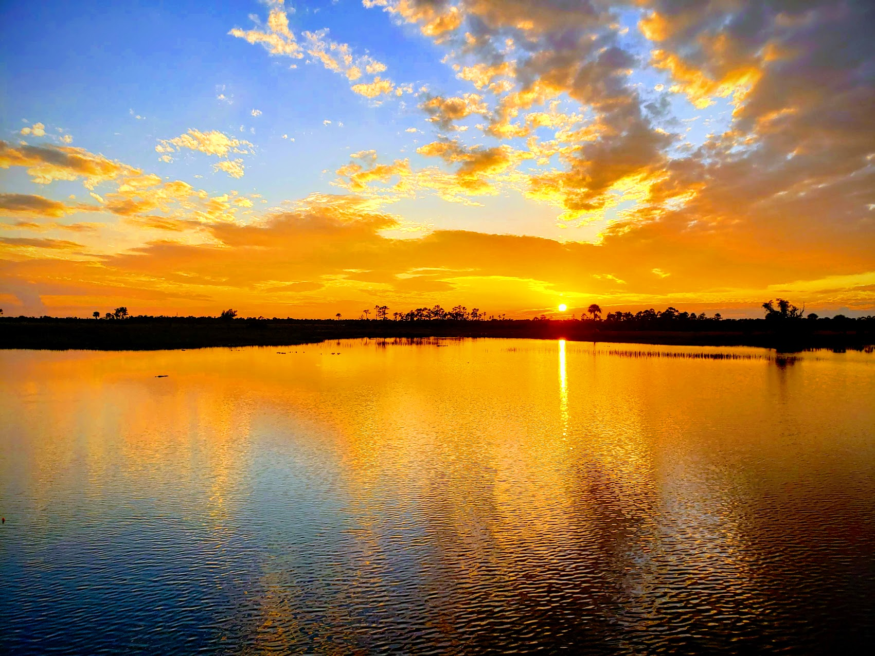
Malachi
His Message for Today (Part 4)
Josh Blackmer
Palm Beach Lakes church of Christ

Slide 2

Malachi: Outline
God’s Sovereign Love (1:1-5)
Priests Sin Against God’s Love (1:6-2:9)
People Sin Against God’s Love (2:10-4:3)
Final Exhortation (4:4-6)

Slide 3

People Sin Against God’s Love
Those who feared the Lord 3:16-4:3
Words of the remnant 3:16
Words of God 3:17-4:3

Slide 4
People Sin Against God’s Love
Concluding Words 4:4-6
An Exhortation 4:4
A Warning 4:5-6

