Slide 1



Slide 2
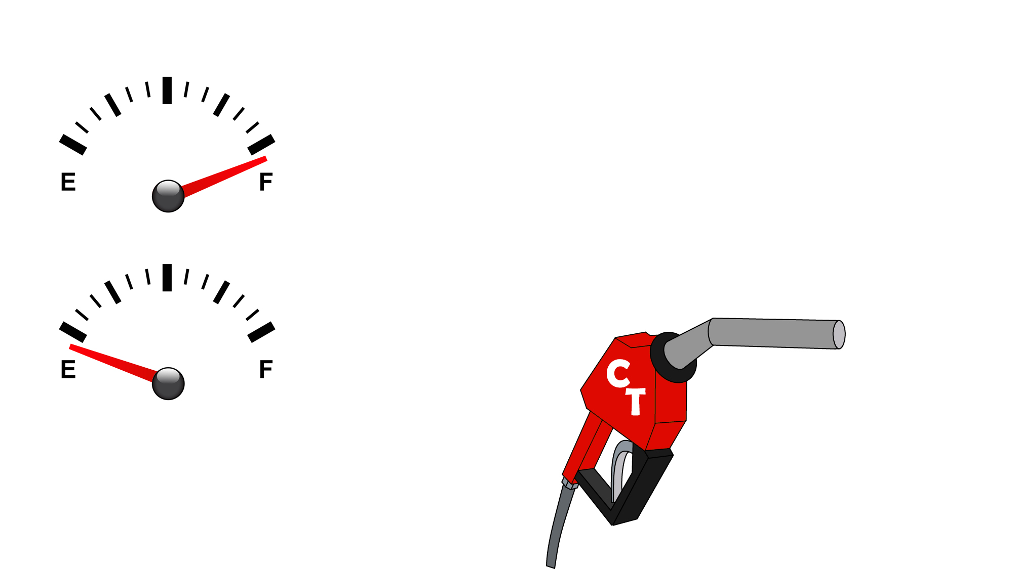
Drains on our joy tank
  Caving to sin (2 Pet. 2:19-20)
  Conforming to the world (2 Tim. 2:4)
  Comparing ourselves to others (2 Cor. 10:12)
  Add: _________________________________
Divine tank-filler-uppers: to fill you full of all joy
  His presence (Deut. 31:6)
  His salvation (Psa. 35:9; Isa. 35:10)
  His people (Phil. 1:3-5; Isa. 35:10)
  Add: _________________________________
Daily CT tank-filling habit
  Count your blessings & thank God
  Make a list every day of 3 joys from God

Slide 3
Drains on our peace tank
  Worry (Matt. 6:25-34)
  Circumstances out of our control (Judg. 6:11-13)
  Uncertainty (Jas. 4:14)
  Add: _________________________________
Divine tank-filler-uppers: to fill you full of all peace
  His Word (Psa. 119:165)
  His providence (Rom. 8:28-31)
  His love (Rom. 8:32-39)
  Add: _________________________________
Daily CT tank-filling habit
  Conversate with God & trust Him
  Talk to God 2 times every day & let Him talk to you through His Word

Slide 4
Drains on our hope tank
  Prosperity of the wicked (Jer. 12:1; Psa. 73:1-3)
  Doubt (Luke 24:21-25)
  Trials (Rom. 5:3-4)
  Add: _________________________________
Divine tank-filler-uppers: to fill you full of all hope
  His resurrection (1 Cor. 15:20-24, 57; 2 Cor. 4:14)
  His promises (Tit. 1:2; Heb. 6:18)
  His power (1 Cor. 6:14; Heb. 11:19)
  Add: _________________________________
Daily CT tank-filling habit
  Contemplate heaven & thirst for it
  Make a list every day of 1 thing about heaven that you’re ready for now

Slide 5
inexpressible and full of glory (1 Pet. 1:8)
which surpasses all understanding (Phil. 4:7)
as a sure and steadfast anchor of the soul (Heb. 6:19)

Slide 6
Believe Jesus is God’s Son – John 3:16
Repent of your sins and turn to God – Luke 13:3
Confess your faith in Jesus Christ – Romans 10:9
Be immersed into Christ – Acts 22:16
  God will forgive all of your sins – Acts 2:38
  God will add you to His church – Acts 2:47
  God will enroll you in heaven – Hebrews 12:23
Faithfully walk with the Lord – 1 John 1:7
  If you’ve strayed, repent and turn away from your sins – Acts 8:22
  If you’ve strayed, confess your sins and ask for forgiveness – 1 John 1:9

