Slide 3
breaking
the law of God
separates us
from God

Slide 4
death
no
they were
separated from God
no
forever

Slide 5
gift
His own Son
He loves us
to save man
forgiveness of sins
everyone

Slide 6
X
Jesus Christ
Christ
all things
Yes

Slide 7
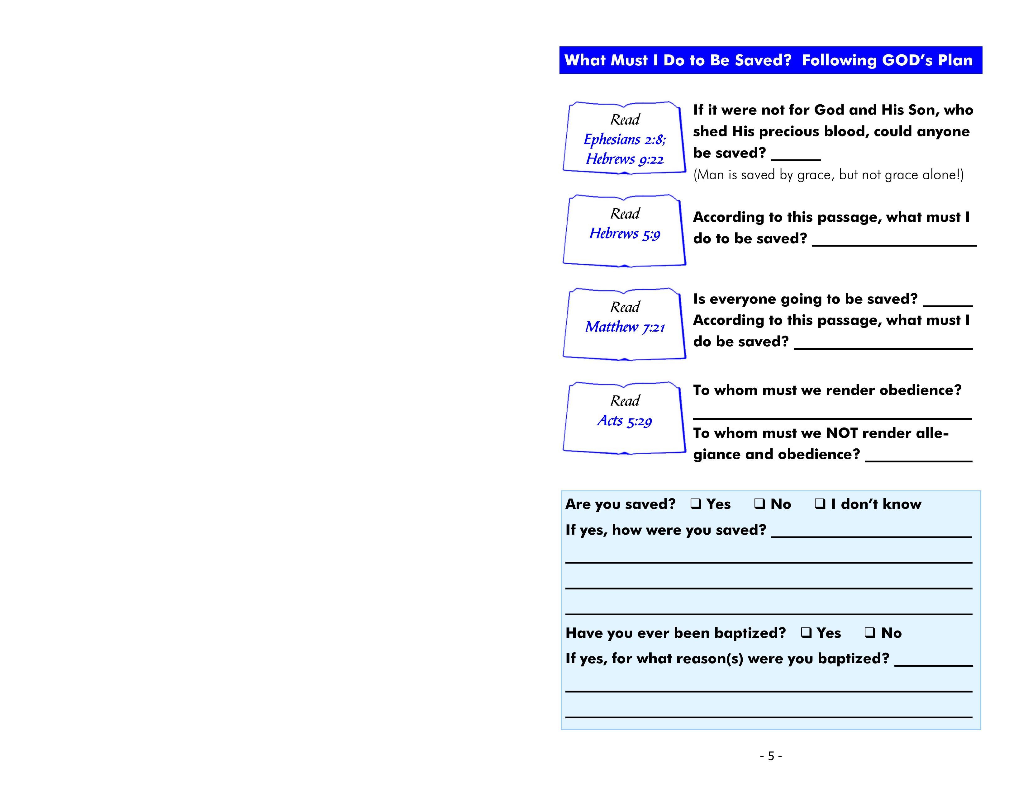
no
obey Christ
no
obey God’s will
God
man

Slide 8
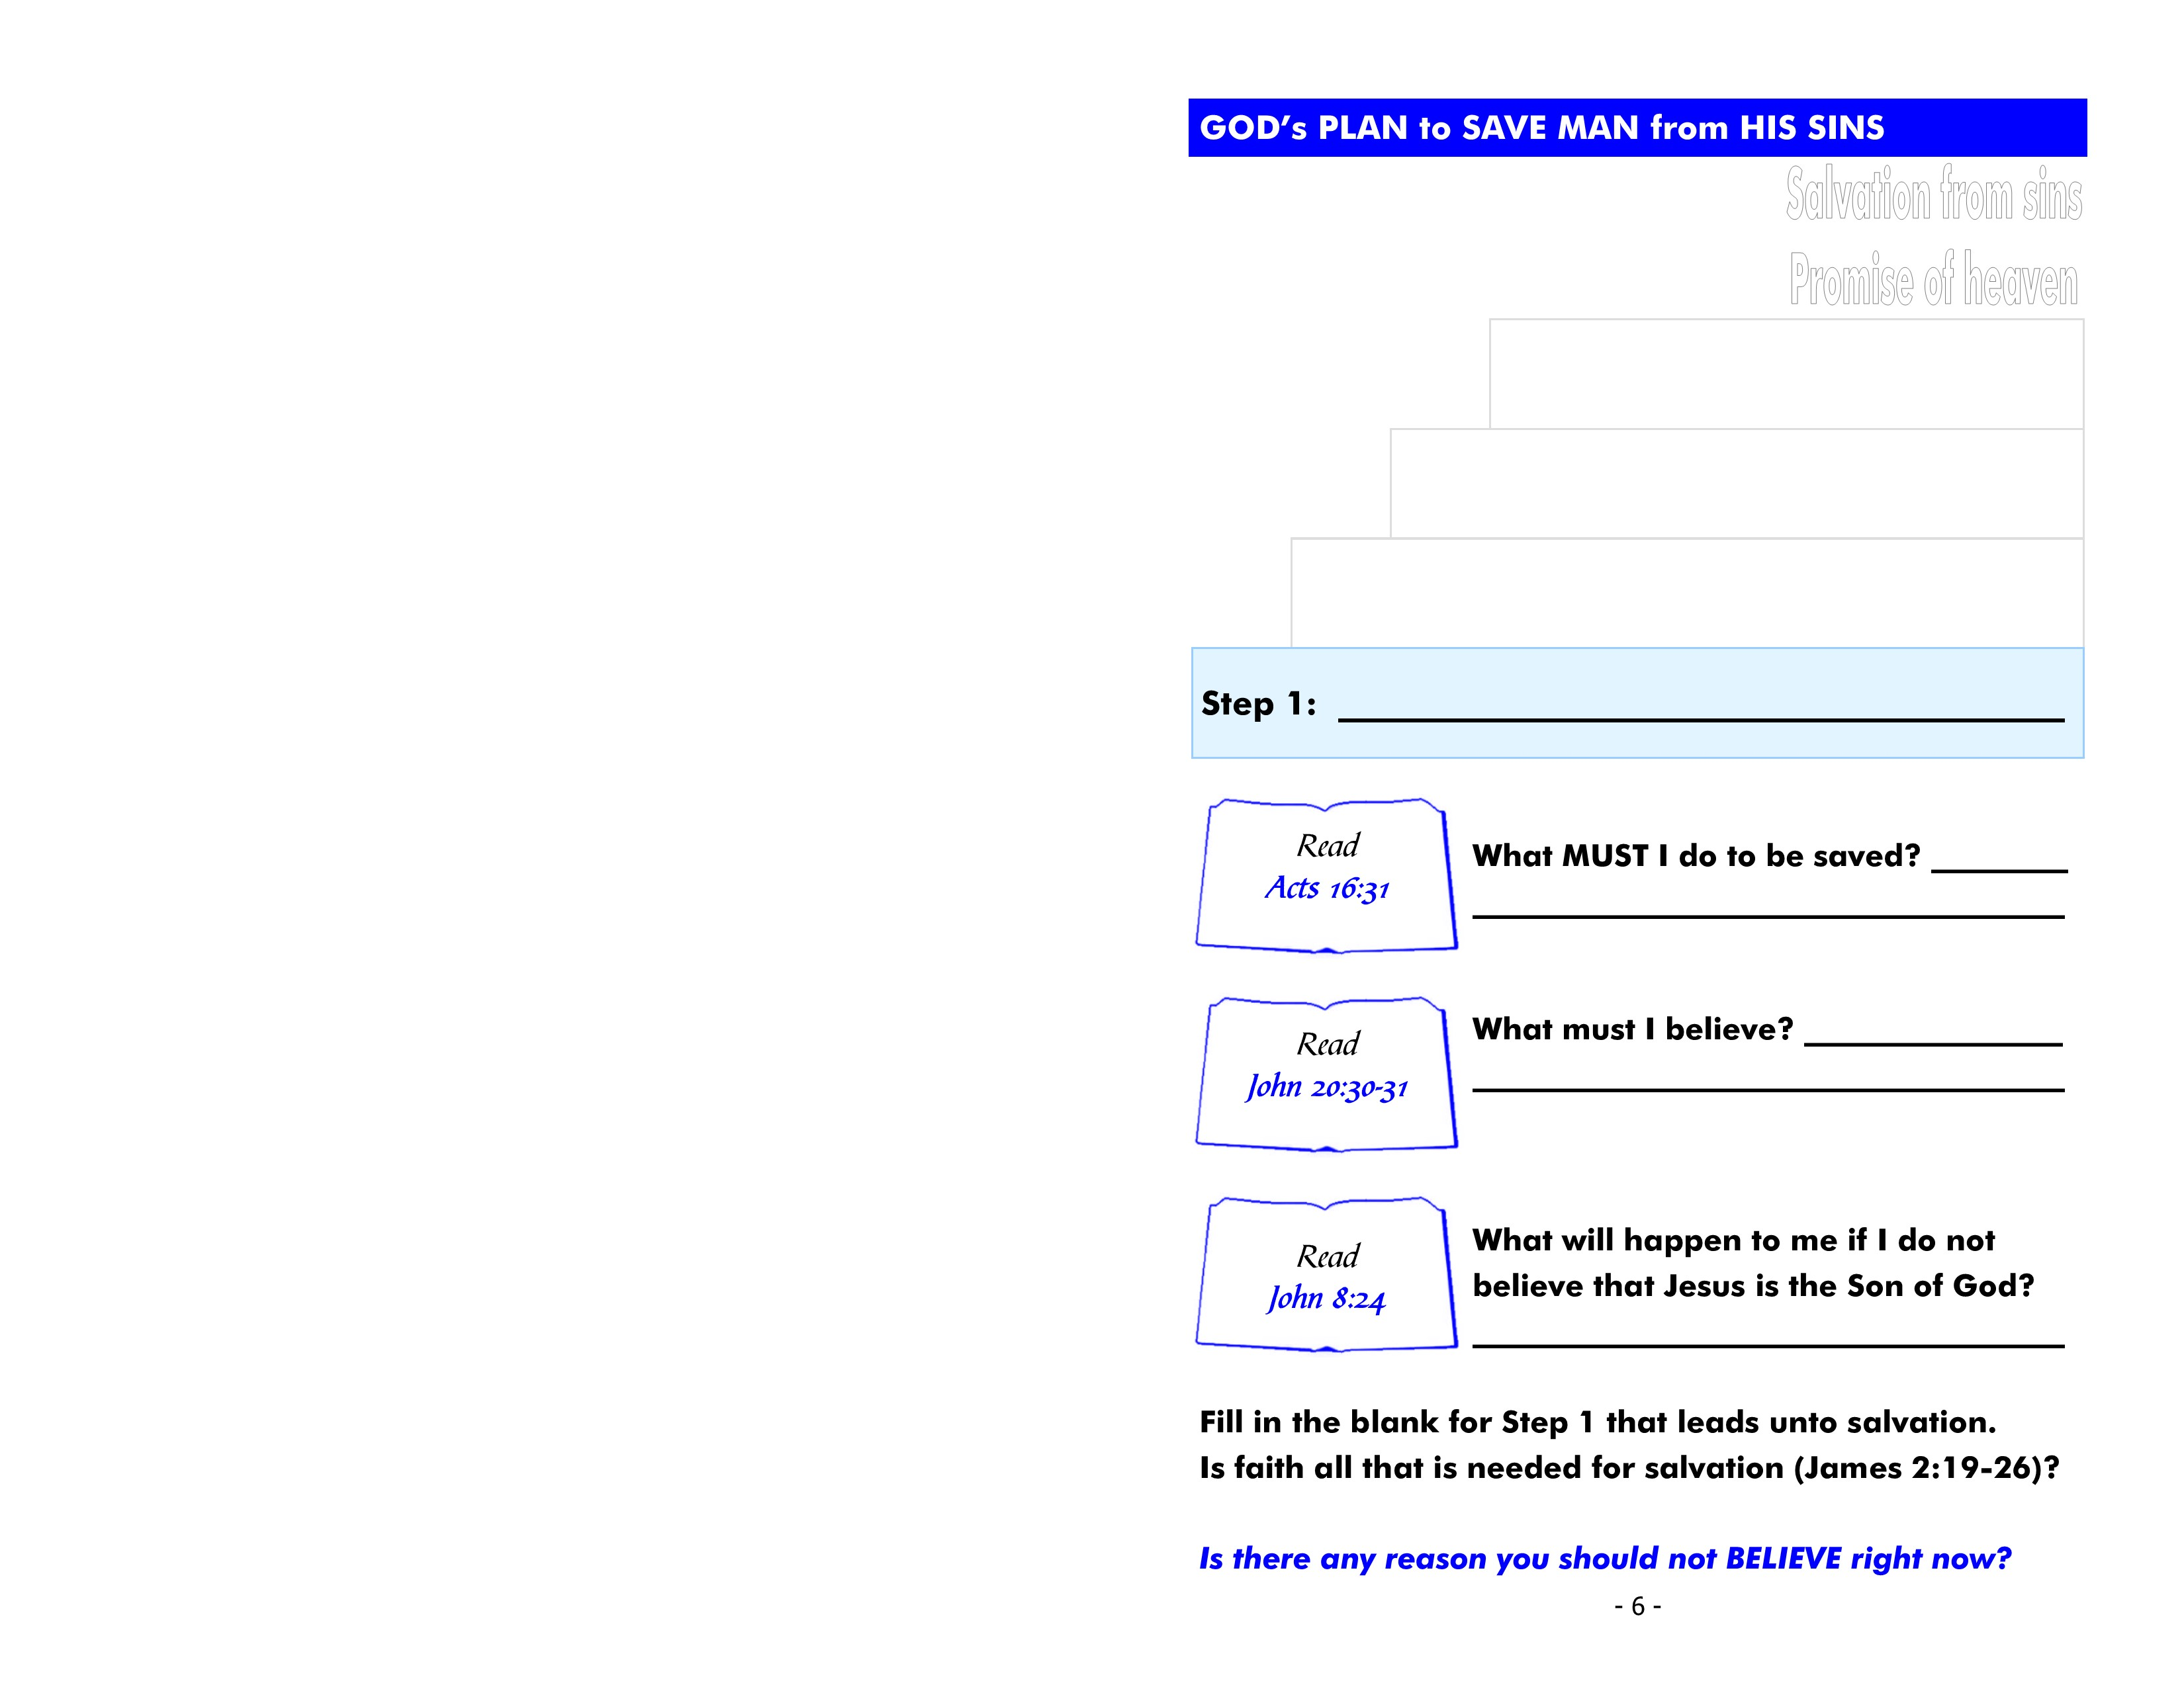
Believe Jesus is God’s Son
believe
Jesus Christ
is God’s Son
die in my sins

Slide 9
Repent from my sins
repent
regret doing wrong
and decide to turn
perish

Slide 10
Confess faith
confess
I believe
Jesus is God’s Son
denied by Jesus

Slide 11
Acts
22:16
Arise + Bapt = Wash
1 Pet. 3:21
Bapt = Saves
Be baptized
Mark 16:16
Bel + Bapt = Saved
Acts
2:38
Rep + Bapt = Forgiven
be baptized
Mark 16:16
Man
Bapt = Saved + Bel
baptism precedes
salvation
Man
Bel = Saved + Bapt
not enter the
kingdom of God
Jesus
Bel + Bapt = Saved

Slide 12
baptism

Slide 13
immediately
today
may not be a
tomorrow

