Slide 2

January 26
Every dollar given on Mission Sunday
goes toward mission work.

Slide 3
This will NOT be projected
Must have $88,800 to cover our base/committed works
Nnanna Aforji (Nigeria) – supported him since 1994
Tamuka Arunashe (Zimbabwe) – since 1994 (horrible inflation; basic necessities not available; political
Robert Martin (Pacific) – since 1989
Joey Treat (Guam) – since 2004 – moved to Guam in 2019 to begin working with three congregations
Wayne Parker (Pacific) – began supporting 2017 (in Pohnpei)
Mauricio Yegros (Hispanics in Coral Springs) – since May 2013
Tavaro Hanna (Eight Mile Rock, Grand Bahama) – since 2017
Robert C. Lupo (Sneedville, TN)
Apologetics Press – since 1986 (oversight since 2004)
  Website, new publications, “Defending the Faith Study Bible,” speaking around the country, etc.
Sr. High & Adult Summer Mission Trip
  Combining Sr. High w/ adults – limited # adults can go, must complete application – see Josh
Josh Blackmer to Easter Island – TWO trips in 2020
House to House/Heart to Heart
  Monthly publication to Approx. 3300 homes each month
  Routes will rotate each month on a quarterly basis, each home receiving 4 issues in the year

Slide 4

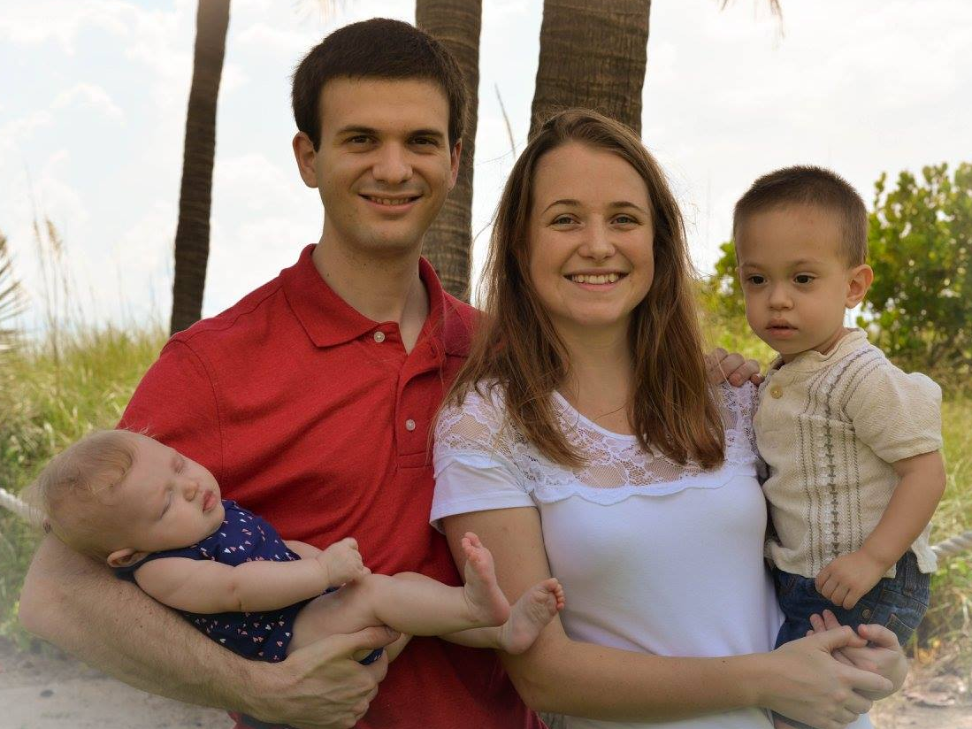
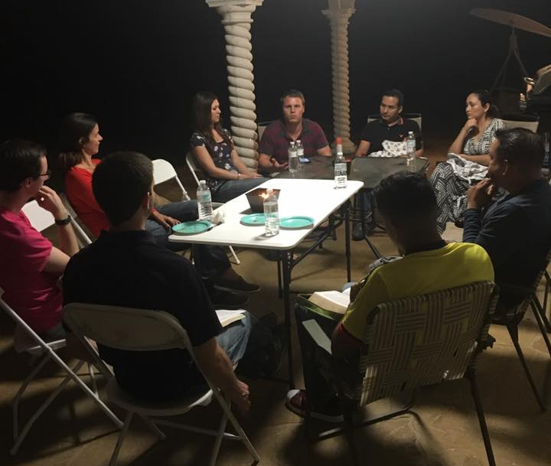
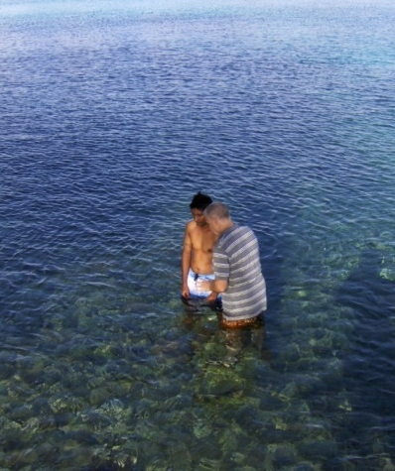


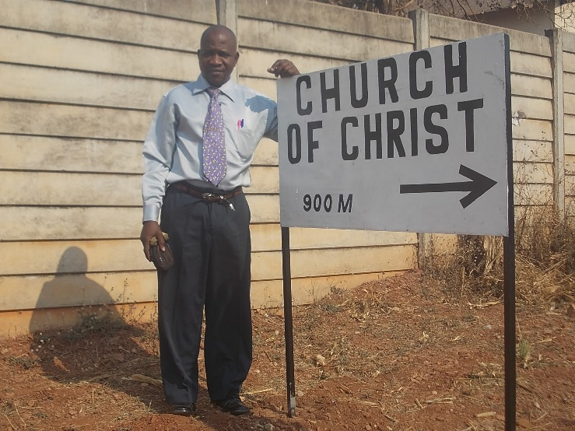
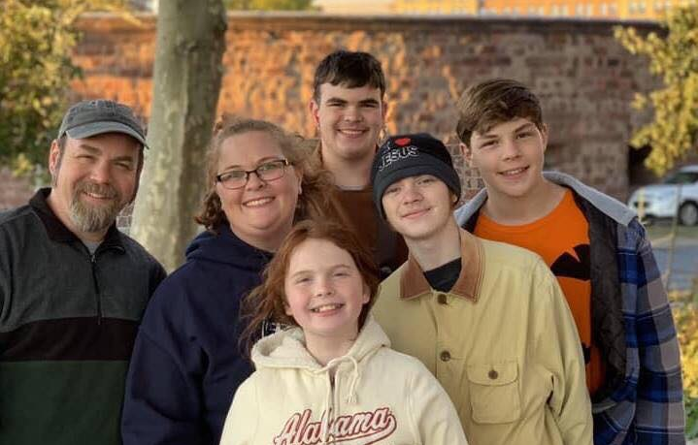

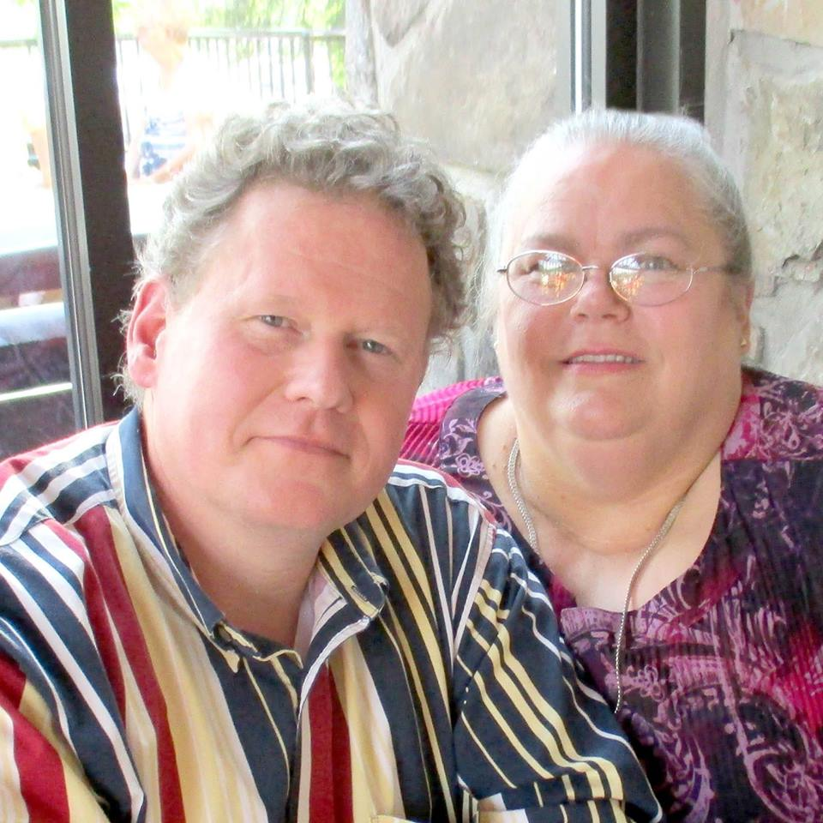
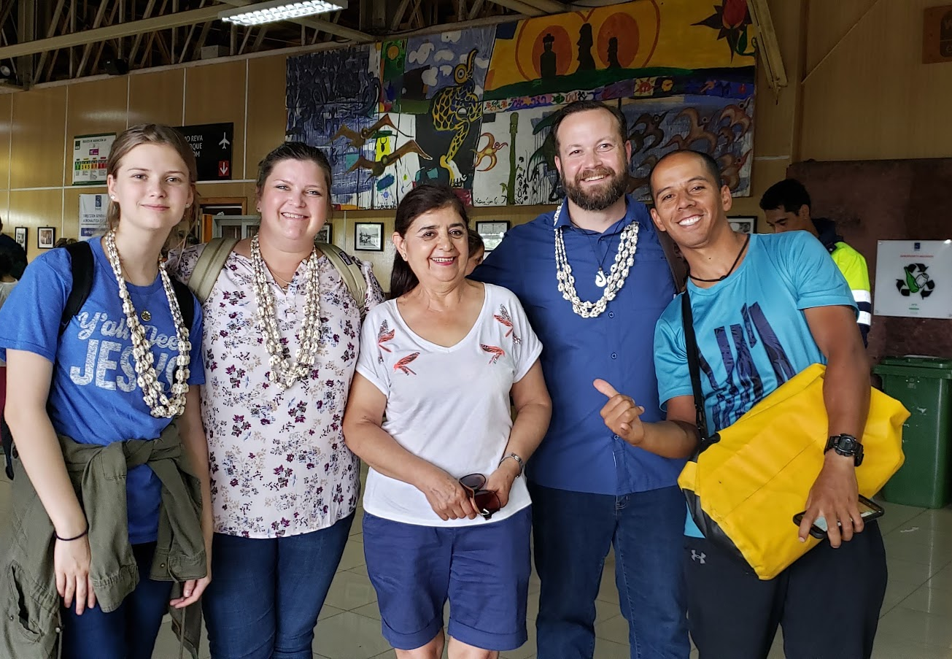
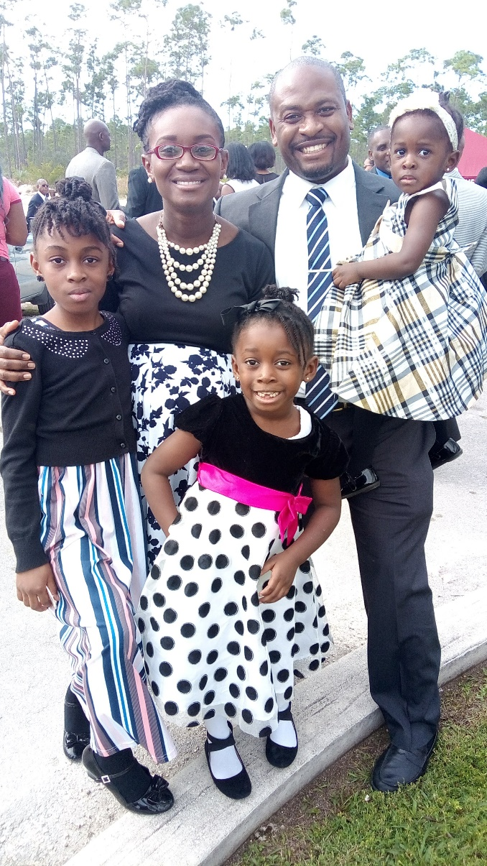

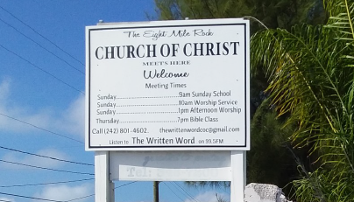


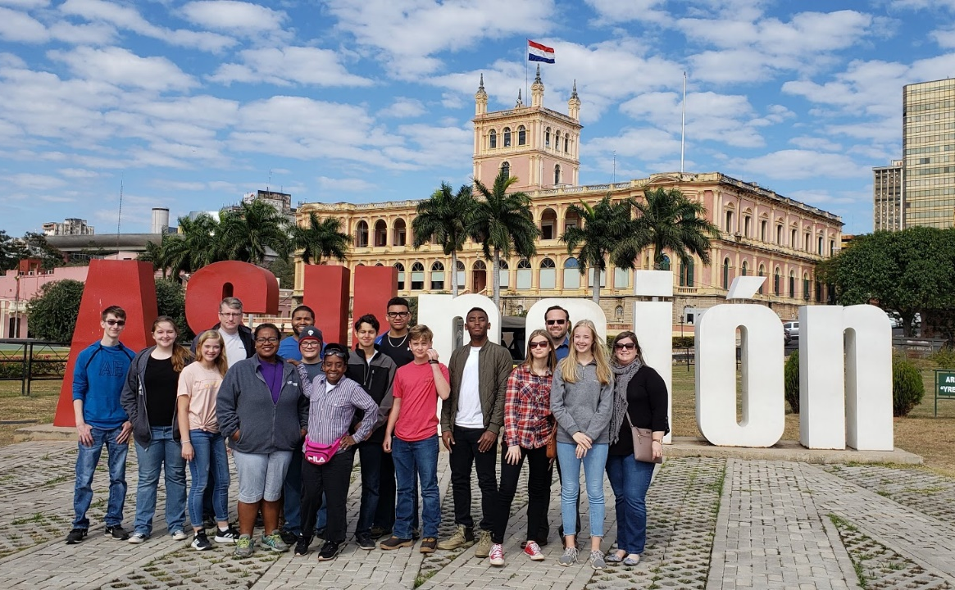
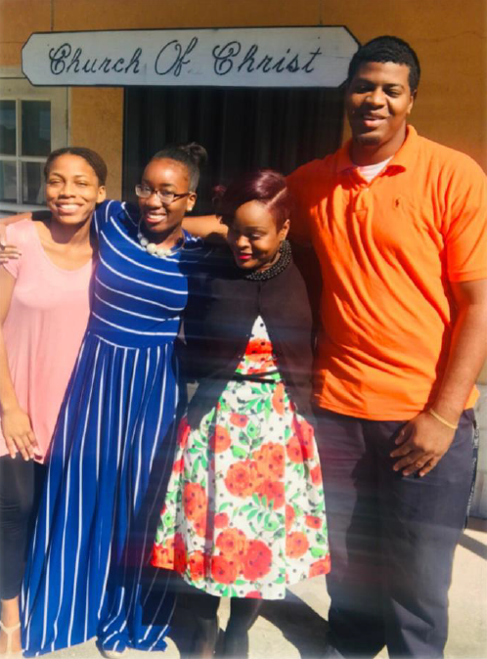
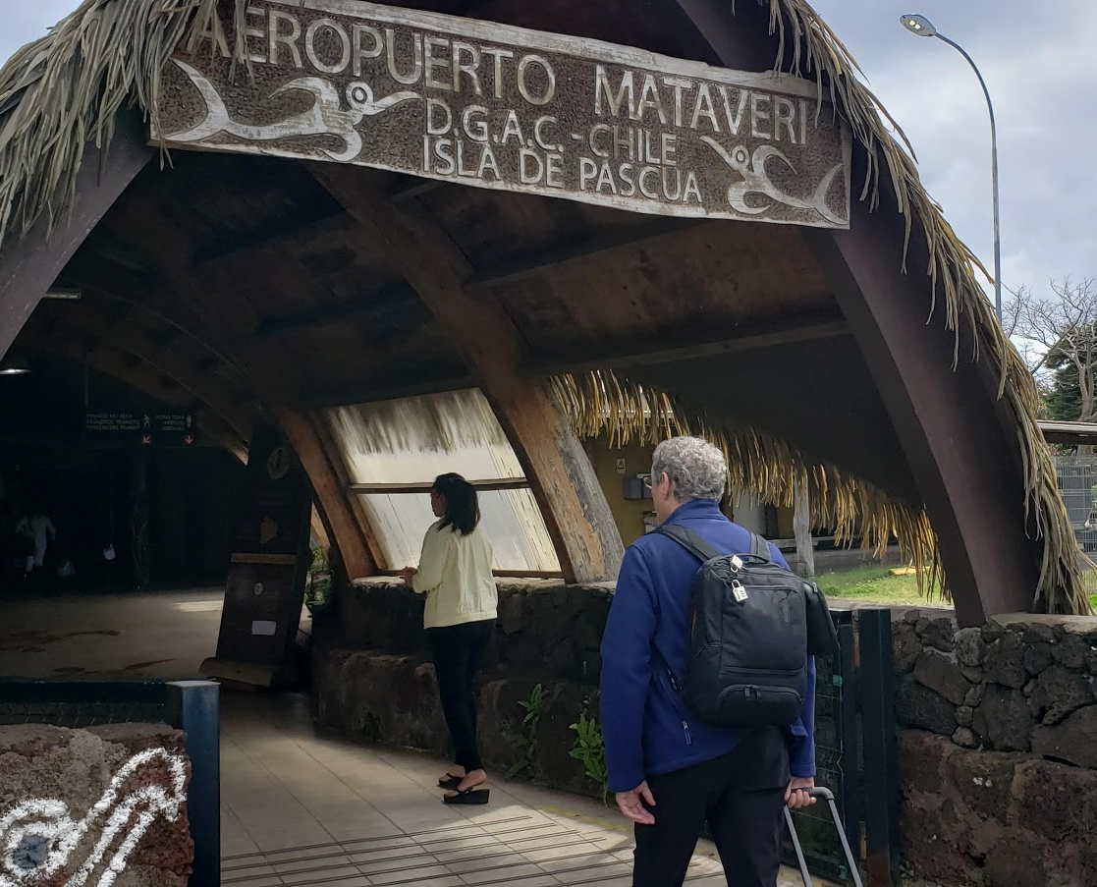
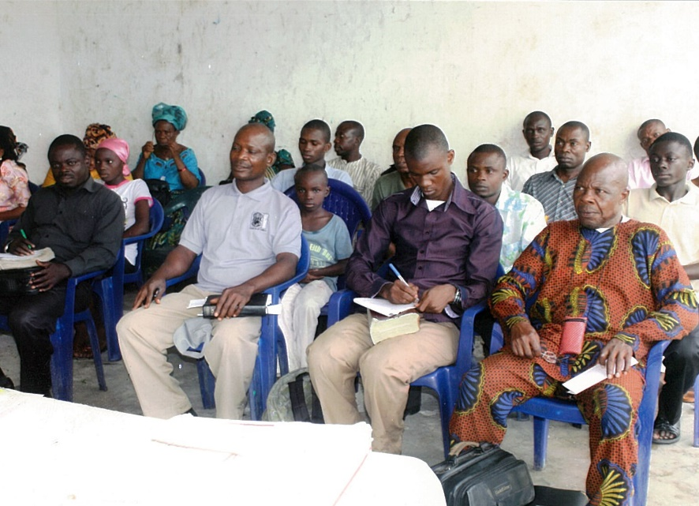
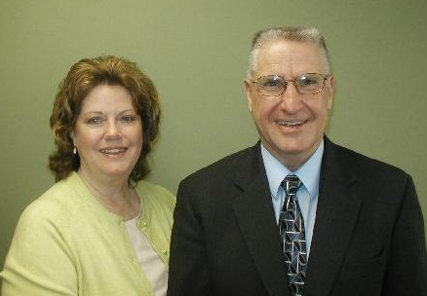
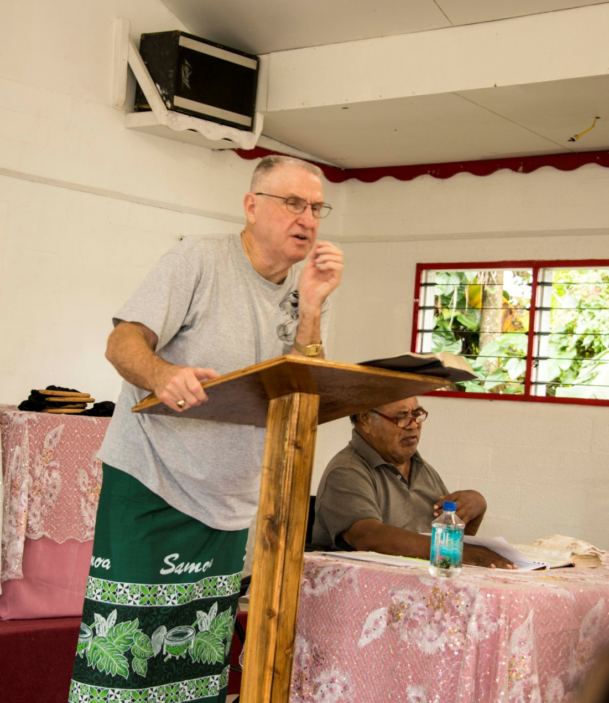
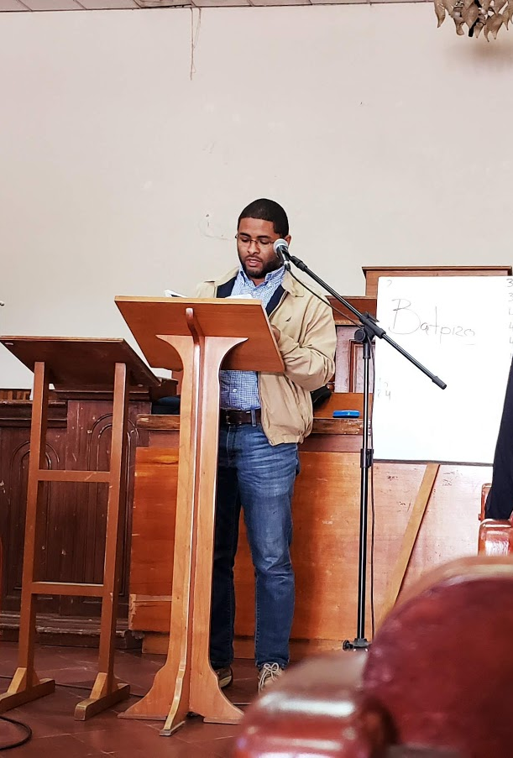
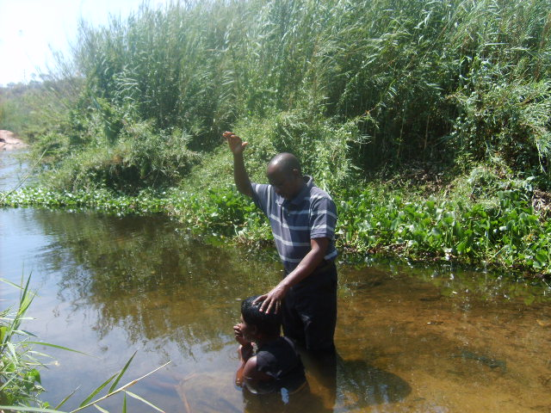

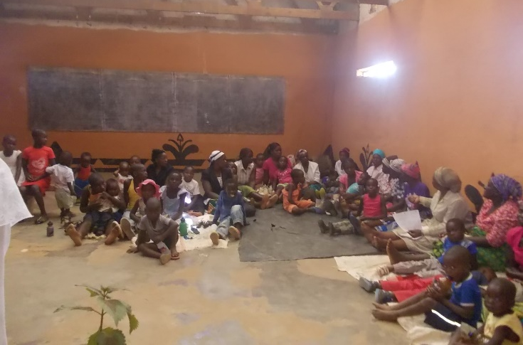


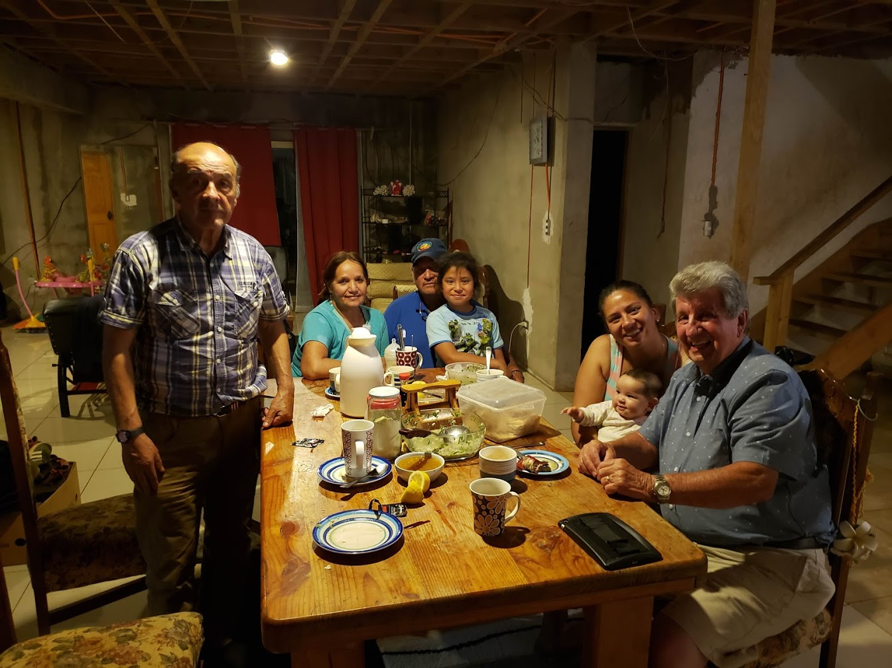




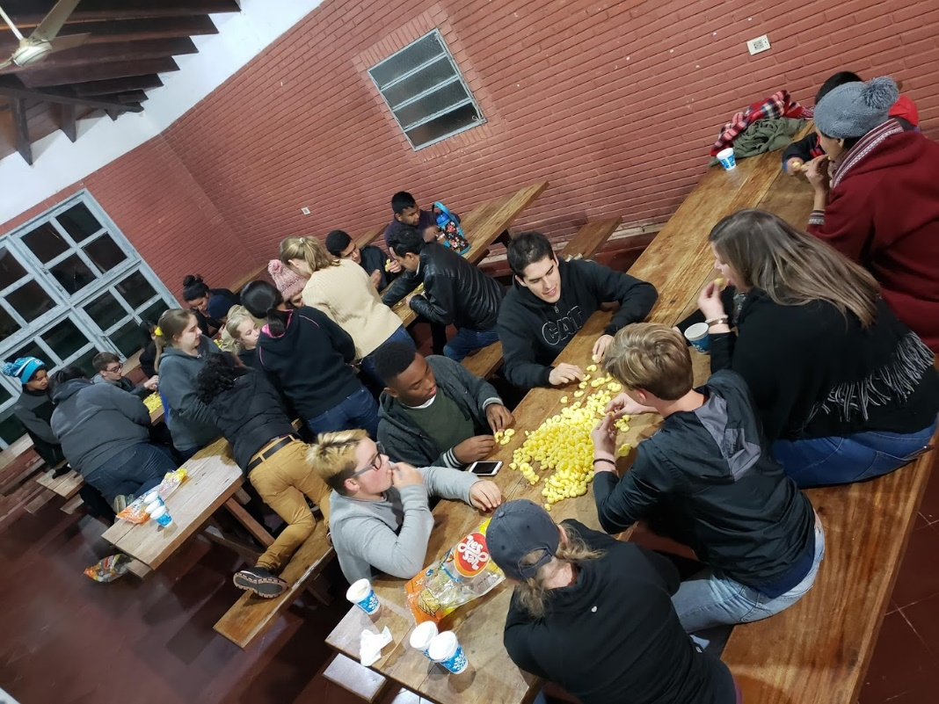
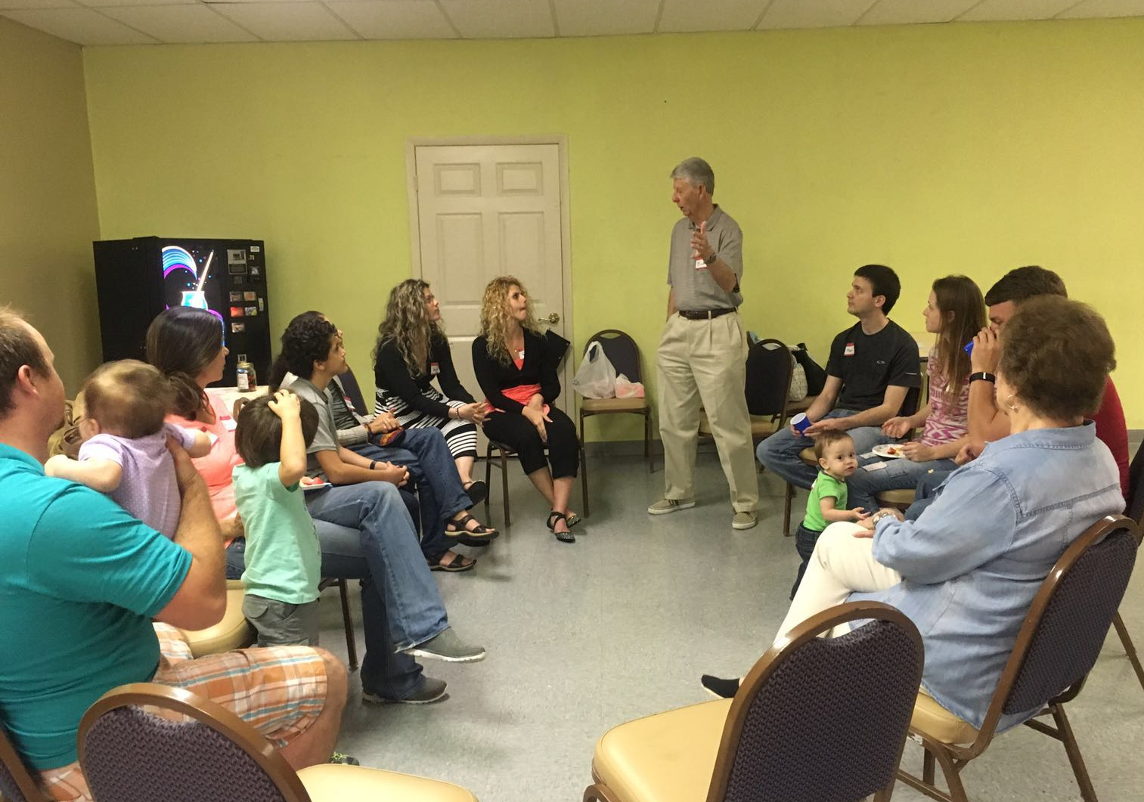
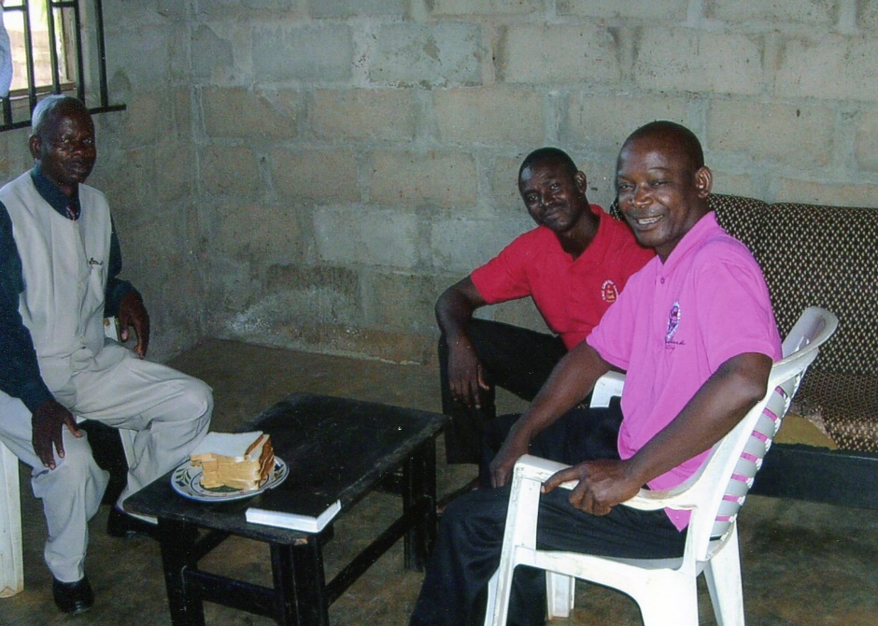
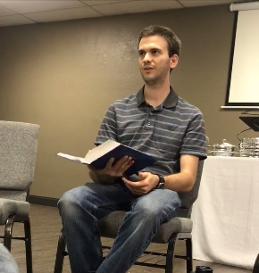

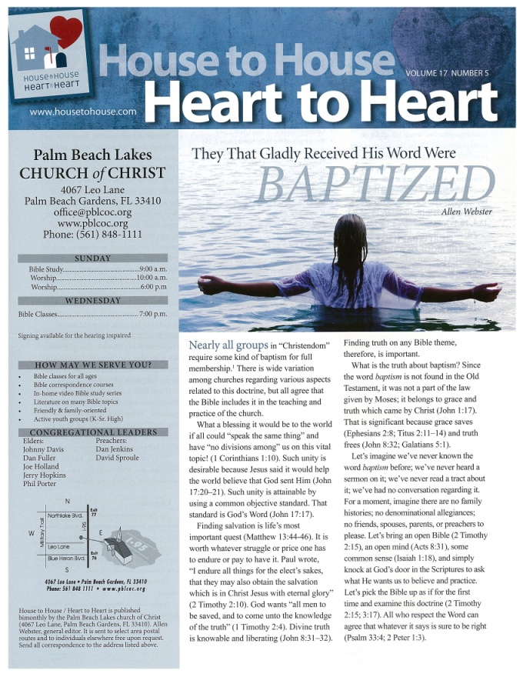
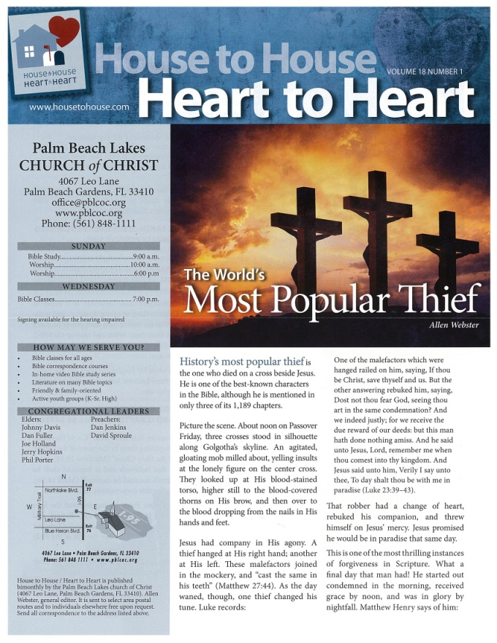

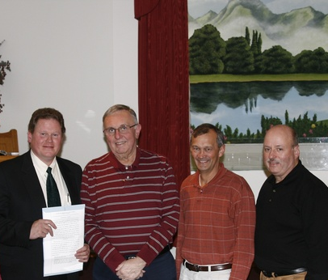
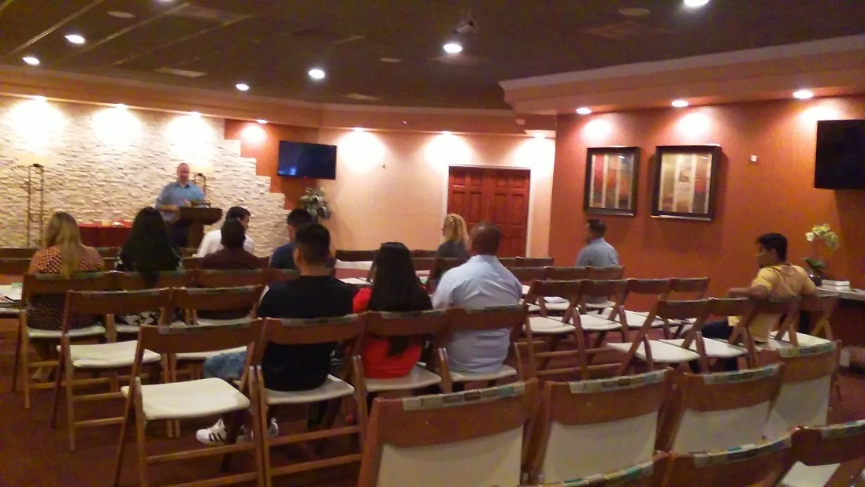

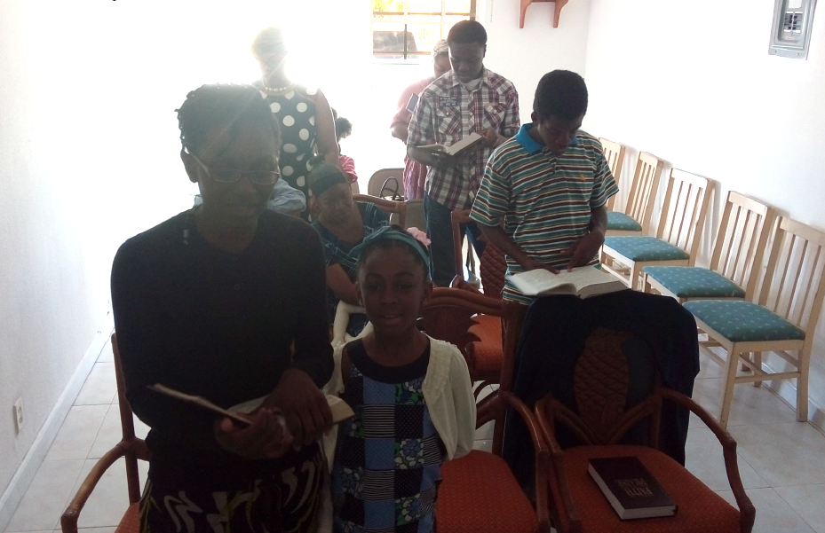
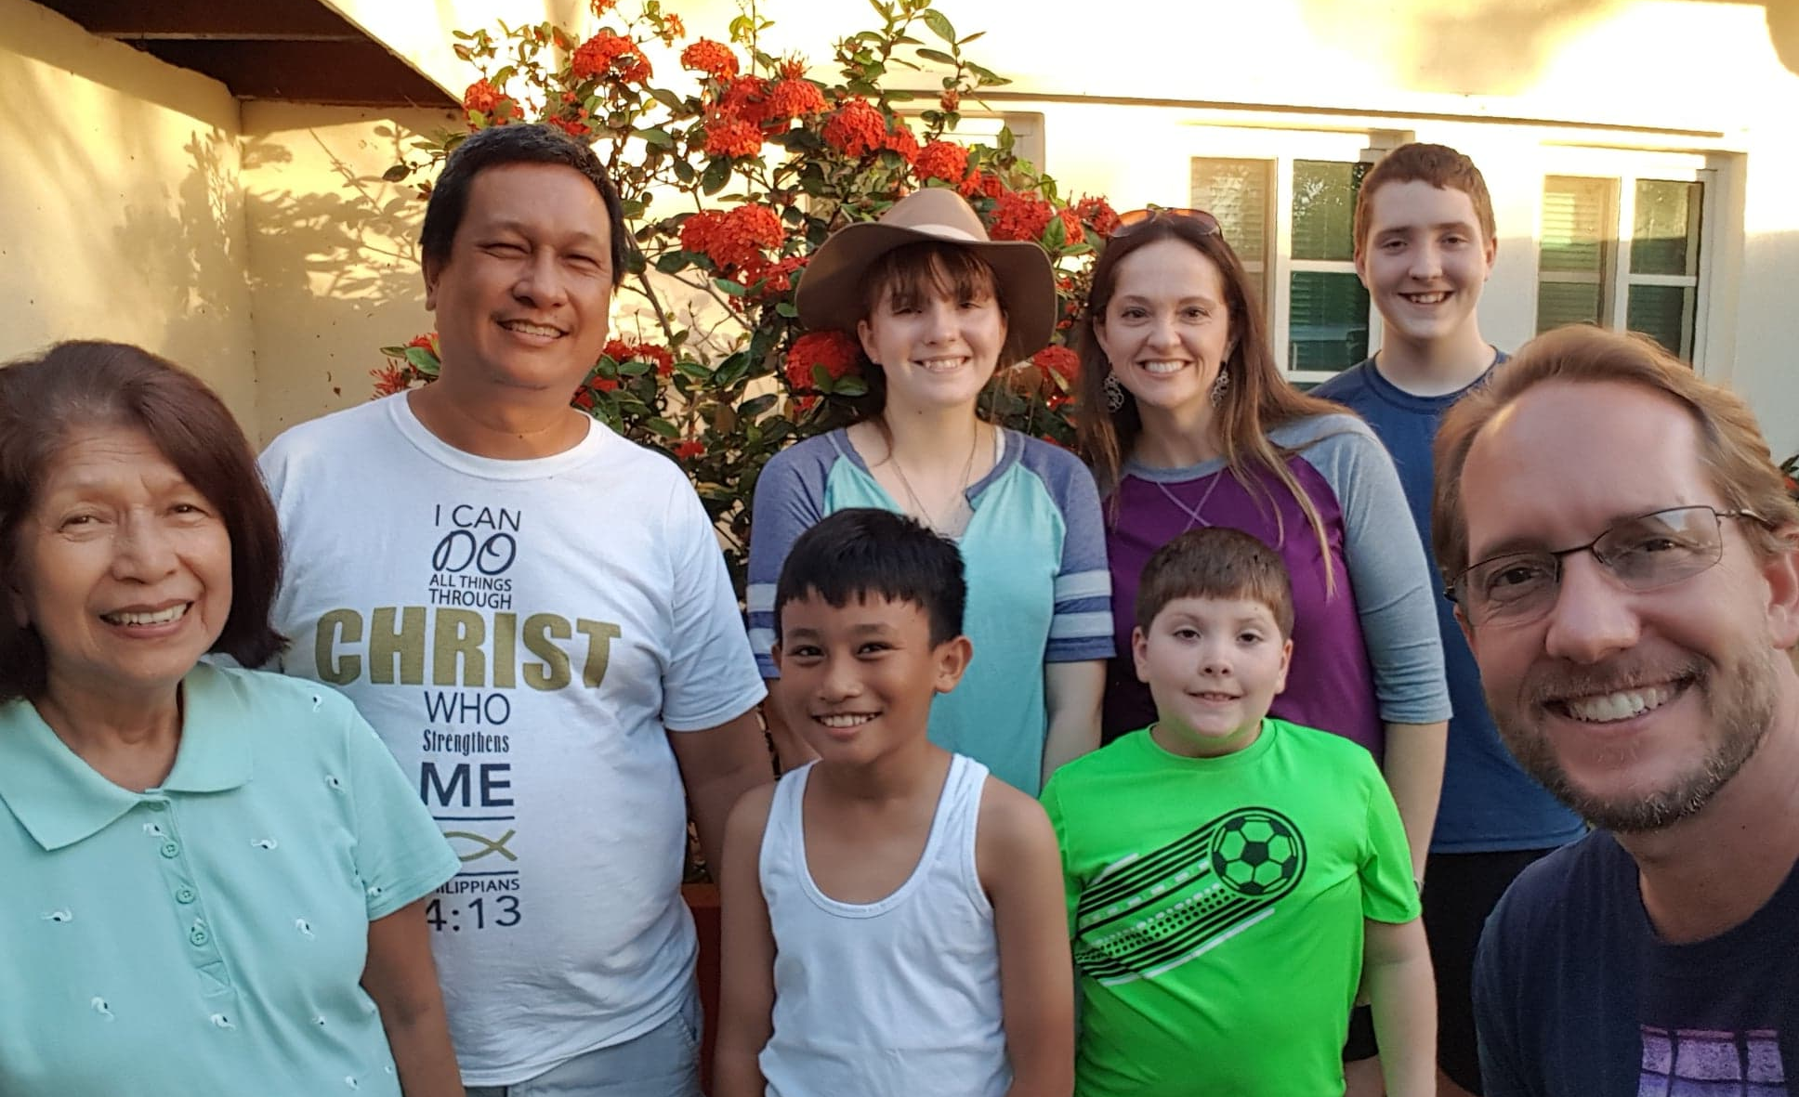

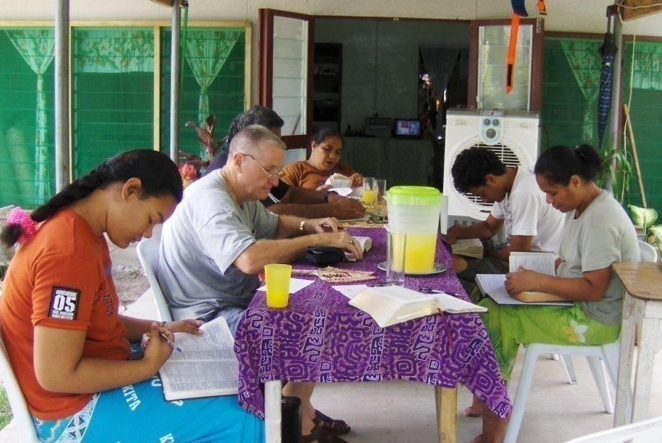

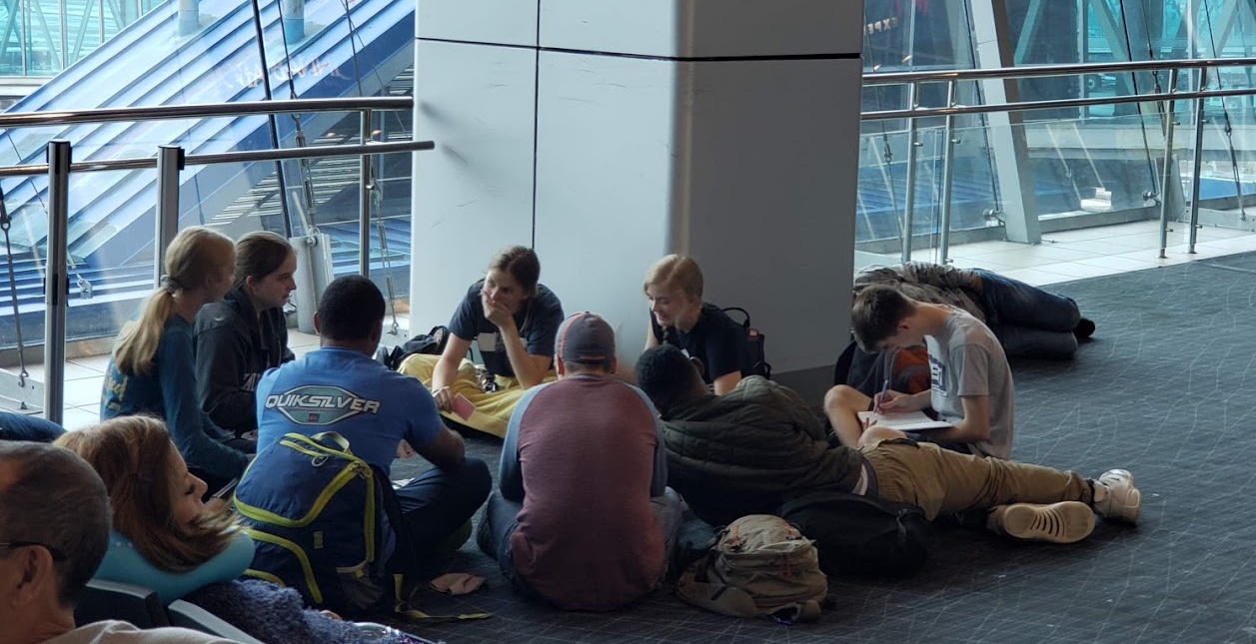
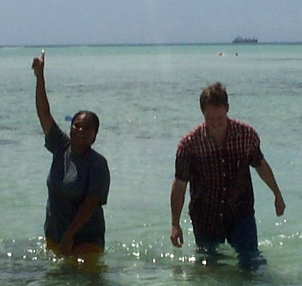
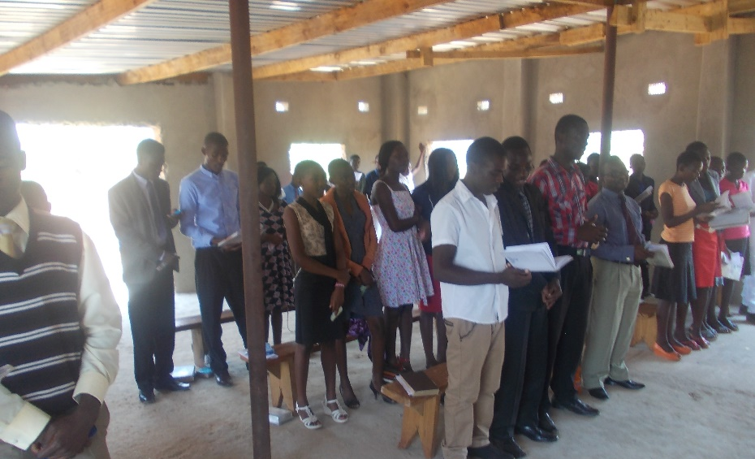

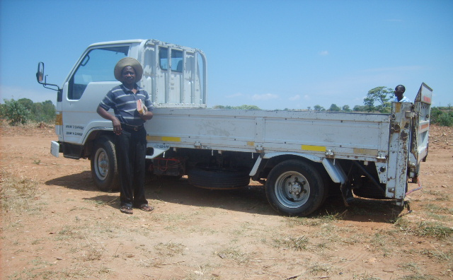
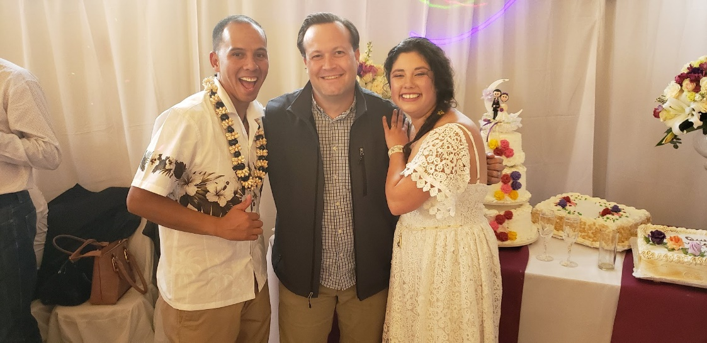
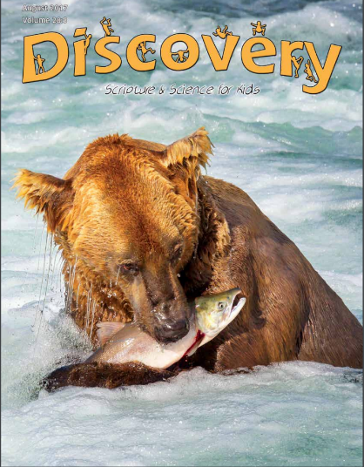


3,300 homes
EVERY month
Rotating Routes
Josh B. to Easter Island
House to House/Heart to Heart
Apologetics Press
Sr. High & Adult Mission Trip
$88,800
Tavaro Hanna (Bahamas)
Robert C. Lupo (Sneedville, TN)
Wayne Parker (Pacific)
Mauricio Yegros (Coral Springs)
Robert Martin (Pacific)
Joey Treat (Pacific)
Nnanna Aforji (Nigeria)
Tamuka Arunashe (Zimbabwe)

Slide 5
This will NOT be projected
If we give $101,800
  Bibles for Easter Island
    Population: 7,750
    Stores that sell Bibles: 0
    Josh has taken 500 Bibles in the last 4 years
  Special Requests for Mission Trips
    From college students and others
  “In Search of the Lord’s Way” TV Program
    Provide some financial support in 2020
    Phil Sanders
    WGN on Sunday mornings at 7:00 a.m.
    Statistics: On the air since 1980

Slide 6

Easter Island
Population: 7,750
Stores that sell Bibles: 0
Bibles taken by Josh so far: 500
$101,800
Bibles for
Easter Island
Josh B. to Easter Island
House to House/Heart to Heart
Apologetics Press
Sr. High & Adult Mission Trip
$88,800
Tavaro Hanna (Bahamas)
Robert C. Lupo (Sneedville, TN)
Wayne Parker (Pacific)
Mauricio Yegros (Coral Springs)
Robert Martin (Pacific)
Joey Treat (Pacific)
Nnanna Aforji (Nigeria)
Tamuka Arunashe (Zimbabwe)

Slide 7
$101,800
Bibles for
Easter Island
Special Requests
for Mission Trips
“In Search”
TV Program
Josh B. to Easter Island
House to House/Heart to Heart
Apologetics Press
Sr. High & Adult Mission Trip
$88,800
Tavaro Hanna (Bahamas)
Robert C. Lupo (Sneedville, TN)
Wayne Parker (Pacific)
Mauricio Yegros (Coral Springs)
Robert Martin (Pacific)
Joey Treat (Pacific)
Nnanna Aforji (Nigeria)
Tamuka Arunashe (Zimbabwe)

Slide 8

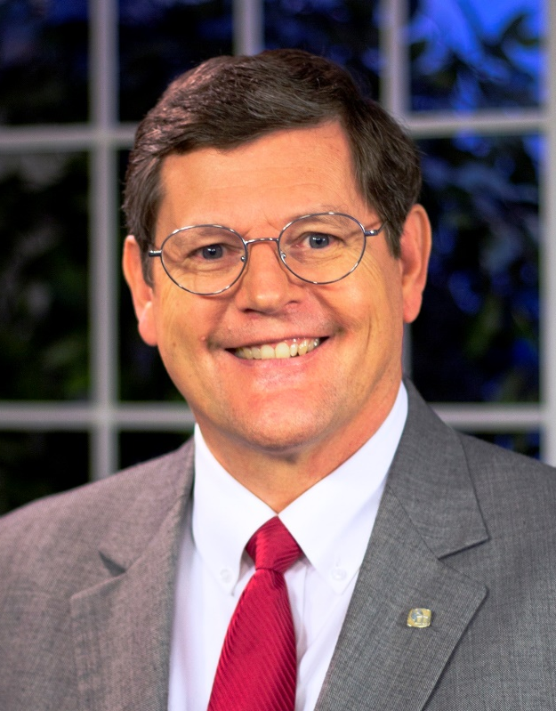

Sunday Mornings
at 7:00 a.m.
Reaching 100 million of 118 million homes in America every week
Phil Sanders

Slide 9
This will NOT be projected
If we give $115,800
  New Movers’ Mailings
    People are moving all of the time = time of transition = prime opportunity
    House to House monitors new movers – has special info to mail to them
    First, send special edition of H2H. 2 weeks later, send postcard “from us”
    Several thousand moved to new addresses around PBL last year
    We’re going to have H2H mail info to new movers in 33403, 33404, 33410, 33418
  Mail House to House/Heart to Heart to Friends & Visitors
    How would you like 3 of your local friends to receive H2H for the rest of 2020?
    Each PBL member will be able to submit names/addresses of 3 local friends
    We will order extra copies, have special envelopes and labels for them
    Also, we can send H2H to every local visitor that we have in 2020
    We will send it to them for the whole year

Slide 10
$115,800
New Movers’
Mailings
$101,800
Bibles for
Easter Island
Special Requests
for Mission Trips
“In Search”
TV Program
Josh B. to Easter Island
House to House/Heart to Heart
Apologetics Press
Sr. High & Adult Mission Trip
$88,800
Tavaro Hanna (Bahamas)
Robert C. Lupo (Sneedville, TN)
Wayne Parker (Pacific)
Mauricio Yegros (Coral Springs)
Robert Martin (Pacific)
Joey Treat (Pacific)
Nnanna Aforji (Nigeria)
Tamuka Arunashe (Zimbabwe)

Slide 11




Slide 12

To: 3 Local Friends of
Every PBL Member
$115,800
New Movers’
Mailings
Mail House to House
to Friends & Visitors
$101,800
Bibles for
Easter Island
Special Requests
for Mission Trips
“In Search”
TV Program
Josh B. to Easter Island
House to House/Heart to Heart
Apologetics Press
Sr. High & Adult Mission Trip
$88,800
Tavaro Hanna (Bahamas)
Robert C. Lupo (Sneedville, TN)
Wayne Parker (Pacific)
Mauricio Yegros (Coral Springs)
Robert Martin (Pacific)
Joey Treat (Pacific)
Nnanna Aforji (Nigeria)
Tamuka Arunashe (Zimbabwe)

Slide 13
This will NOT be projected
If we give $125,400
  One-time assistance for Trinidad School of Preaching
    School has been in existence for 50 years
    They have trained hundreds of preachers
    They have students from all over the Caribbean, including some from Albania
    Dominic Dos Santos is the director of the school
  Supporting a student in a School of Preaching
    The elders want to help men who are training to preach
    They are looking for the right man in a SOP this year to support while in school

Slide 14
$125,400
Trinidad School
of Preaching
$115,800
New Movers’
Mailings
Mail House to House
to Friends & Visitors
$101,800
Bibles for
Easter Island
Special Requests
for Mission Trips
“In Search”
TV Program
Josh B. to Easter Island
House to House/Heart to Heart
Apologetics Press
Sr. High & Adult Mission Trip
$88,800
Tavaro Hanna (Bahamas)
Robert C. Lupo (Sneedville, TN)
Wayne Parker (Pacific)
Mauricio Yegros (Coral Springs)
Robert Martin (Pacific)
Joey Treat (Pacific)
Nnanna Aforji (Nigeria)
Tamuka Arunashe (Zimbabwe)

Slide 15
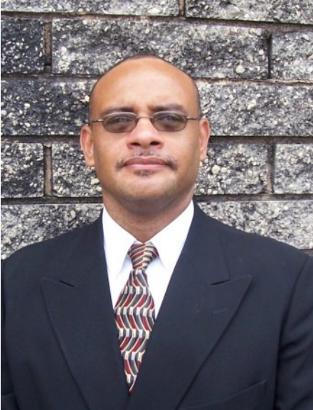
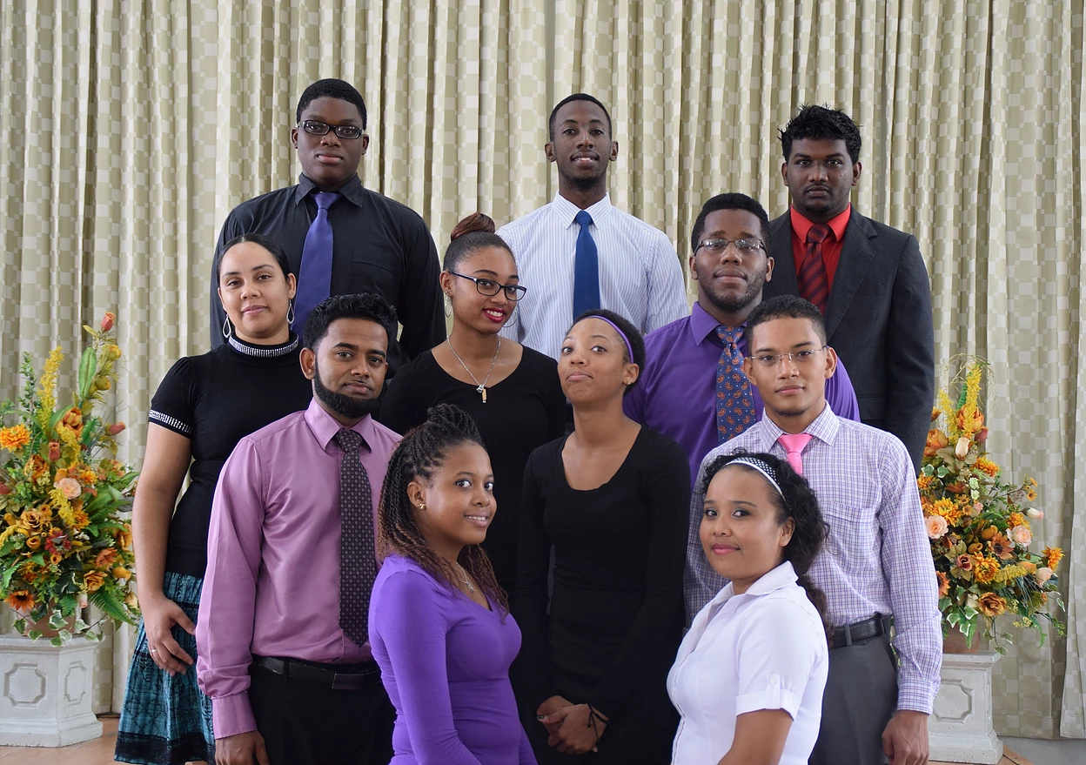
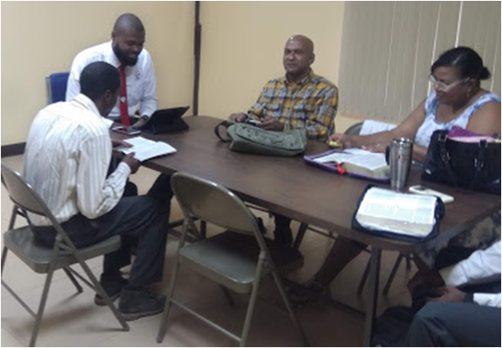
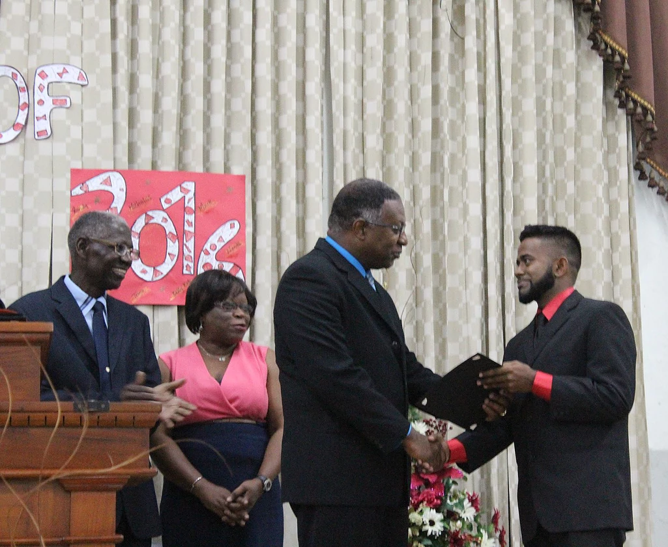
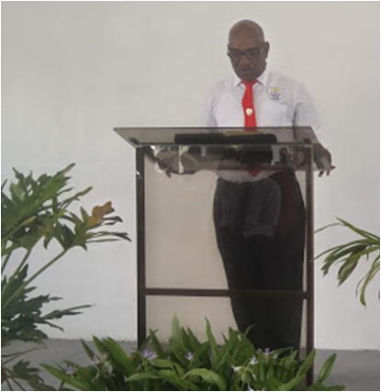
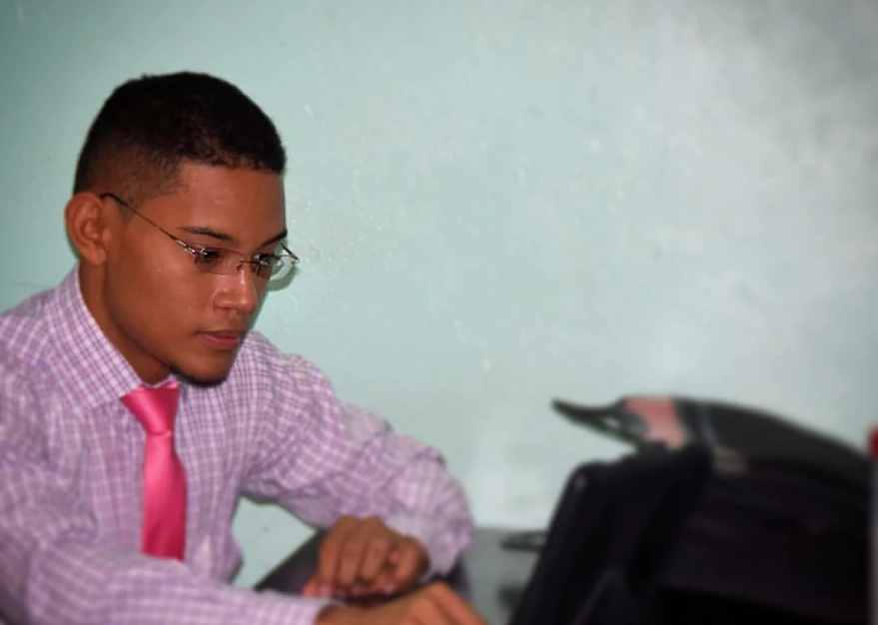
Trinidad School of Preaching
Dominic Dos Santos
(Director)

Slide 16
$125,400
Trinidad School
of Preaching
Support Student
in Preaching School
$115,800
New Movers’
Mailings
Mail House to House
to Friends & Visitors
$101,800
Bibles for
Easter Island
Special Requests
for Mission Trips
“In Search”
TV Program
Josh B. to Easter Island
House to House/Heart to Heart
Apologetics Press
Sr. High & Adult Mission Trip
$88,800
Tavaro Hanna (Bahamas)
Robert C. Lupo (Sneedville, TN)
Wayne Parker (Pacific)
Mauricio Yegros (Coral Springs)
Robert Martin (Pacific)
Joey Treat (Pacific)
Nnanna Aforji (Nigeria)
Tamuka Arunashe (Zimbabwe)

Slide 17
This will NOT be projected
If we give $137,900
  “In Search of the Lord’s Way” TV Program
    Provide additional support, over what we can do in first level
    It’s worth it
    Costs $9,000 per day for Search to operate
  Assist Truth for Today World Missions
    A work overseen by Eddie Cloer in Searcy, Arkansas
    TFT sends Bible study materials to 32,000 preachers around world every month
    These are done in 14 different languages
    Started online courses for these preachers in several different languages

Slide 18
$137,900
“In Search”
TV Program
$125,400
Trinidad School
of Preaching
Support Student
in Preaching School
$115,800
New Movers’
Mailings
Mail House to House
to Friends & Visitors
$101,800
Bibles for
Easter Island
Special Requests
for Mission Trips
“In Search”
TV Program
Josh B. to Easter Island
House to House/Heart to Heart
Apologetics Press
Sr. High & Adult Mission Trip
$88,800
Tavaro Hanna (Bahamas)
Robert C. Lupo (Sneedville, TN)
Wayne Parker (Pacific)
Mauricio Yegros (Coral Springs)
Robert Martin (Pacific)
Joey Treat (Pacific)
Nnanna Aforji (Nigeria)
Tamuka Arunashe (Zimbabwe)

Slide 19
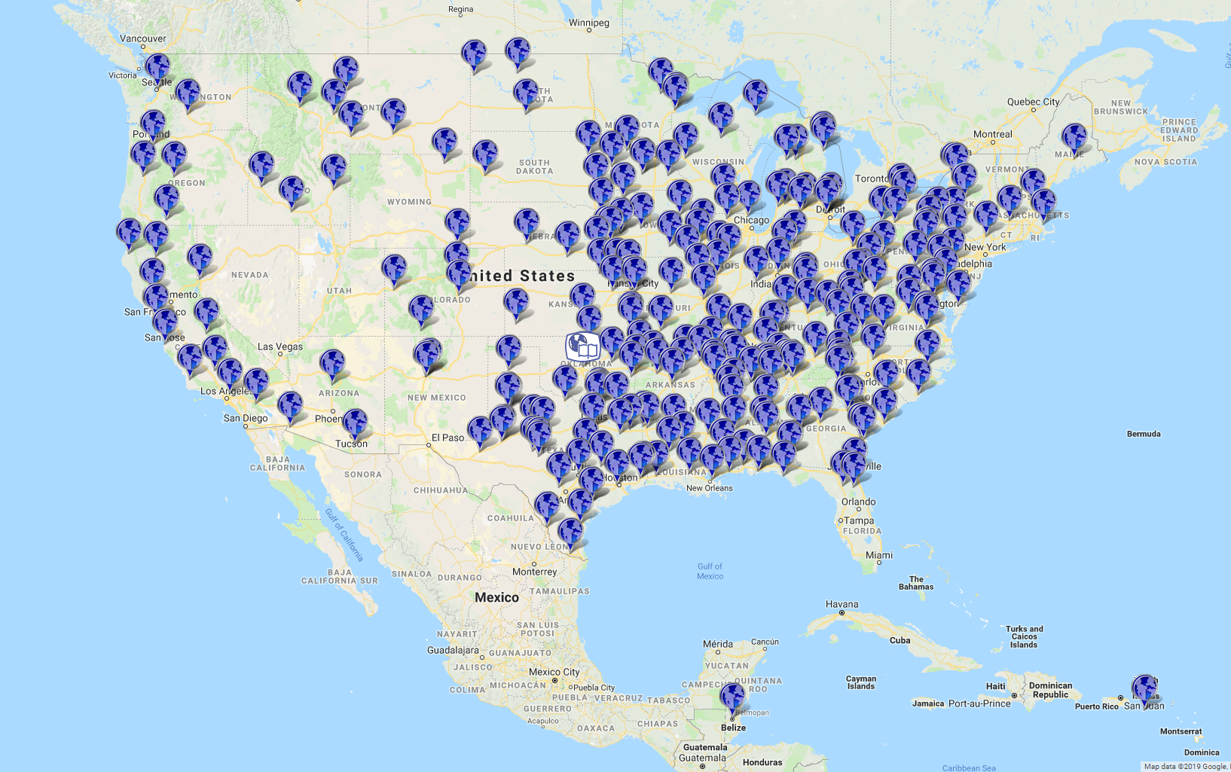

Station Map

Slide 20
$137,900
“In Search”
TV Program
“Truth for
Today”
$125,400
Trinidad School
of Preaching
Support Student
in Preaching School
$115,800
New Movers’
Mailings
Mail House to House
to Friends & Visitors
$101,800
Bibles for
Easter Island
Special Requests
for Mission Trips
“In Search”
TV Program
Josh B. to Easter Island
House to House/Heart to Heart
Apologetics Press
Sr. High & Adult Mission Trip
$88,800
Tavaro Hanna (Bahamas)
Robert C. Lupo (Sneedville, TN)
Wayne Parker (Pacific)
Mauricio Yegros (Coral Springs)
Robert Martin (Pacific)
Joey Treat (Pacific)
Nnanna Aforji (Nigeria)
Tamuka Arunashe (Zimbabwe)

Slide 21

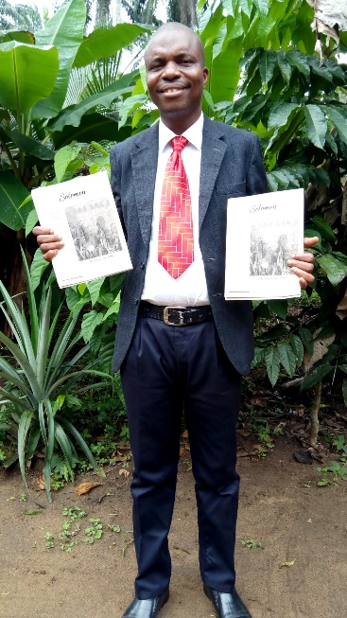
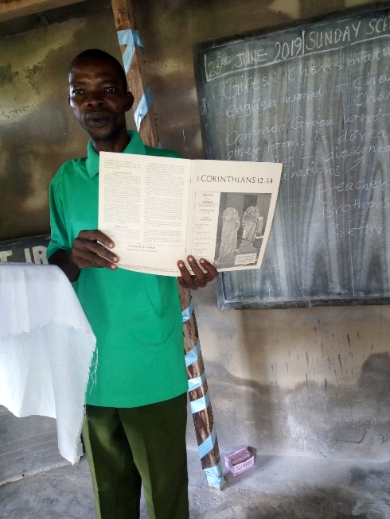
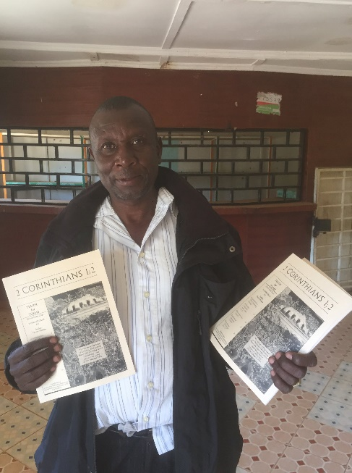
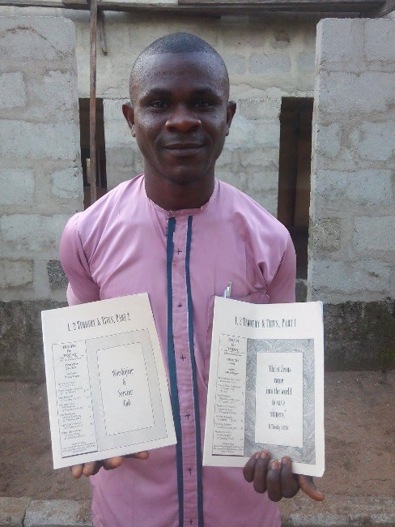
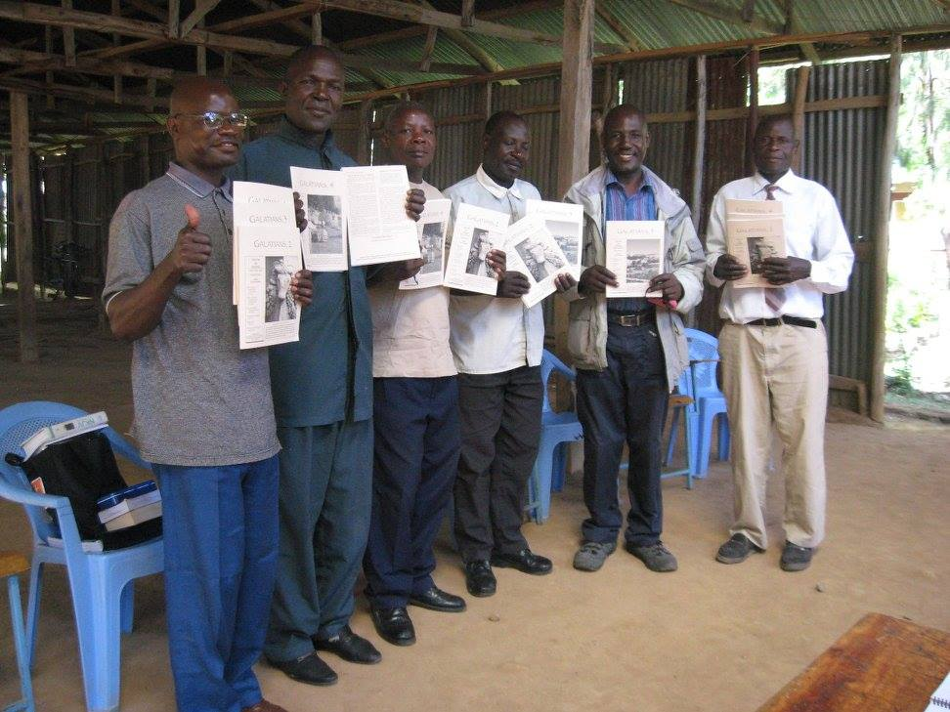



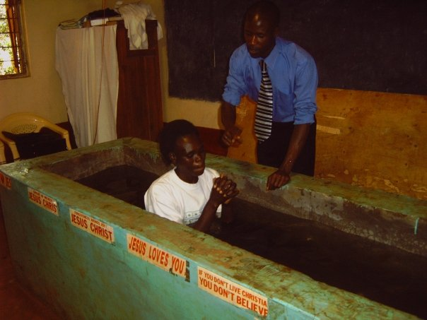

Slide 22
$+++,+++
+
+
+
$137,900
“In Search”
TV Program
“Truth for
Today”
$125,400
Trinidad School
of Preaching
Support Student
in Preaching School
$115,800
New Movers’
Mailings
Mail House to House
to Friends & Visitors
$101,800
Bibles for
Easter Island
Special Requests
for Mission Trips
“In Search”
TV Program
Josh B. to Easter Island
House to House/Heart to Heart
Apologetics Press
Sr. High & Adult Mission Trip
$88,800
Tavaro Hanna (Bahamas)
Robert C. Lupo (Sneedville, TN)
Wayne Parker (Pacific)
Mauricio Yegros (Coral Springs)
Robert Martin (Pacific)
Joey Treat (Pacific)
Nnanna Aforji (Nigeria)
Tamuka Arunashe (Zimbabwe)

Slide 23

The Purpose of
Mission Sunday
The Purpose of
The Gospel
is to
Save
Souls!
Are you
Saved?
Believe Jesus is God’s Son John 8:24
Repent/Turn from your sins Acts 2:38
Confess your faith Romans 10:9
Be baptized Mark 16:16
Live faithfully Revelation 2:10

Slide 24
$+++,+++
+
+
+
$137,900
“In Search”
TV Program
“Truth for
Today”
$125,400
Trinidad School
of Preaching
Support Student
in Preaching School
$115,800
New Movers’
Mailings
Mail House to House
to Friends & Visitors
$101,800
Bibles for
Easter Island
Special Requests
for Mission Trips
“In Search”
TV Program
Josh B. to Easter Island
House to House/Heart to Heart
Apologetics Press
Sr. High & Adult Mission Trip
$88,800
Tavaro Hanna (Bahamas)
Robert C. Lupo (Sneedville, TN)
Wayne Parker (Pacific)
Mauricio Yegros (Coral Springs)
Robert Martin (Pacific)
Joey Treat (Pacific)
Nnanna Aforji (Nigeria)
Tamuka Arunashe (Zimbabwe)

