Slide 1
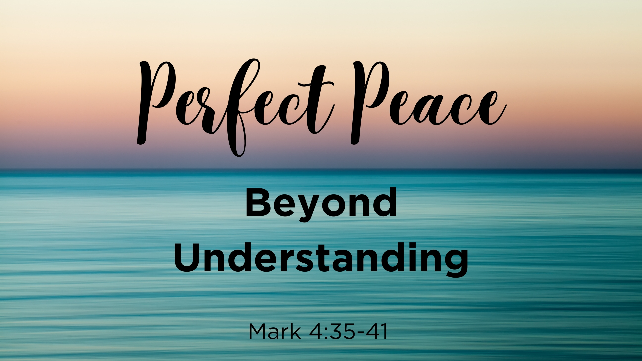

Slide 2
Perfect Peace Beyond Understanding
Mark 4:35-41

Slide 3
Text—Mark 4:35-41
35 On the same day, when evening had come, He said to them, "Let us cross over to the other side."
36 Now when they had left the multitude, they took Him along in the boat as He was. And other little boats were also with Him.
37 And a great windstorm arose, and the waves beat into the boat, so that it was already filling.
38 But He was in the stern, asleep on a pillow. And they awoke Him and said to Him, "Teacher, do You not care that we are perishing?"
39 Then He arose and rebuked the wind, and said to the sea, "Peace, be still!" And the wind ceased and there was a great calm.
40 But He said to them, "Why are you so fearful? How is it that you have no faith?"
41 And they feared exceedingly, and said to one another, "Who can this be, that even the wind and the sea obey Him!"

Slide 4
Looking at the Text
It really happened, what did the apostles learn from it

Slide 5
Master, the tempest is raging!
The billows are tossing high!
The sky is o’er shadowed with blackness,
No shelter or help is nigh;
Carest Thou not that we perish?
How canst Thou lie asleep,
When each moment so madly is threatening
A grave in the angry deep?
The winds and the waves obey Thy will,
Peace, be still!
Whether the wrath of the storm tossed sea,
Or demons or men, or whatever it be
No waters can swallow the ship where lies
The Master of ocean, and earth, and skies;
They all shall sweetly obey Thy will,
Peace, be still! Peace, be still!
They all shall sweetly obey Thy will,
Peace, peace, be still!

Slide 6
Master, the terror is over,
The elements sweetly rest;
Earth’s sun in the calm lake is mirrored,
And heaven’s within my breast;
Linger, O blessed Redeemer!
Leave me alone no more;
And with joy I shall make the blest harbor,
And rest on the blissful shore.
The winds and the waves obey Thy will,
Peace, be still!
Whether the wrath of the storm tossed sea,
Or demons or men, or whatever it be
No waters can swallow the ship where lies
The Master of ocean, and earth, and skies;
They all shall sweetly obey Thy will,
Peace, be still! Peace, be still!
They all shall sweetly obey Thy will,
Peace, peace, be still!

Slide 7
Looking at the Text
It really happened, what did the apostles learn from it
It really happened, what do we learn from it

Slide 8
Master, with anguish of spirit
I bow in my grief today;
The depths of my sad heart are troubled
Oh, waken and save, I pray!
Torrents of sin and of anguish
Sweep o’er my sinking soul;
And I perish! I perish! dear Master
Oh, hasten, and take control.
The winds and the waves obey Thy will,
Peace, be still!
Whether the wrath of the storm tossed sea,
Or demons or men, or whatever it be
No waters can swallow the ship where lies
The Master of ocean, and earth, and skies;
They all shall sweetly obey Thy will,
Peace, be still! Peace, be still!
They all shall sweetly obey Thy will,
Peace, peace, be still!

Slide 9
Looking at the Text
It really happened, what did the apostles learn from it
It really happened, what do we learn from it
They could sing, as we can sing, “Master, the … peace be still”

Slide 10
Looking at the Text
It really happened, what did the apostles learn from it
It really happened, what do we learn from it
They could sing, as we can sing, “Master, the … peace be still”
The Prince of peace longs to give Christians today peace, perfect peace

Slide 11
Prophecy—Perfect Peace is Coming
Isa 26:1 In that day this song will be sung in the land of Judah: "We have a strong city; God will appoint salvation for walls and bulwarks.
Isa 26:2 Open the gates, That the righteous nation which keeps the truth may enter in.
Isa 26:3 You will keep him in perfect peace, Whose mind is stayed on You, Because he trusts in You.
Isa 26:4 Trust in the LORD forever, For in YAH, the LORD, is everlasting strength.
. . . .

Slide 12
Prophecy—Perfect Peace is Coming
Isa 26:1 In that day this song will be sung in the land of Judah: "We have a strong city; God will appoint salvation for walls and bulwarks.
Isa 26:2 Open the gates, That the righteous nation which keeps the truth may enter in.
Isa 26:3 You will keep him in perfect peace, Whose mind is stayed on You, Because he trusts in You.
Isa 26:4 Trust in the LORD forever, For in YAH, the LORD, is everlasting strength.
. . . .
Isa 25:8 He will swallow up death forever, And the Lord GOD will wipe away tears from all faces; The rebuke of His people He will take away from all the earth; For the LORD has spoken.
Isa 25:9 And it will be said in that day: "Behold, this is our God; We have waited for Him, and He will save us. This is the LORD; We have waited for Him; We will be glad and rejoice in His salvation."

Slide 13
6 Be anxious for nothing, but in everything by prayer and supplication, with thanksgiving… Phil. 4:6
? ? ?
? ? ?
? ? ?
? ? ?

Slide 14
6 Be anxious for nothing, but in everything by prayer and supplication, with thanksgiving… Phil. 4:6
A World Filled With Sin
? ? ?
? ? ?
? ? ?

Slide 15
6 Be anxious for nothing, but in everything by prayer and supplication, with thanksgiving… Phil. 4:6
A World Filled With Sin
? ? ?
Depression, Sorrow, Grief
? ? ?

Slide 16
6 Be anxious for nothing, but in everything by prayer and supplication, with thanksgiving… Phil. 4:6
A World Filled With Sin
My Family and Their Life
Depression, Sorrow, Grief
? ? ?

Slide 17
6 Be anxious for nothing, but in everything by prayer and supplication, with thanksgiving… Phil. 4:6
A World Filled With Sin
My Family and
Their Life
Depression, Sorrow, Grief
What is Going to Happen

Slide 18
6 Be anxious for nothing, but in everything by prayer and supplication, with thanksgiving… Phil. 4:6
A World Filled With Sin
My Family and
Their Life
Depression, Sorrow, Grief
What is Going to Happen
…Let your requests be made known to God; and the peace of God, which surpasses all understanding, will guard your hearts and minds through Christ Jesus. Phil. 4:6-7

Slide 19
Finding Peace IN Christ
  Believe John 3:16
  Repent Acts 17:30
  Confess Faith in Him Rom. 10:10
  Be Baptized Into Him Gal. 3:27
Added to His Church, His Kingdom, His Family, His One Body
  Be Faithful Rev. 2:10

