Slide 1


Slide 2
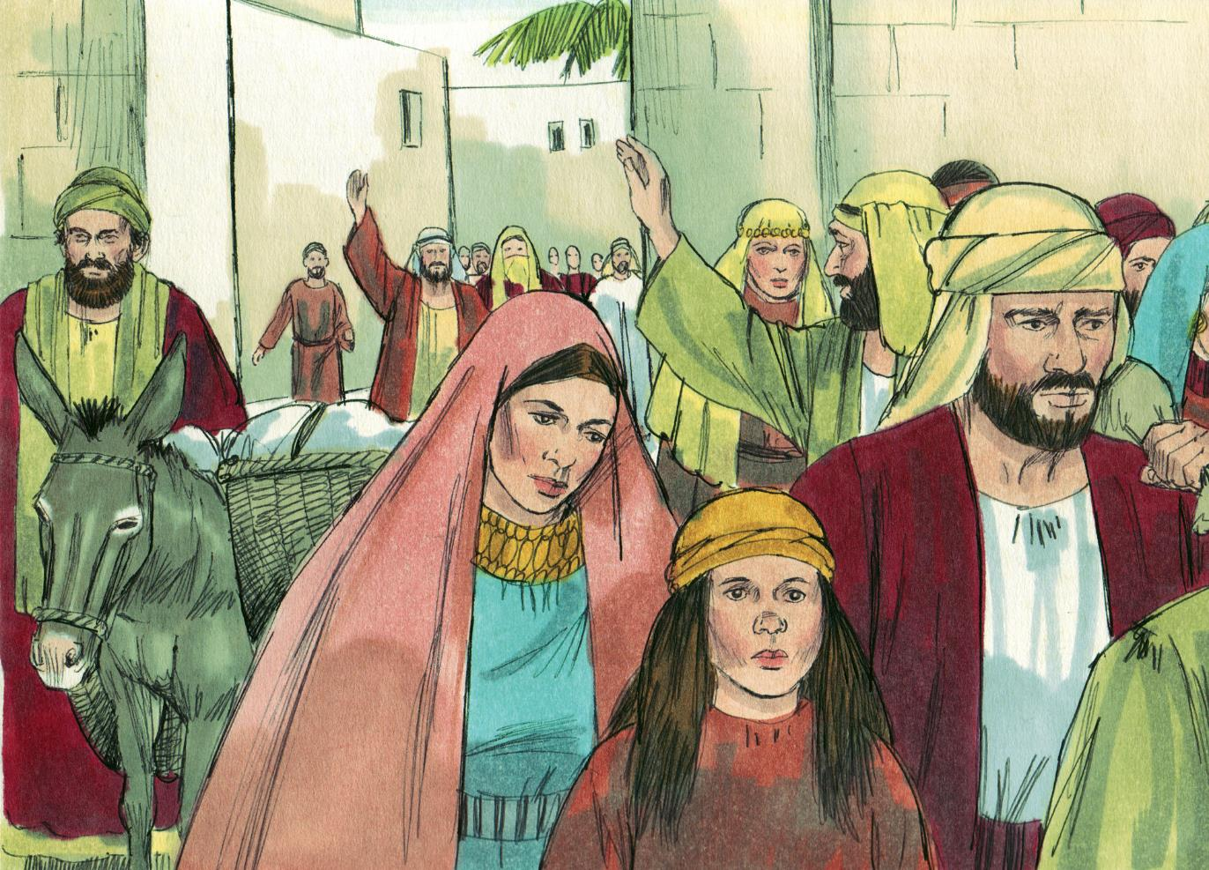

Slide 3
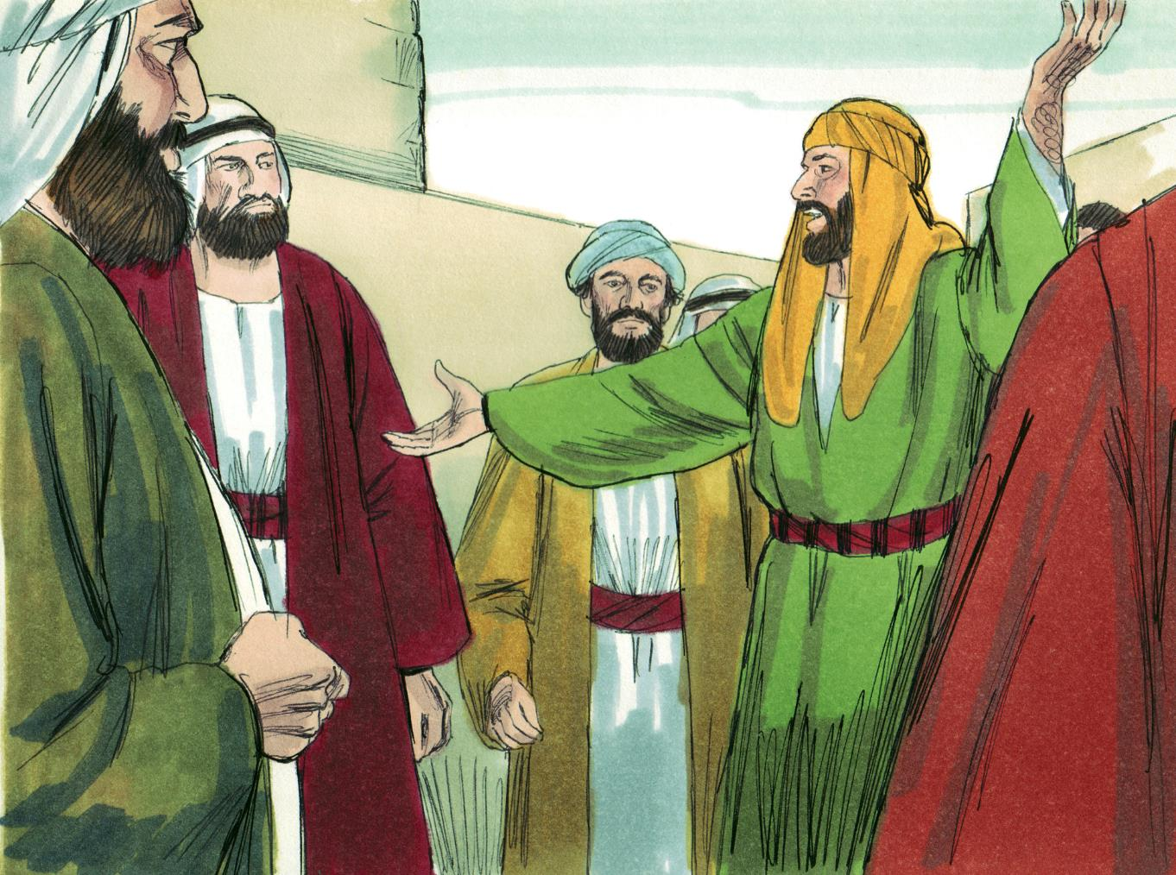

Slide 4
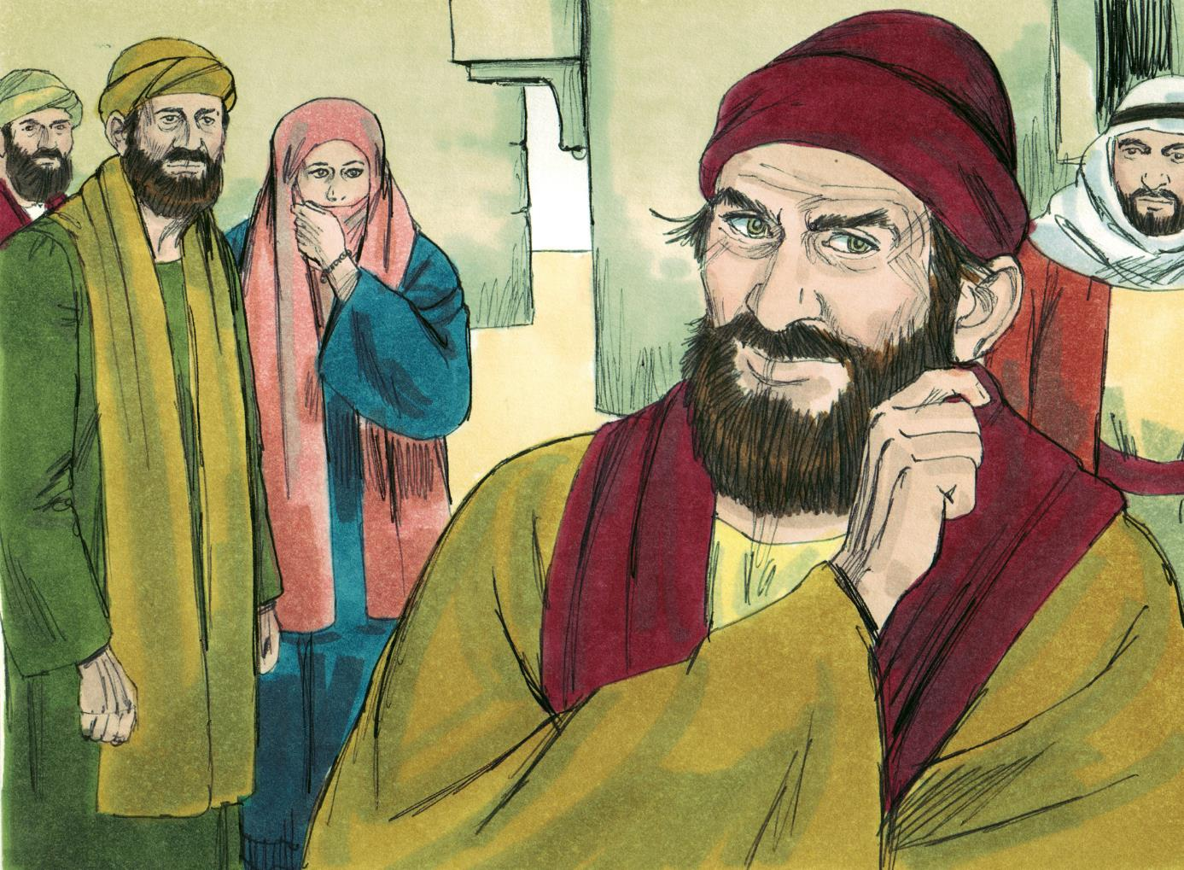

Slide 5
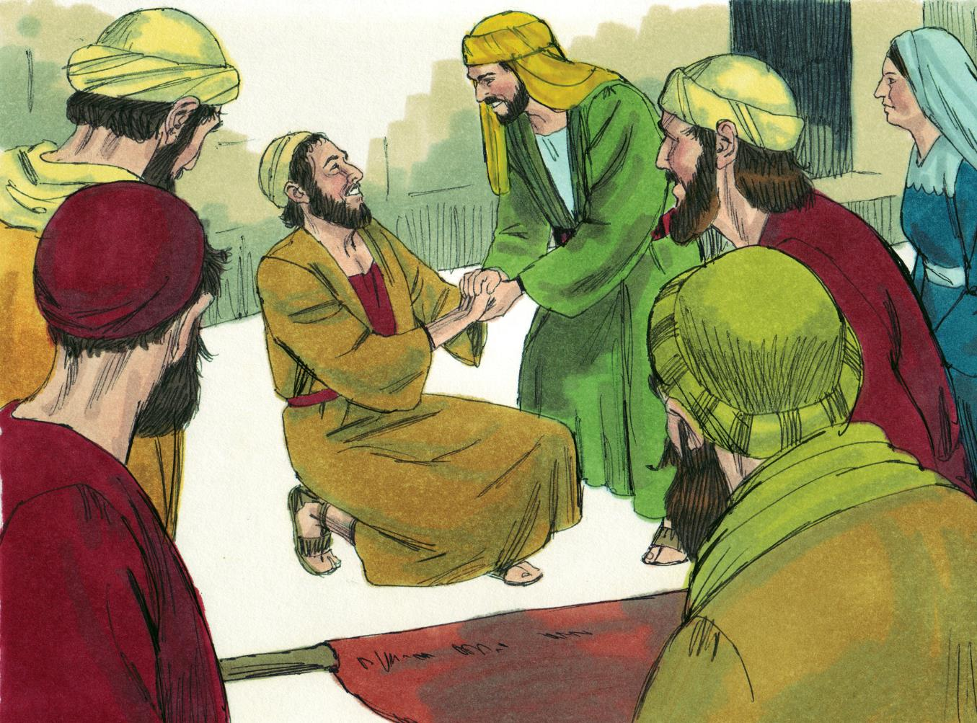

Slide 6
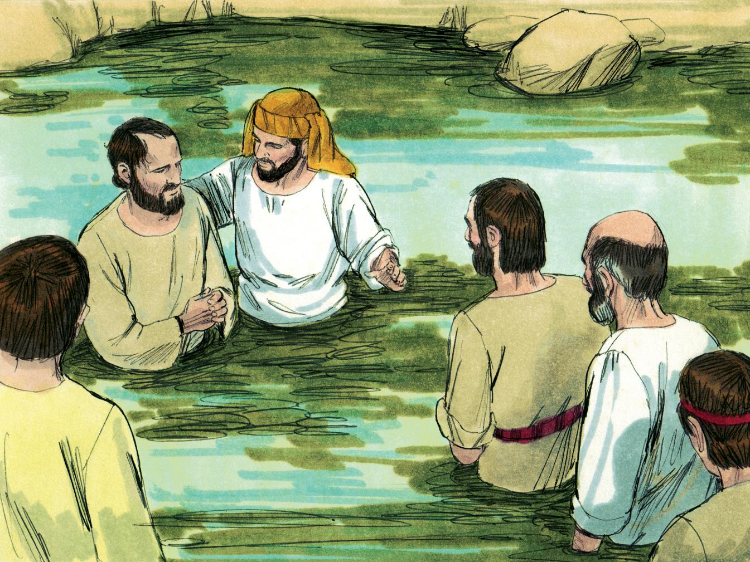

Slide 7
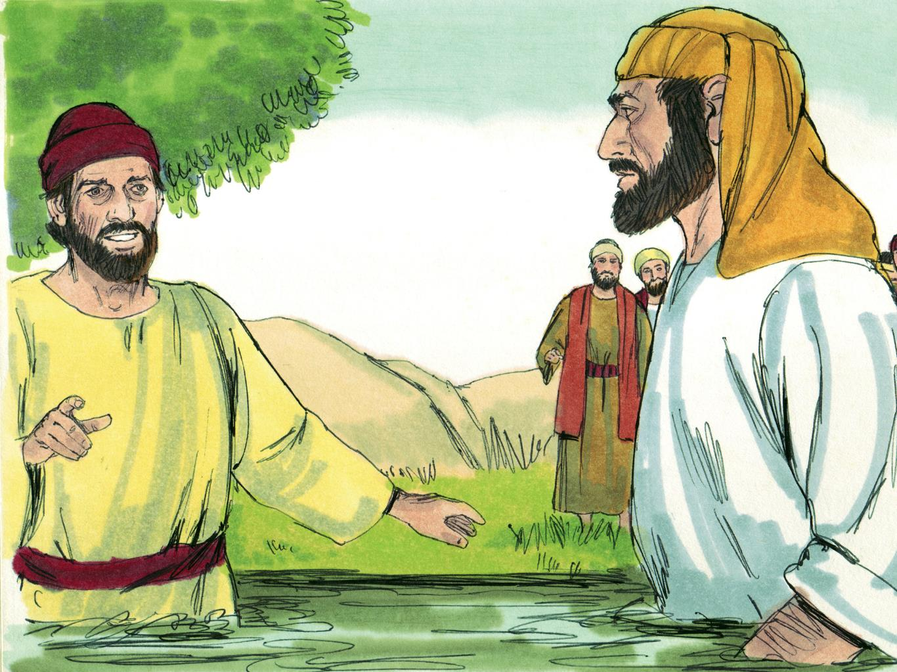

Slide 8
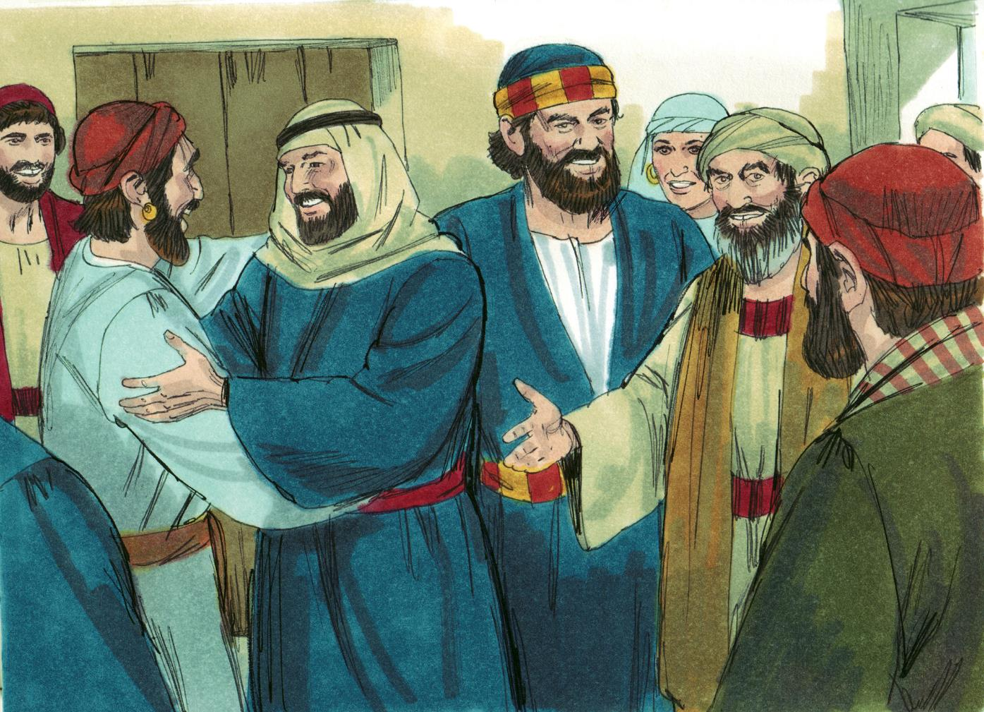

Slide 9
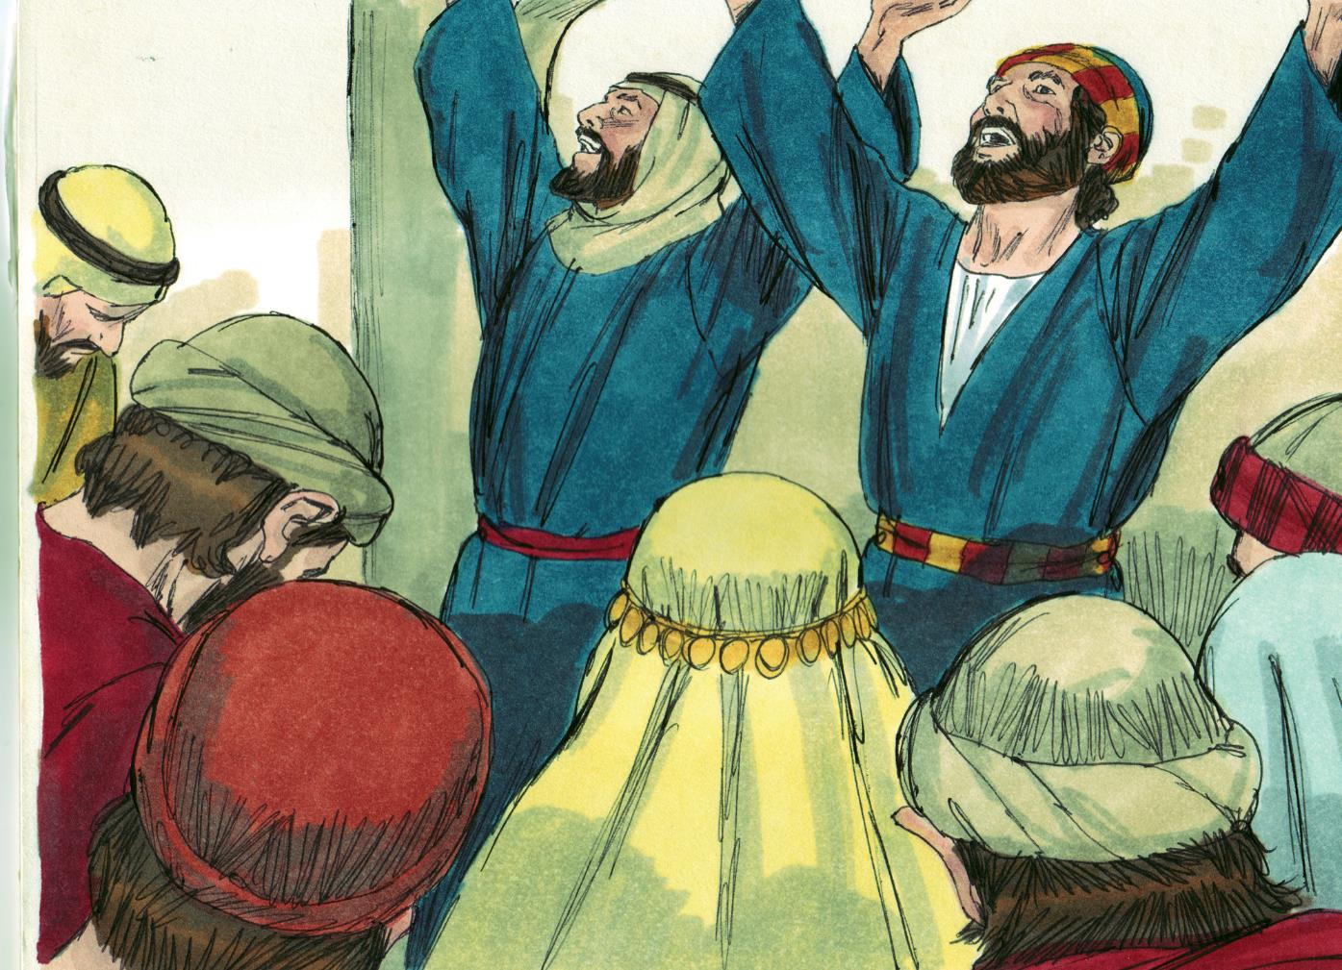

Slide 10
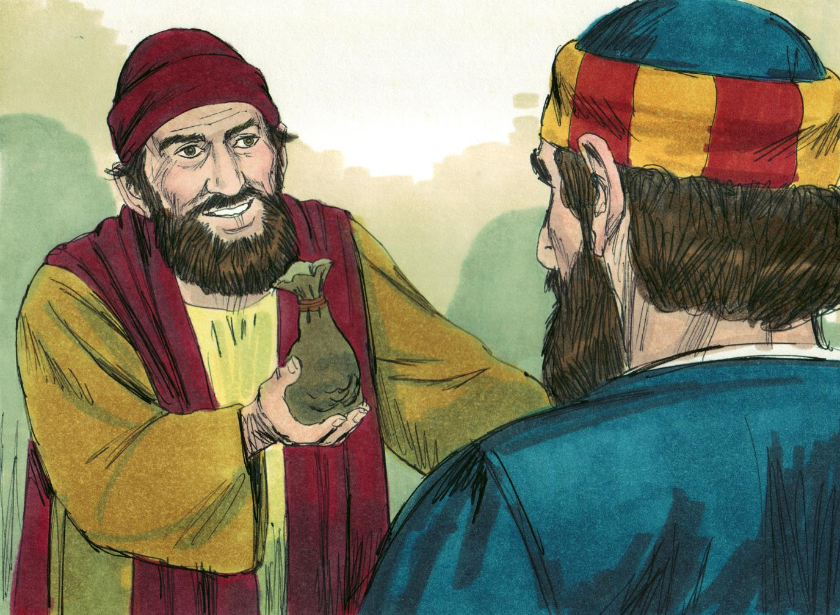

Slide 11
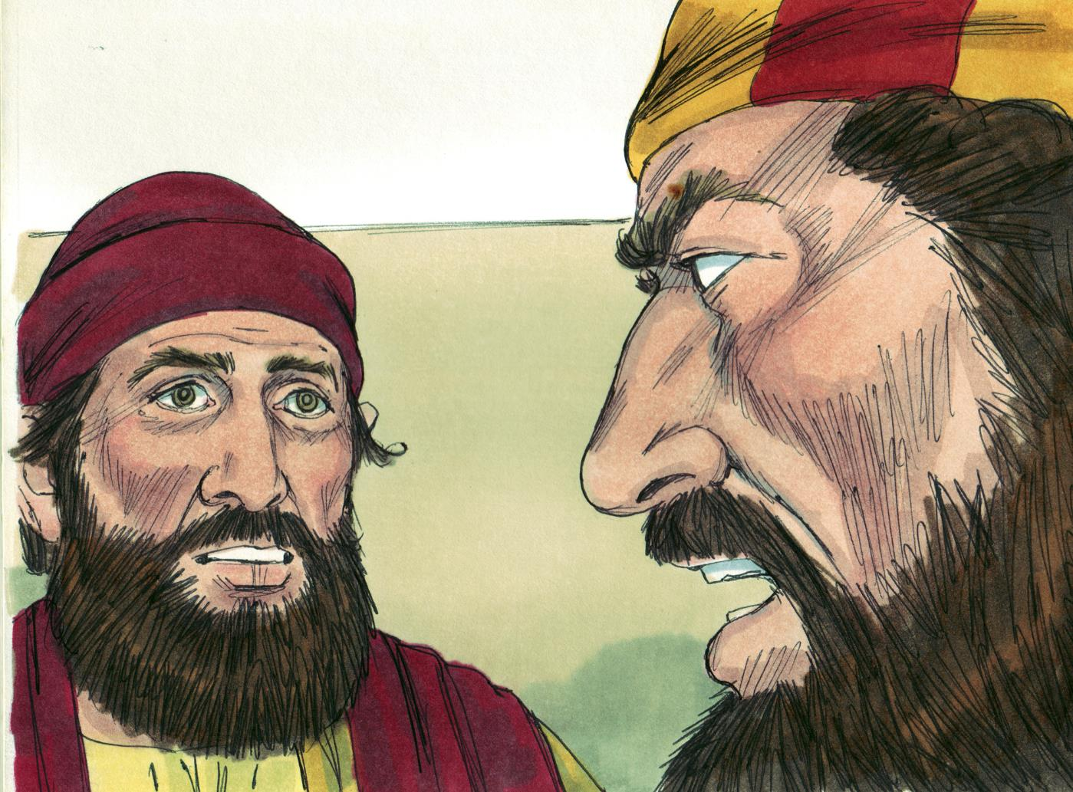

Slide 12
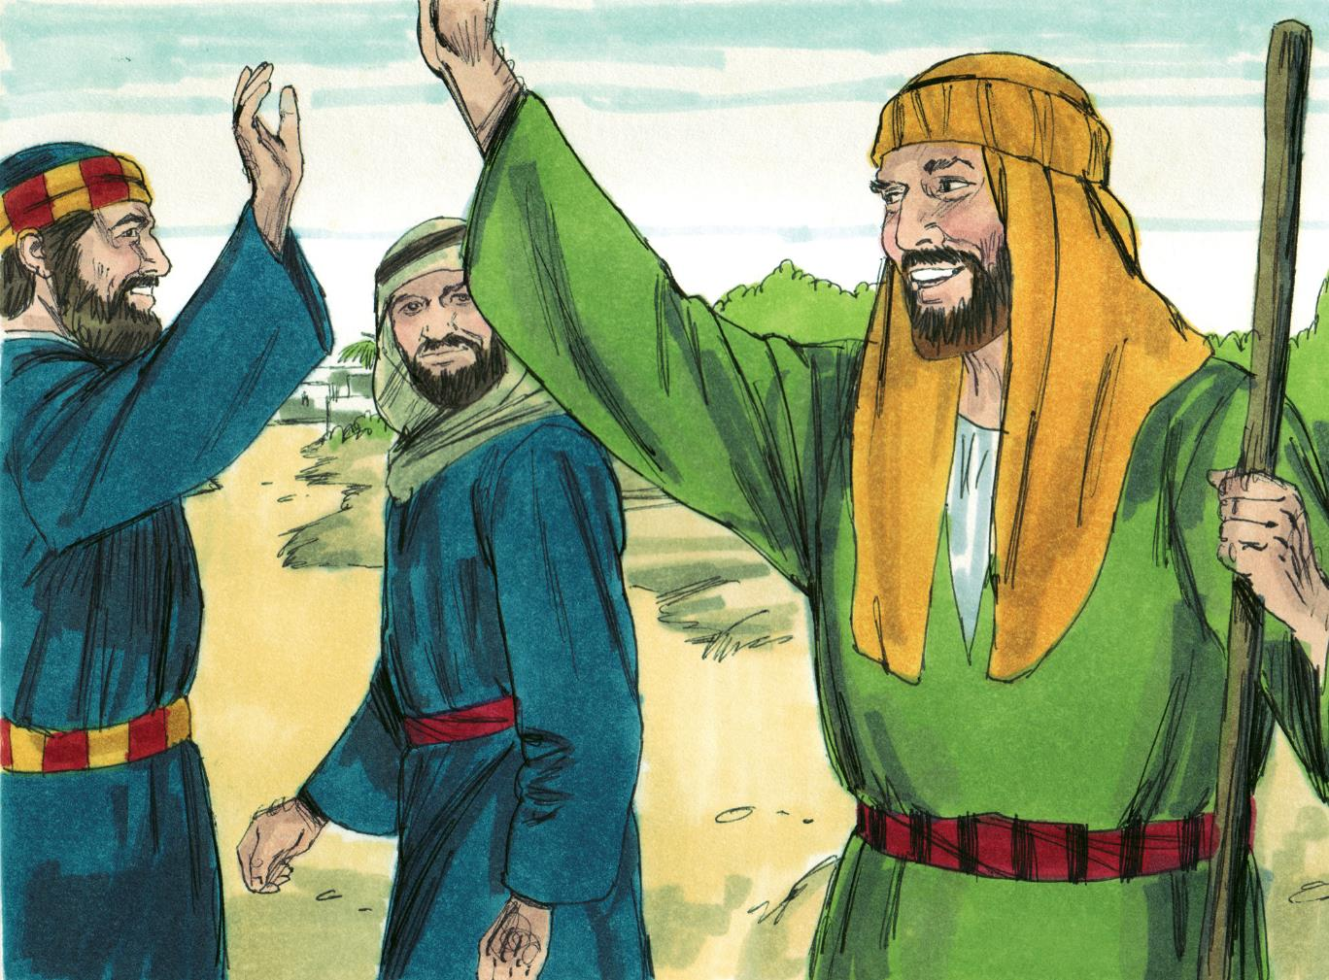

Slide 13
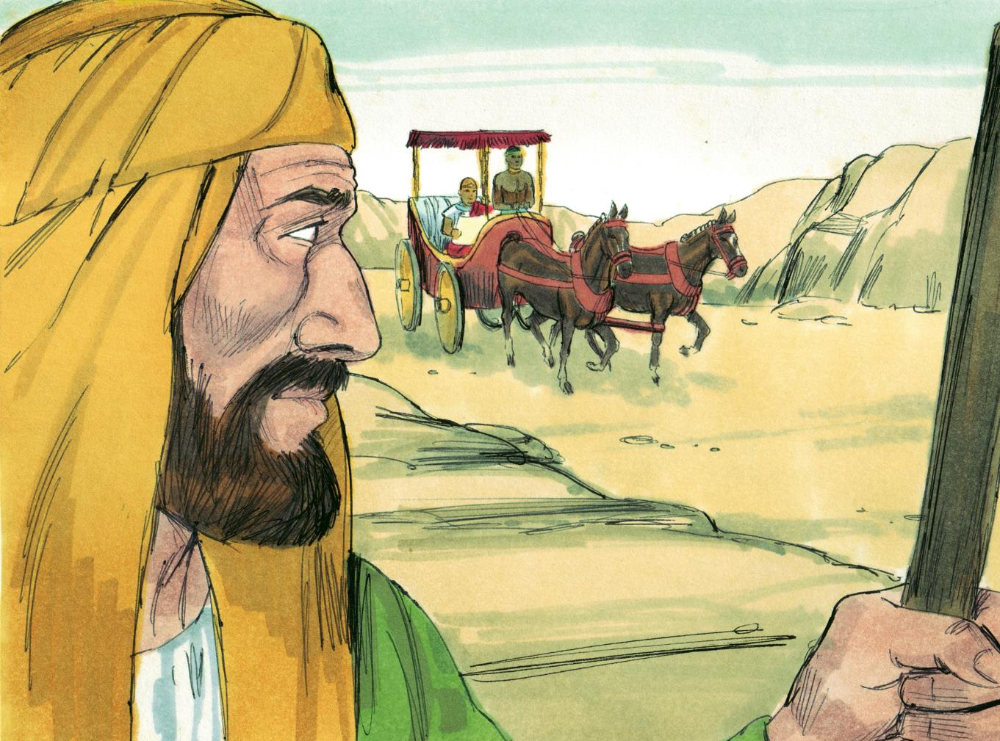

Slide 14
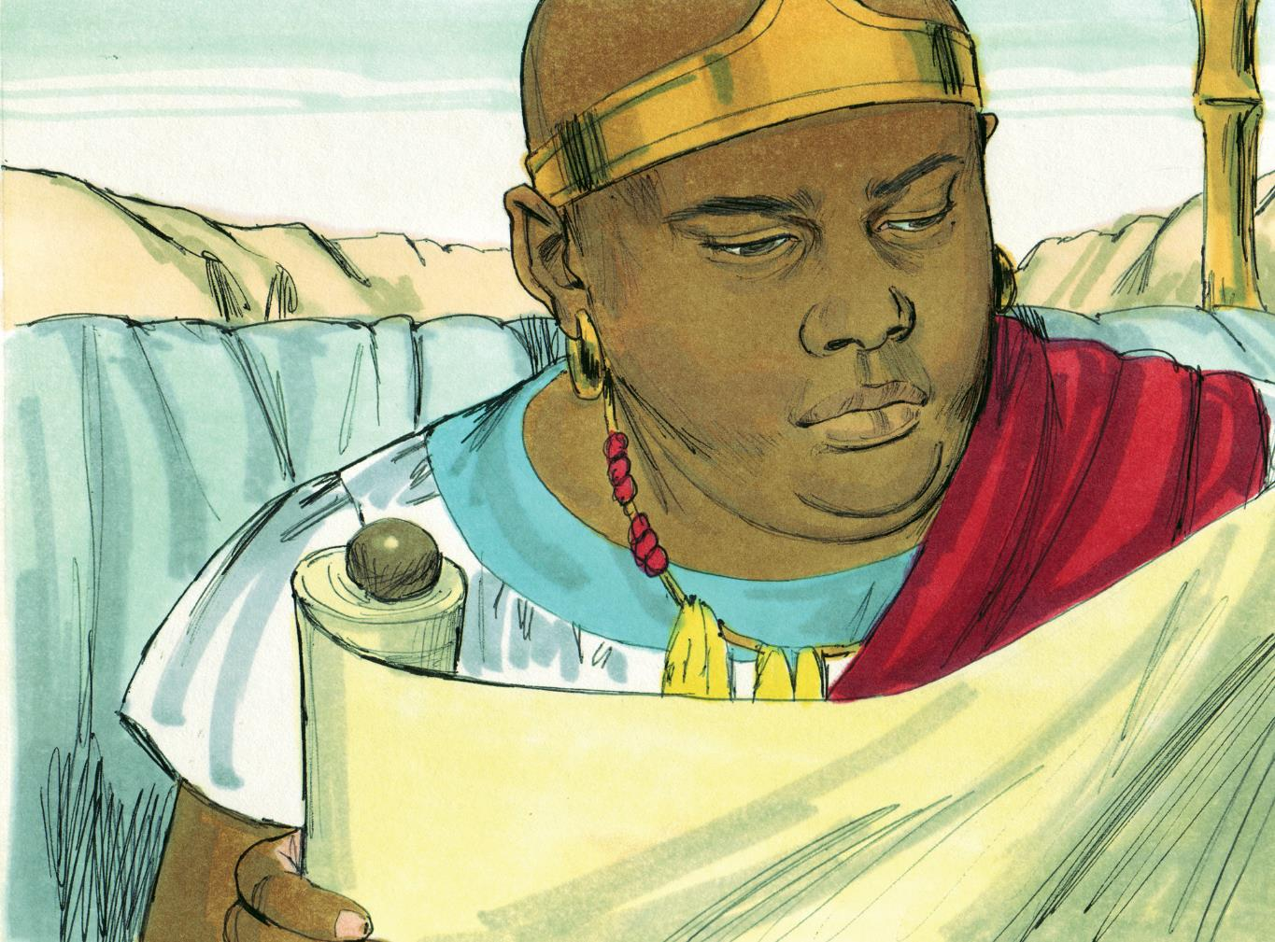

Slide 15
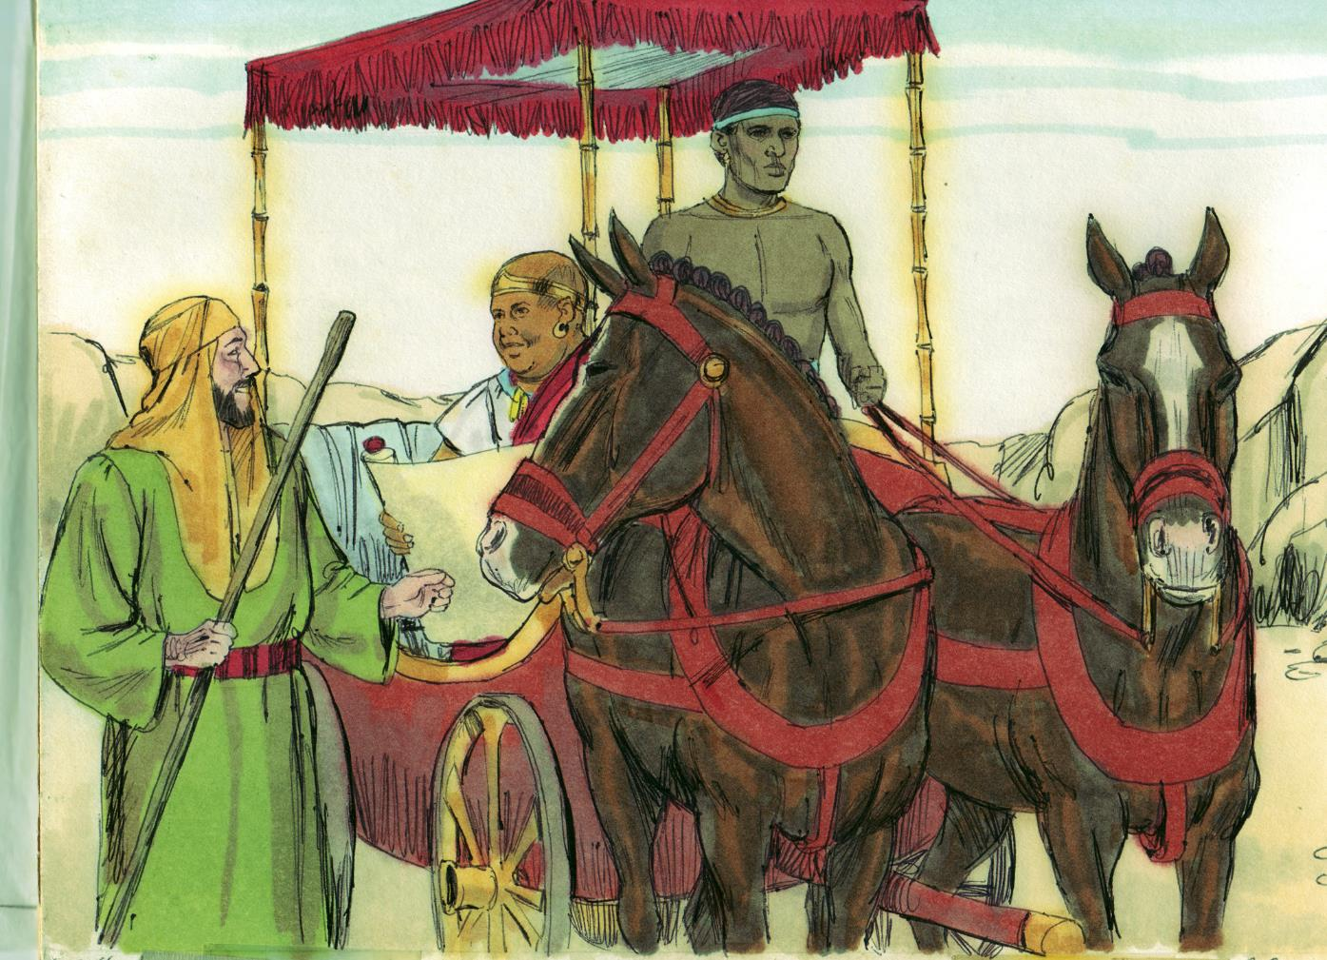

Slide 16
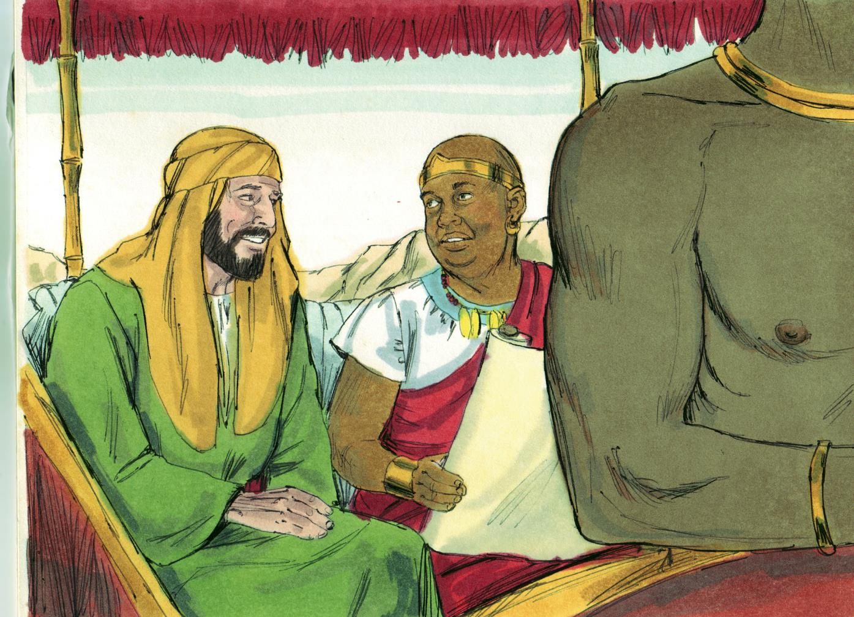

Slide 17
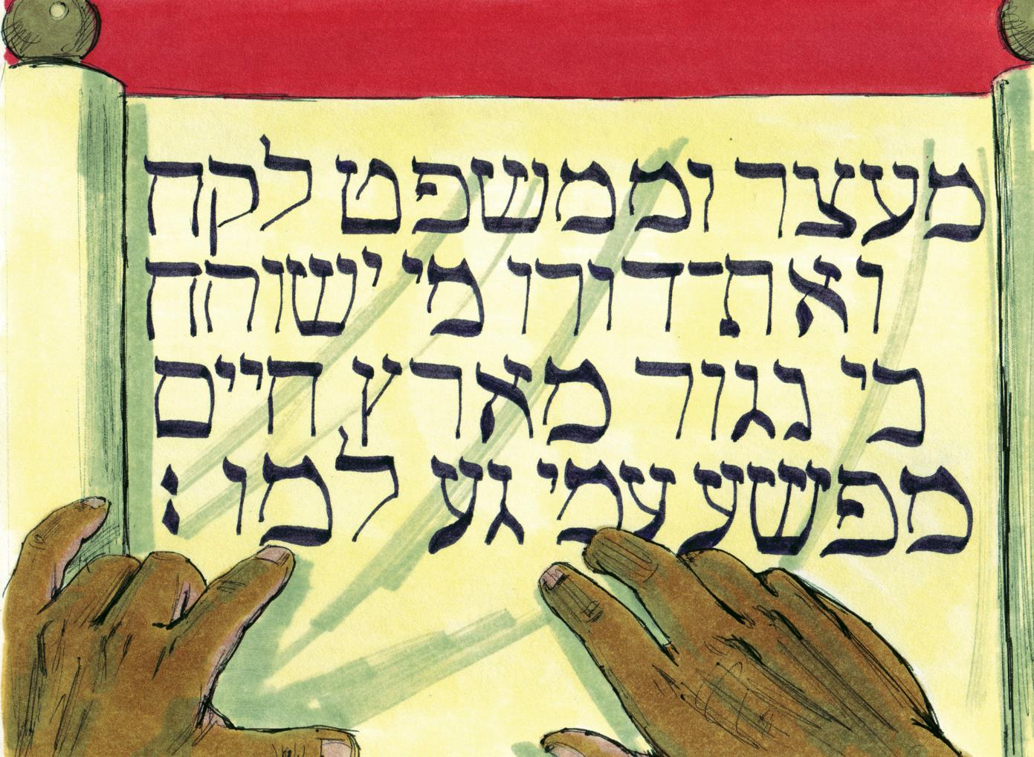

Slide 18
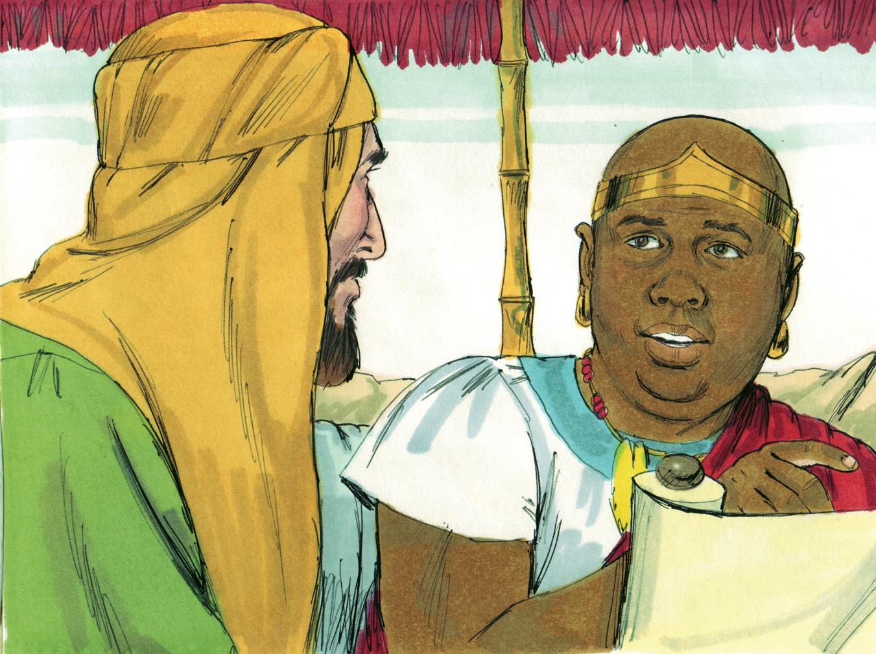

Slide 19
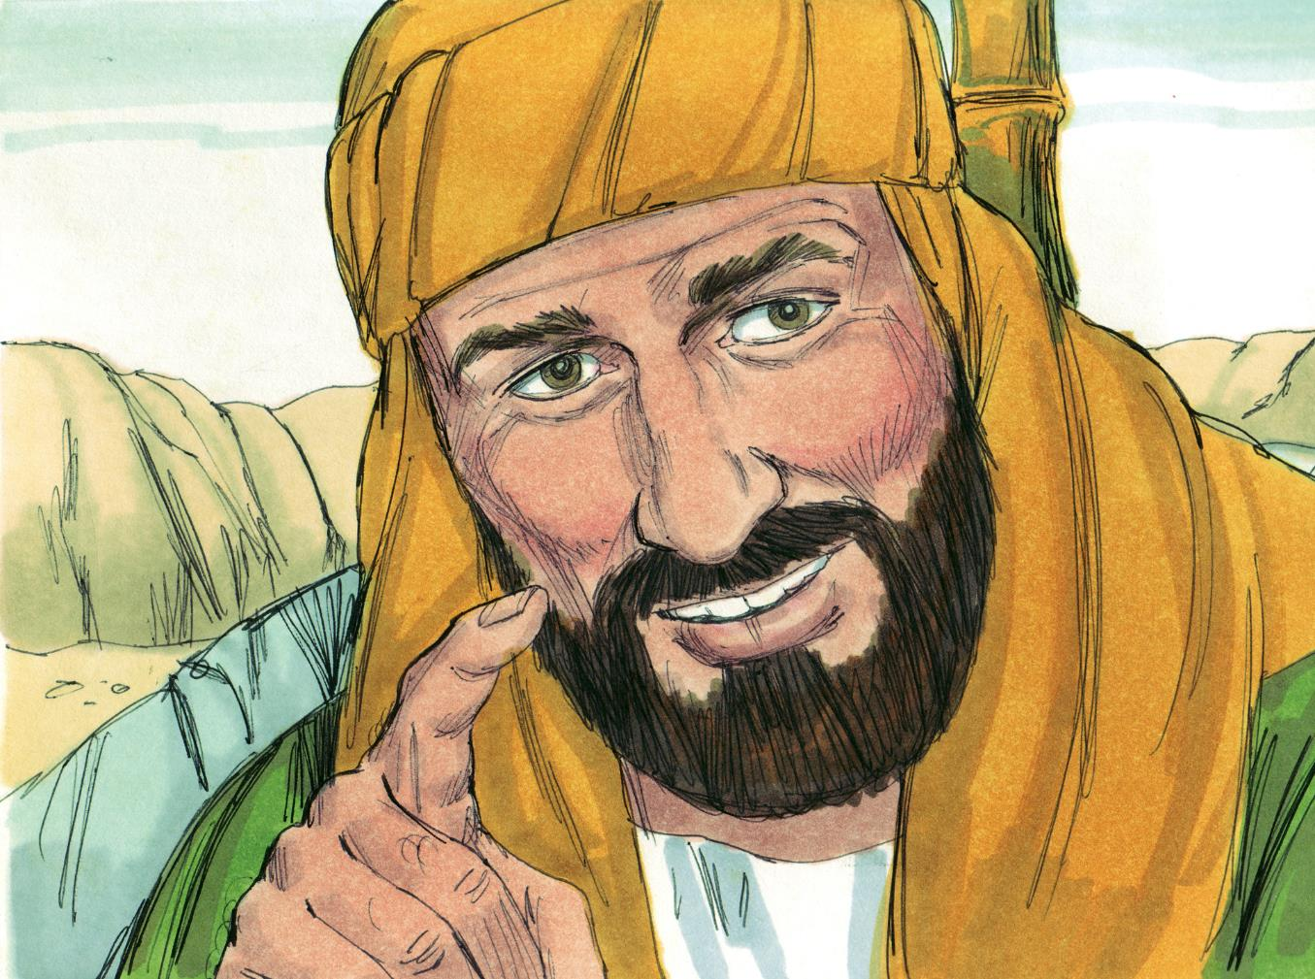

Slide 20
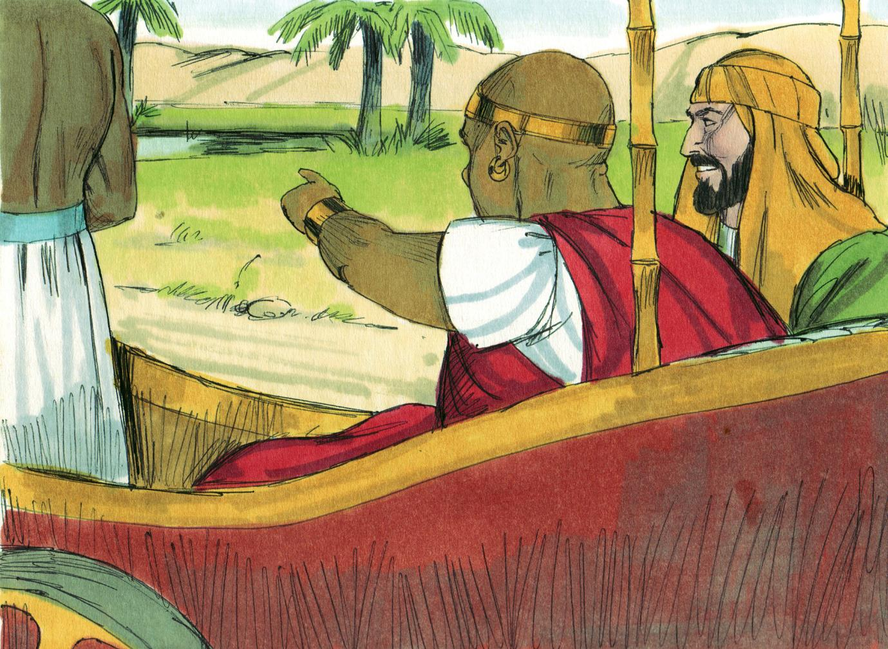

Slide 21
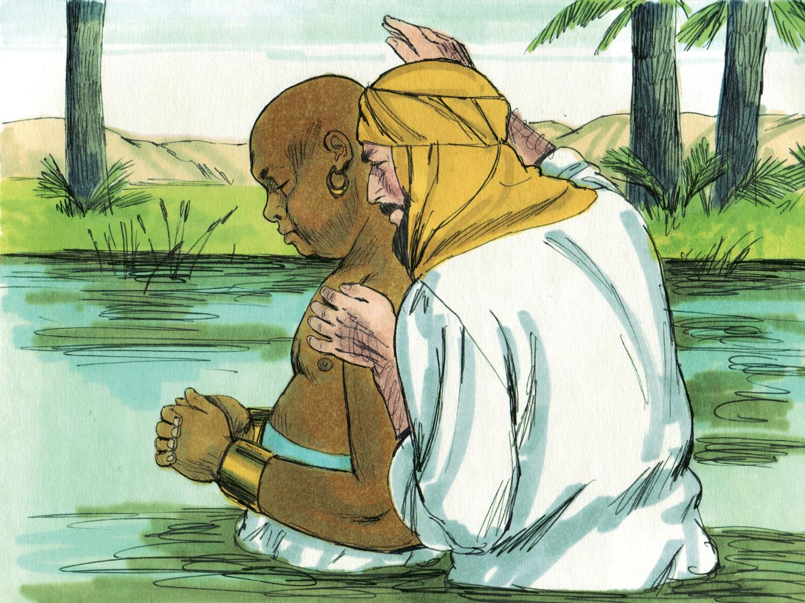

Slide 22
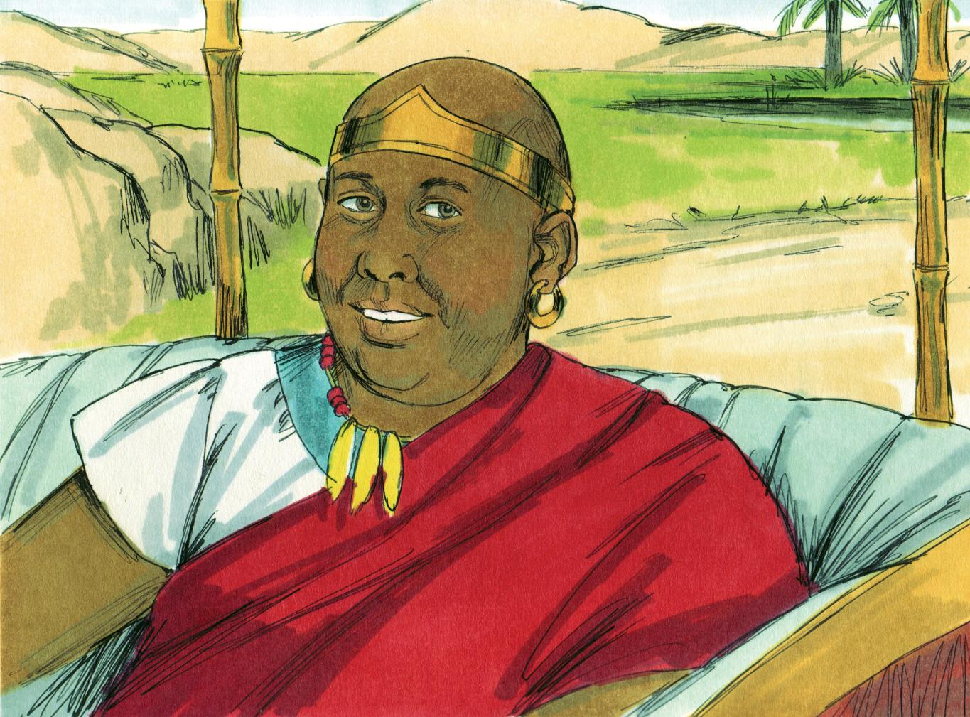

Slide 23
Go Where God Sends
  Philip went to Samaria (cf. John 4:9)
  Philip faced a challenger (cf. 2 Cor. 4:7)
  Philip saw the value of a single soul (cf. John 1:41)
  Philip continued to preach “in all the cities” (8:40)
  We need to understand the need of “every” person (Mark 16:15)

Slide 24
Speak What God Says
  Greek word used most often in Acts 8 for “preach” is “euangelizo” = “speak good news”
  Philip preached the good news about:
    “the word” (8:4)
    “the name of Jesus Christ” (8:12)
    “the kingdom of God” (8:12)
    “Jesus” (8:35)
  We must “speak” only the “oracles of God” (1 Pet. 4:11)
  We must “not be ashamed” (Rom. 1:16)

Slide 25
Have the Attitude God Wants
  Philip was brave (8:1-5)
  Philip was humble (8:14-25)
  Philip was eager (8:26)
  Philip was submissive

Slide 26
Trust God’s Results
  Truth is powerful in converting (cf. Rom. 1:16)
  Truth does not show partiality (cf. Jas. 2:1-13)
  Truth brings true joy (8:8, 39)

