Slide 1
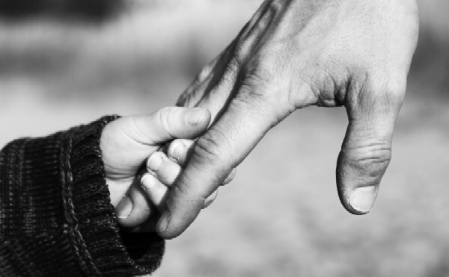
Rearing Christian Children in a Crazy World
Ephesians 6:1-4

Slide 2

1. Young People, Obey Your Parents
Ephesians 6:1
Colossians 3:20
Matthew 3:17
Luke 2:51

Slide 3
2. Parents, Obey The Lord
Ephesians 6:1
Luke 2:41
Luke 4:16
Luke 2:52

Slide 4
3. Young People, Honor Your Parents
Ephesians 6:2-3
Exodus 20:12
Genesis 5:27
John 21:25

Slide 5
4. Parents, Live Honorably
Ephesians 6:4
Colossians 3:21
Ephesians 5:21-27
Psalm 127:3-4
Proverbs 22:6

Slide 6
Now What Do We Do?
How Do I Become a New Testament Christian?
Hear Him (Romans 10:17)
Believe Him (Mark 16:16)
Repent Of Sins Against Him (Acts 2:38)
Confess Him (Acts 8:37)
Be Baptized Into Him (Acts 22:16)
Live For Him (Galatians 2:20)
What Do I Do to be Restored?
Come Back To Him (Matthew 11:28-30)
Repent (Acts 8:22)
Pray (James 5:16)

