Slide 1
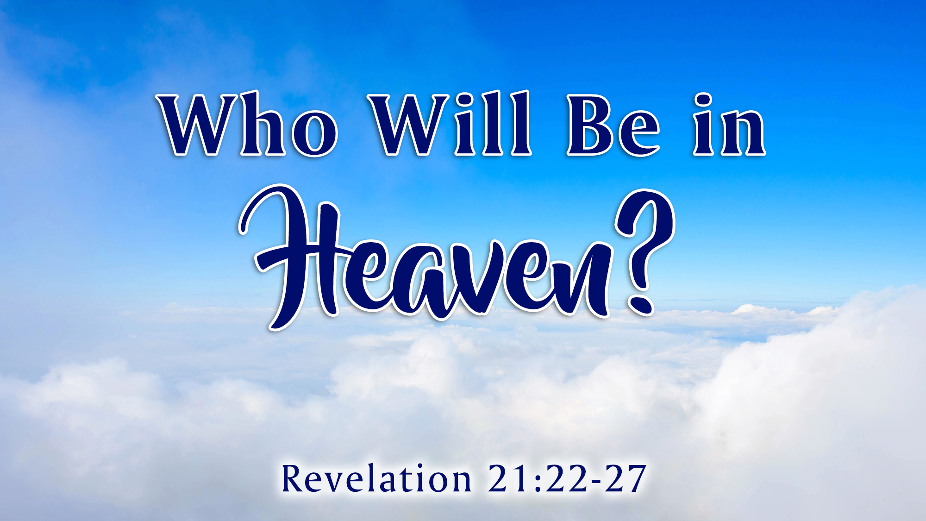
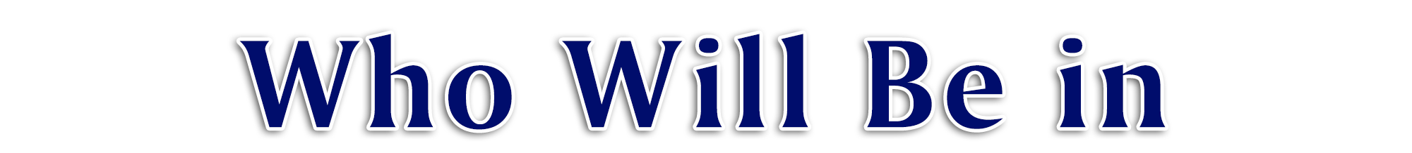
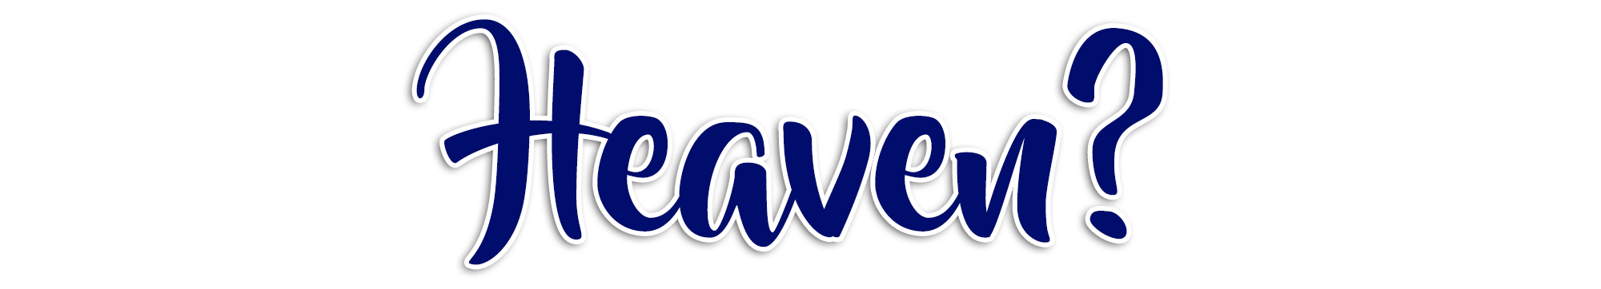

Slide 2


Faithful Old Testament Characters
(Matt. 8:11; Heb. 11:16, 26; 2 Kgs. 2:11)
Faithful New Testament Characters
(2 Tim. 4:8; Phil. 4:3; Rev. 3:5)
Faithful Christian Martyrs
(Rev. 6:9-11; Acts 7:57-60; 12:1-3)
Faithful Church Members
(1 Cor. 15:24; Eph. 5:26-27; 1 Thess. 4:13-18)
Faithful Family Members
(Gen. 25:8; 35:29; 49:33; 37:35; Num. 27:13)
Children
(2 Sam. 12:23; Matt. 18:3; 19:14; Ezek. 18:20)
Unborn Babies
(Luke 1:41, 44 + 2:12; Zech. 12:1; Jer. 1:5)
JESUS!
(John 14:3; Col. 3:1; Rev. 21:22-23; 22:1-5)
You?
Matt 7:21-23 + Rev. 21:27
John 8:24 + Luke 13:3 + Rom. 10:9 + Acts 22:16
Rev. 2:10; 1 Cor. 15:58; Matt. 25:23; Rev. 22:14; Heb. 5:9
Rom. 6:23 + Heb. 12:23
Entry into heaven is limited, based upon God’s conditions!

