Slide 2
“But Jesus said to them, ‘You do not know what you ask.
Are you able to drink THE CUP that I drink,
and be baptized with THE BAPTISM that I am baptized with?’”
(Mark 10:38)
“Again, a second time, He went away and prayed, saying,
‘O My Father, if THIS CUP cannot pass away from Me
unless I drink it, Your will be done.’”
(Matt. 26:42)
“So Jesus said to Peter, ‘Put your sword into the sheath.
Shall I not drink THE CUP which My Father has given Me?’”
(John 18:11)

Slide 3
“But I have a BAPTISM to be baptized with,
and how distressed I am till it is accomplished!”
(Luke 12:50)
“He went a little farther and fell on His face, and prayed, saying,
‘O My Father, if it is possible, let THIS CUP pass from Me; nevertheless, not as I will, but as You will.’”
(Matt. 26:39)

Slide 5
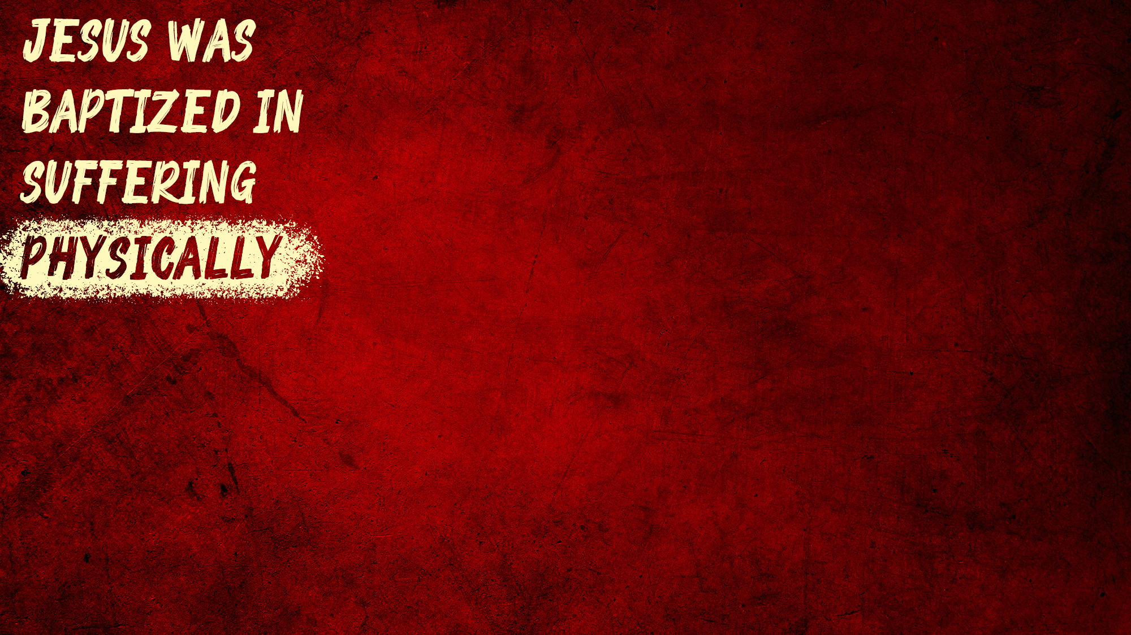
His HEAD (Matt. 26:67; 27:29-30; Mark 15:19)
His FACE (Matt. 26:67; Mark 15:19)
His CHEEKS (Mark 14:65; Isa. 50:6)
His SHOULDERS (John 19:17)
His BACK (Isa. 50:6; John 19:1)
His CHEST (John 19:1; Mark 15:37)
His ARMS (John 19:1)
His SIDE (John 19:34)
His LEGS (John 19:1)
His HANDS (Matt. 27:35; Luke 24:39-40;
John 20:25-27; Psa. 22:16)
His FEET (Matt. 27:35; Luke 24:39-40; Psa. 22:16)

Slide 6
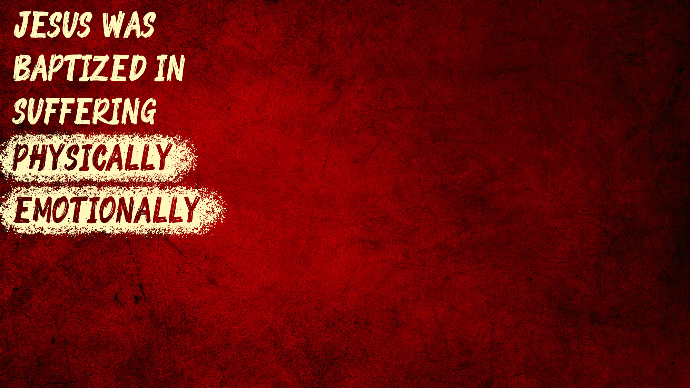
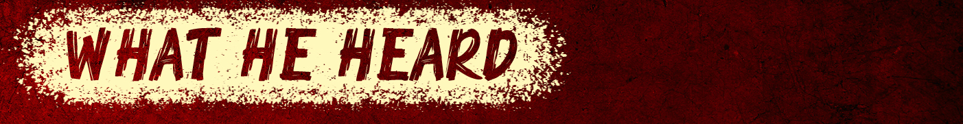
“All the disciples: ‘I will not deny You’” (Matt. 26:35)
“False testimony against” Him (Matt. 26:59)
Sanhedrin: “He is deserving of death” (Matt. 26:66)
Peter (3x): “I do not know the Man” (Matt. 26:69-75)
Barabbas the murderer instead of Jesus (Luke 23:18-19)
Soldiers mocking: “Hail, King of the Jews!” (Mark 15:18-20)
Pilate (3x): “I find no fault in this Man” (Lk. 23:4,14,22)
Mob: “Let Him be crucified!” (Matt. 27:22, 23)
Mob shouting: “Crucify Him! Crucify Him!” (Luke 23:21, 23)
Passersby: “IF You are the Son of God…” (Matt. 27:40)
Chief priests: “He saved others; Himself He cannot save” (Matt. 27:42-43)

Slide 7
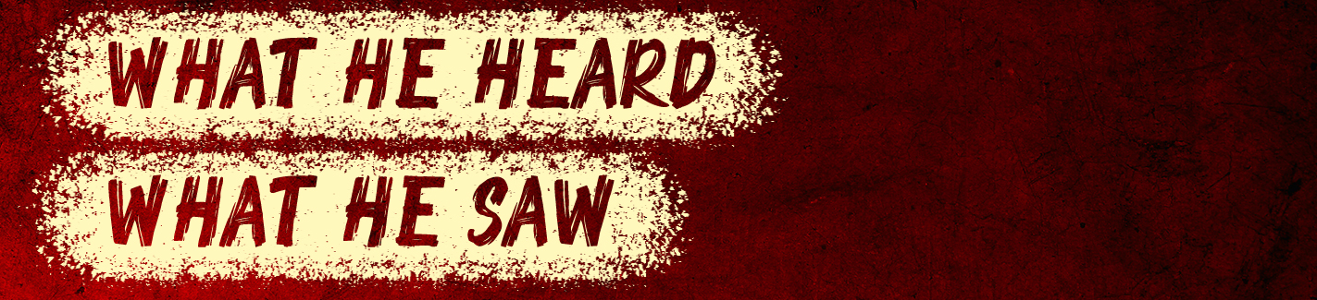
His disciples sleeping in the garden (Matt. 26:40, 43, 45)
His friend Judas come and kiss Him (Matt. 26:47-49)
All the disciples forsake Him and flee (Matt. 26:56)
His close friend Peter denying Him three times (Luke 22:61)
He was considered a criminal, crucified as such (Luke 23:33)
Soldiers gambling for His clothes (Matt. 27:35)
Passersby wagging their heads at Him (Matt. 27:39)
His mother at the foot of His cross (John 19:25-27)
Darkness over the whole land for three hours (Mark 15:33)

Slide 8
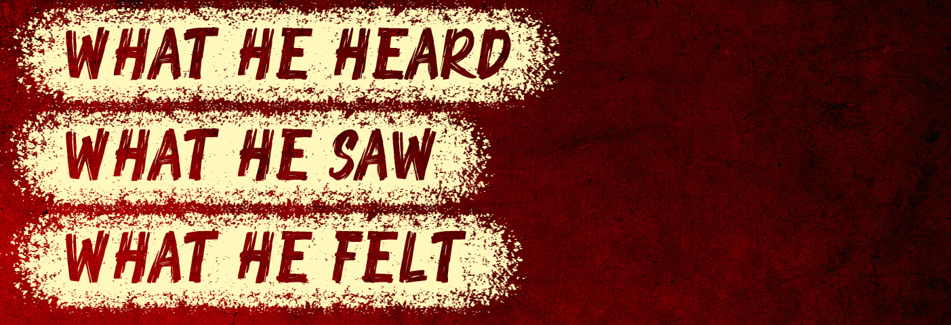
He was “troubled and deeply distressed”
(Mark 14:33; John 12:27)
He was “exceedingly sorrowful, even to death”
(Mark 14:34)
Severe agony caused blood vessels to rupture into sweat glands (Luke 22:44)

Slide 9
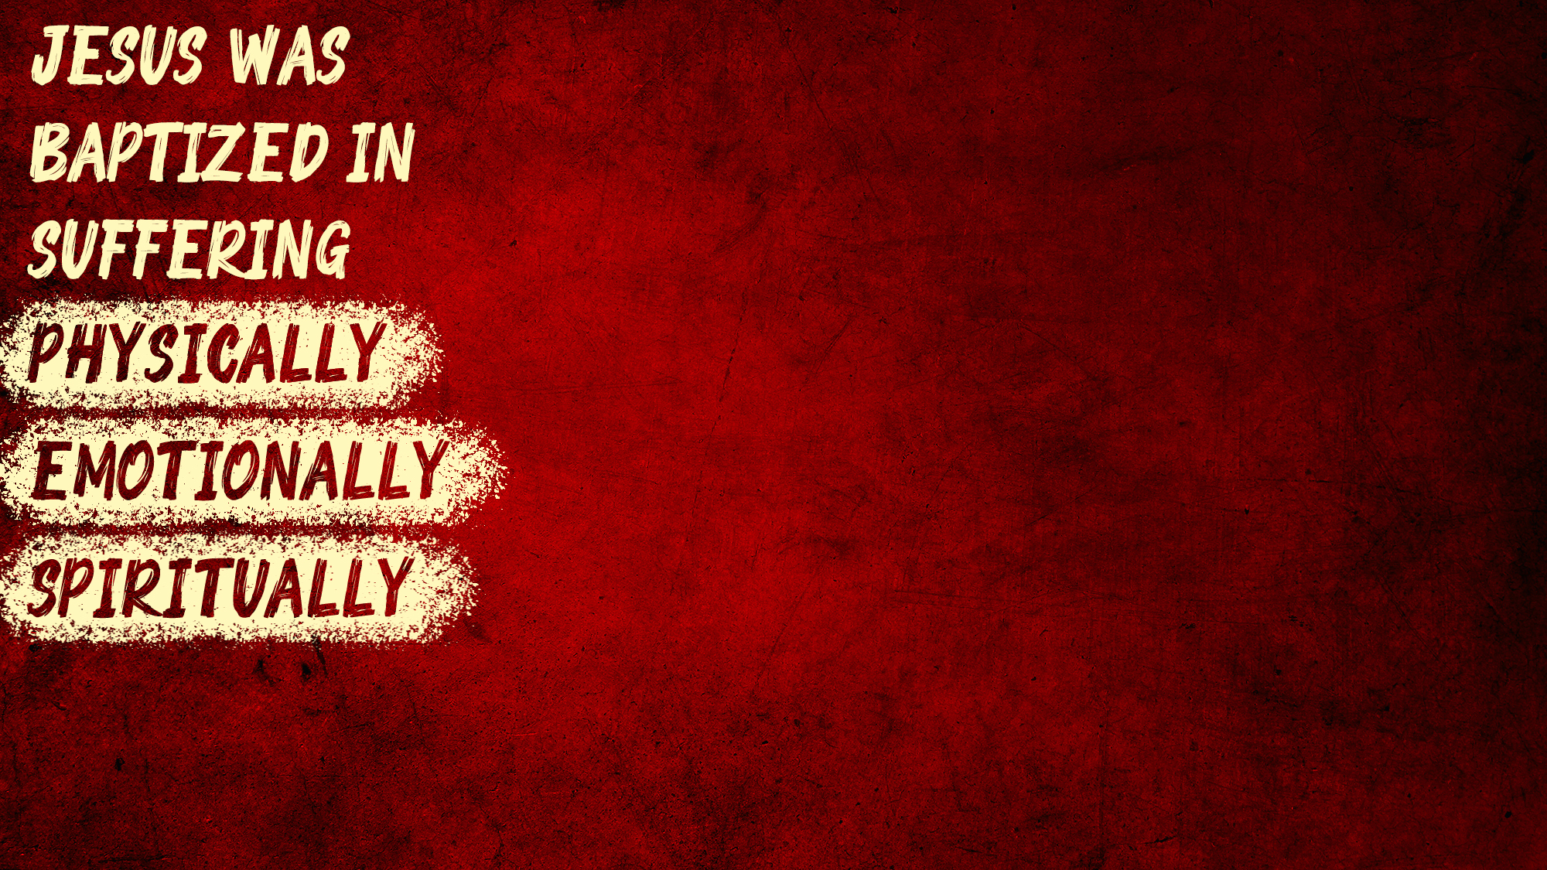
He was “pierced through for our” sins (Isa. 53:5)
He was “crushed for our” sins (Isa. 53:5)
“The Lord…laid on Him the sins of us all” (Isa. 53:6)
He “bore our sins in His own body on the tree”
(Isa. 53:11-12; 1 Pet. 2:24)
Because of our sins (NOT His):
  He was made “to be sin for us” (2 Cor. 5:21)
  He is the “propitiation for our sins” (1 John 2:2; Rom. 3:25)
  He was “forsaken” by the Father (Matt. 27:46; 26:39)

Slide 10
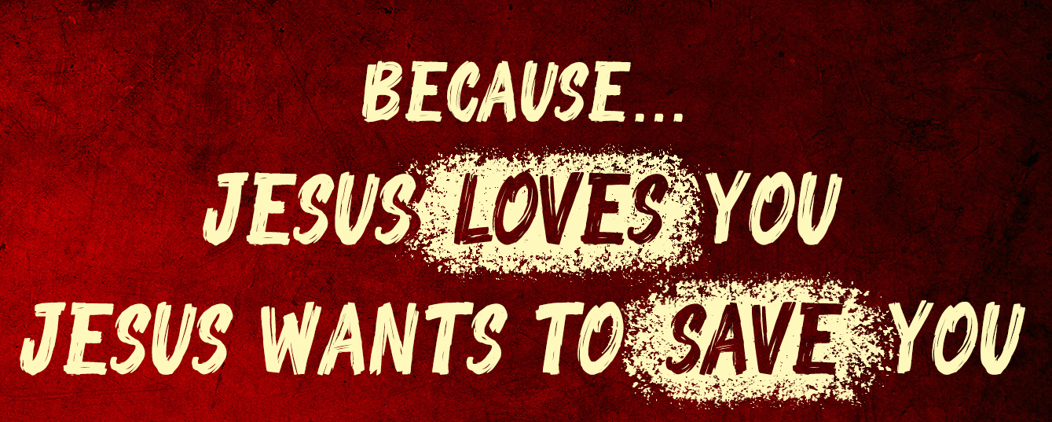
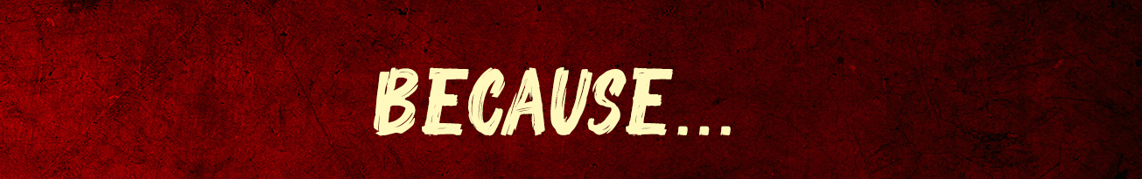
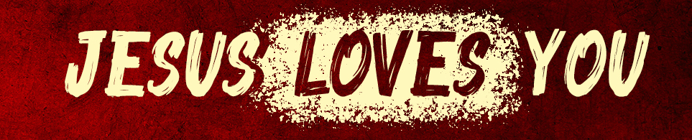

Slide 11
Believe Jesus is God’s Son – Acts 16:31
Repent of your sins – Acts 3:19
Confess your faith – Romans 10:9
Be baptized into Christ – Acts 2:38
Be a living sacrifice for Him – Romans 12:1

