Slide 1
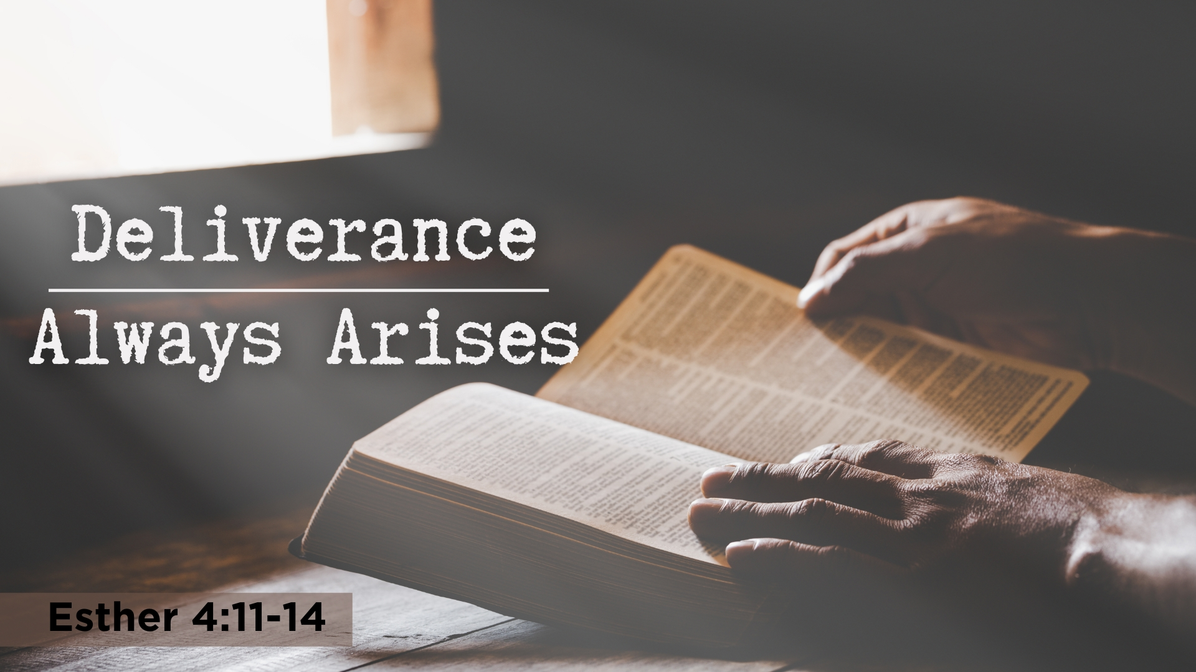

Slide 2
The Text—Esther 4:10-14
10 Then Esther spoke to Hathach and commanded him to go to Mordecai and say,
11 “All the king's servants and the people of the king's provinces know that if any man or woman goes to the king inside the inner court without being called, there is but one law—to be put to death, except the one to whom the king holds out the golden scepter so that he may live. But as for me, I have not been called to come in to the king these thirty days.”
12 And they told Mordecai what Esther had said.
13 Then Mordecai told them to reply to Esther, “Do not think to yourself that in the king's palace you will escape any more than all the other Jews.
14 For if you keep silent at this time, relief and deliverance will rise for the Jews from another place, but you and your father's house will perish. And who knows whether you have not come to the kingdom for such a time as this?”

Slide 3
Background of the Text
The place of Esther in the Bible—at the end of the Old Testament
Two major characters who saved the Jews: Esther & Mordecai
The bravery of Esther and the wisdom of Mordecai
One truth was the foundation of his faith and wisdom, “Deliverance will rise…”
The purpose of this lesson is to encourage us to write this wisdom on our hearts and then face the unknown future with hope

Slide 4
How Could Mordecai
Have This Wisdom
God could have just told him, or he could have told him years before
Possible Bible events which demand this wisdom
  The story of Noah shows it—faith, storms and then a rainbow
  The story of sons of Jacob who were starving and helpless in the Promised Land, but unknown deliverance arose
  The story of Joseph who for 20 years lived in deep concern and never saw himself as that deliverer
  The story of Moses—rejected as deliverer at 40, and the “storms” faced for next 40 years when he, was the unknown deliverer
  Time does not permit to talk of “storm” in Elijah’s life and deliverance arising with Elisha and countless other OT stories

Slide 5
How Could YOU
Have This Wisdom
God could have just told you, or He could have told you years before
Possible Bible events which demand this wisdom
  Every story that Mordecai could have known plus the New Testament which is filled with many other stories
  The story of the apostles who never imagined He might use them
  The story of the early church when Saul was determined to kill it and “made havoc” of the church
  The story of the church when James, one of the big three, was killed and another James arose from unexpected sources
  The story of the “hopeless” helpless task, and Saul/Paul arose
  The story of countless NT stories of God raising deliverers

Slide 6
Becoming a “Deliverer” for Christ
      Believe John 8:24
      Repent Luke 13:3
      Confess Your Faith Romans 10:9
      Baptized/Immersed Acts 2:38
      When You Do These, He Adds You to His Flock, His Church
      As a Christian, Live Faithfully Until You Die Rev. 2:10

