Slide 2
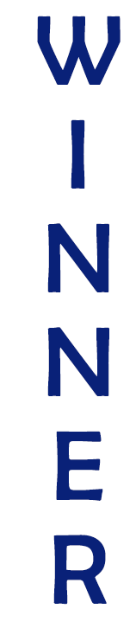
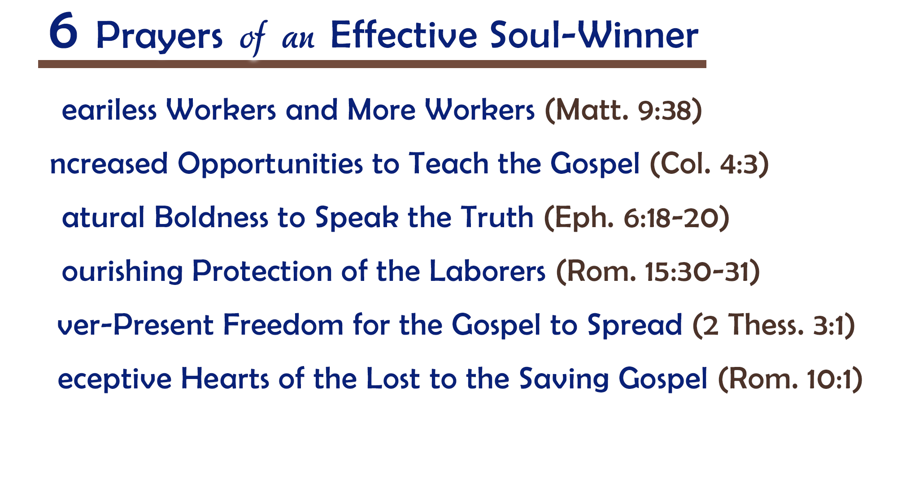
We must not “grow weary” when “laboring” for Him
(Rev. 2:3; Gal. 6:9)
There is plenty of work to do and souls to save
(Matt. 9:37; Luke 10:2)
Let us pray for more workers, and then let us answer with ourselves
(Isa. 6:8)

Slide 3
Just as God opens a way of escape (1 Cor. 10:13),
He opens doors for the gospel
We must trust God and “always be ready” to step into opportunities
(1 Pet. 3:15)
When one door closes, another may be opening (Acts 19:8-10)

Slide 4
Even if already bold (Acts 4:19-20),
ask for “all boldness” to “keep speaking” (4:29)
True boldness will not let fear (Phil. 1:14) or shame (Rom. 1:15-16) interfere or cause to ease up
Be eager to keep going, seeking souls and talking to people
(Acts 5:41-42)

Slide 5
Teaching the truth in a world of error creates enemies
(1 Cor. 16:9; 2 Thess. 3:2-3)
God is ready and able to guard hearts (Phil. 4:7)
and extend grace (2 Cor. 12:9-10)
Our “helping together” finds its strength “in prayer” (2 Cor. 1:10-11)

Slide 6
Forces of evil always seek to oppose truth (Gen. 3:4; 1 Tim. 4:1-3; 2 Tim. 4:3-4)
Our prayer should be that all obstructions and hindrances be removed…
in our communities, country and world (Acts 1:8; 8:4; 17:8-11; 18:2)
The gospel brings peace (Rom. 10:15),
but those who oppose it bring calamity (Acts 17:5-6)

Slide 7
Not all hearts are willing or ready to receive for the gospel (Luke 8:4-15)
The Word of God is living and powerful and can change hearts (Heb. 4:12)
As much as we want receptive hearts, God wants it more (1 Tim. 2:4)

Slide 8
Believe Jesus is the Son of God – John 3:16
Repent of your sins and turn toward God – 2 Peter 3:9
Confess your faith in Jesus Christ – Matthew 10:32
Be baptized into Christ – 1 Peter 3:21
  God will forgive all of your sins – Acts 2:38
  God will add you to His church – Acts 2:47
  God will register you in heaven – Hebrews 12:23
Live faithfully to the Lord – Revelation 2:10

