Slide 1
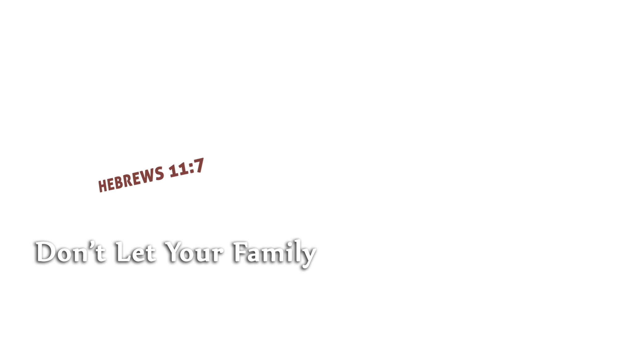


Slide 2
Biblical faith takes God at His word (with firm conviction)
  “Divinely warned of things not yet seen”
  “I believe God that it will be just as it was told me” (Acts 27:25)
Biblical faith submits to God (in trustful surrender)
  “Moved with godly fear”
  “Not My will, but Yours, be done” (Luke 22:42)
Biblical faith obeys God
  “Prepared an ark”
  “At Your word I will” (Luke 5:5)

Slide 3
Charting the proper course causes one to “condemn the world”
  Righteousness and lawlessness have no communion (2 Cor. 6:14-15)
  Things in darkness are exposed, made manifest by the light (Eph. 5:8-13)
Charting the proper course leads one to “become heir of the righteousness”
  There is only ONE path to righteousness – God sets it and rewards it
  (Gen. 15:6; Phil. 3:9)

Slide 4
Noah’s purpose for EVERYTHING he did:
“for the saving of his household”
  “For” (from Greek eis) = denotes purpose, in order to obtain (cf. Acts 2:38)
  We must set our goal on eternity in heaven (Col. 3:1-2; Phil. 3:14)…
  and NOT deviate from it

Slide 5
Believe Jesus is the Son of God – John 8:24
Repent of your sins and turn toward God – Luke 13:3
Confess your faith in Jesus Christ – Matthew 10:32-33
Be baptized into Christ – Acts 2:38
  God will forgive all of your sins – Acts 2:38
  God will add you to His church – Acts 2:47
  God will enroll you in heaven – Hebrews 12:23
Serve the Lord faithfully – Matthew 25:23

