Slide 1
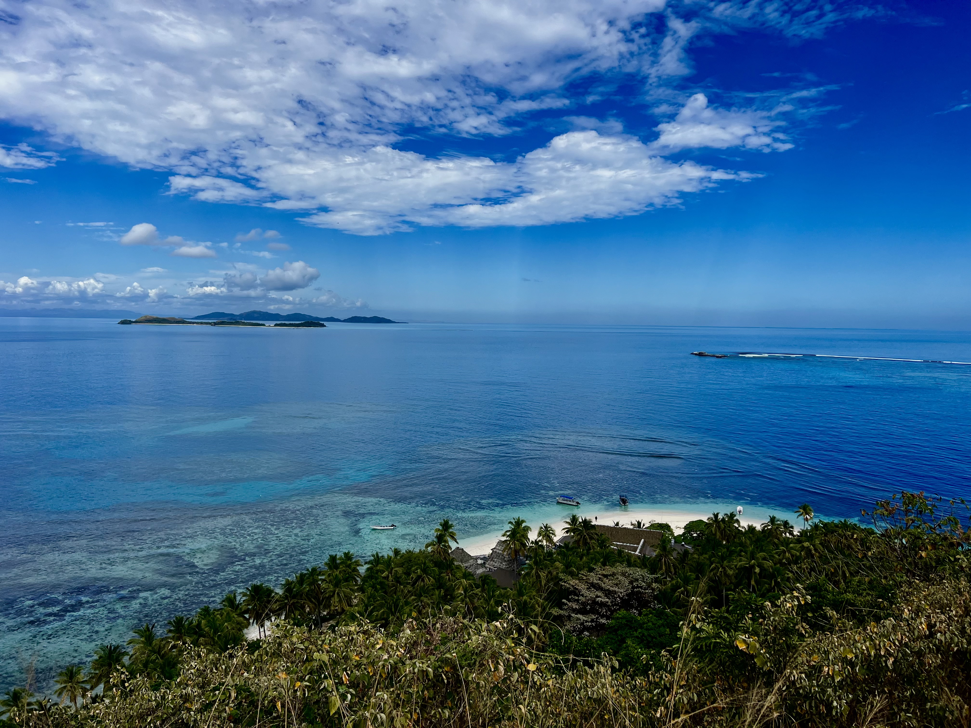
Pacific Islands Bible College
June-July 2024

Slide 2
Thank you
For your encouragement
your prayers
Your emails
Your support of Mission Works

Slide 3
Pacific Islands Bible College Mission
The purpose of the college is to increase the Bible knowledge, Bible study skills, and evangelistic methods of church leaders, preachers, teachers, and soul winners in the Pacific Islands. These leaders can evangelize, edify, and enable the church to mature and grow so as to be INDIGENOUS/SELF SUPPORTING. These goals apply to both brothers and sisters in their respective Biblical roles.

Slide 4
Pacific Islands Bible College
Taking advanced Bible study to the Pacific Islands
Students who are taught and trained stay and work in the local congregation where they are members.
  14 Instructors
  Non-accredited curriculum
20 Required classes and 4 Elective
  Must pass exams to get diploma
  Must complete all 24 classes (360 hours of class time)
Graduates receive a nice Diploma upon completion
In 28 years PIBC has grown from 52 students enrolled to 2,897 students and growing. Students are graduating annually. We are in 27 locations in the Pacific and 7 countries outside the Pacific and we use at least 20+ instructors.

Slide 5
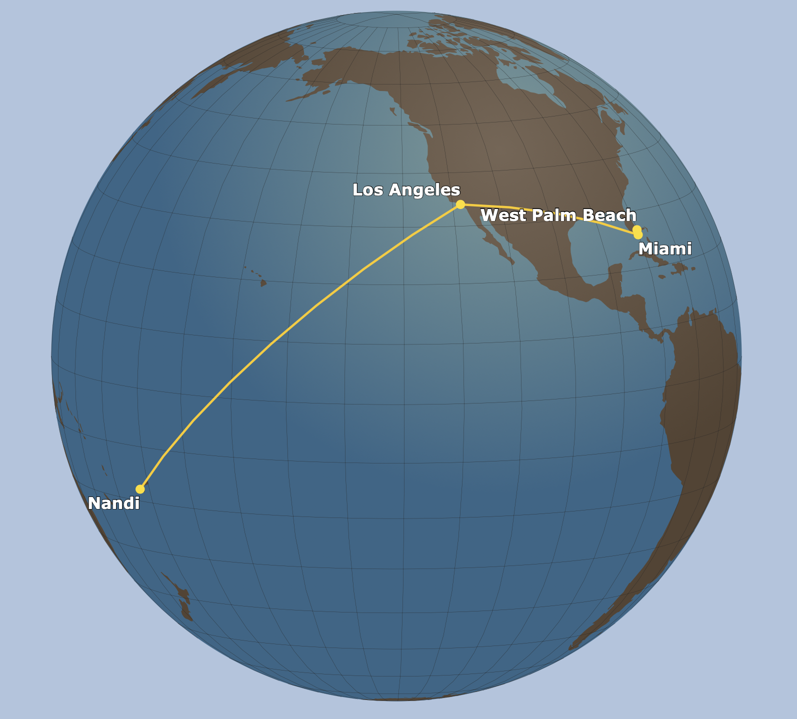
Where is Fiji and How far is it from Florida?
7,923 miles
24+ hours travel time
36 hours on return
Fiji straddles the 180º meridian (halfway around the world)
Fiji
Islands

Slide 6
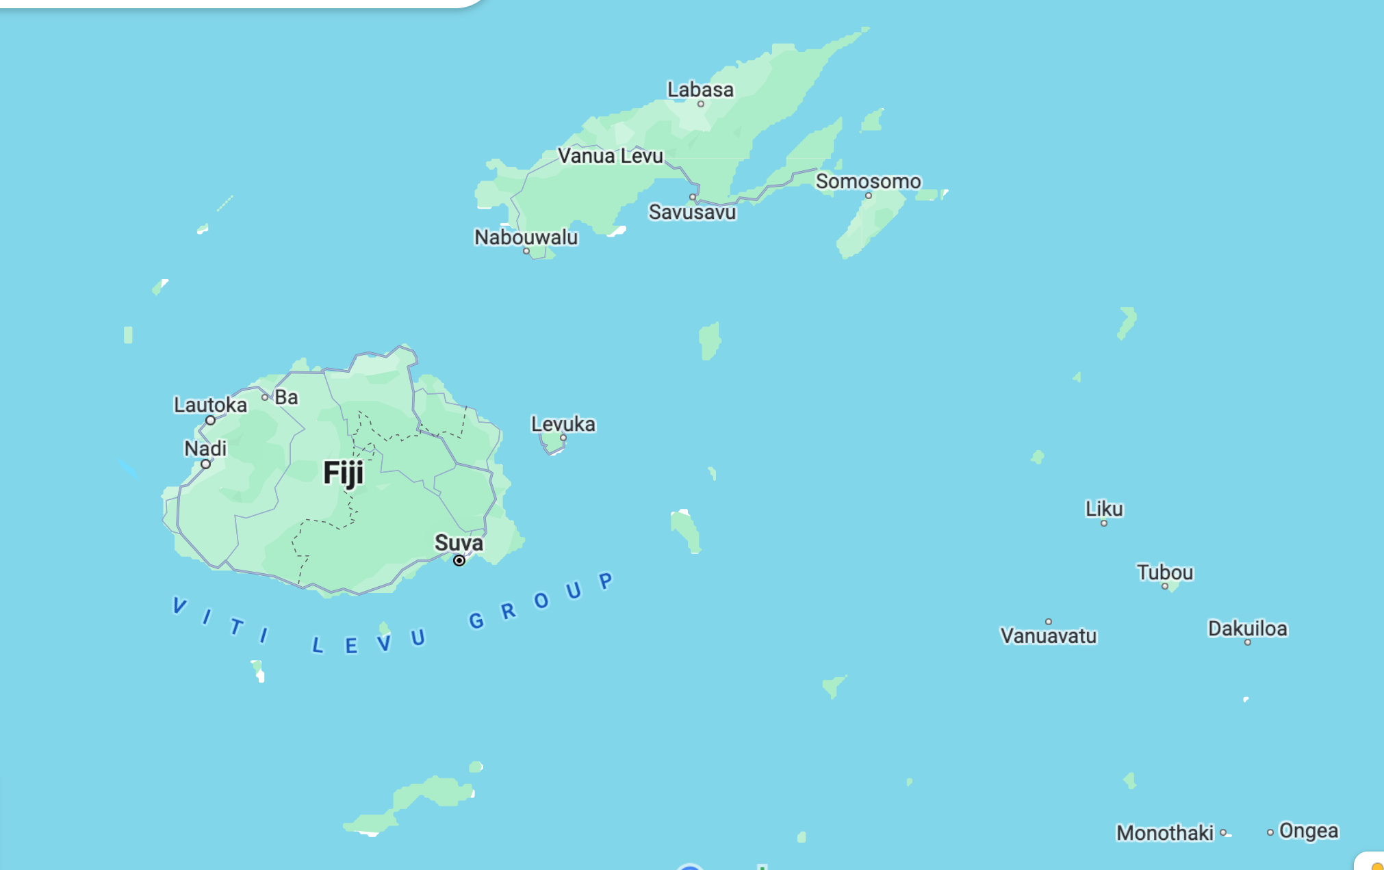
2023
Vatudamu
Buca
Vanua Balavu
2017 and 2024
2022 and 2024
Raiwaqa
Naila, 10 Mile, Southern, Vatuwaqa, Nausori, Delamadu
Mission of the Local Church
Church Leadership

Slide 7
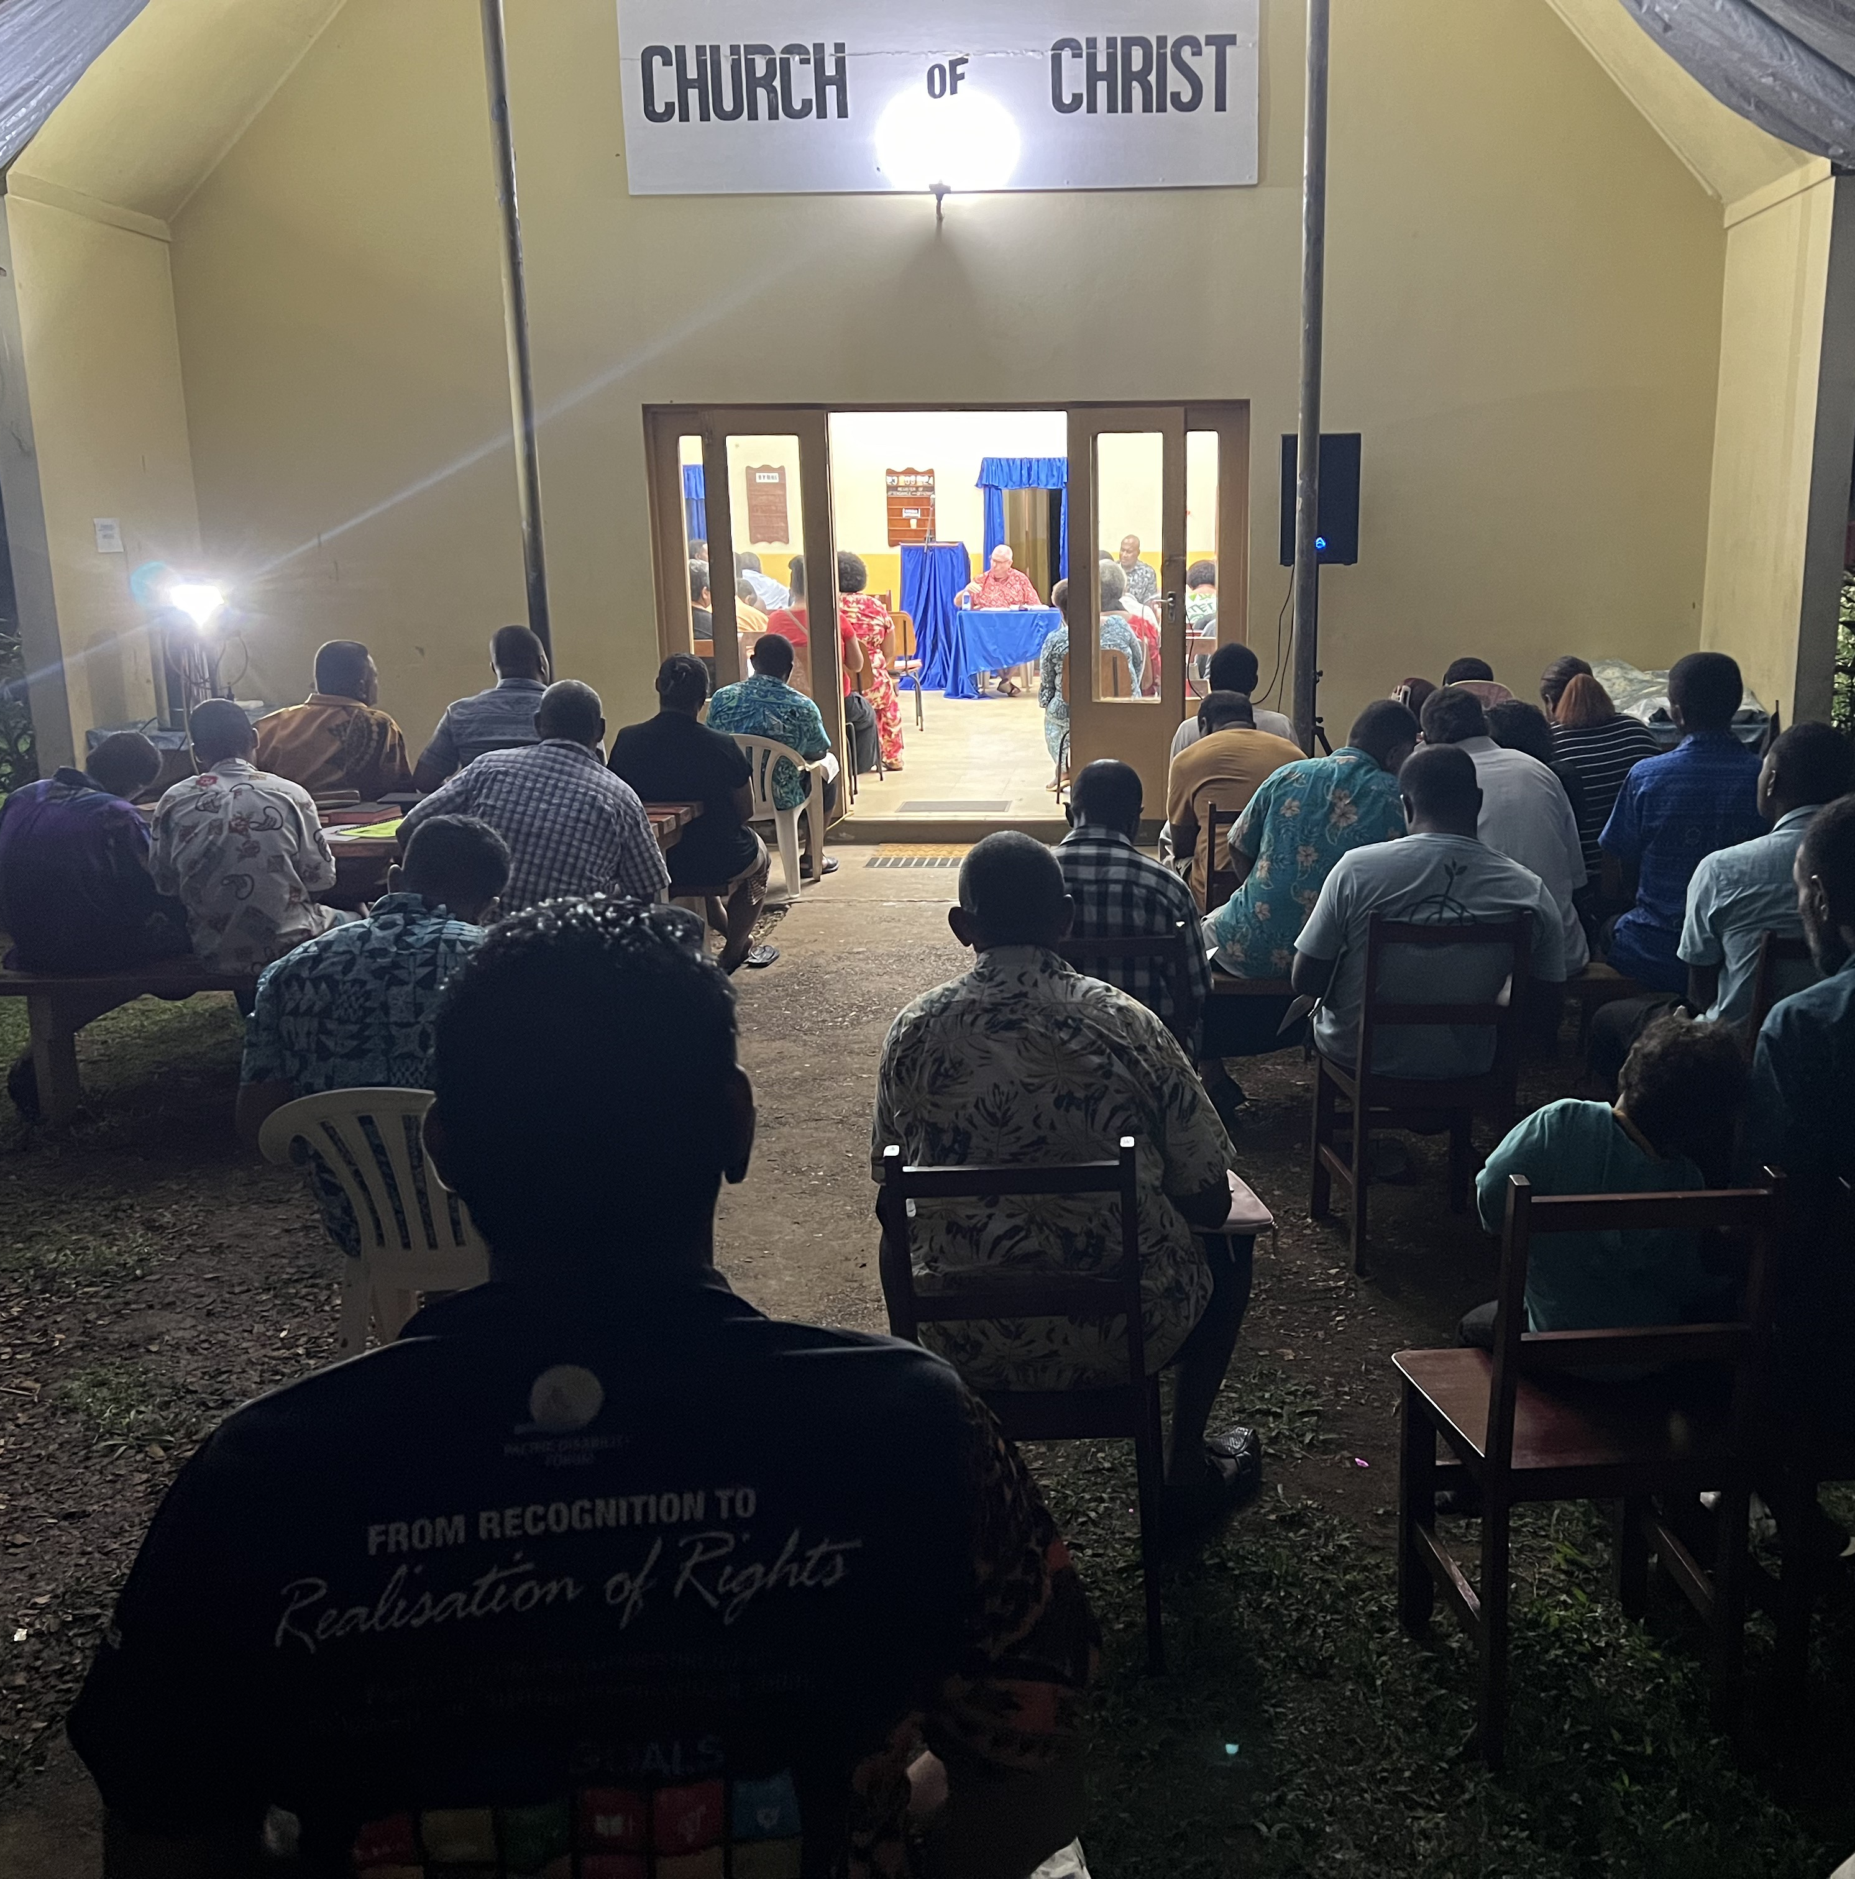
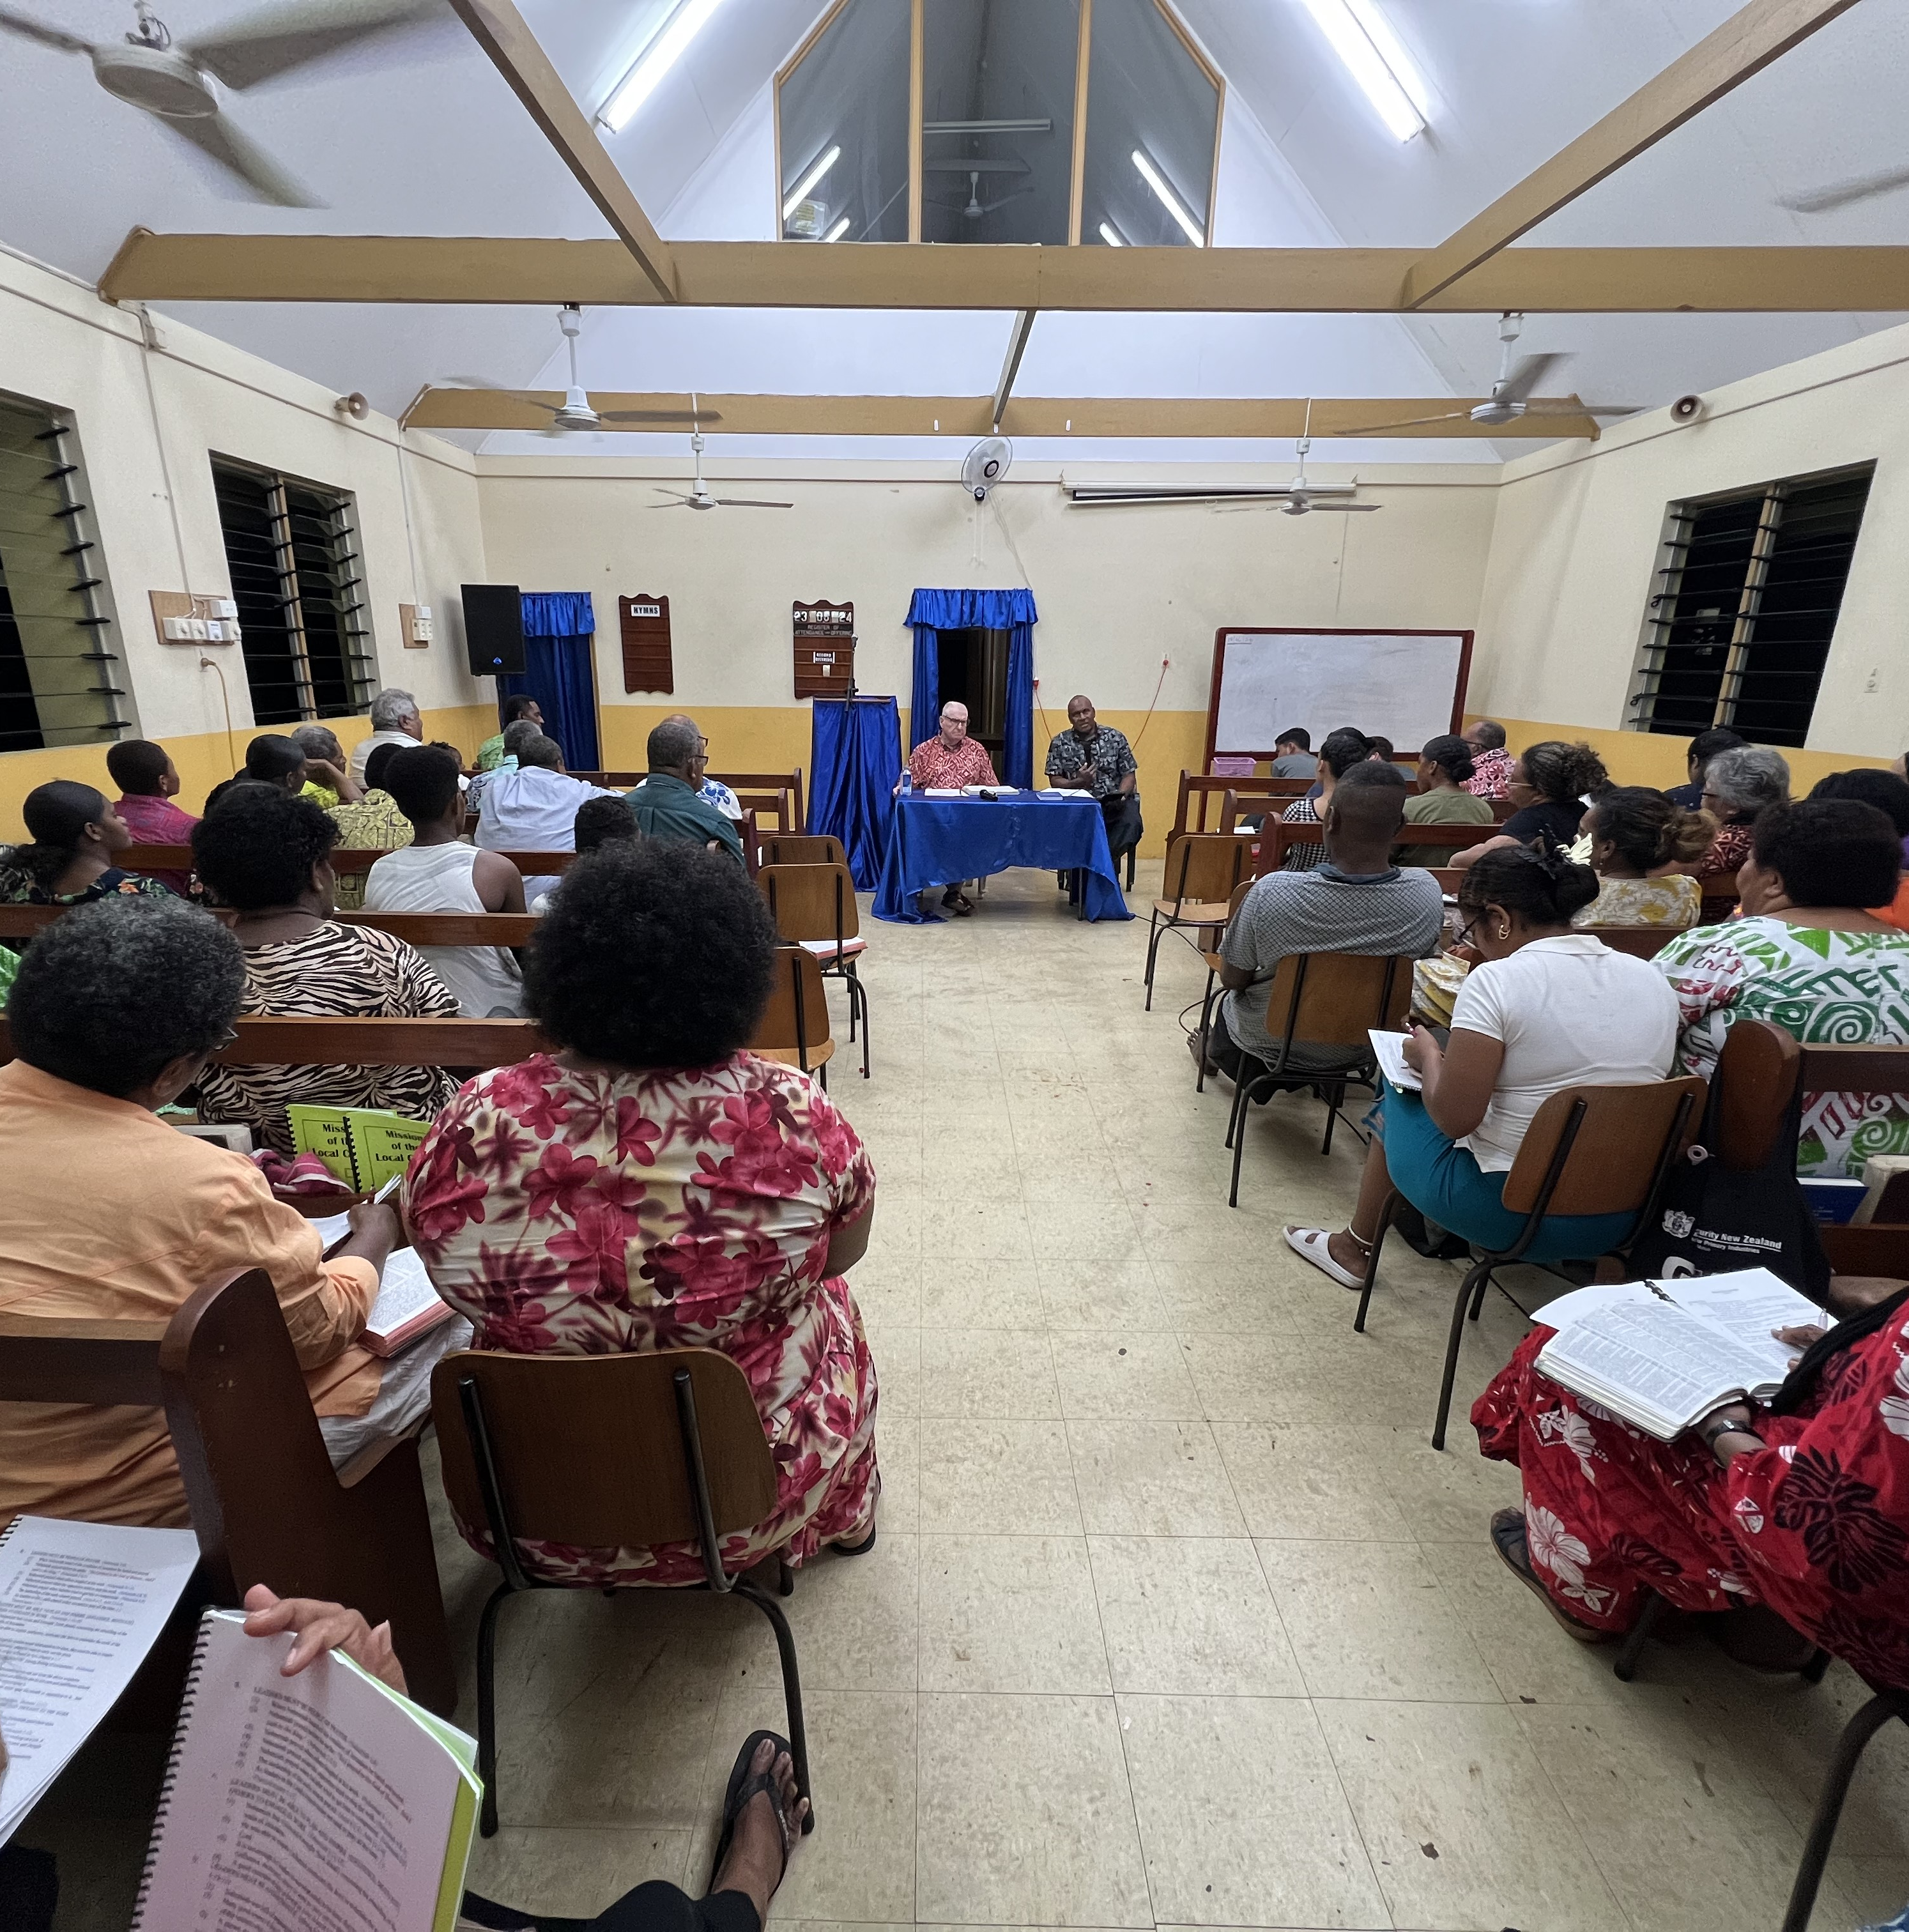
Raiwaqa Congregation Hosted PIBC
Record Attendance
89 Average
60 received credit
Outside under Tarp
Auditorium

Slide 8
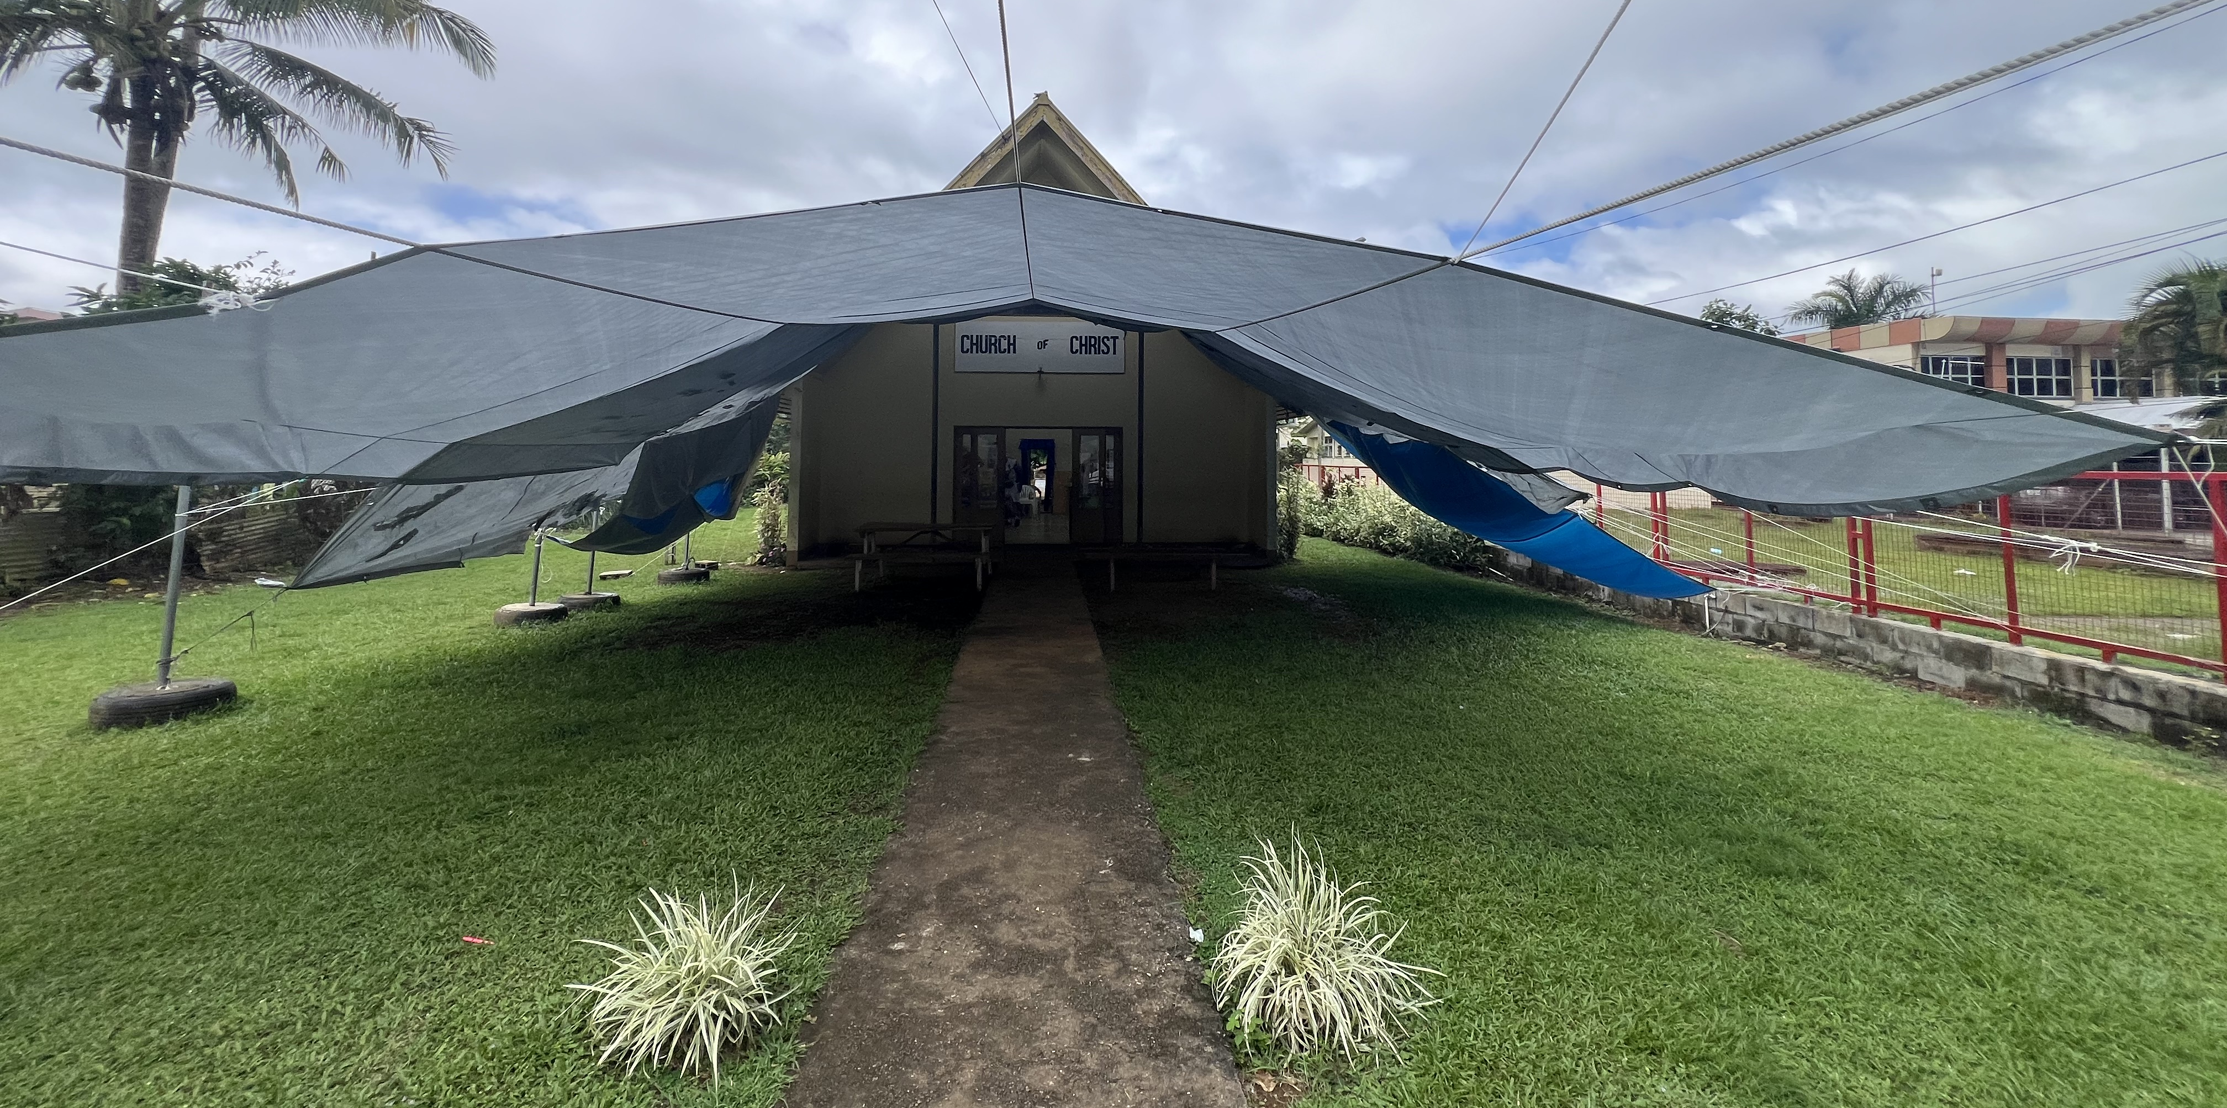
Auditorium Spillover is Outside covered by a large Tarp
Often wind driven rain soak those outside and saturates the ground

Slide 9
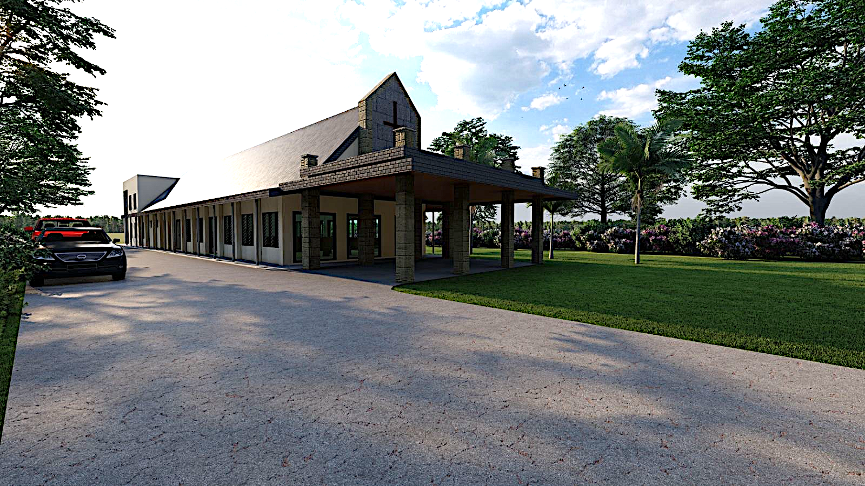
Planned Raiwaqa Building Expansion
Brethren are applying for Permits and raising funds to construct the addition
Expand Auditorium by 100%
Add classrooms in the back of the building
Notes:
Exciting work for Raiwaqa
Building expansion
Now using a tarp outside of the building for overflow (pict)
The congregation has raised some money
Existing building has been there for almost 50 years and needs some upgrades and refurbishment
The expansion includes adding to the auditorium where the tarp is now and upgrading the back of the building to add classrooms and more modern restrooms.
NO Air Conditioning!! Louvered windows and fans
Wooden 2x4 unpadded pews

Slide 10
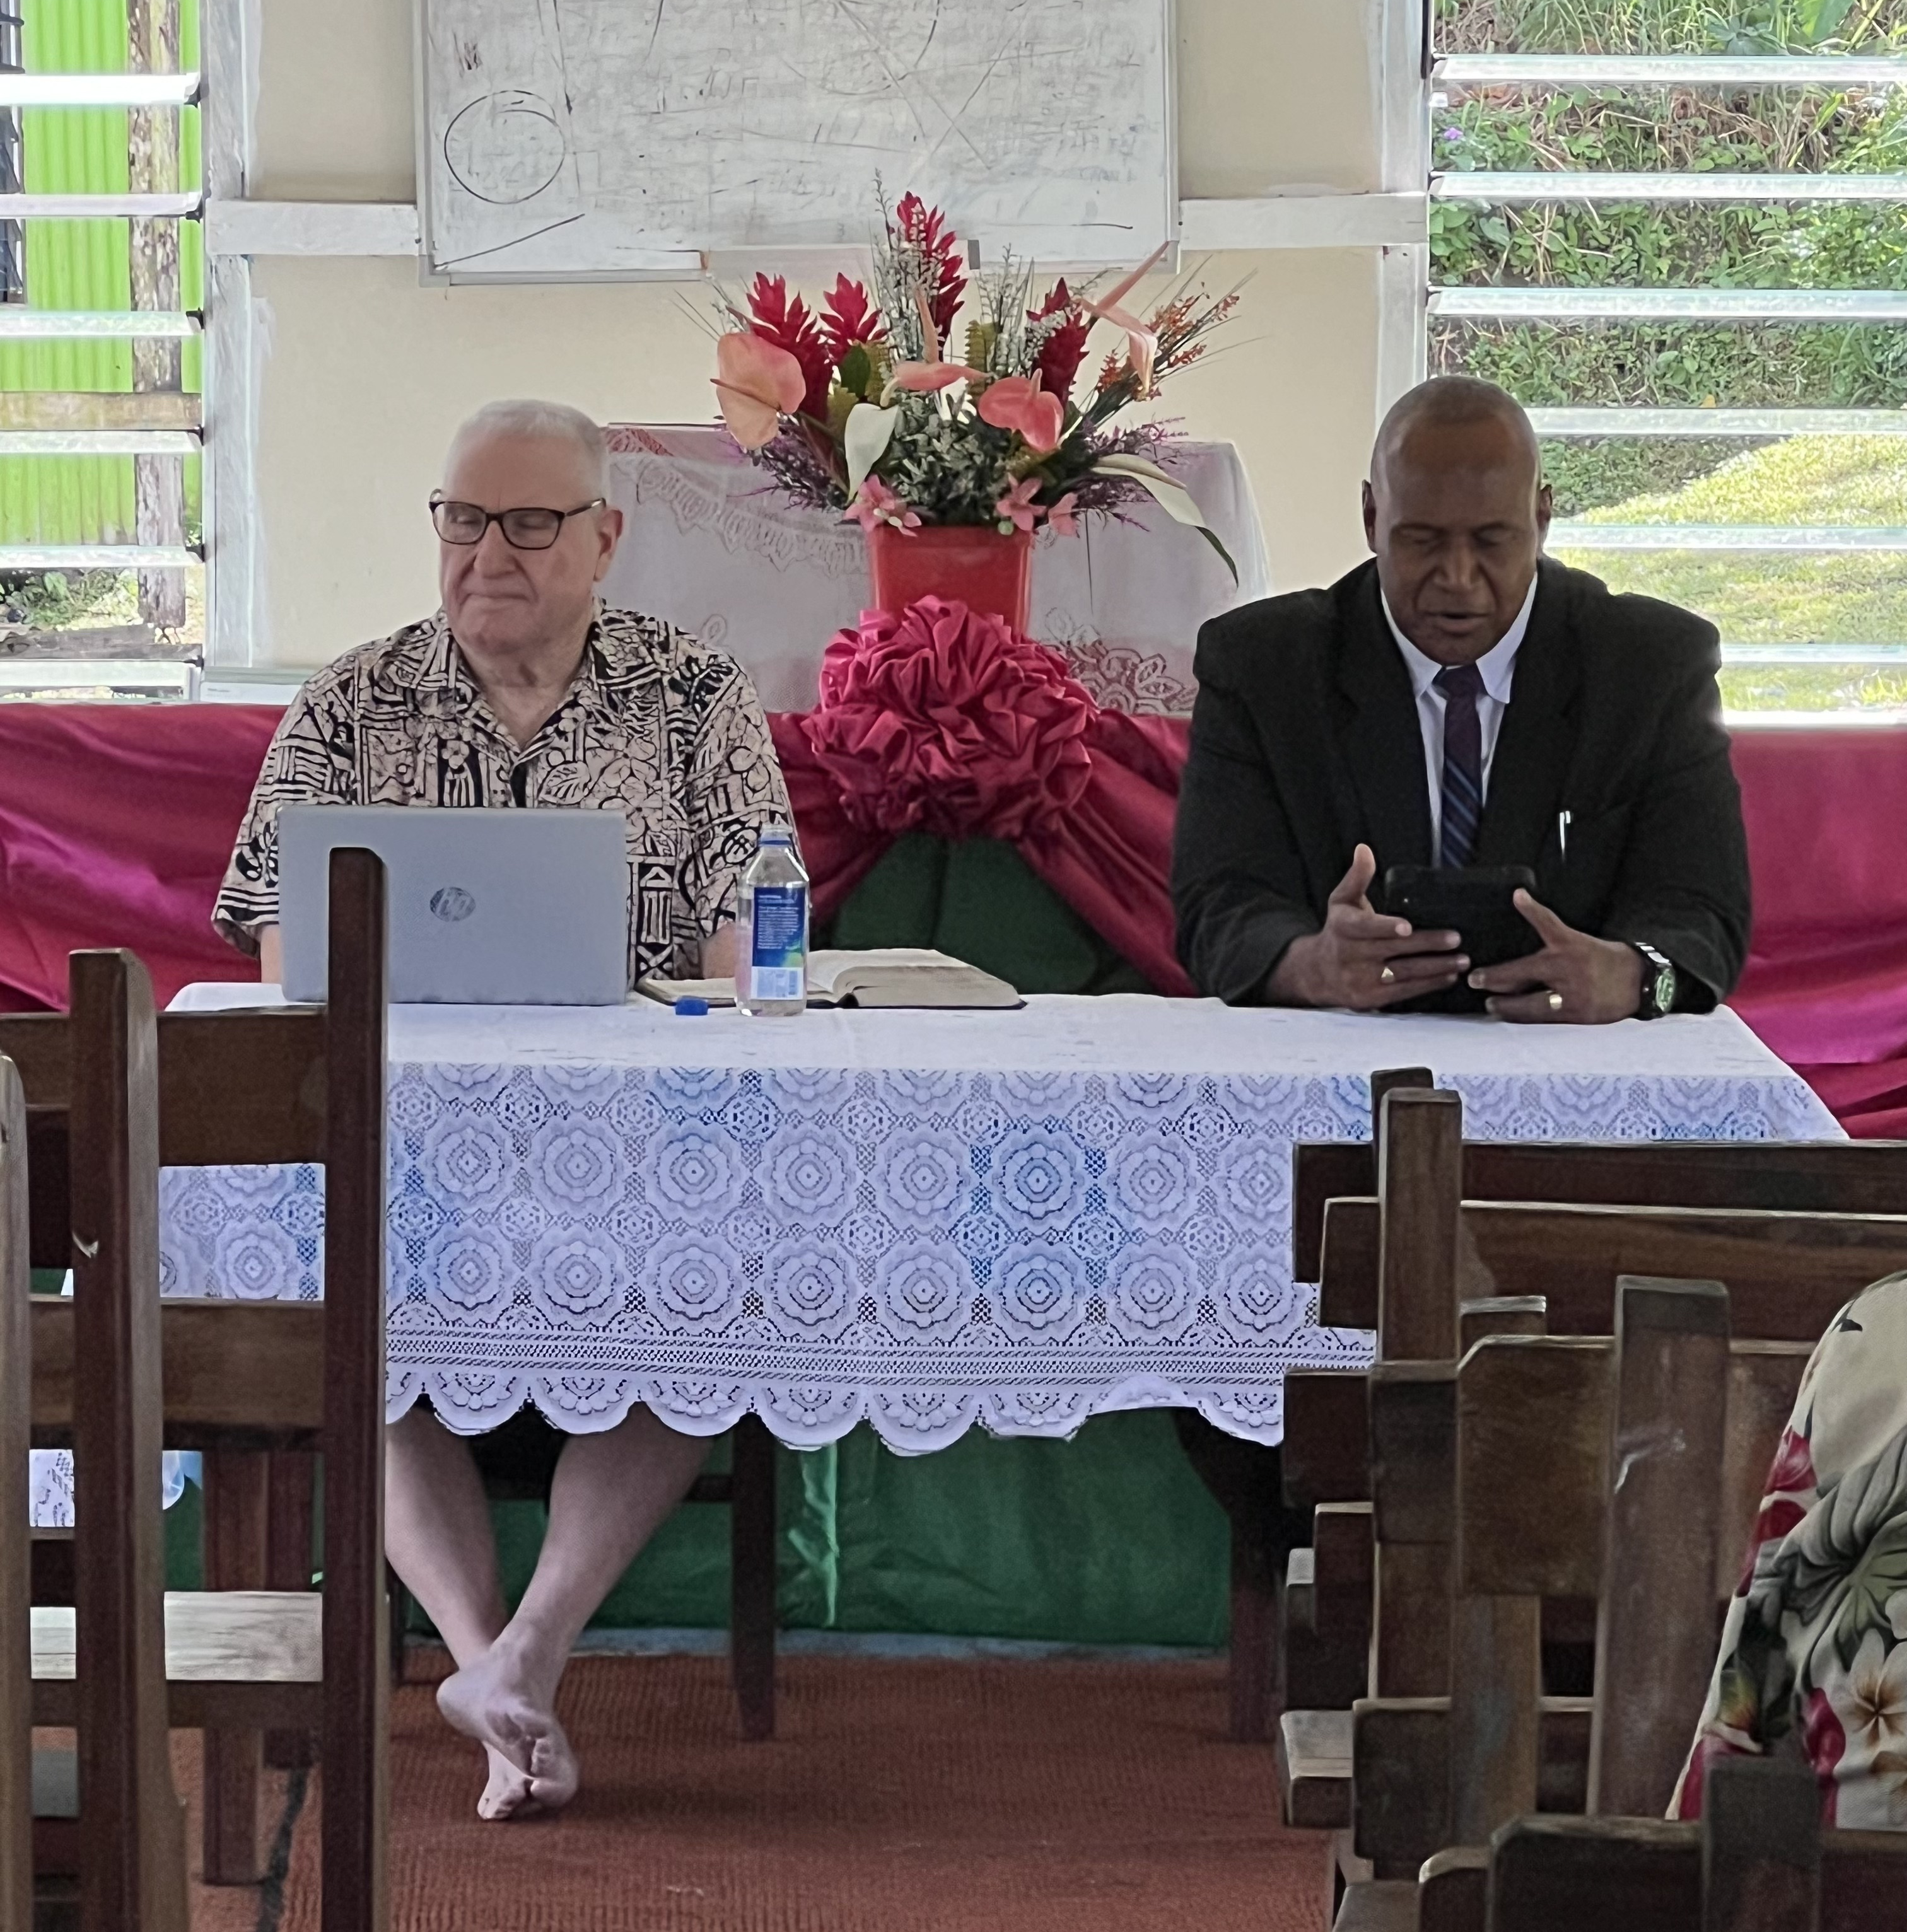
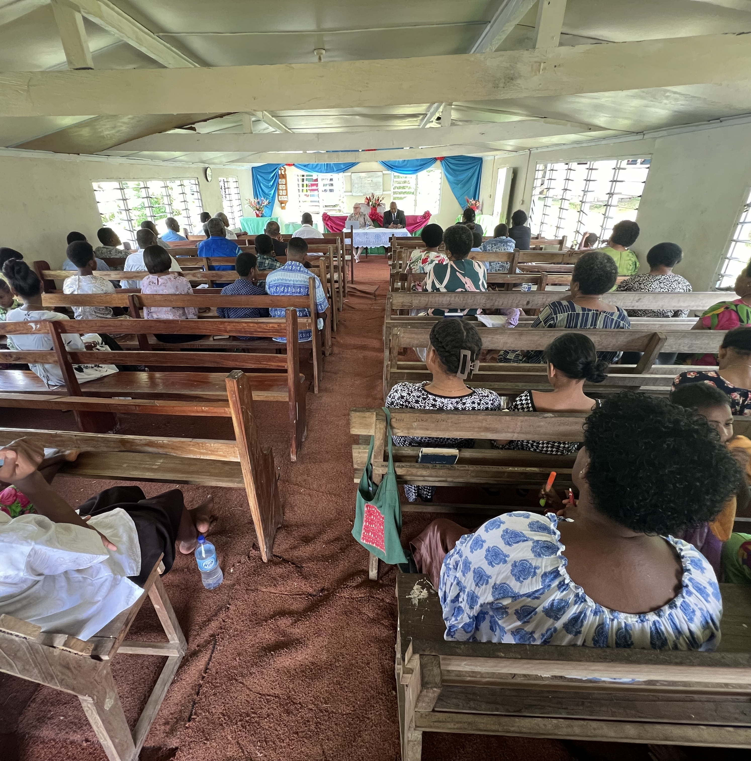
Deladamadu Congregation

Slide 11
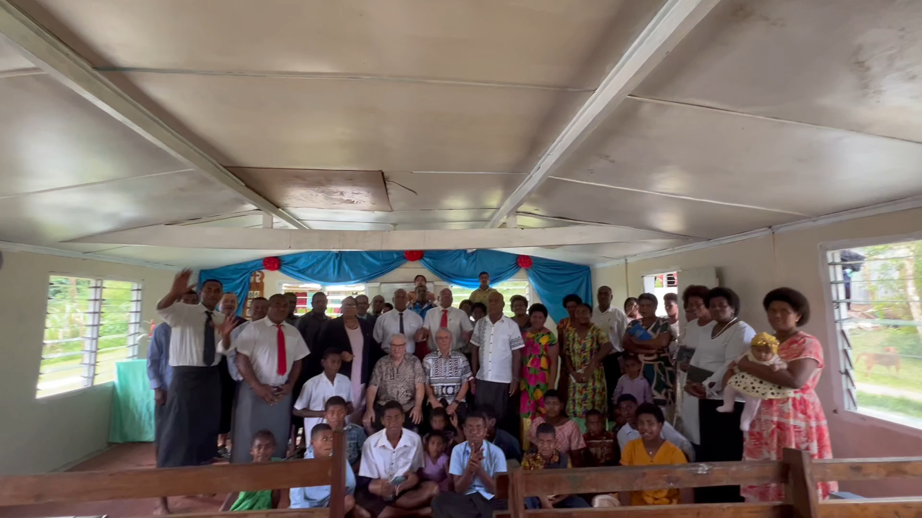
Deladamadu Greeting Palm Beach Lakes

Slide 12
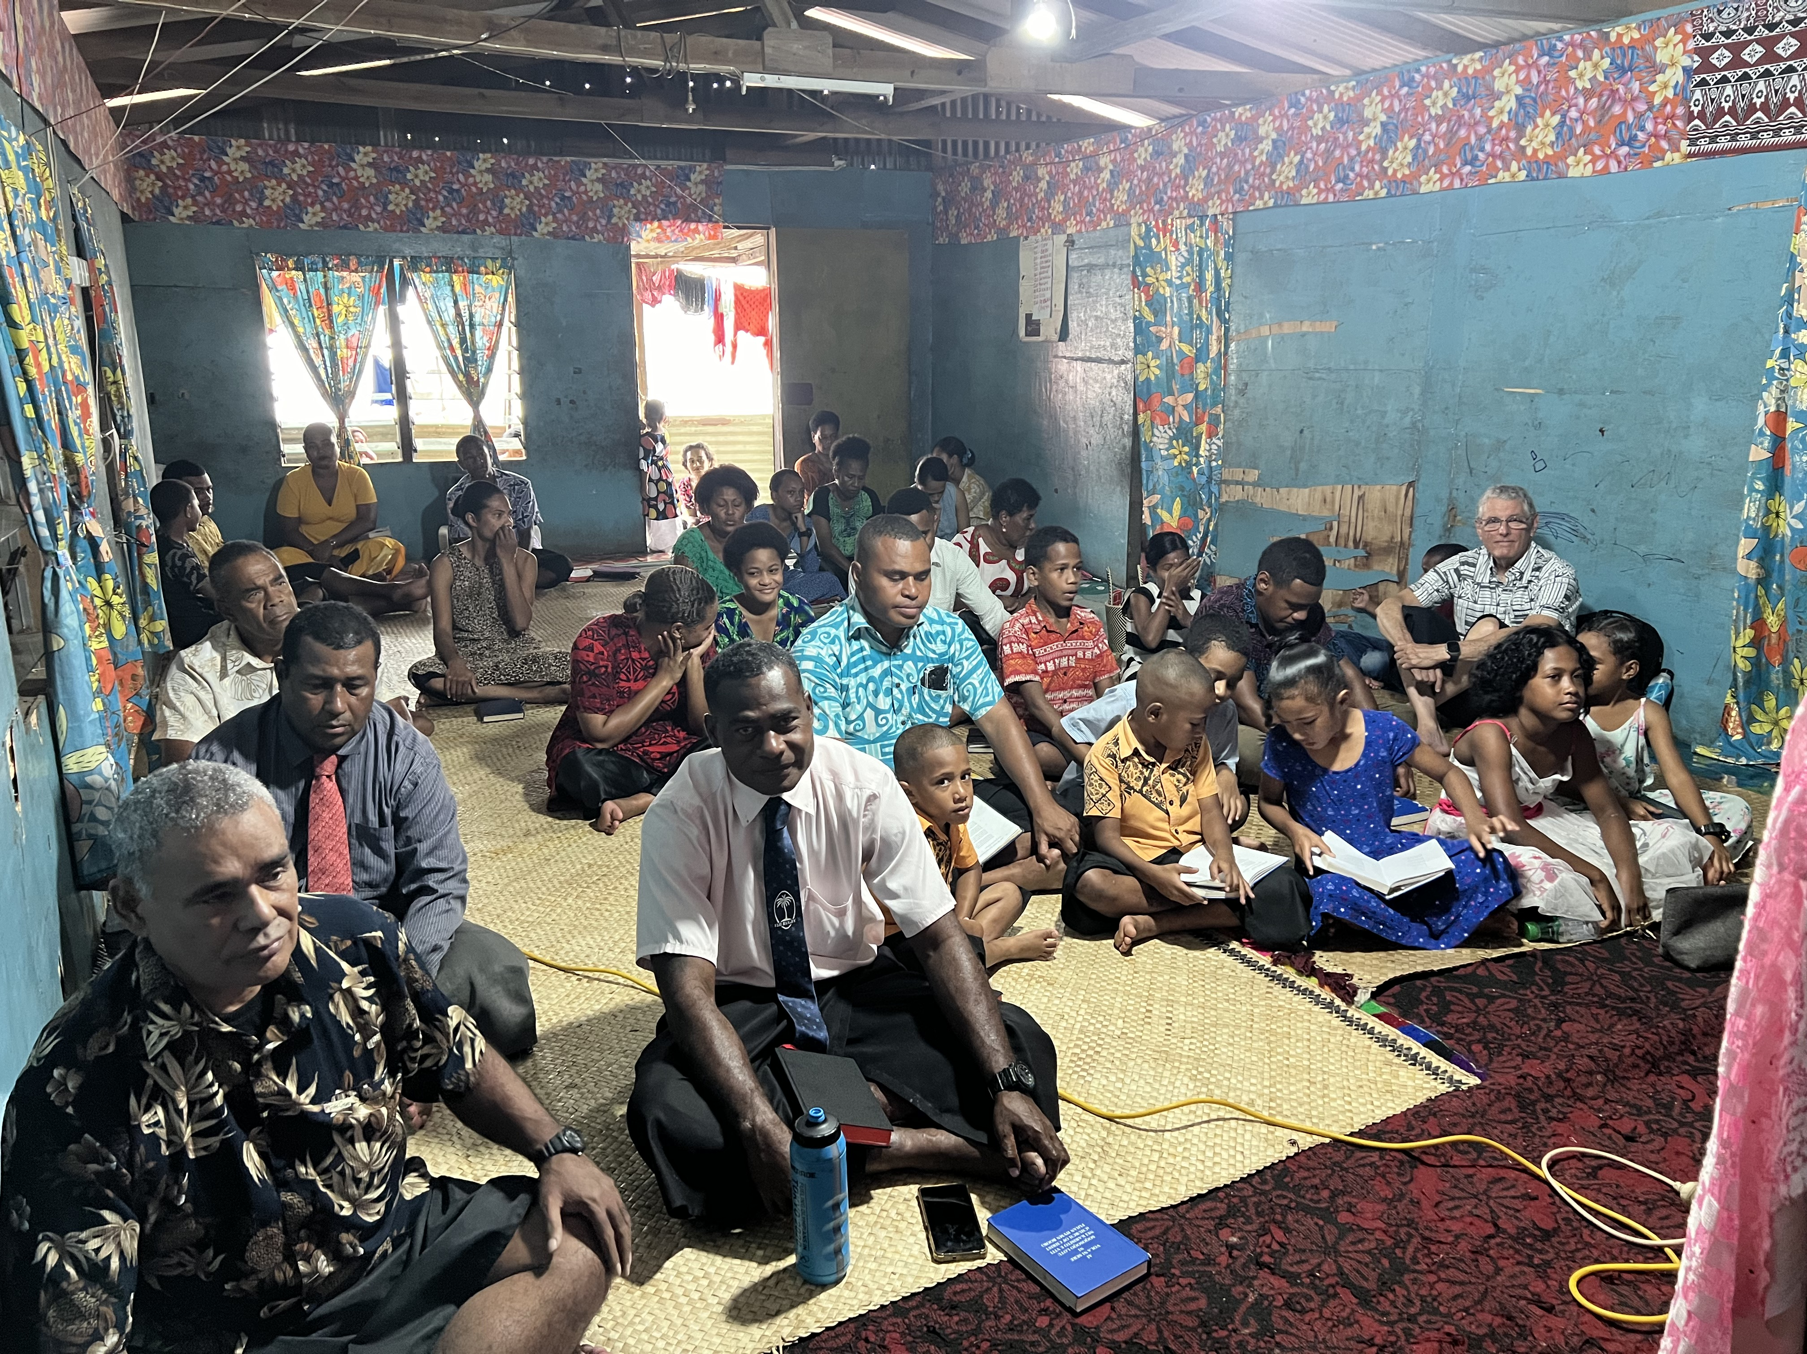
Vatuwaqa Congregation

Slide 13
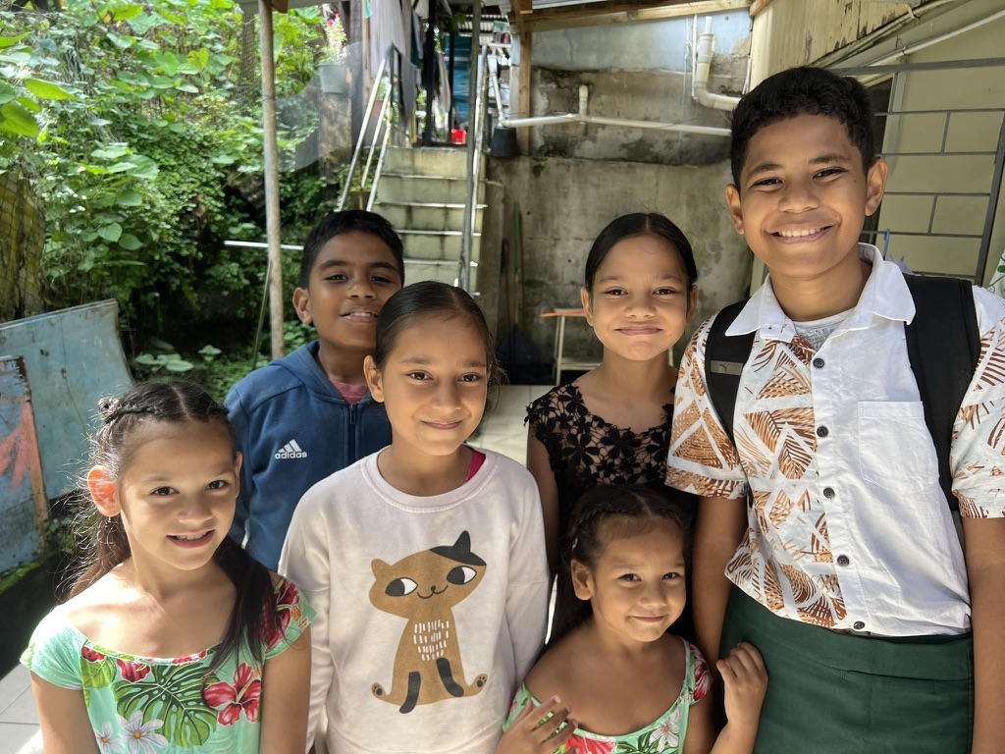
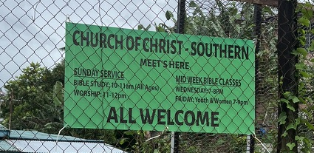
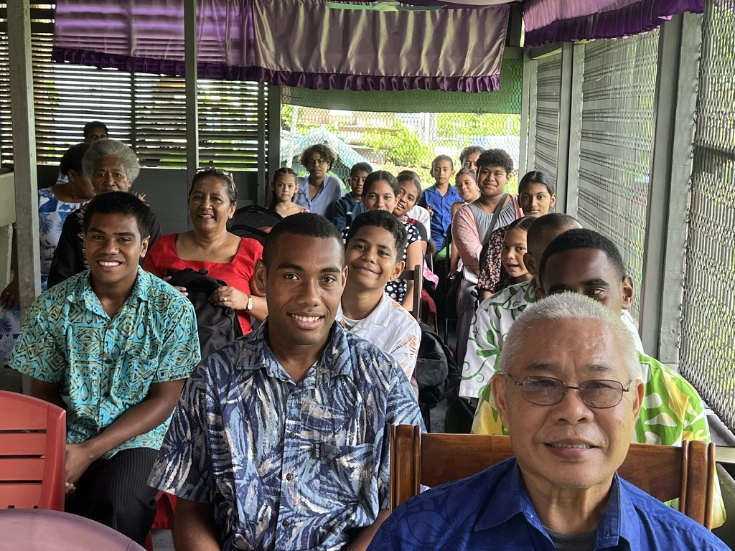
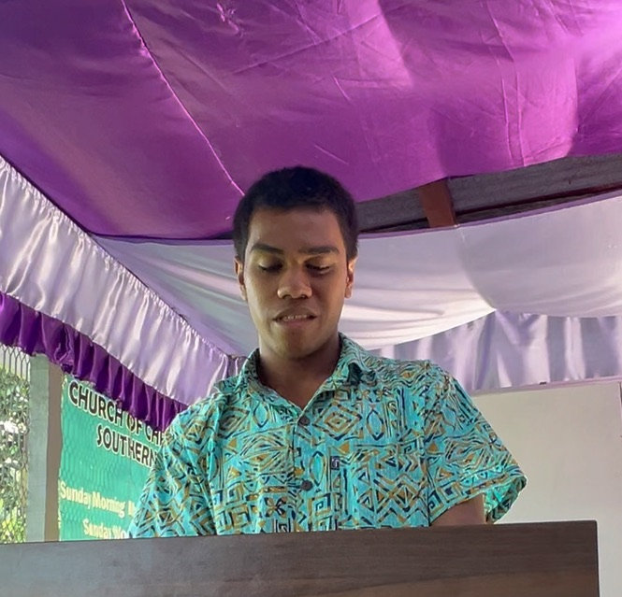
Southern Congregation

Slide 14
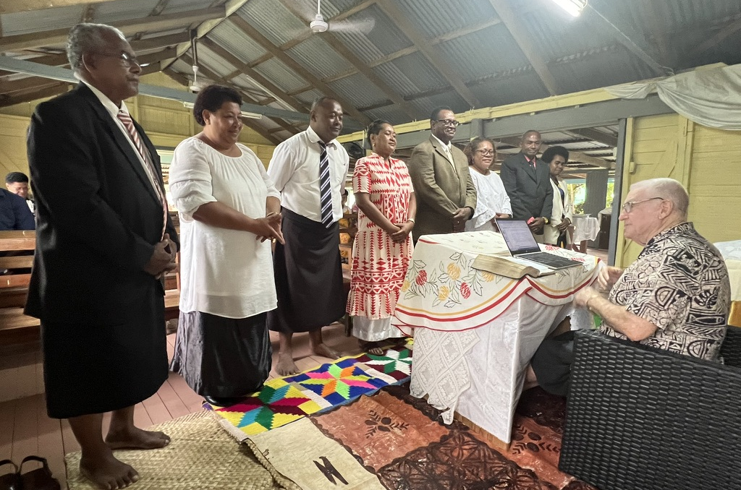
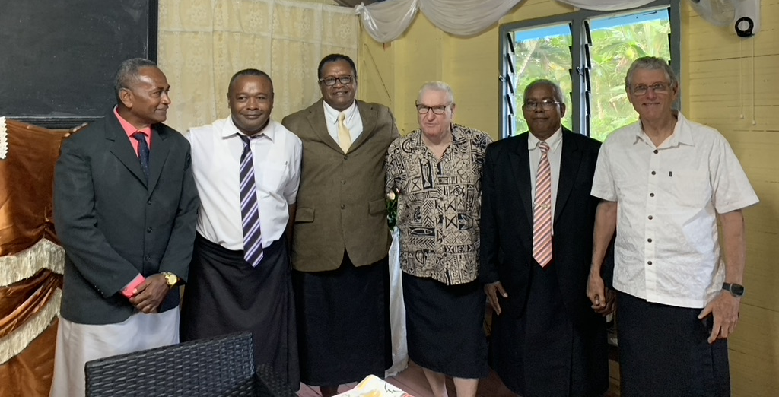
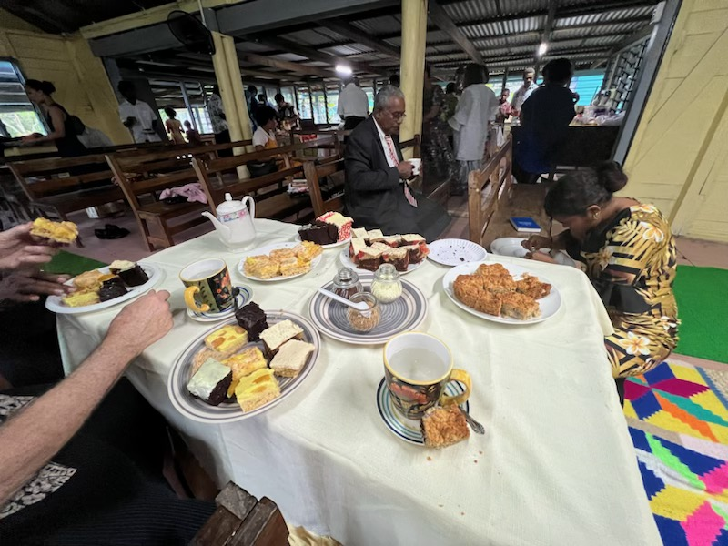
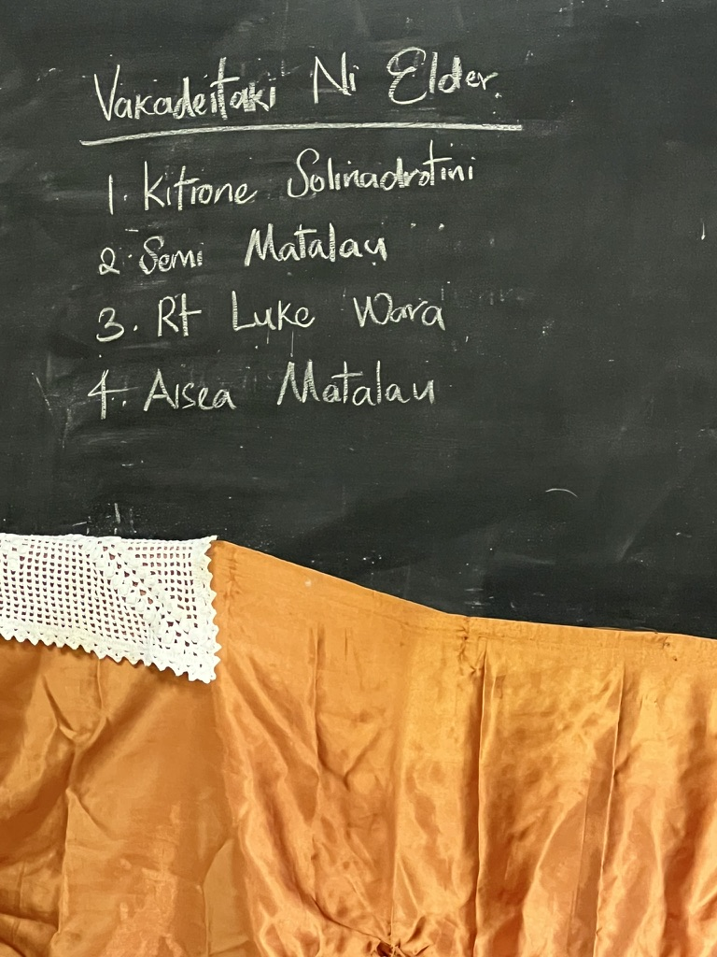
Four Elders Installed at Naila Congregation

Slide 15
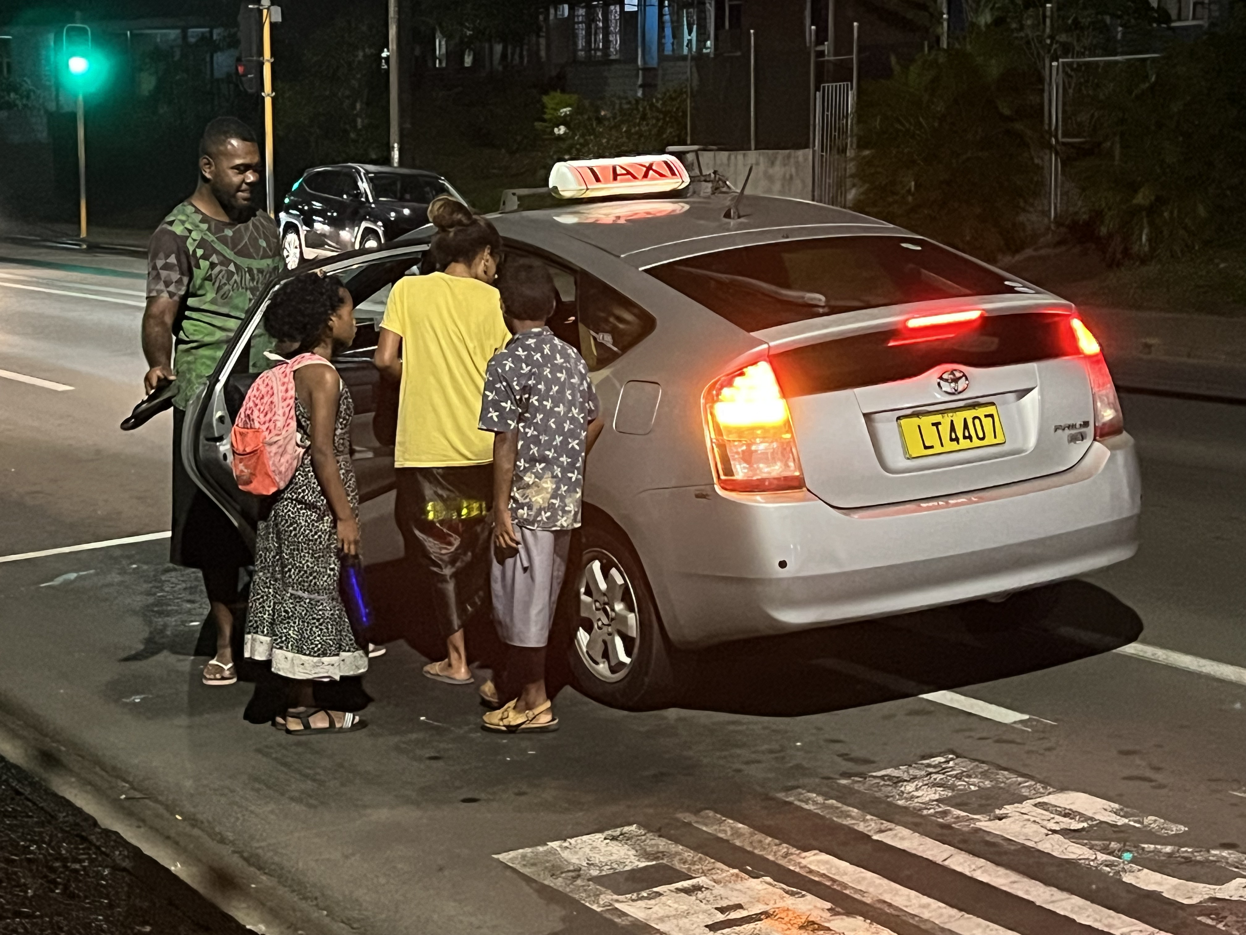
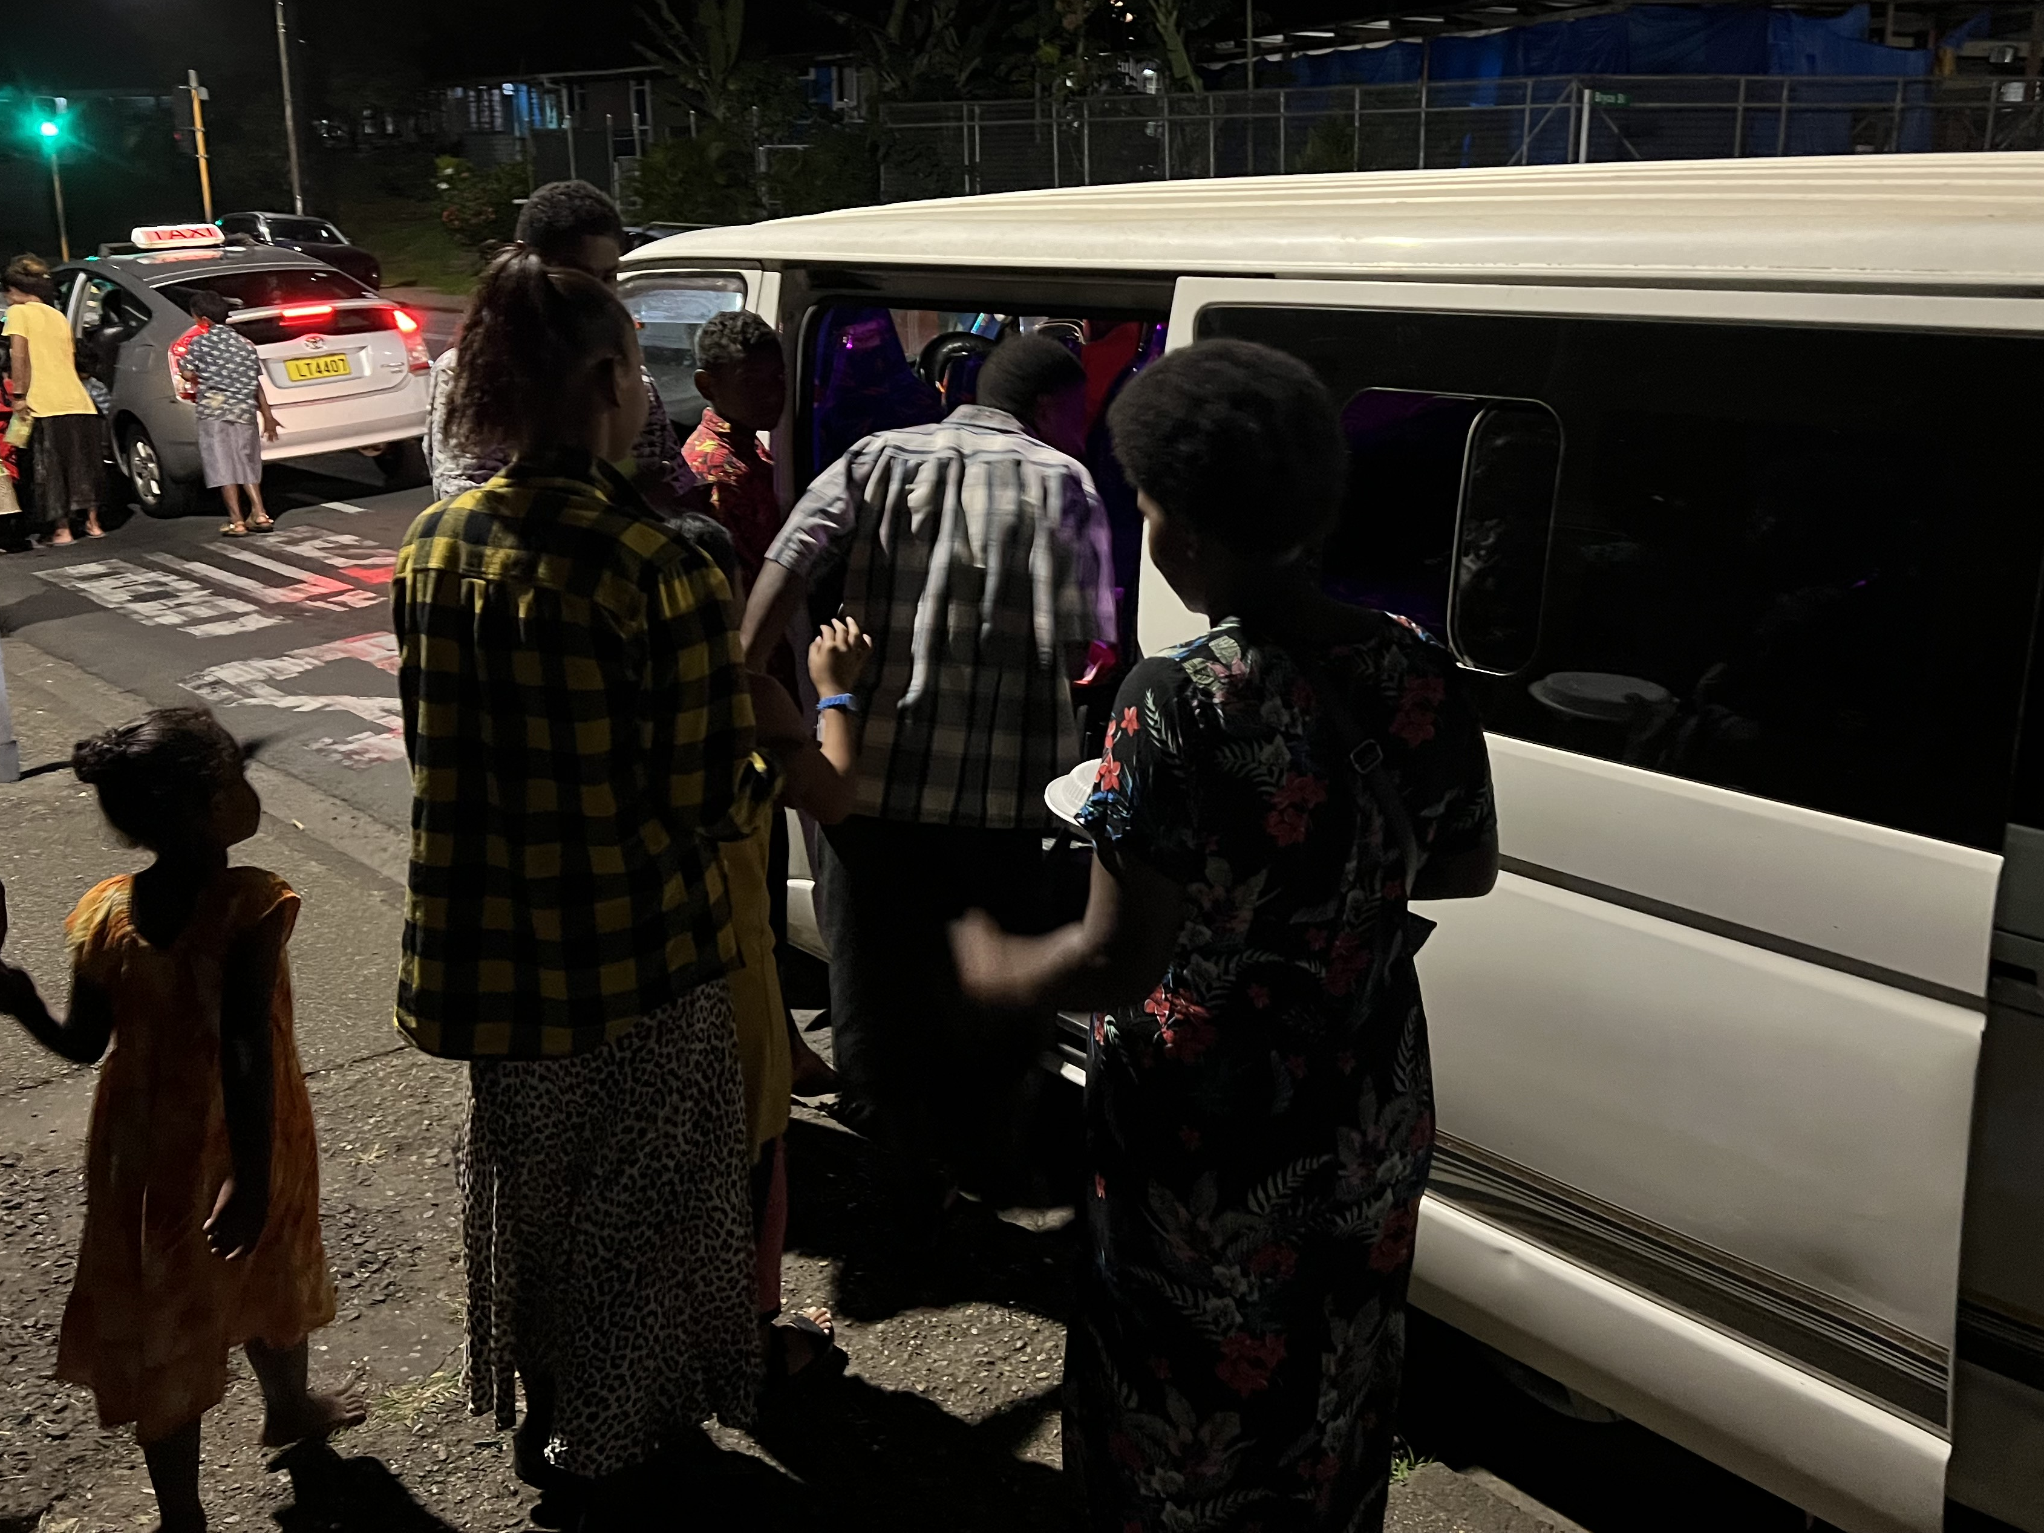
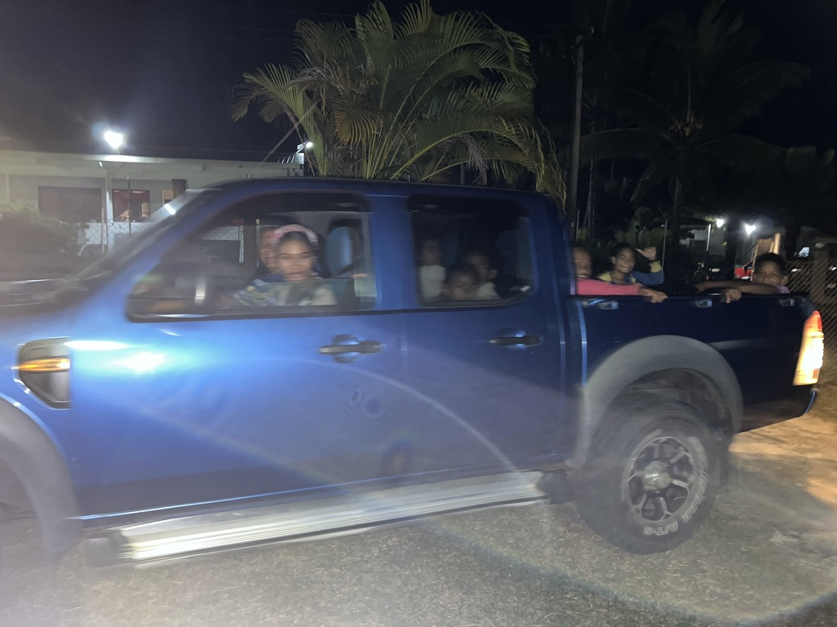
Transportation
The few Personal Cars Packed Full
Cabs and Hire Vans
Local Buss
15 nights of round-trip

Slide 16

Vatudamu
Buca
Vanua Balavu
2024
We relocated from Suva to Nadi to conduct Second 3 week round of PIBC Classes
3 ½ Hour Drive from Suva to Nadi
Joshua – Esther
And Revelation

Slide 17
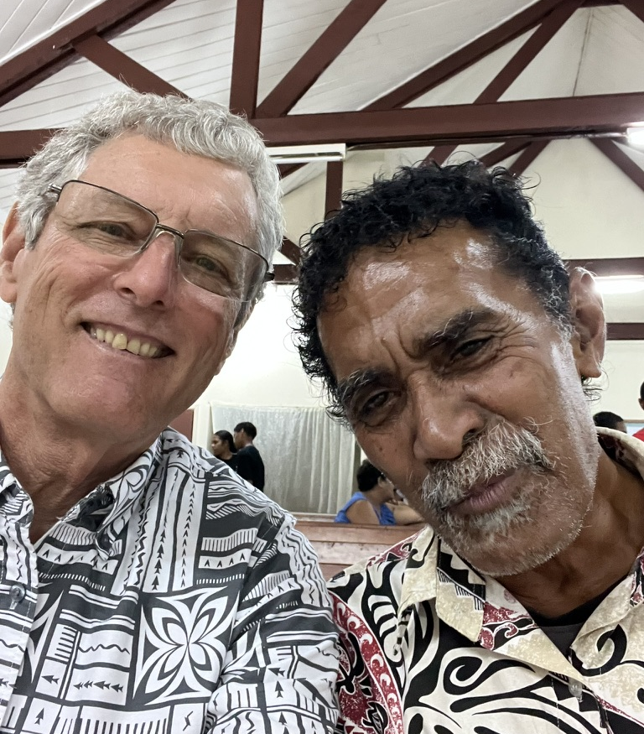
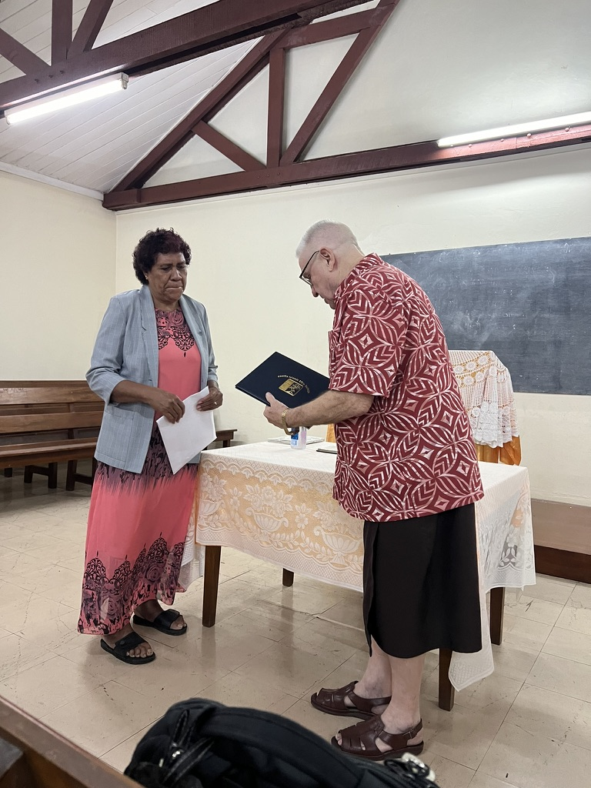
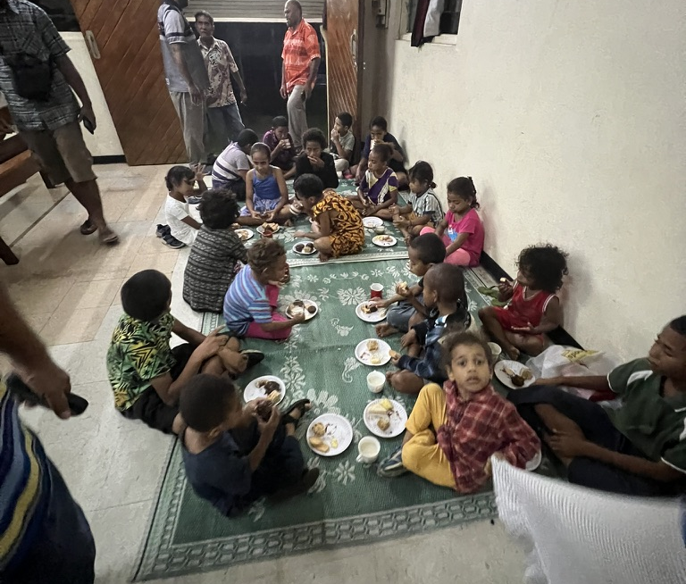
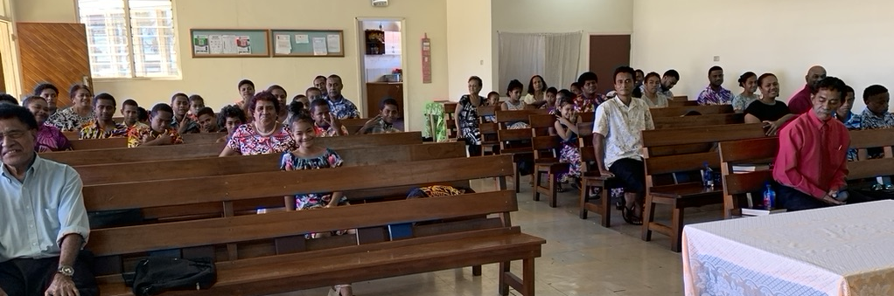
Lautoka Congregation hosted PIBC Classes
Sala Receiving Diploma
Sala Receiving DiplomaRecord Attendance
Average 43
40 Received Credit

Slide 18

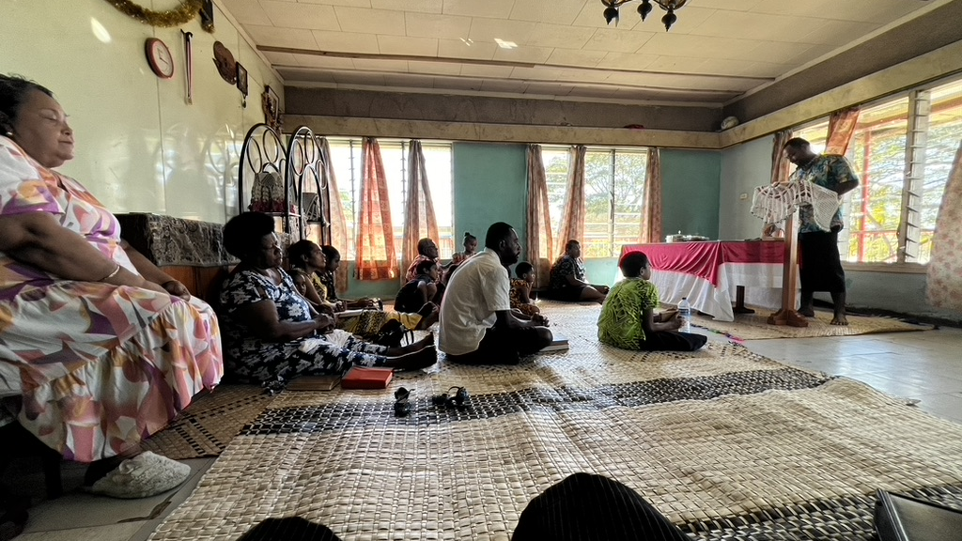
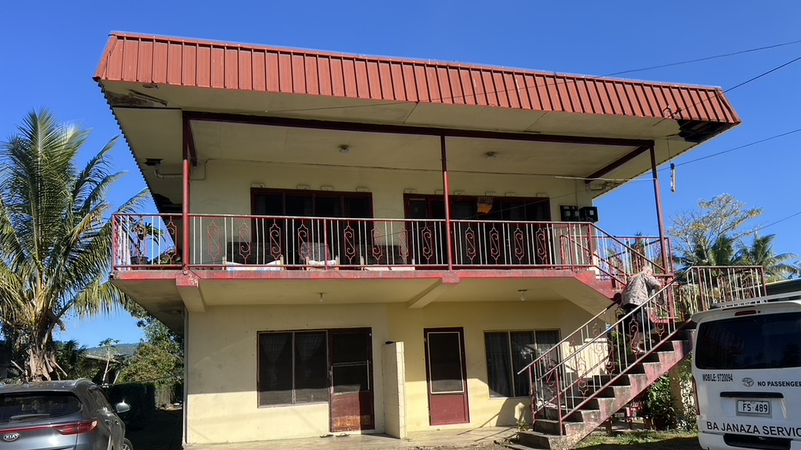
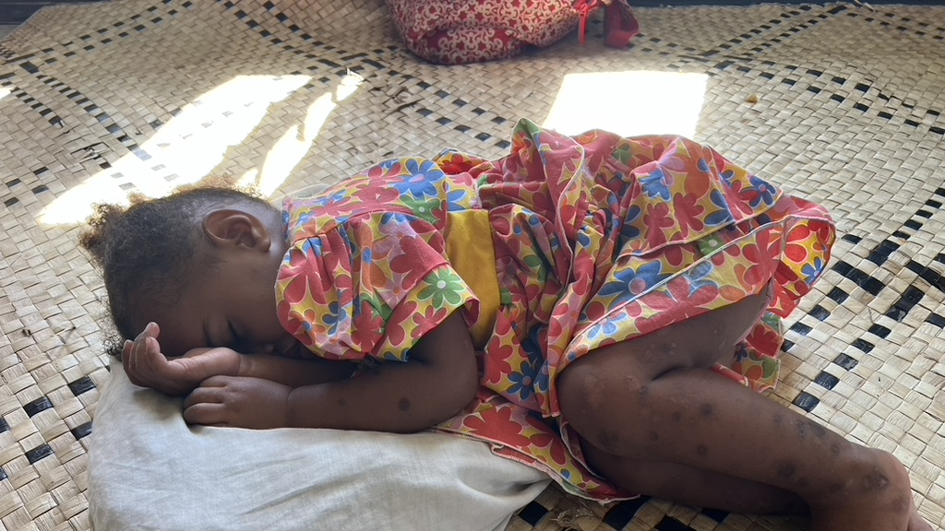
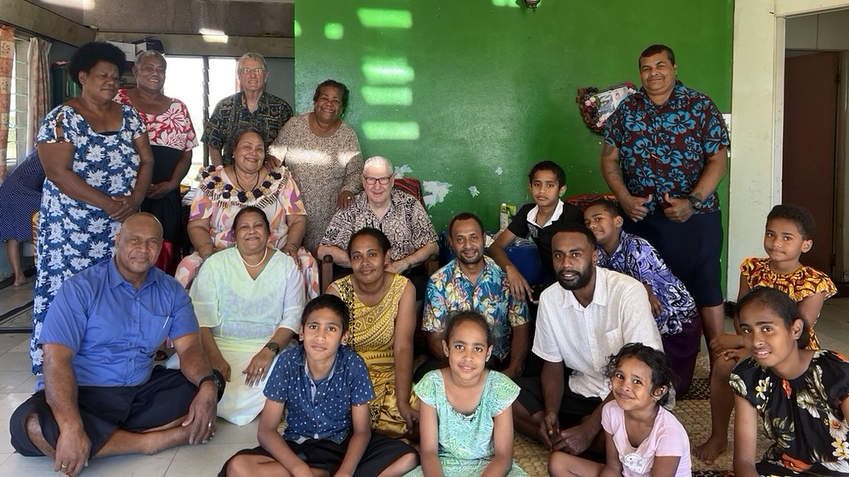
Ba Congregation

Slide 19
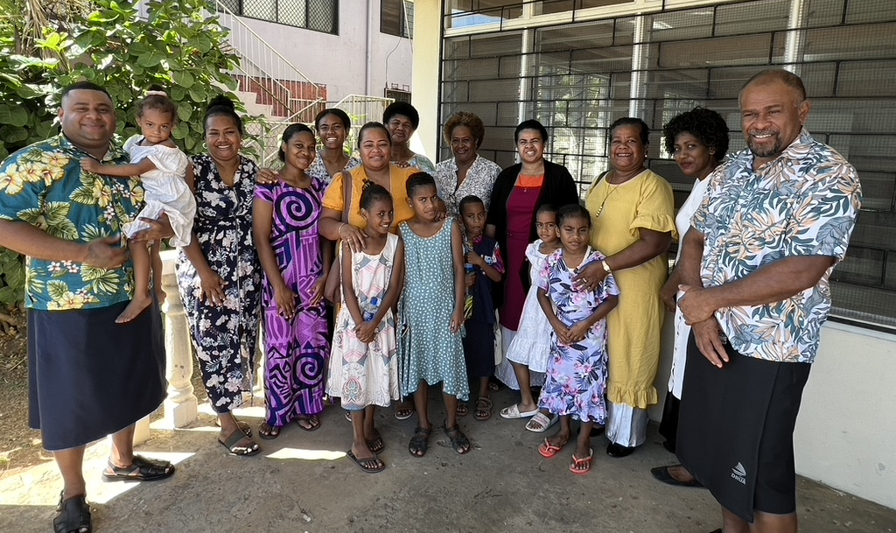
Nadi Congregation
Nadi

Slide 20
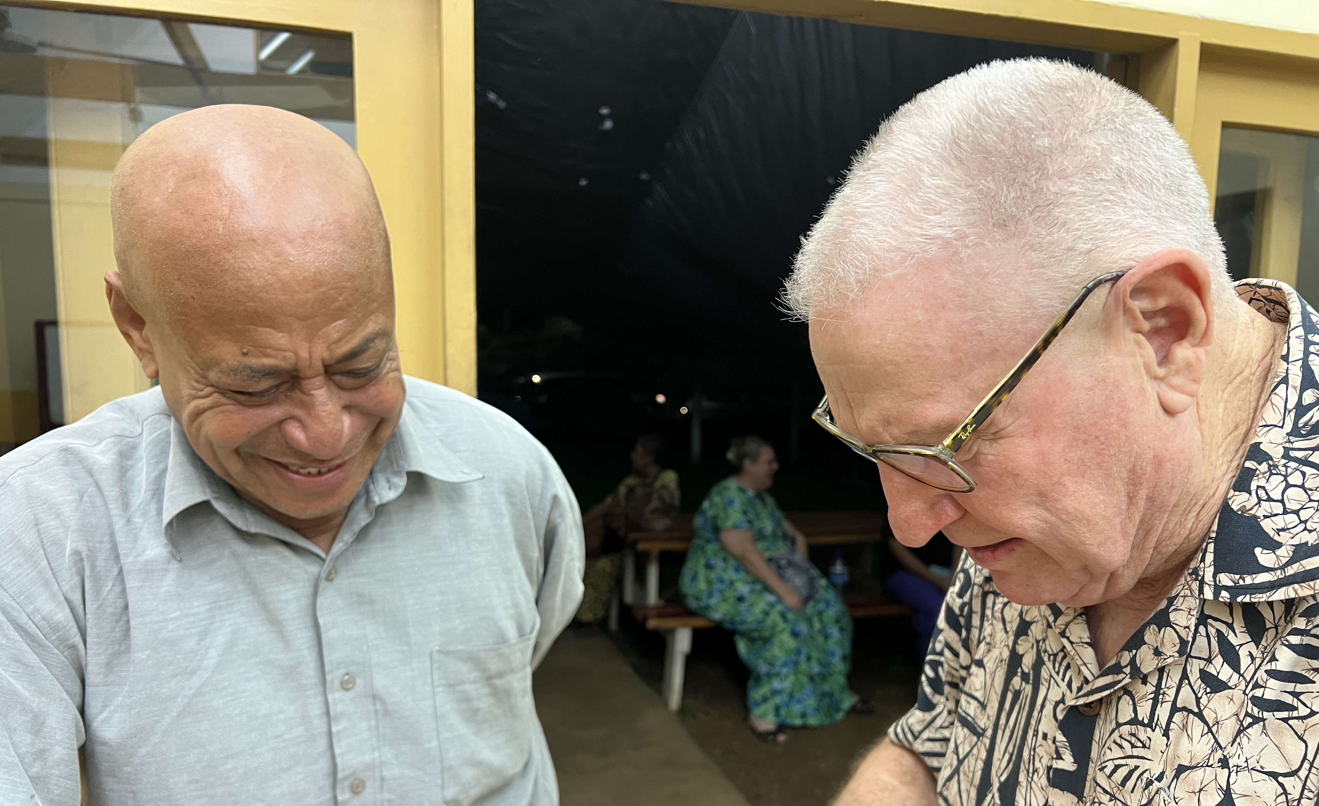
Vatudamu
Buca
Vanua Balavu
2017 and 2024
Joni Kali
Only 3 fights a week 9 seat aircraft weather permitting
Or a 3 day trip on cargo vessel
Reunion with Joni Kali

Slide 21
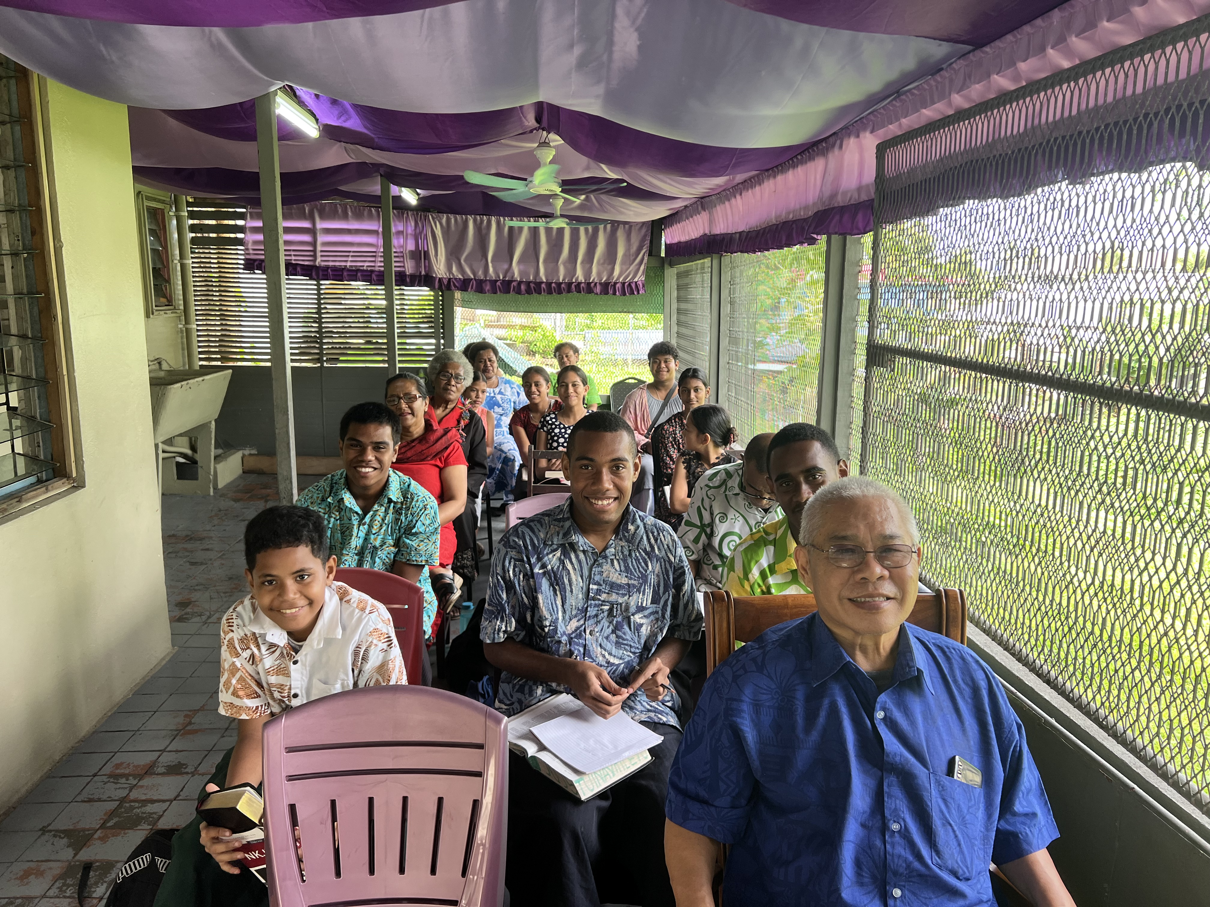
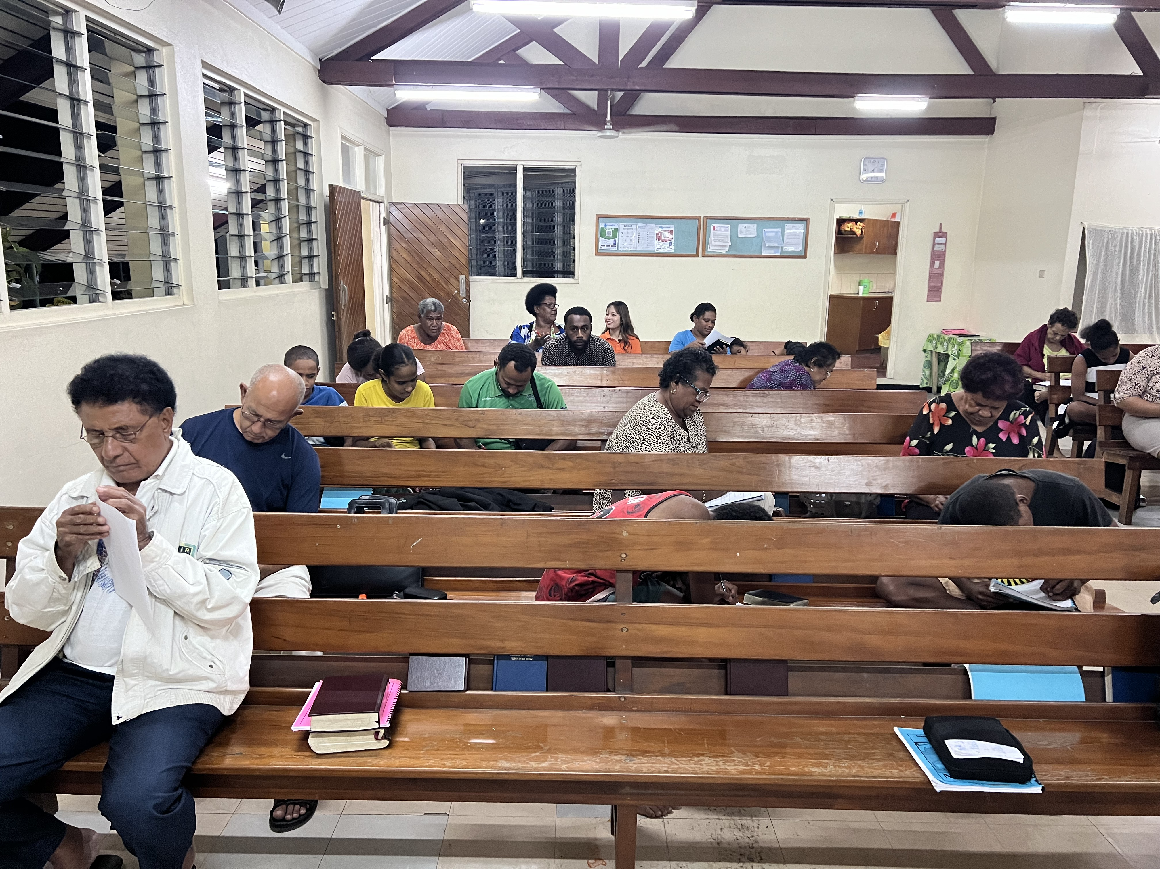
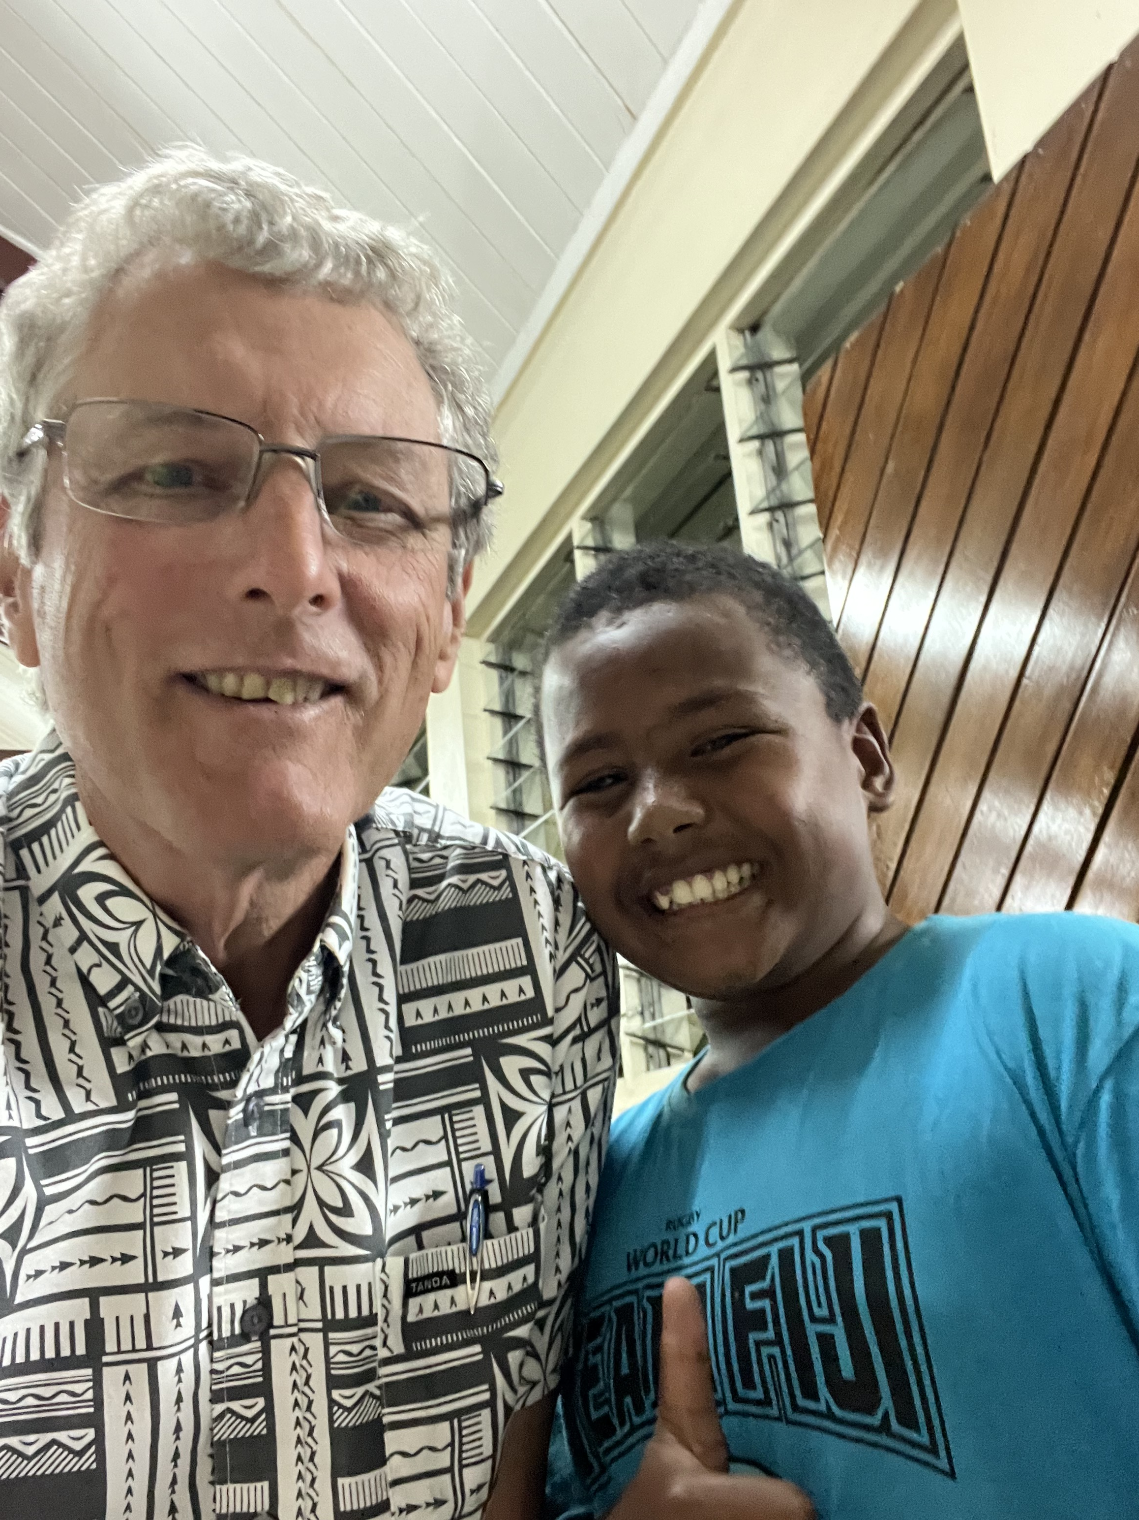
Young People – Interested in Bible Learning
Soko 13 yrs old – took the Revelation exam
+ Many Others
Young Indian Girl
Young Japanese Girl

Slide 22
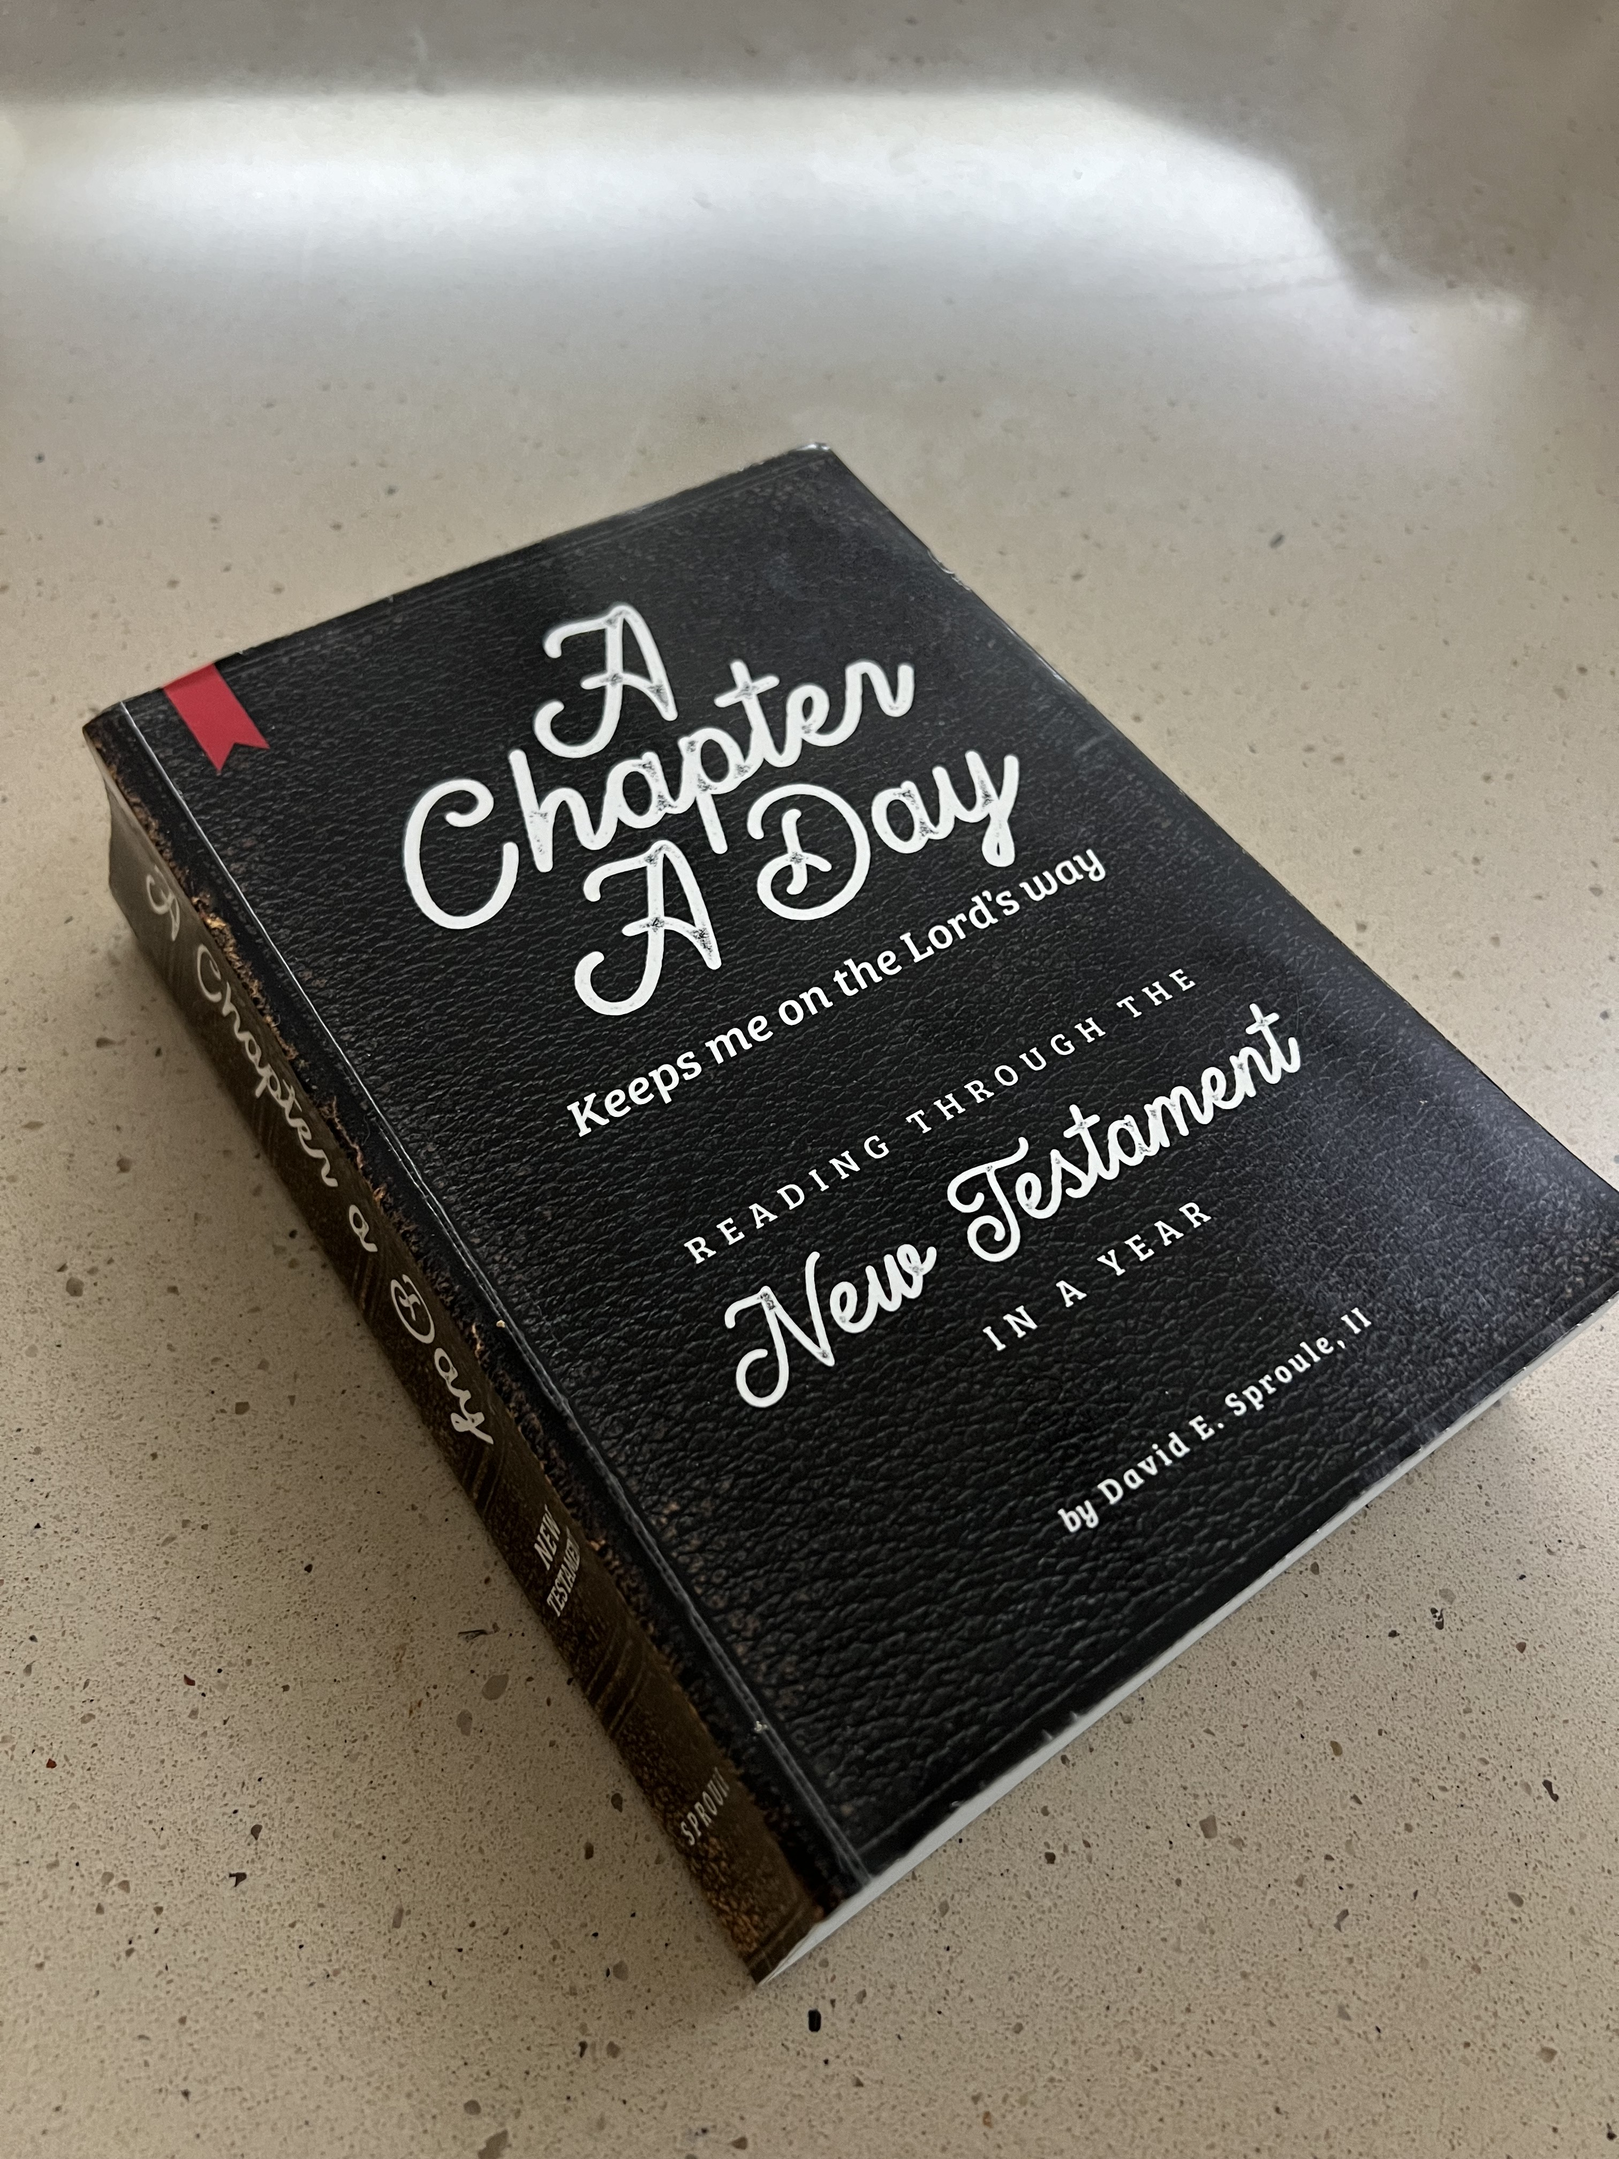
A Chapter a Day for Fiji Brethren
The elders and Preachers are providing the A Chapter a Day workbook for all of the congregations in Fiji with the intention that each of the congregations will be reading through the NT in 2024…Together
David and Ivan are working through the logistics of shipping 400 lbs. of books halfway across the world.

Slide 23
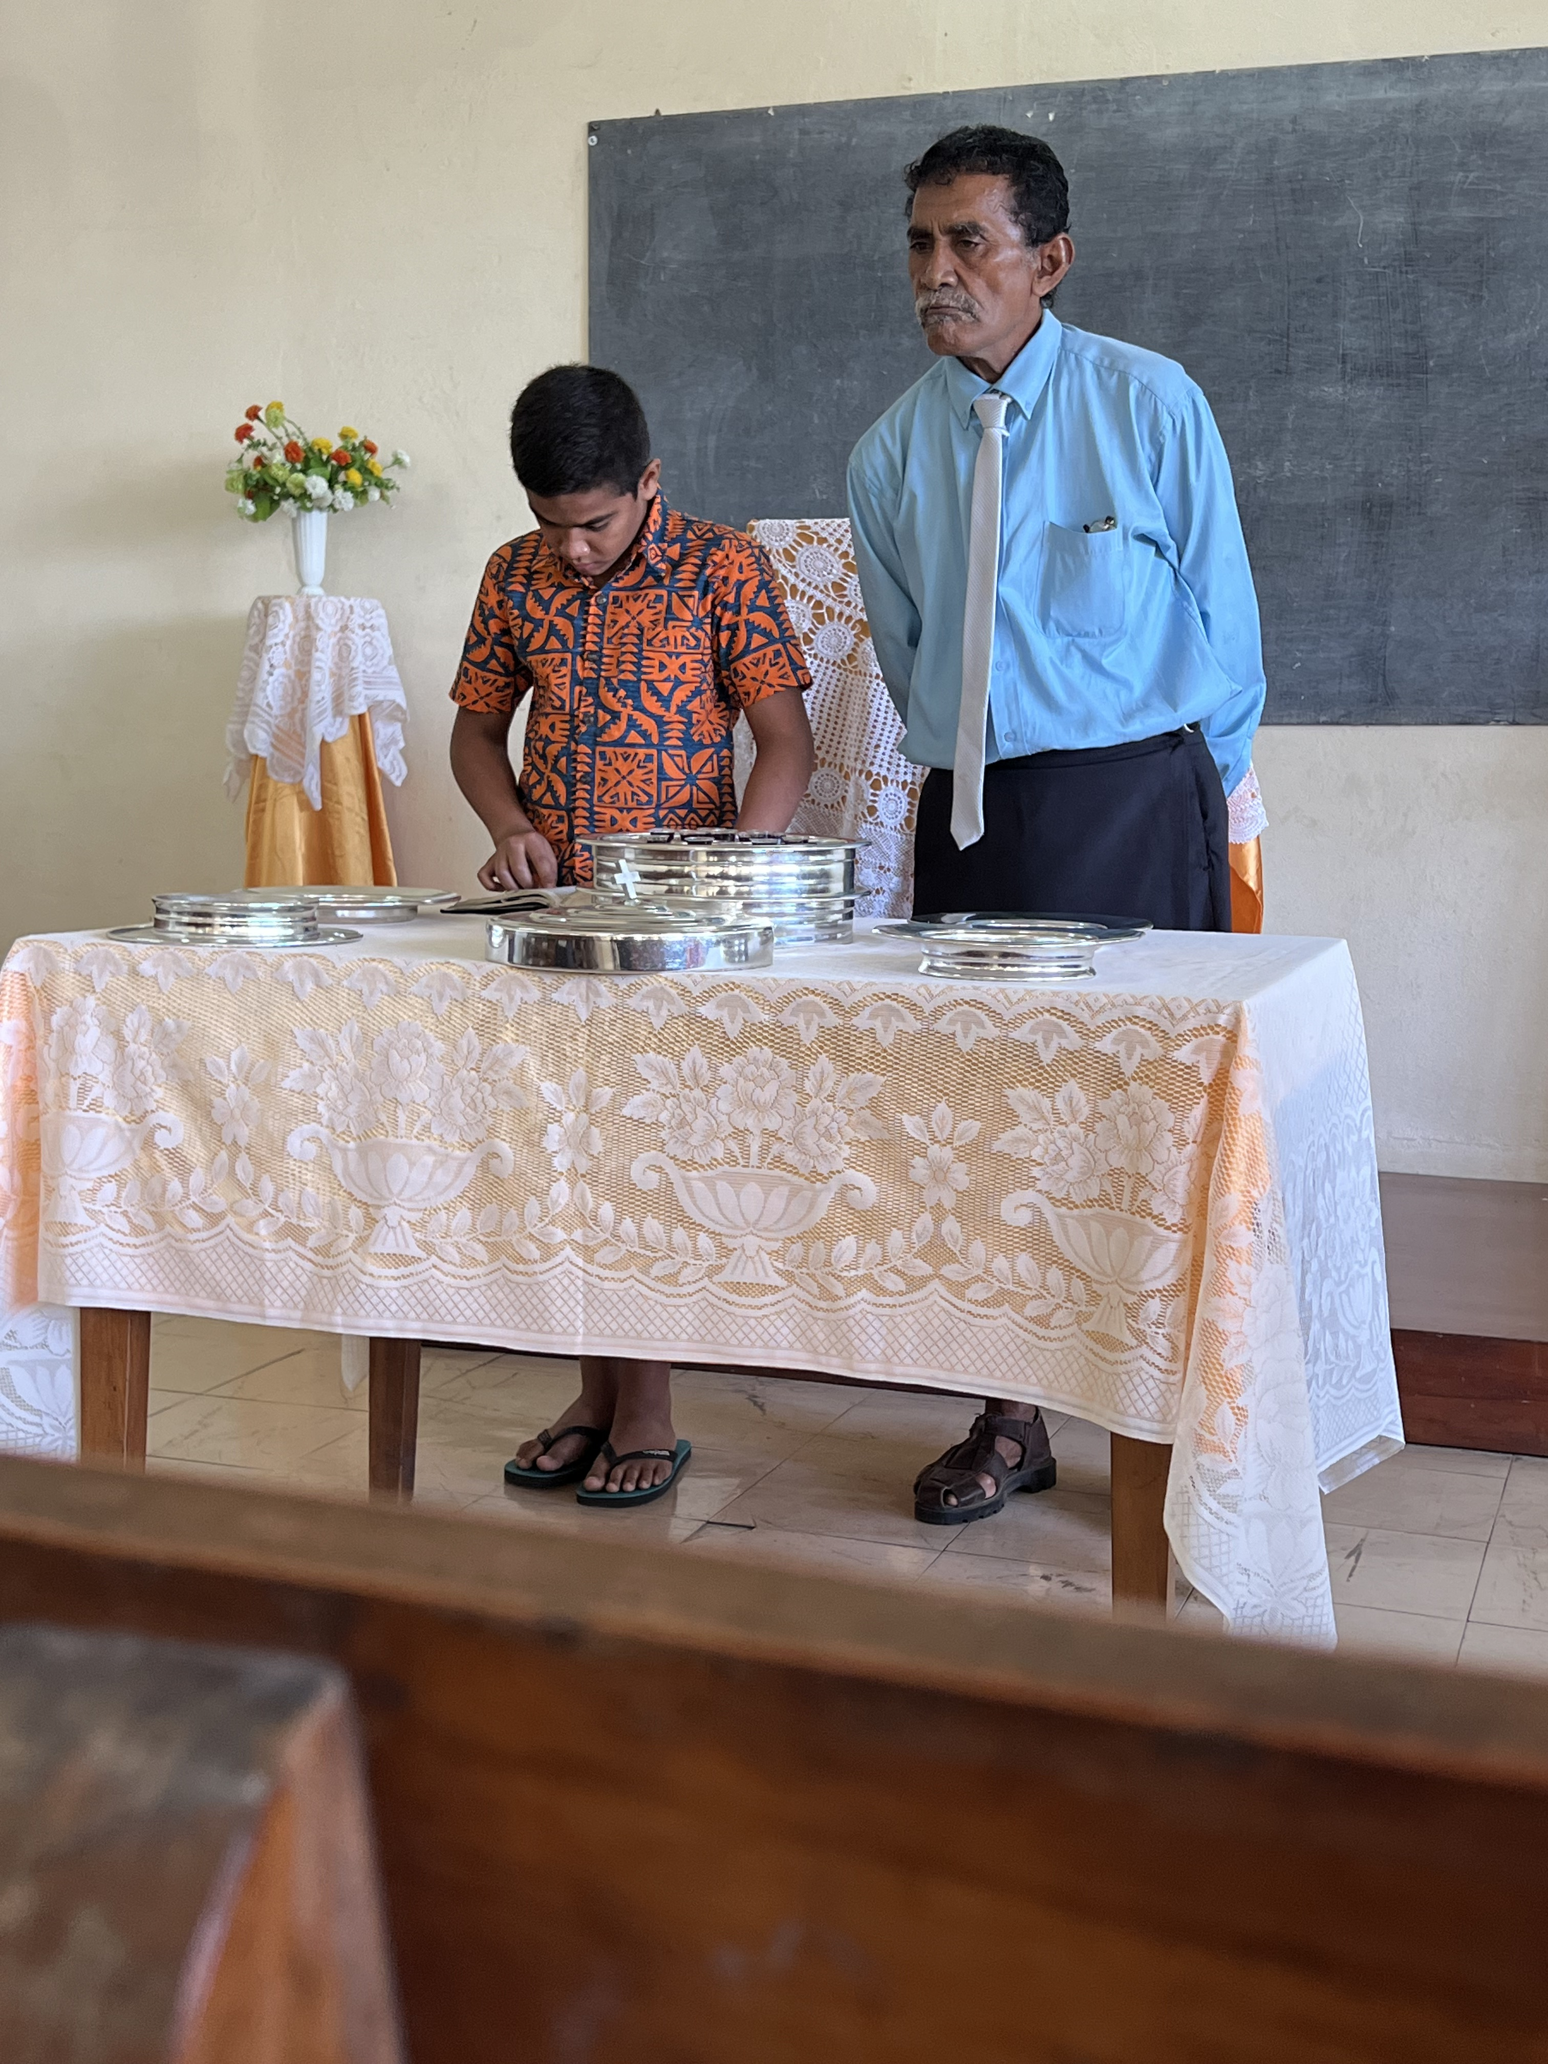
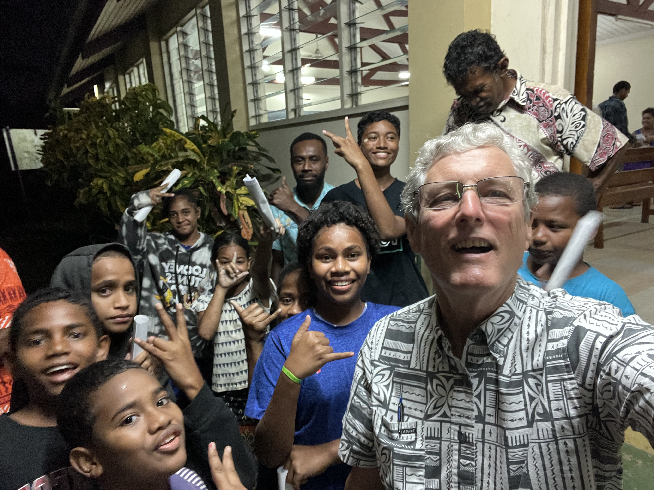
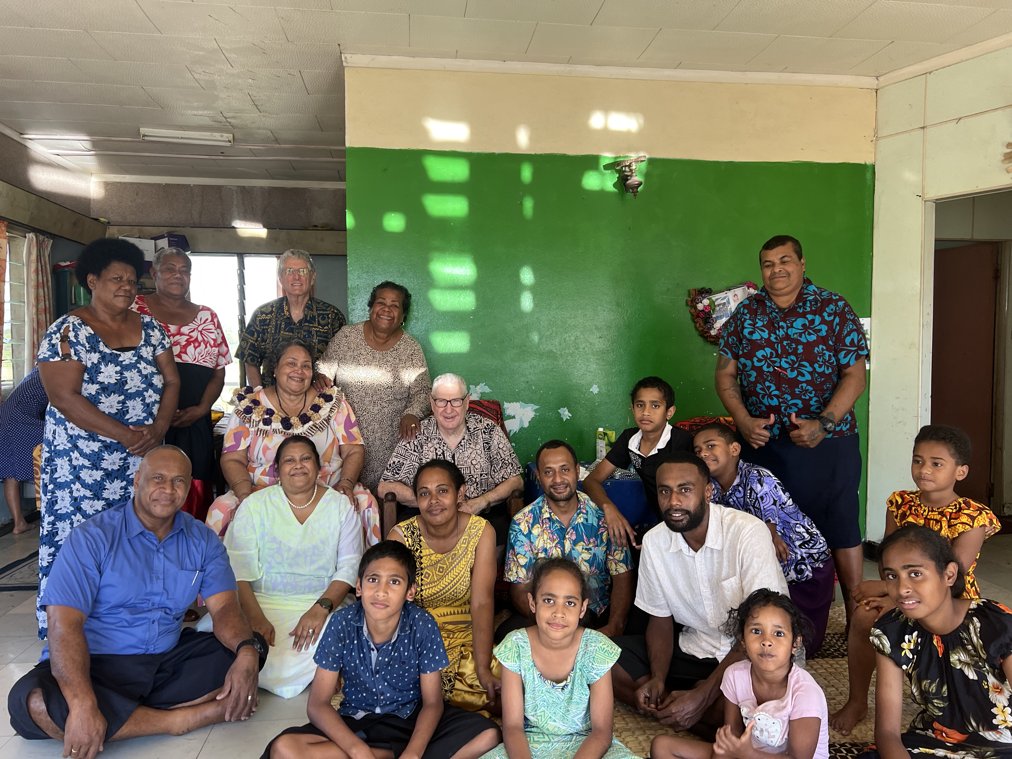
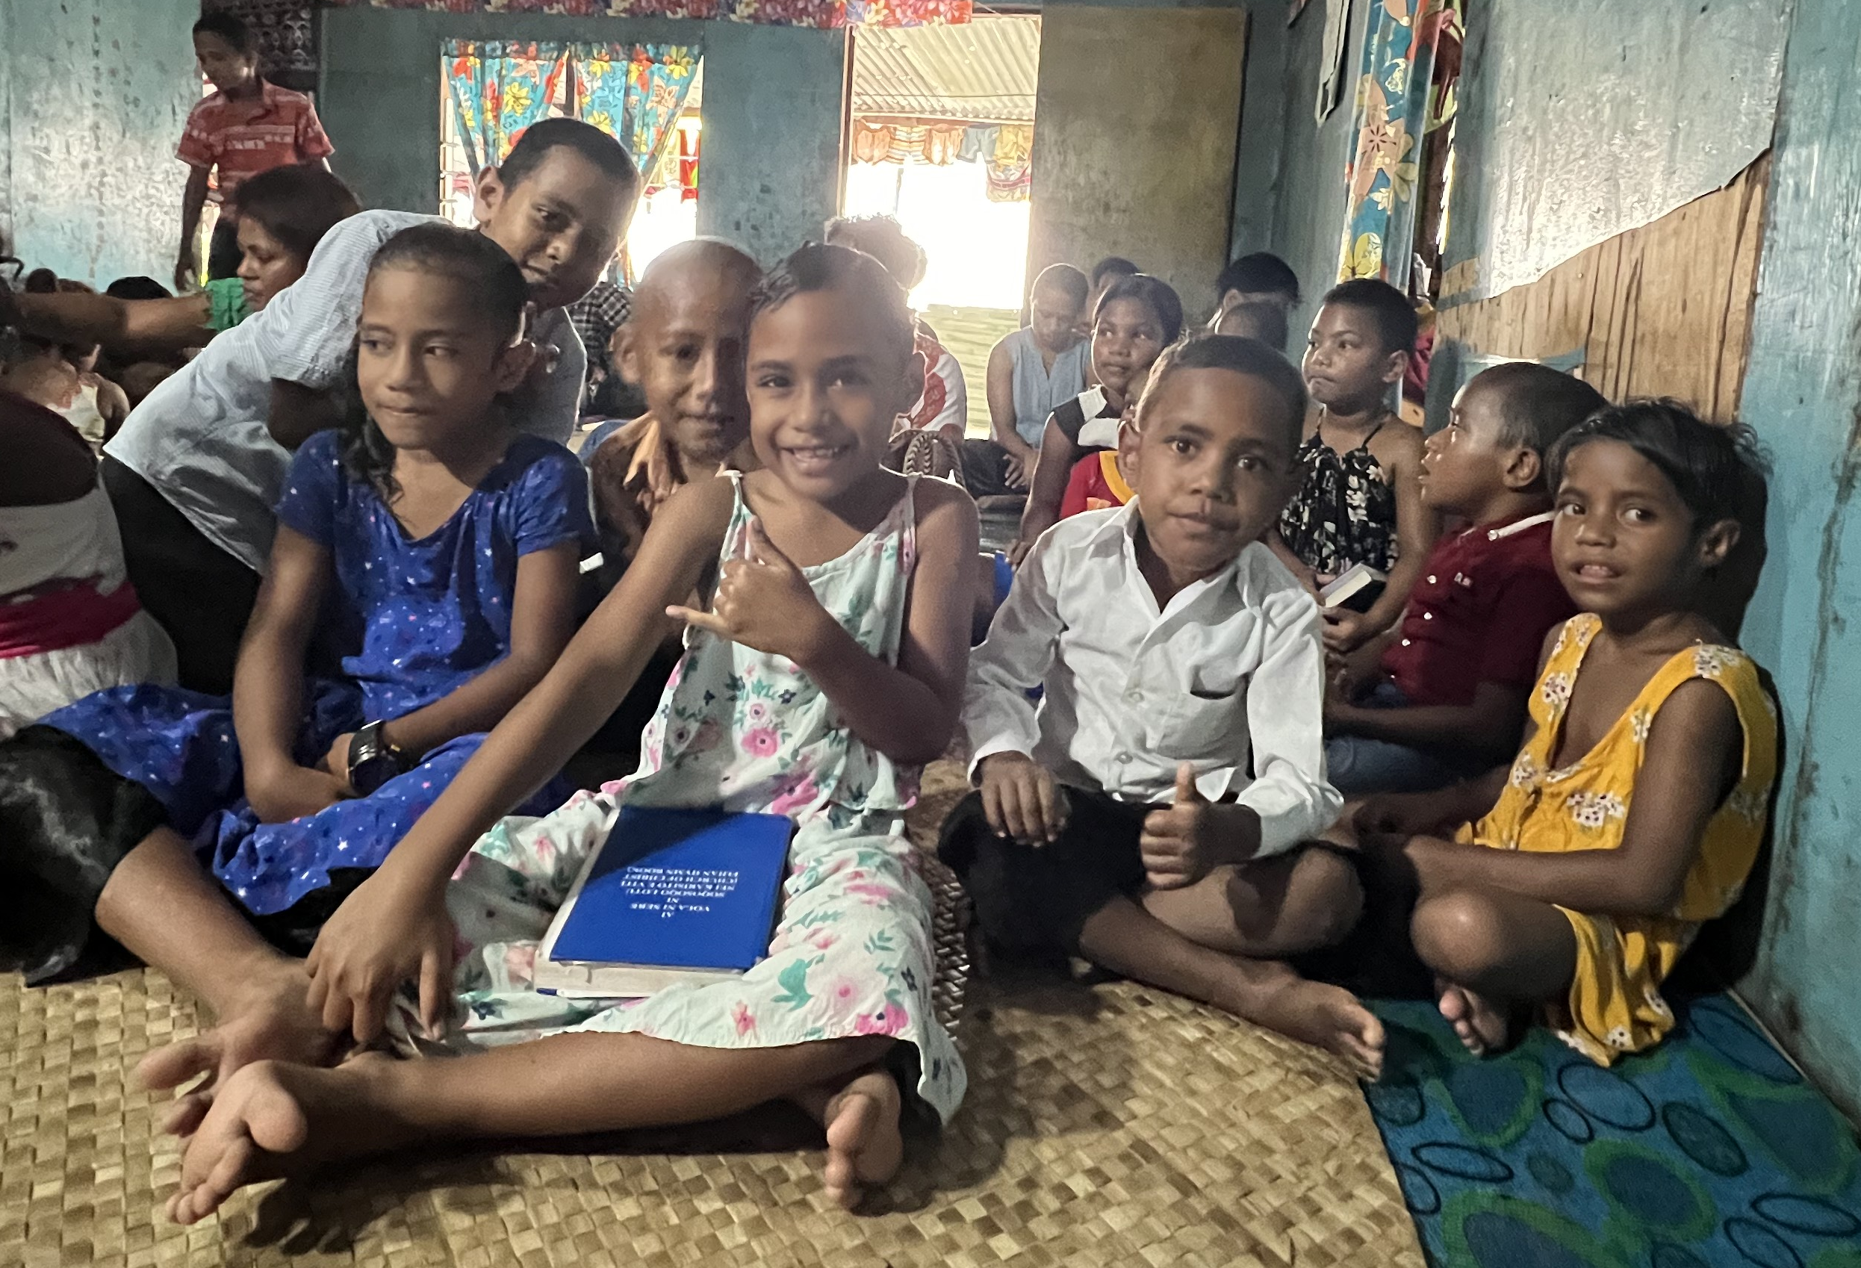
Greet one another with a holy kiss. The churches of Christ greet you. Rom 16:16

Slide 24
Thank you very much!
For your encouragement
Your Prayers
Your mission Sunday contributions
Vinaka vaka levu

Slide 25
