Slide 1


Slide 2
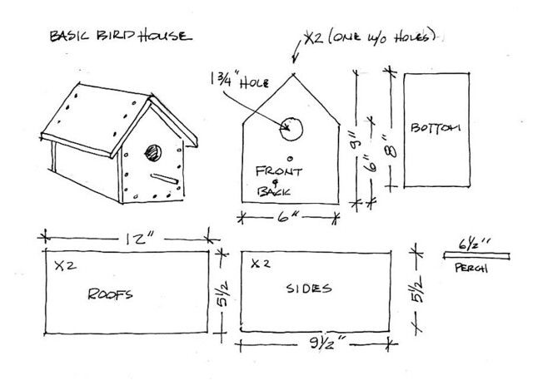
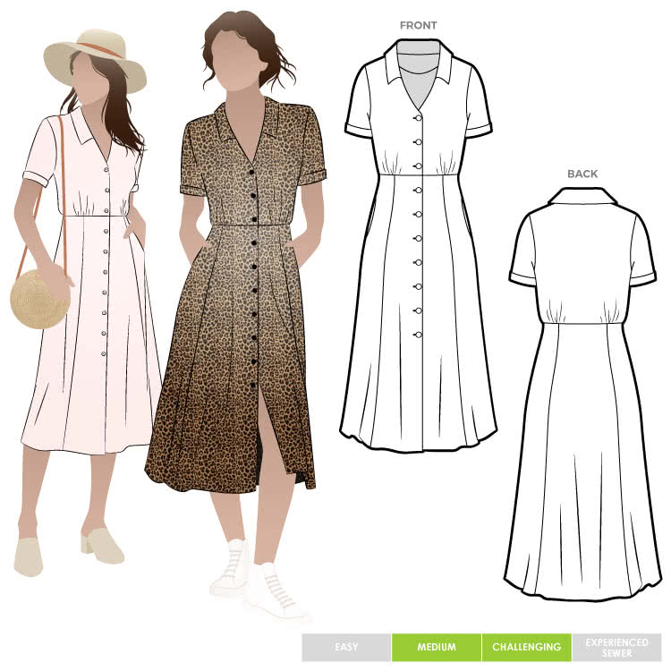
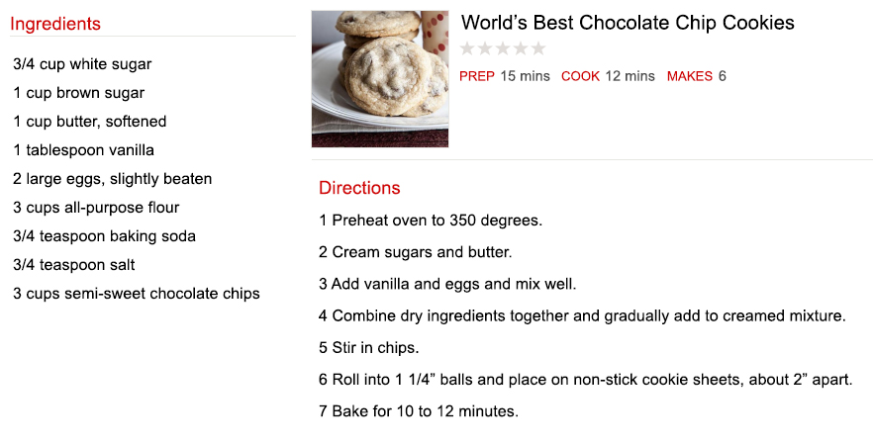

Slide 3
A pattern involves directions, specifications, uniformity, continuity, longevity
Patterns are designed to be duplicated, and when followed properly,
  Can be duplicated countless times
  Producing the same result every time
If a pattern is changed one bit, then it will NOT produce the same result (“close” is not the same)

Slide 4
God gave Noah a pattern for the ark (Gen. 6:13-22)
  Size, Materials, Construction specs, Those permitted to enter “into”
  “Thus Noah did; according to all that God commanded him, so he did.” (Gen. 6:22)
  What if Noah changed part of the pattern?
God gave Moses a pattern for the tabernacle (Ex. 25-31)
  Size, Materials, Construction specs, Those permitted to enter “into”
  “Thus Moses did; according to all that the LORD had commanded him, so he did.”
  (Ex. 40:16; cf. “pattern,” Ex. 25:9, 40; 26:30; Heb. 8:5)
  What if Moses changed part of the pattern?
It is evident when a pattern is not being followed
  In 2 Kings 23:22
    How did Josiah know that they had not been keeping the Passover properly and how did he know how to keep it properly? (23:21, 24, 25; 22:13)
  In Nehemiah 8:17
    How did Ezra know that they had not been keeping the Feast of Tabernacles properly and how did he know how to keep it properly? (8:8, 14, 18)

Slide 5
The church is “the eternal purpose” of God (Eph. 3:9-11; cf. 1 Pet. 1:19-21)
The pattern for the Lord’s church is found in His inspired revelation = the Bible
  2 Tim. 3:16-17; 2 Pet. 1:3, 20-21; Jude 3
  Rev. 22:18-19; 1 Cor. 4:6
  2 Tim. 1:13
The book of Acts provides the Lord’s pattern for His church
  The establishment, growth, work and worship of His church
The New Testament epistles provide the Lord’s pattern for His church
  The prescribed, ongoing work for congregations and Christians

Slide 6

THE SINGULARITY OF THE LORD’S CHURCH
Jesus built “My church…the kingdom” (singular) (Matt. 16:18-19)
Jesus bought His “church” (singular) with His blood (Acts 20:28)
Jesus has “one body=church” (Eph. 4:4+1:22-23)
Jesus is the one “head” of His one body/church (Eph. 5:23)
There are to be “no divisions” in His one church (1 Cor. 1:10)

Slide 7
THE DOCTRINE OF THE LORD’S CHURCH
The church is to teach the “same” doctrine (1 Cor. 1:10)
“Every” church is to teach and follow the same doctrine
(1 Cor. 4:17; 7:17; 14:33; 16:1)
There is “no other” or “any other” doctrine for the church to teach than “the apostles’ doctrine” and “one faith” revealed in the N.T.
(1 Tim. 1:3; Gal. 1:6-9; Acts 2:42; Eph. 4:5; 1 Pet. 4:11; Jude 3)

Slide 8
THE ORGANIZATION OF THE LORD’S CHURCH
Christ is the head of the church (Eph. 5:23; Col. 1:18)
Qualified males oversee individual congregations as shepherds
(Acts 14:23; 20:28-31; 1 Tim. 3:1-7; Tit. 1:5-9; 1 Pet. 5:1-4)
Qualified males serve in specific capacities as deacons
(1 Tim. 3:8-13; Acts 6:1-6)
Qualified males preach and teach God’s Word
(2 Tim. 4:1-4; 1 Tim. 2:8-14)

Slide 9
THE WORSHIP OF THE LORD’S CHURCH
Assemble every first day of the week (Acts 20:7; 1 Cor. 16:1-2; Heb. 10:25)
Pray to God through Christ (Acts 2:42; 12:5; 1 Cor. 14:14-15)
Sing acapella as a congregation (Eph. 5:19; Col. 3:16; Heb. 2:12)
Observe the Lord’s Supper every Sunday (Acts 20:7; 1 Cor. 11:20; 16:1-2)
Give of our means to support the work of the church (1 Cor. 16:1-2; 2 Cor. 8-9)
Preach the Word of God (Acts 20:7; 2 Tim. 4:2)
All avenues of worship led by Christian males (1 Tim. 2:8-14; 1 Cor. 14:34-35)

Slide 10
THE ENTRANCE INTO THE LORD’S CHURCH
There is only one path for salvation (Acts 4:12; John 14:6)
There is only one entrance into Christ (Rom. 6:3; Gal. 3:27)
There is only one entrance into the church (1 Cor. 12:13; John 3:3-5)
Salvation is only in the Lord’s church (Acts 2:38-47; Eph. 5:23; 1 Cor. 15:24)
Entrance requires faith in Jesus Christ (Acts 16:31; John 8:24)
Entrance requires repentance from sin (Acts 2:38; 17:30)
Entrance requires confession of faith (Matt. 10:32; Rom. 10:9)
Entrance requires baptism into Christ (Mark 16:16; Acts 2:38)
Entrance must be maintained through faithful living (Rev. 2:10; 1 Co. 15:58)

