Slide 1
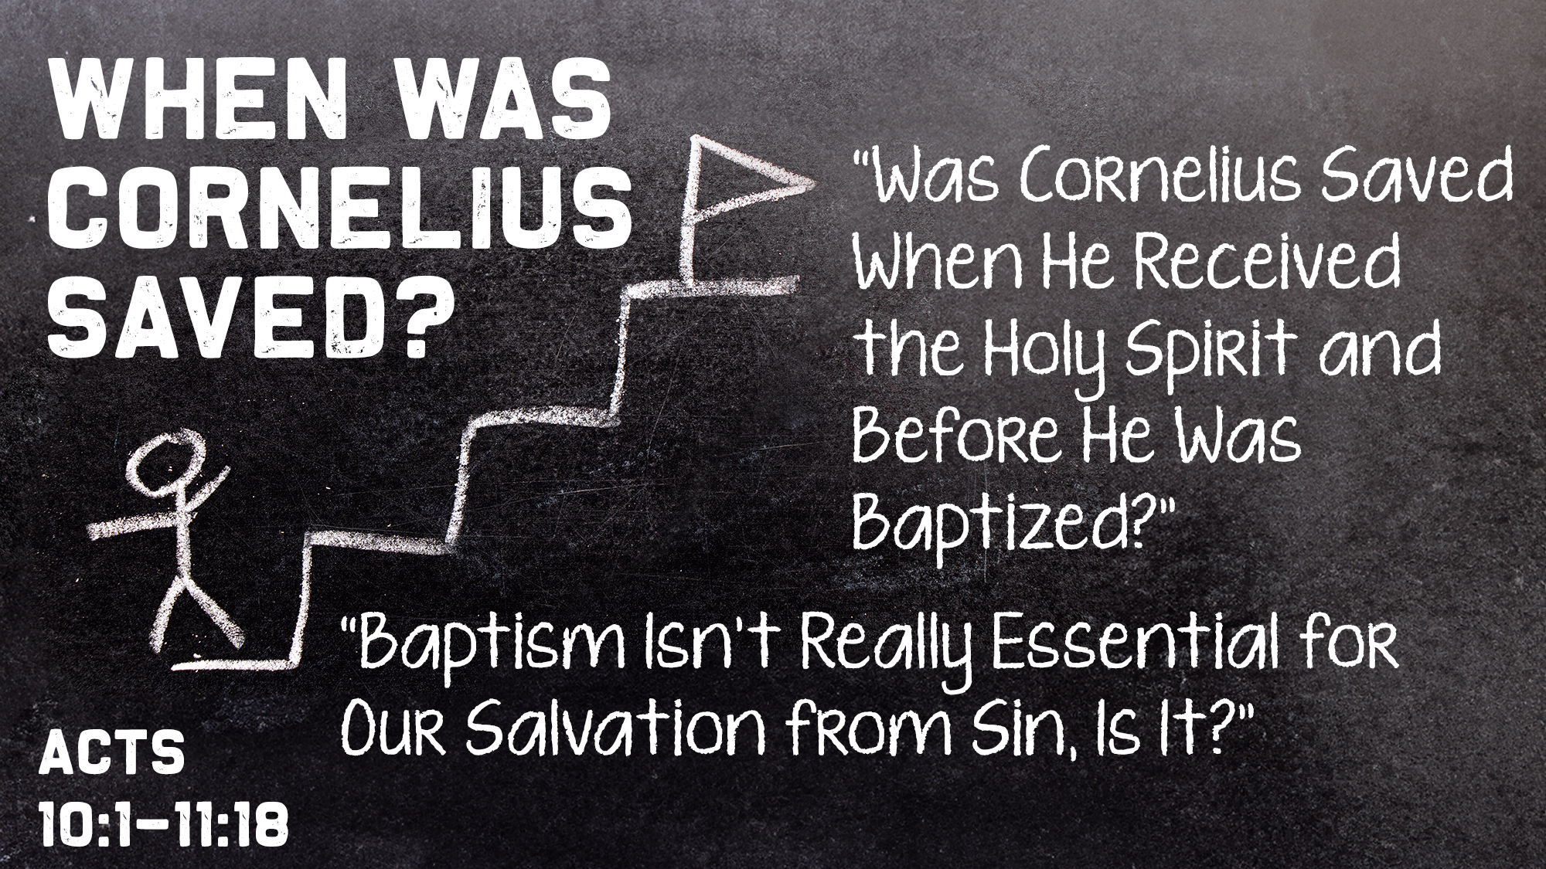


Slide 2
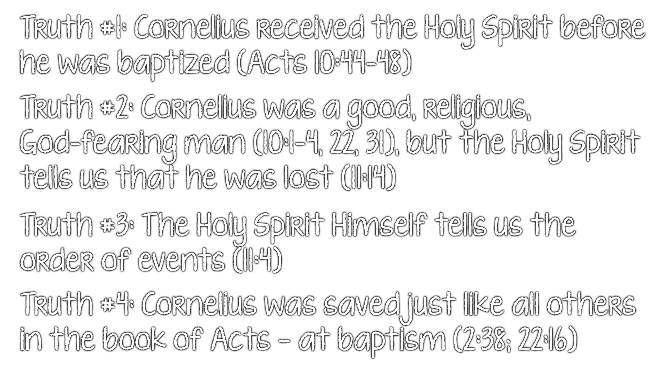

“The Holy Spirit fell upon all those who heard the word” in v. 44
They were “commanded…to be baptized in the name of the Lord” in verse 48
Does that prove that baptism is not essential for salvation?
  If it does, where does it say that?
  If it does, what does that say about the full N.T. teaching on baptism?
  If it does, why (for what purpose) was Cornelius baptized then?
  If it does, why were others baptized in the New Testament?
  If it does, what else does it prove from this text?

Slide 4

God told Cornelius that he would be told what he “must do” (10:6)
  With God, there are “must do’s” (cf. Acts 9:6; 16:30; John 3:7)
God told Cornelius “to hear words from” Peter (10:22)
  God told Cornelius that Peter “will speak to you” with words (10:32)
  Cornelius was ready “to hear all the things commanded…by God” (10:33)
  “The thingS commanded by God” are what he “must do” to be saved! (Matt. 7:21; Luke 6:46; Heb. 5:9; cf. Acts 17:30; 10:48)
God told Cornelius that Peter “will tell you wordS by which you…will be saved” (11:14)
  One cannot be saved without “the word of this salvation” (Acts 13:26; cf. Eph. 1:13)
  Without hearing those words, he was not saved (Rom. 10:13-17)
  Without obeying those words, he was not saved (Matt. 7:24-27; Heb. 5:9; Jas. 1:21-25)
The Holy Spirit told Peter to go to Cornelius’ house, “doubting nothing” (10:20; 11:12)

Slide 5
Peter arrived, “opened his mouth” and “began to speak” the words of salvation
(10:34-35; 11:15)
  His sermon begins with affirming the impartiality of God (10:34)
  His sermon begins with affirming who is “accepted by” God (10:35)
  Was Cornelius saved when Peter “began to speak”?
  The first words from Peter’s mouth are: “In truth I perceive that God shows no partiality”
“The Holy Spirit fell upon them” “as [Peter] began to speak” (11:15)
Peter realized what was going on and made the connection
  He told the apostles, “the Holy Spirit fell upon them, as upon us at the beginning” (11:15; 2:1-4)
  He “remembered” Jesus’ promise to baptize the apostles “with the Holy Spirit” (11:16+1:5)
  He concluded, “God gave them the SAME GIFT as He gave us” (11:17)
  The promise the Father made was, “I will pour out My Spirit upon all flesh”
  [Jew and Gentile] (Joel 2:28; Acts 2:17; cf. Luke 24:49; Acts 1:4; 2:33)
  The pouring out of the Spirit was “seen and heard” in Acts 2:1-6, 33
  The pouring out of the Spirit was “seen and heard” in Acts 10:45-46
The baptism of the Holy Spirit only happened twice
(in Acts 2 & Acts 10)

Slide 6
Why did the Holy Spirit interrupt Peter, as he began to speak, to be poured out on the Gentiles in Acts 10?
  Look at the first words of Peter’s sermon (10:34-35)
  The Jews “were astonished…because the gift of the Holy Spirit had been poured out on the Gentiles also” (10:45) = a CLEAR message from God to the Jews regarding the Gentiles
  The “same gift” to the Gentiles (11:17) meant that the Gentiles were “also granted” the opportunity to eternal “life” (11:18) and needed to hear what Peter had come to preach
Peter, then, preached the life, death and resurrection of Christ (10:36-42)
Peter taught that one must “believe” in Christ to be saved (10:43)
Peter taught that one must “repent” to have life (11:18)
Peter commanded to be baptized in the name of Christ to be saved (10:48; cf. 2:38)
At that point, Cornelius and his household were saved (11:14; 10:43; 11:18; 2:38)
The door of salvation was opened wide to the Gentiles (1:8; 11:18)

Slide 8
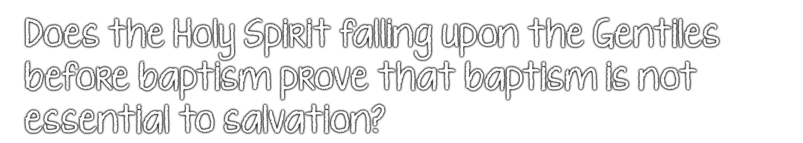
If the Gentiles receiving the Holy Spirit before their baptism in Acts 10 proves that baptism is not essential to salvation, then:
  What does receiving the Holy Spirit before repentance prove?
  What does receiving the Holy Spirit before believing prove?
  What does receiving the Holy Spirit before hearing the Word prove?
Are those not essential for salvation either?

Slide 9

By believing that Jesus is the Son of God – Acts 10:43
By repenting of your sins and turning toward God – Acts 11:18
By confessing your faith in Jesus Christ – Romans 10:9
By being baptized into Christ – Acts 10:48
  So that, at that point, God will forgive all of your sins – Acts 2:38
  So that, at that point, God will add you to His church – Acts 2:47
  So that, at that point, God will enroll you in heaven – Hebrews 12:23
By continuing faithfully with the Lord – Acts 11:23

