Slide 2
Some things are objectively morally right and
some things that are objectively morally wrong
There is universal contempt for murder, rape, stealing your money, etc.
  In The Warren-Flew Debate on the Existence of God (1976, p. 248):
    Question to Anthony Flew: “True/False. In murdering six million Jewish men, women, and children, the Nazis were guilty of real (objective) moral wrong.”
    Flew answered “True.”
  Michael Ruse: “The man who says that it is morally acceptable to rape little children, is just as mistaken as the man who says that 2 + 2 = 5” (Darwinism Defended, p. 275)
  Jean Paul Sartre: “Everything is indeed permitted if God does not exist”
Where did right and wrong being right and wrong for everyone come from?
  Right and wrong are NOT based on human thinking or human opinion
  Right and wrong had to come from above mankind, from a moral Lawgiver
  “The ways of the Lord are right” (Hos. 14:9)

Slide 3
Belief in God is natural to man (85-90% of the world are theists)
Even atheists agree that humans are predisposed to believe in an intelligent Creator of some sort
  Richard Dawkins:
  “Why, if it is false, does every culture in the world have religion? True or false, religion is ubiquitous, so where does it come from?...Though the details differ across the world, no known culture lacks some version…of religion” (The God Delusion, p. 159, 166)
  Christopher Hitchens:
  “Sigmund Freud was quite correct to describe the religious impulse, in The Future of an Illusion, as essentially ineradicable…” (God Is Not Great: How Religion Poisons Everything, p. 247)

Slide 4
Belief in God is natural to man (85-90% of the world are theists)
Even atheists agree that humans are predisposed to believe in an intelligent Creator of some sort
  Sam Harris:
  “Similarly, several experiments suggest that children are predisposed to assume design and intention behind natural events—leaving many psychologists and anthropologists to believe that children, left entirely to their own devices, would invent some conception of God” (The Moral Landscape: How Science Can Determine Human Values, p. 151)
  Paul Bloom and Deena Skolnick Weisberg:
  “[W]hen asked about the origin of animals and people, children spontaneously tend to provide and prefer creationist explanations” (“Childhood Origins of Adult Resistance to Science,” Science magazine, May 2007, p. 996)

Slide 5
Belief in God is natural to man (85-90% of the world are theists)
Even atheists agree that humans are predisposed to believe in an intelligent Creator of some sort
  Paul Bloom:
  “There is by now a large body of research suggesting that humans are natural-born creationists. When we see nonrandom structure and design, we assume that it was created by an intelligent being…Evolutionary biologist Richard Dawkins was right to complain, then, that it seems ‘as if the human brain were specifically designed to misunderstand Darwinism’” (“In Science We Trust: Beliefs About the Natural World that are Present in Infancy Influence People’s Response to Evolutionary Theory,” Natural History Magazine, 118[4]:16-19)

Slide 6
Belief in God is natural to man (85-90% of the world are theists)
Even atheists agree that humans are predisposed to believe in an intelligent Creator of some sort
There is a universal, built-in, in-born, intuitive human tendency to believe in an intelligent Creator – How did it get there?
  God “has made from one blood every nation of men to dwell on all the face of the earth…so that they should seek the Lord, in the hope that they might grope for Him and find Him, though He is not far from each one of us” (Acts 17:26-27)

Slide 7
The universe has 300 sextillion (23 zeros) stars in billions of galaxies
  We live in the Milky Way galaxy (only 100,000 light years across)
  Approximately 100 billion stars (or 100 to 400 billion stars) in Milky Way galaxy
  Our solar system is one of about 4,000 solar systems in Milky Way
  The position, distance, tilt, composition and atmosphere of the earth is perfect for life
Where did such precision in design come from?
  The existence of a poem demands the existence of a poet
  The existence of a painting demands the existence of a painter
  The existence of a building demands the existence of a builder
  The existence of an engine demands the existence of an engineer
  The existence of a watch demands the existence of a watch-maker
  The existence of a shoe demands the existence of a shoe-maker
  The existence of a universe demands the existence of a universe-maker

Slide 8
Evolutionists and atheists are in a predicament:
  Michael Shermer:
  “The design inference comes naturally. The reason people think that a Designer created the world is because it looks designed” (Why Darwin Matters, p. 65)
  Jerry Coyne,
  “If anything is true about nature, it is that plants and animals seem intricately and almost perfectly designed for living their lives…Nature resembles a well-oiled machine, with every species an intricate cog or gear…The more one learns about plants and animals, the more one marvels at how well their designs fit their ways of life” (Why Evolution Is True, p. 1, 3)
  Richard Dawkins:
  “So compelling is that illusion [of design] that it has fooled our greatest minds for centuries, until Charles Darwin burst onto the scene” (The Greatest Show on Earth, p. 416)

Slide 9
Evolutionists and atheists are in a predicament:
  Paul Davies:
  The universe is “ordered in an intelligible way,” with “fine-tuned properties…Like Baby Bear’s porridge in the story of Goldilocks, our universe seems ‘just right’ for life. It looks…as if ‘a super-intellect has been monkeying with physics’” (“Laying Down the Laws,” New Scientist, 194[2610]:30-34, June)
There is evidence in the universe of planning, intelligence, intent, purpose and complexity, which means…
  There must have been an intelligent, universe Designer!
“The heavens declare the glory of God; And the firmament shows His handiwork. Day unto day utters speech, And night unto night reveals knowledge. There is no speech nor language Where their voice is not heard” (Psalm 19:1-6)

Slide 10
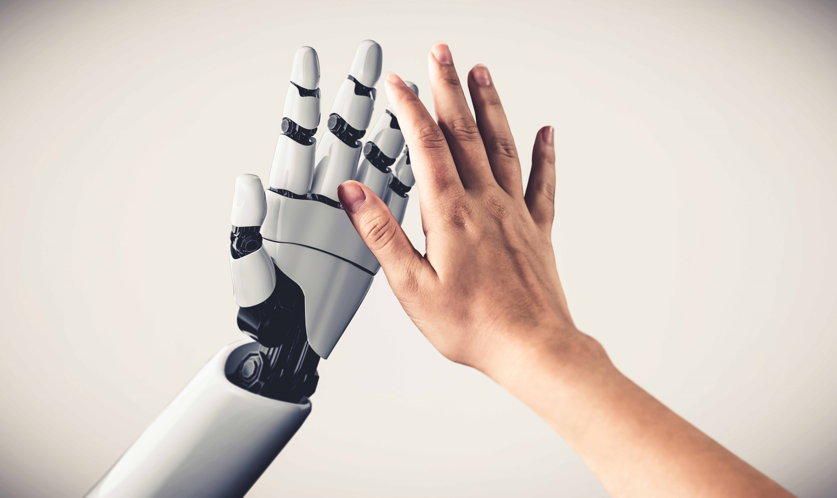
THE HUMAN HAND evidences design and has been used by scientists for the creation of prosthetics
  Was the prosthetic designed?
  Was the human hand designed?
  “My frame was not hidden from You,
  When I was made in secret”
  (Psa. 139:15)

Slide 11
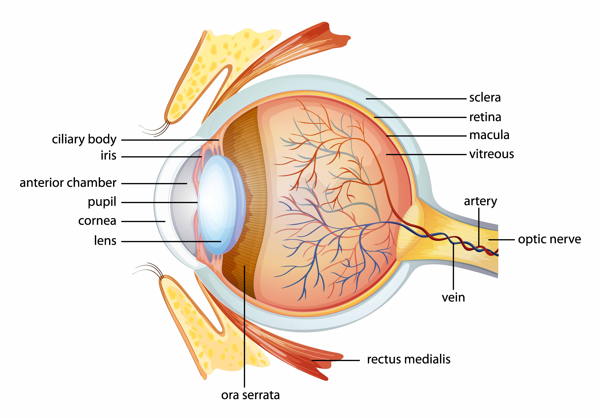
THE HUMAN EYE evidences design and has been studied to mimic its design
  The human eye is made up of many intricate parts
  Article in Technology Review, by Emily Singer, published by MIT,
  entitled, “Decoding the Human Eye:
  Superdense Arrays of Silicon Electrodes Will
  Bring Scientists Closer to an Artificial Retina
  That Approximates Normal Vision”
    A review of research at UCSC which designed a
    microchip that attempted to detail the process
    used by the human retina to encode information
    UCSC physicist Alan Litke: “The retina is a very
    sophisticated visual-information-processing device.”
  A “device” demands devising
    How would mindless, purposeless evolution devise?

Slide 12
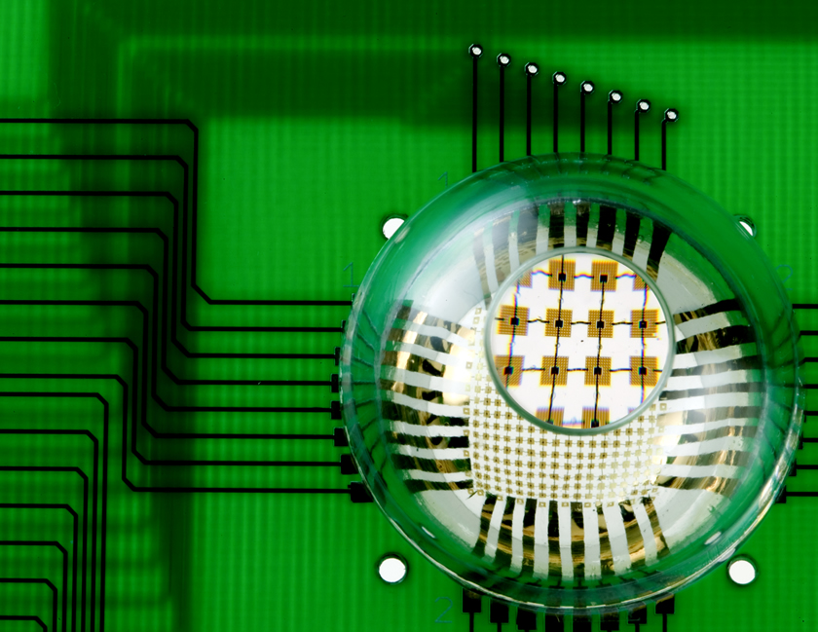
THE HUMAN EYE evidences design and has been studied to mimic its design
  Engineers in Illinois studied the eye to determine how the eye can see
  with such a wide view at a single glance
    They designed a special camera in the shape of the eye
  Scientists and engineers are studying the human
  eye and then making designs based upon the eye
    Powerful testimony that the eye itself is designed!
    “While the retina is often likened to a camera, it is in
    reality much more complicated” (Emily Singer)
  Charles Darwin: “To suppose that the eye with all its inimitable contrivances for adjusting the focus to different distances, for admitting different amounts of light, and for the correction of spherical and chromatic aberration, could have been formed by natural selection, seems, I freely confess, absurd in the highest sense” (On the Origin of the Species, p. 170)
  “The hearing ear and the seeing eye, the Lord has made them both” (Prov. 20:12)

Slide 13
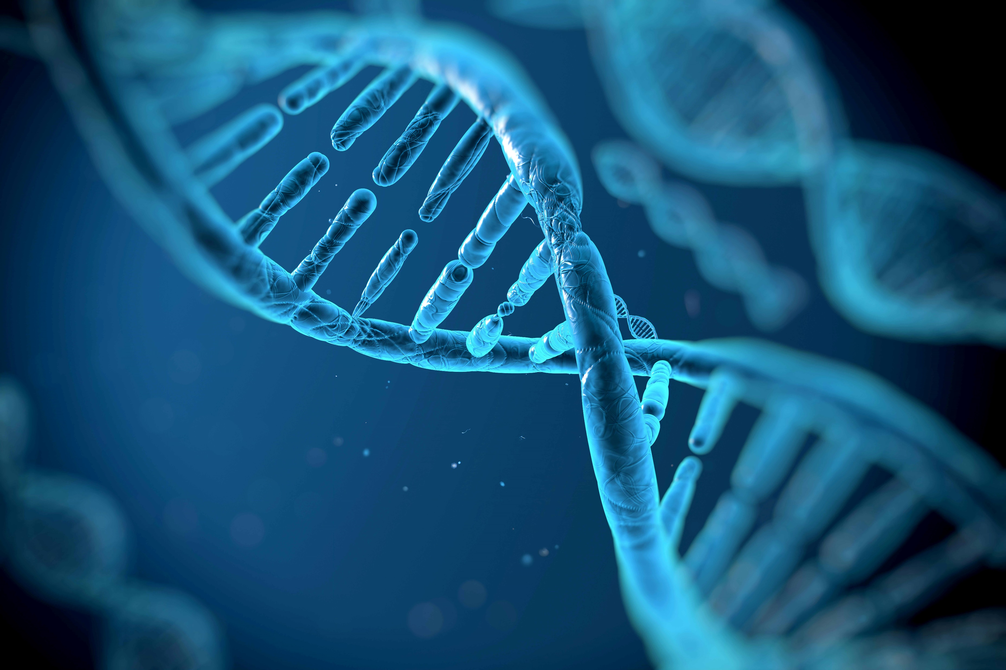
THE HUMAN CELLS AND DNA evidence design and have been studied to try to replicate the design
  Our bodies are composed of over 30 trillion cells
    Inside the nucleus of every cell is the DNA
    which contains the genetic code (or blueprint),
    which tells the cell how to function
  DNA stores coded information, like a language
    If the information in the DNA of a single human cell
    were written out in English, it would fill a 300-volume
    set of encyclopedias of approx. 2,000 pages each
    Computer engineers have tried figuring out how to
    produce such efficient data storage
  If a robot requires complicated code to function,
  does not human DNA require a Programmer?
  “I am fearfully and wonderfully made” (Psa. 139:14)

Slide 14

Toymakers draw out detailed designs and steps for assembling Lego structures
Architects draw blueprints for houses and buildings
  “Every house is built by someone” (Heb. 3:4a)
Who drew the blueprints for:
  The universe with its intricate details?
  Your human body with its intricate details?
  Your hand, your eye, your cells, your DNA?
Explosions (like a “Big Bang”):
  Do NOT result in design and order
  Result in chaos and disorder
“He who built all things is God” (Heb. 3:4)
Loads of helpful information:
apologeticspress.org

Slide 15
What should be our response?
  God expects His creations to examine the abundant and obvious evidence all around them and come to the conclusion that He exists (Rom. 1:19-21)
  God desires that those who realize that He exists and that He made them will “seek the Lord, in the hope that they might grope for Him and find Him” (Acts 17:26-27)
  God sent His Son to:
    Profess His love for His creation (John 3:16)
    Prove that we are “the offspring of God” (Acts 17:29), not the result of naturalistic chance
    Provide for us His will for our lives (Acts 17:30)
    Prepare us for the day of judgment, that we might live with Him (Acts 17:31)
Will you give your life to the God who gave you life and gave His life for you?

Slide 16
God’s plan requires faith that Jesus is God’s Son – Acts 16:31
God’s plan requires repentance from sin – Luke 13:3
God’s plan requires confession of faith – Romans 10:9
God’s plan requires baptism into Christ – John 3:5
  Then, and only then, will God forgive all sins – Acts 2:38
  Then, and only then, will God add to His church – Acts 2:47
  Then, and only then, will God enroll in heaven – Hebrews 12:23
God’s plan requires faithful living – Revelation 2:10

