Slide 2
We absolutely must:
A waken to the prospects all around us!
C reate opportunities to teach!
T each the gospel to others!
Creating opportunities to teach is NOT the same thing as teaching the gospel.
Creating opportunities is merely a means to an end of our heavenly commission.
Eventually, we must come to ask, “Can we study the Bible together sometime?”
Christianity is a taught religion.
Christianity cannot be spread by osmosis.

Slide 3
EACH and EVERY Christian has a PERSONAL responsibility
to teach the gospel!
  WORLD evangelism is NOT PERSONAL evangelism!
  FRIENDSHIP evangelism is NOT personal EVANGELISM!
  PERSONAL evangelism involves and requires PERSONAL TEACHING!
Personal teaching is the most effective means of spreading the gospel.
  The gospel can and is taught effectively today via television, radio, the internet, etc.
  Even if I support such efforts financially, that has not removed and/or reduced my personal responsibility to teach.
  In fact, one-on-one teaching of the gospel can be the most effective.

Slide 4
Jesus made the Great Commission personal!
  “[You] Go therefore and make disciples of all the nations,
  baptizing them…teaching them…” (Matt. 28:19-20).
  “[You] Go into all the world and preach the gospel…” (Mark 16:15).
I cannot fulfill this command for someone else.
Someone else cannot fulfill this command for me.

Slide 5


Ask WHEN is the best TIME for them?
  Make it as convenient for them as possible.
  Make your schedule fit their schedule (not vice versa).
Ask WHERE is the best PLACE for them?
  Make it as convenient for them as possible.
  At their home? At your home? At the church building?
Decide WHAT/HOW you will teach.
  Will you teach them straight out of the Bible yourself?
  Is there a resource available that fits your style?
Would you prefer to have help? Then, WHO?
  Ask a preacher. Ask an elder. Ask a proven soul-winner.
  There is no shame in asking for someone to help you.
  If you do not teach it yourself, you will learn from the one who does.

Slide 6
EVERY Christian knows what to teach.
Jesus said, “Preach the gospel” in Mark 16:15.
Paul defined “the gospel” in 1 Corinthians 15:1-4.
Every Christian has obeyed God’s plan of salvation!
  Having obeyed it, he knows it (and knows it intimately).
  Who is there who cannot teach someone else (from Scripture) what he learned and what he knew that prompted him to obey the gospel?
  Who is there who cannot teach someone else (from Scripture) to do the very thing that he did to be saved from sin?

Slide 7
WHAT JESUS DID FOR YOU AND WHY.
  He created you (John 1:3; Col. 1:16).
  He came to this earth for you (Phil. 2:6; John 1:14).
  He died on the cross for you (Rom. 5:8; Gal. 2:20).
  He shed His blood for you (Eph. 1:7; Heb. 9:12).
  He was raised from the dead for you (1 Cor. 15:1-26; Ro. 8:34).
  BECAUSE:
    He loves you (Eph. 5:2; 1 John 3:16).
    He wants to save you (Matt. 20:28; Tit. 2:14).
    He wants to take you to heaven (John 14:1-3; 1 Thess. 4:17).

Slide 8
WHAT JESUS EXPECTS OF YOU AND WHY.
  Learn and know the truth (Rom. 10:17; John 8:32).
  Obey the will of God (Matt. 7:21; John 14:15; Heb. 5:8-9).
  Believe Jesus is God’s Son (John 1:12; 3:16; 20:30-31).
  Repent (turn) from your sins (Luke 13:3; Acts 17:30).
  Confess your faith in Jesus (Matt. 10:32; Rom. 10:9-10).
  Be immersed into Christ (Acts 2:38; 22:16; Gal. 3:27).
  Live faithfully and serve Him (Rev. 2:10; 1 Cor. 15:58).
  SO THAT:
    You can prove your love for Him (John 14:15; 1 John 5:2-3).
    You can be saved from your sins (Acts 2:38; 22:16; 1 Jn. 1:7).
    You can go to heaven (Matt. 7:21; Heb. 5:8-9).

Slide 9



“Visualized Bible Study” by Jule Miller

Slide 10



“Open Bible Study” by Ivan Stewart

Slide 11

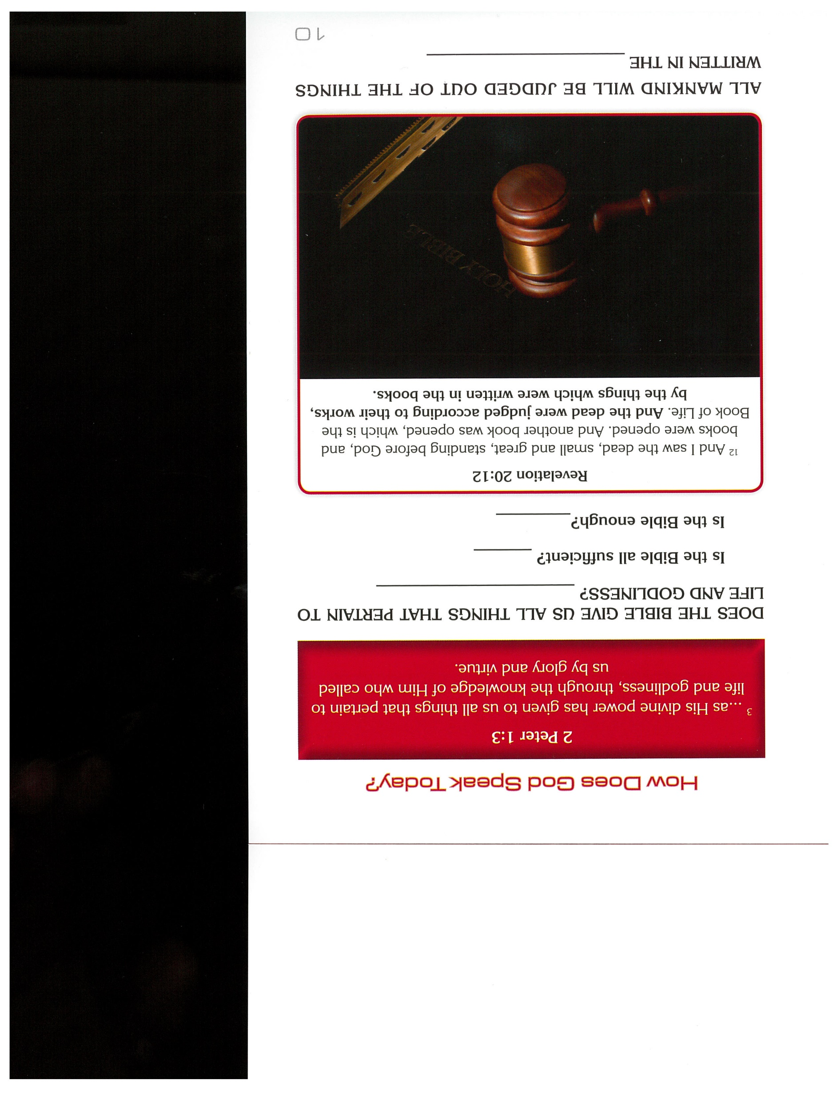
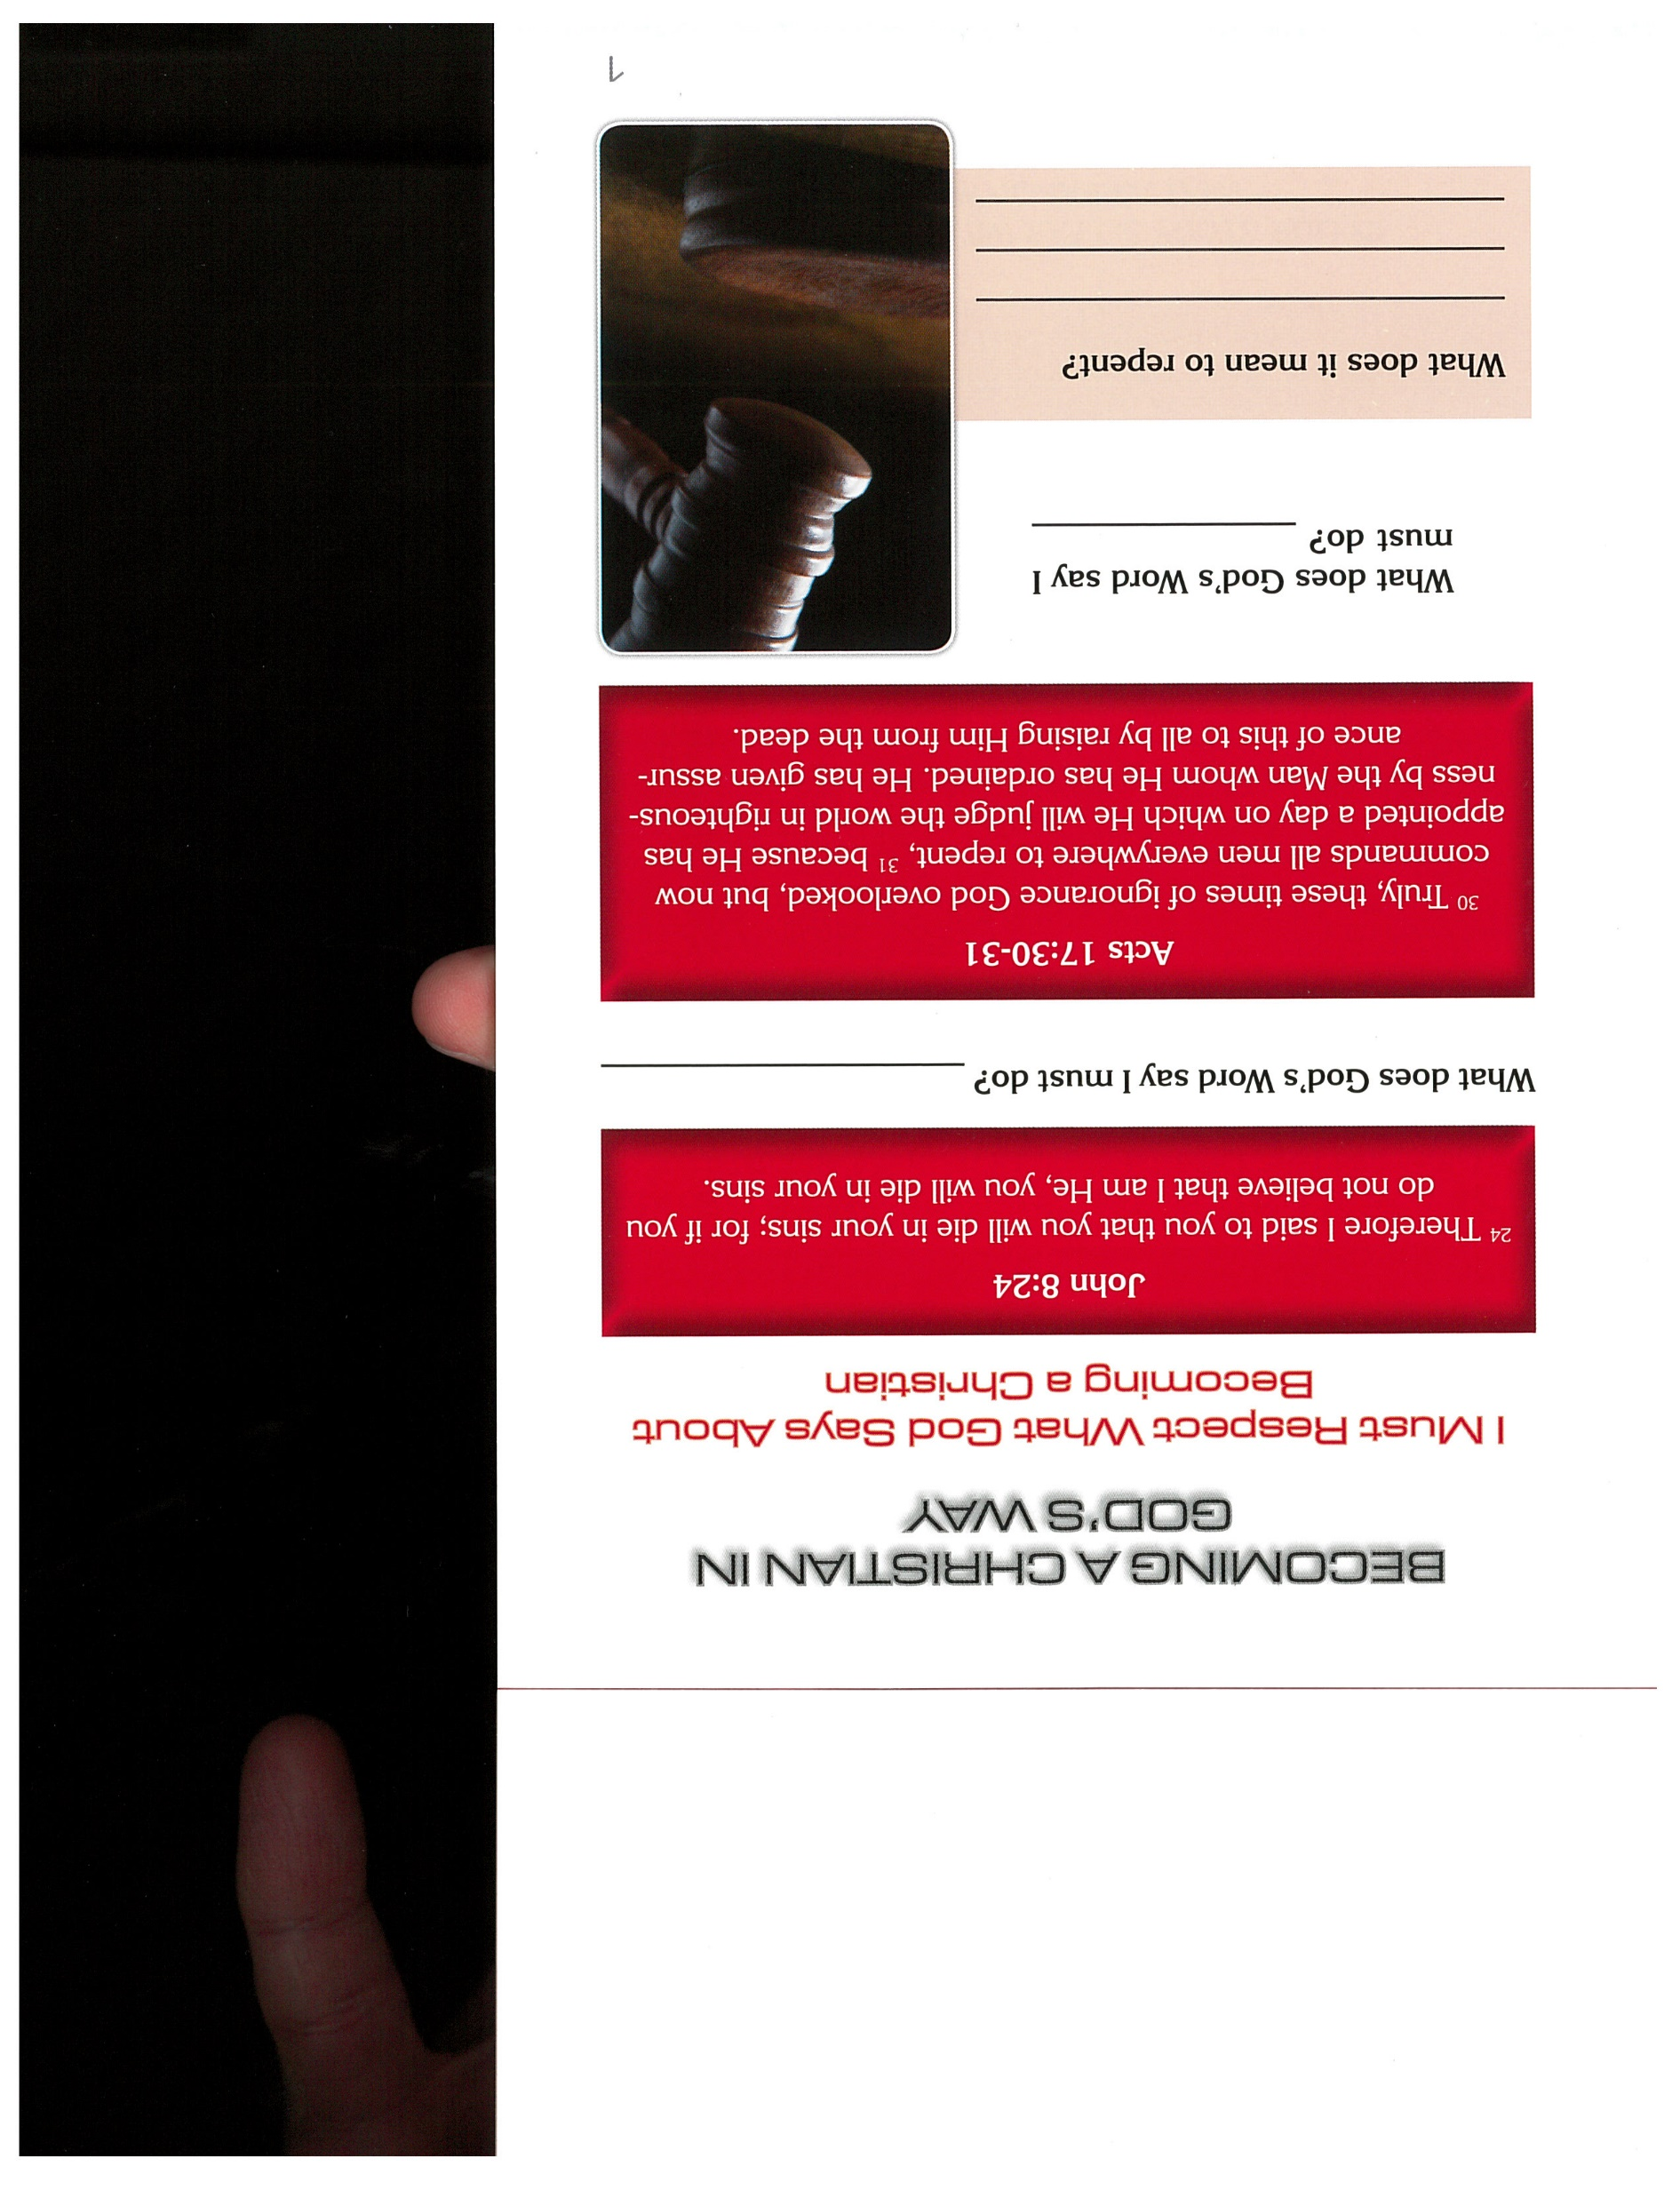
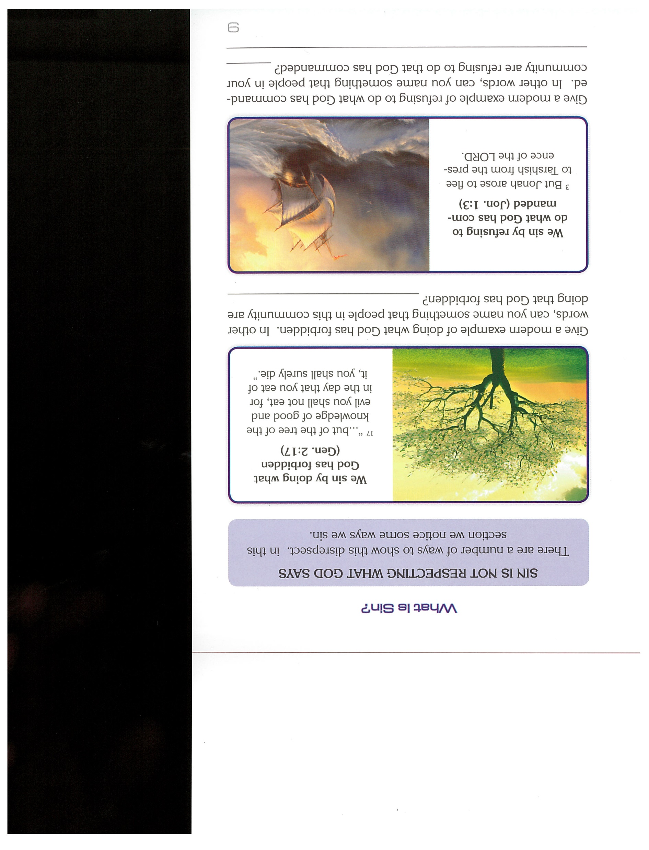

“God Speaks Today” by Jerry A. Jenkins

Slide 12

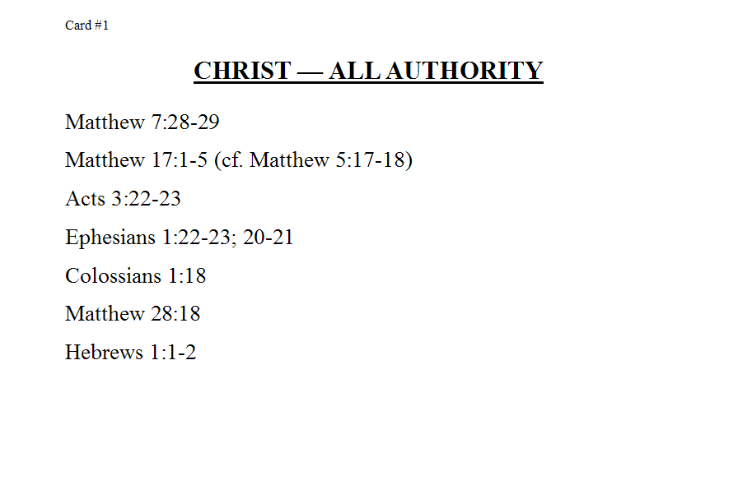
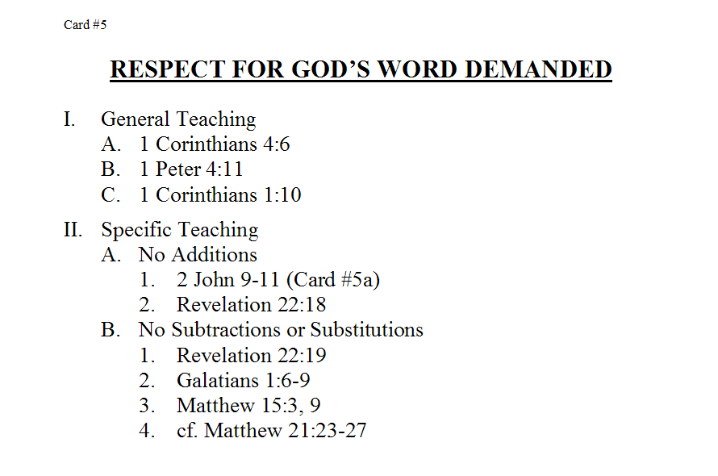
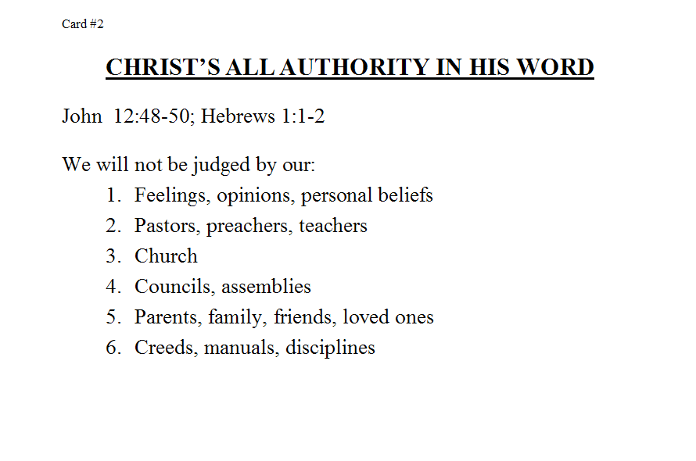
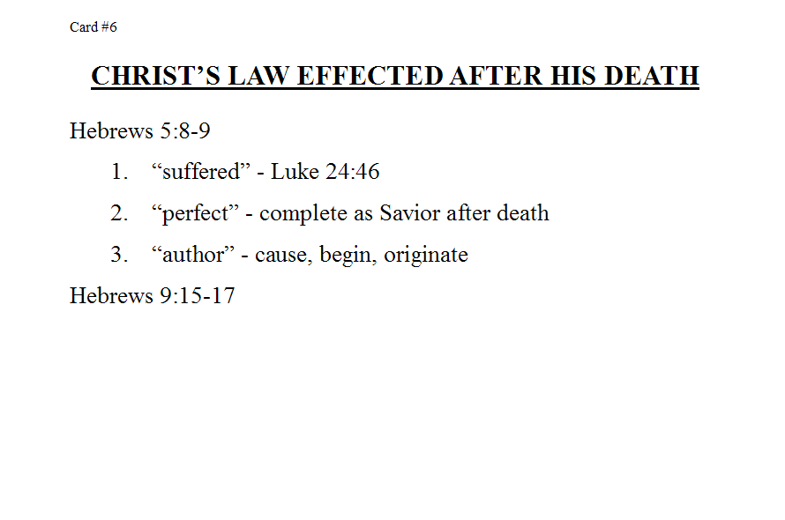
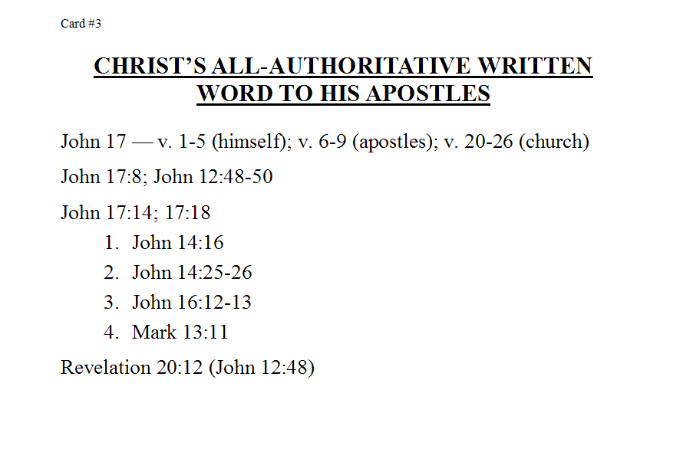
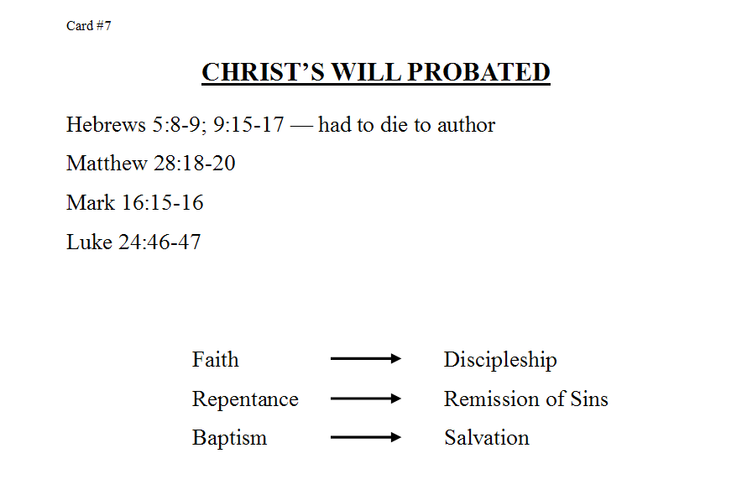

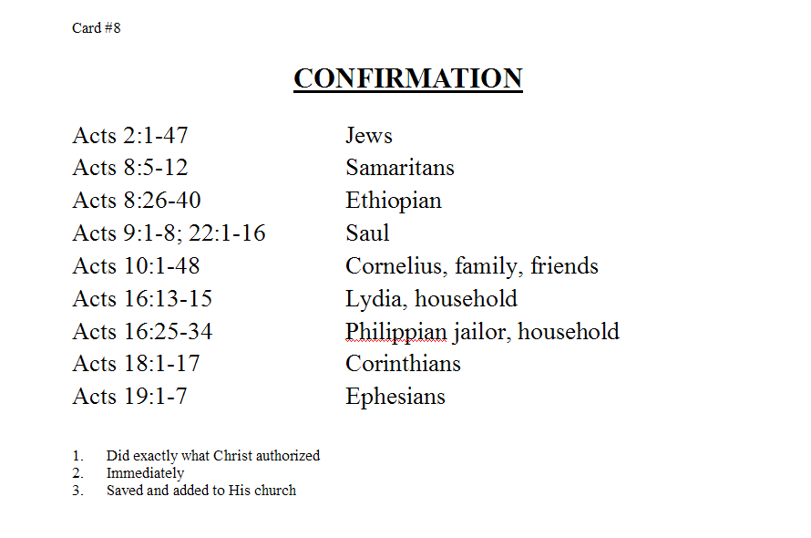
“Circles of Truth” by Bill Hatcher

Slide 13

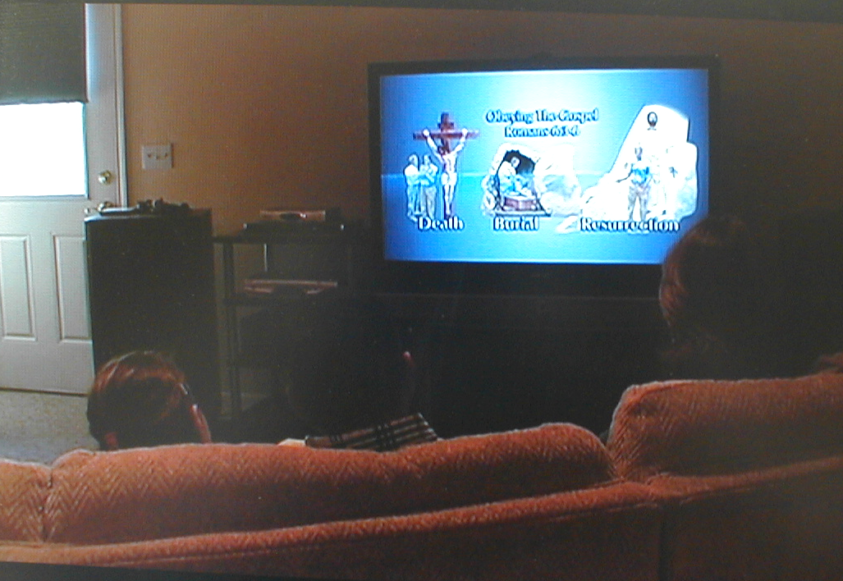
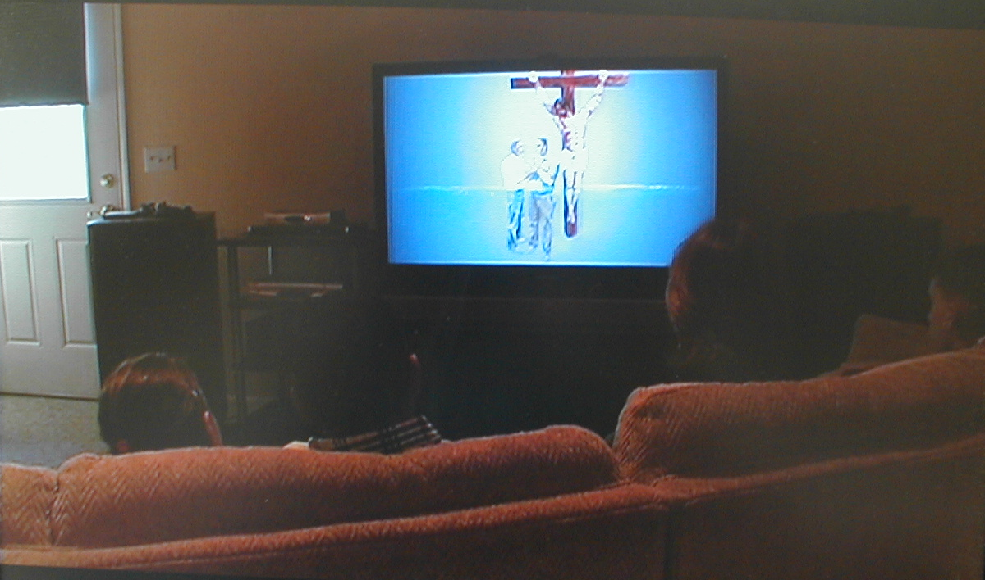
“Searching for Truth” by WVBS

Slide 14

“Back to the Bible” by Bobby Bates

Slide 15

“Fishers of Men”
16-Lesson Course

Slide 16


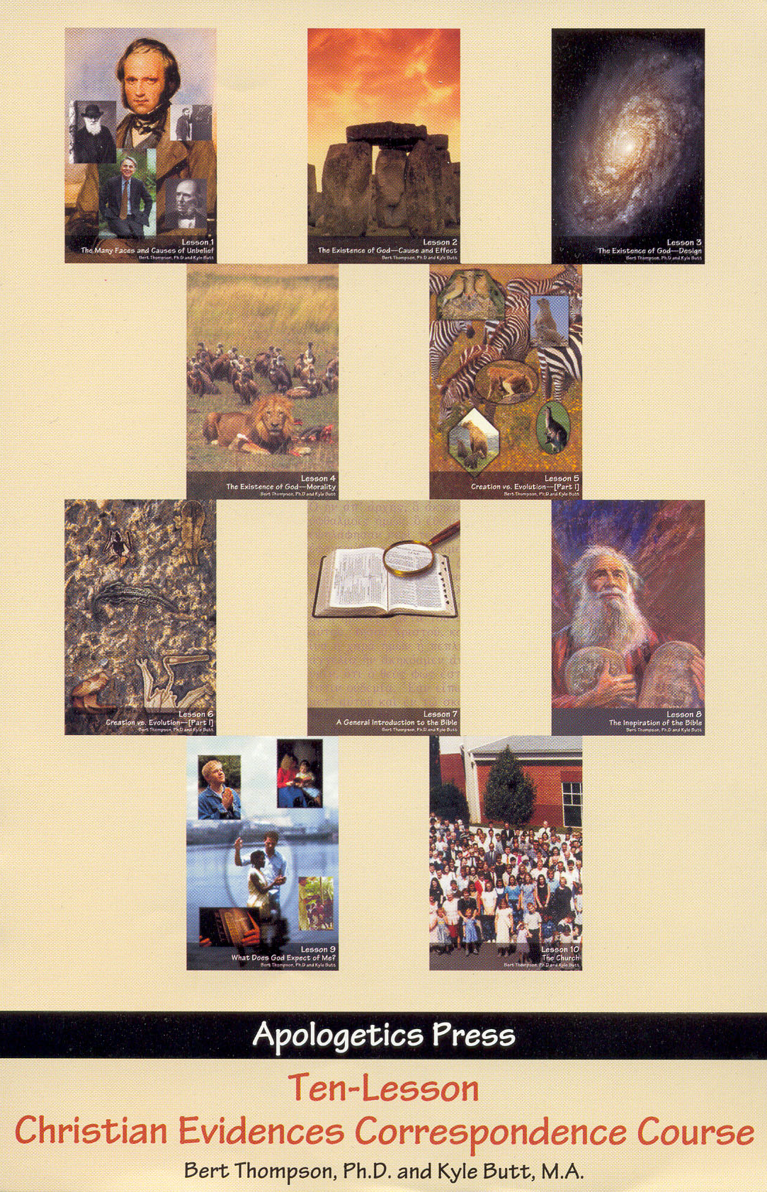
Bible Correspondence Courses

