Slide 1

Judges
Palm Beach Lakes
April-May 2024
Dan Jenkins

Slide 2
Faithful
“Clock”
of the Judges
Deliverer/Judge
Idolatry
Repentance

Slide 3
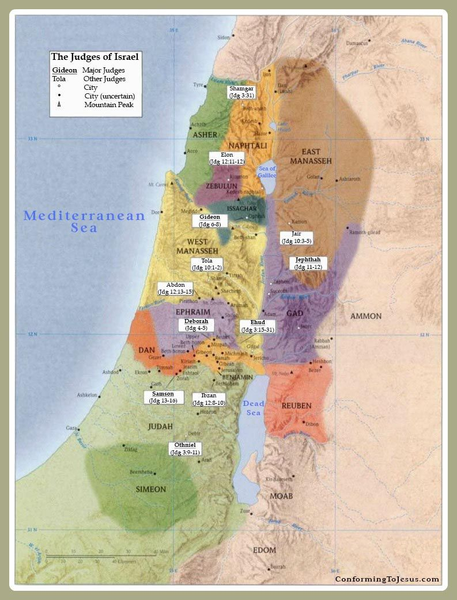
Shamgar
Othniel
Ehud
Shamgar
Deborah
Gideon, Abimelech
Tola, Jair, Jephthah
Ibzan, Elon, Abdon
Samson, Eli, Samuel

Slide 4
Draw a Line Matching Judges to Their Description
Othniel
Ehud
Shamgar
Deborah
Gideon
Abimelech
Tola, Jair
Jephthah
Ibzan, Elon, Abdon
Samson
Eli, Samuel
The Last Judge
The Woman Judge
The Strong Judge
The Left-Handed Judge
The Judge Who Tried to Be a King
The Judge Who Made a Foolish Vow
The Judge Who Killed 600 Philistine With a Goad
The Old Judge
The Three “Insignificant” Judges
The Judge With an Army of 300
The Two “Insignificant” Judges
The First Judge—Caleb’s son-in-law

Slide 5
Othniel—Caleb’s son-in-law
Ehud
Shamgar
Deborah
Gideon
Abimelech
Tola, Jair
Jephthah
Ibzan, Elon, Abdon
Samson
Eli, Samuel

Slide 6
Othniel—Caleb’s son-in-law
Ehud—The Left-handed judge
Shamgar
Deborah
Gideon
Abimelech
Tola, Jair
Jephthah
Ibzan, Elon, Abdon
Samson
Eli, Samuel

Slide 7
Othniel—Caleb’s son-in-law
Ehud—The Lefthanded Judge
Shamgar—The Judge who killed 600 Philistines with an ox goad
Deborah
Gideon
Abimelech
Tola, Jair
Jephthah
Ibzan, Elon, Abdon
Samson
Eli, Samuel

Slide 8
Othniel—Caleb’s son-in-law
Ehud—The Lefthanded Judge
Shamgar—killed 600 Philistines with an ox goad
Deborah—The Woman Judge
Gideon
Abimelech
Tola, Jair
Jephthah
Ibzan, Elon, Abdon
Samson
Eli, Samuel

Slide 9
Othniel—Caleb’s son-in-law
Ehud—The Lefthanded Judge
Shamgar—The Judge who killed 600 Philistines with an ox goad
Deborah—The Woman Judge
Gideon—The Judge with an army of 300
Abimelech
Tola, Jair
Jephthah
Ibzan, Elon, Abdon
Samson
Eli, Samuel

Slide 10
Othniel—Caleb’s son-in-law
Ehud—The Lefthanded Judge
Shamgar—The Judge who killed 600 Philistines with an ox goad
Deborah—The Woman Judge
Gideon—The Judge with an army of 300
Abimelech—The Judge who tried to be a king
Tola, Jair
Jephthah
Ibzan, Elon, Abdon
Samson
Eli, Samuel

Slide 11
Othniel—Caleb’s son-in-law
Ehud—The Lefthanded Judge
Shamgar—the Judge who killed 600 Philistines with an ox goad
Deborah—The Woman Judge
Gideon—The Judge with an army of 300
Abimelech—The Judge who tried to become a king
Tola, Jair—Two “Insignificant” Judges
Jephthah—The Judge who made a foolish promise
Ibzan, Elon, Abdon—Three “Insignificant” Judges
Samson—The strong Judge
Eli, Samuel—The old Judge AND the last Judge

Slide 12
Othniel—Caleb’s son-in-law
Ehud—The Left-handed judge
Shamgar
Deborah
Gideon
Abimelech
Tola, Jair
Jephthah
Ibzan, Elon, Abdon
Samson
Eli, Samuel

