Slide 2

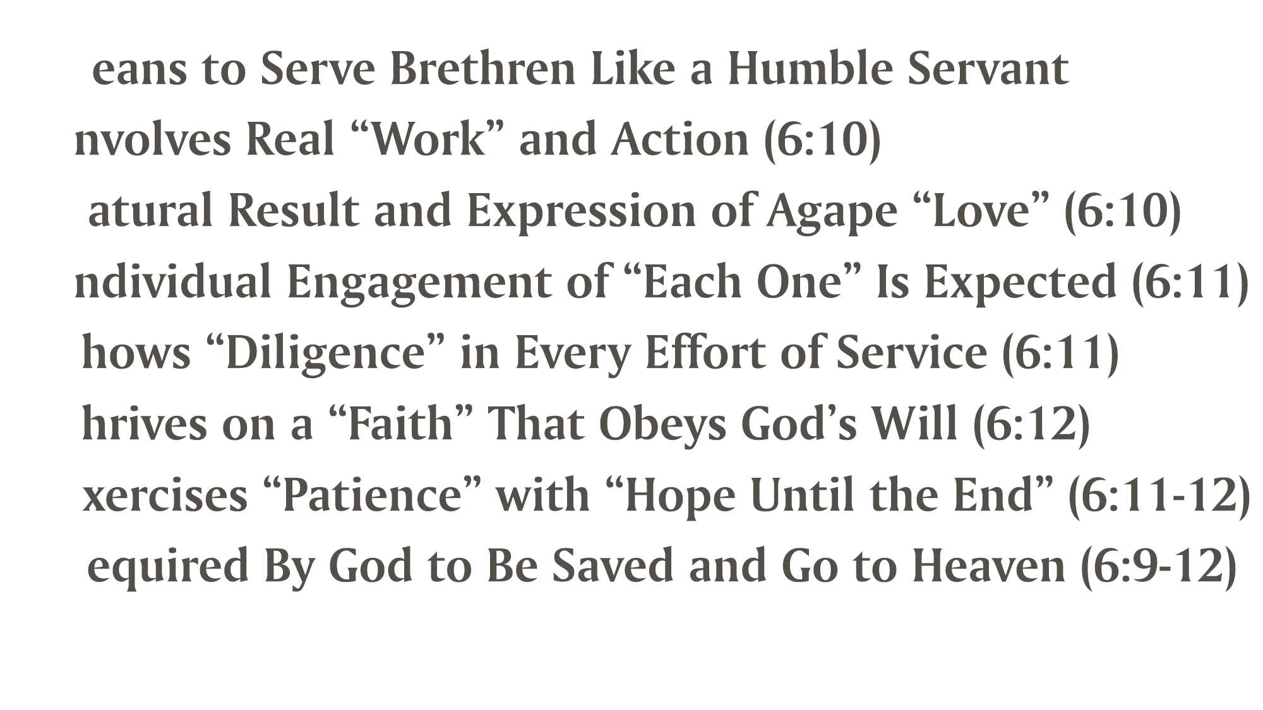
Greek “diakonos” = primarily a “servant, one who helps,
waits on someone”
  It can refer to special servants called “deacons” (1 Tim. 3:8, 12; Phil. 1:1)
  It can refer to preachers of the gospel (Rom. 15:16; Col. 1:23; 1 Tim. 4:6)
It often refers to a Christian as a “servant” or “minister”
(Mark 9:35; 10:43; Rom. 15:25; Phile. 13)

Slide 3
The “work” of serving my brethren is part of the “good works”
for which we exist in Christ (Eph. 2:10)
If I am not “ministering,” I am useless to God and His purpose for me (Matt. 25:26; 1 Pet. 4:10)

Slide 4
Biblical love for one another is moving “in deed and in truth”
(1 John 3:18)
“Love toward His name” moves us to “serve one another in love”
(Gal. 5:13)

Slide 5
Serving/Ministering is always the responsibility of “each one”
(1 Cor. 10:24; 1 Pet. 4:10)
Judgment will be measured out to “each one”
(2 Cor. 5:10; Rom. 2:6; 1 Pet. 1:17)

Slide 6
God will not accept “sluggish” (6:12) or “lagging/slothful” efforts
(Rom. 12:11)
Ministering is to be done eagerly and fervently
(Rom. 12:11; 1 Pet. 1:22; 1 Cor. 16:15)

Slide 7
Serving my brethren is a measure of the genuineness of my faith
(Jas. 2:15-18)
Serving my brethren is Biblical “faith…made perfect…by works”
(Jas. 2:20-24)

Slide 8
We must practice the Golden Rule (Luke 6:31) and (without growing “weary”) “do good to all” (Gal. 6:9-10)
Our focus is NOT on the serving but on serving the Lord and His reward (Col. 3:23-24)

Slide 9
The Judge of all mankind (Acts 17:31) made ministering to others a salvation issue and condition for eternal life (Matt. 25:31-46)

Slide 10
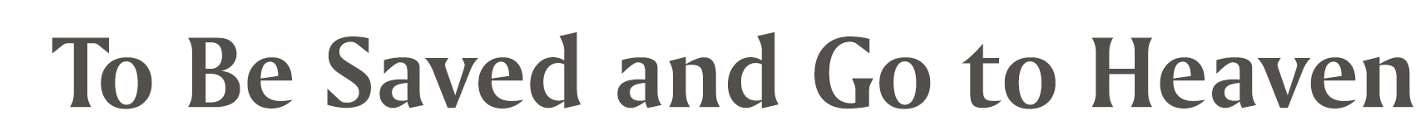
Believe Jesus is the Son of God – Mark 16:16
Repent of your sins and turn toward God – Acts 17:30
Confess your faith in Jesus Christ – Romans 10:9
Be baptized into Christ – Romans 6:3
  God will forgive all of your sins – Acts 2:38
  God will add you to His church – Acts 2:47
  God will register you in heaven – Hebrews 12:23
Serve the Lord faithfully – Matthew 25:34

