Slide 1


The Evangelistic Spirit of Early Christians

Slide 2
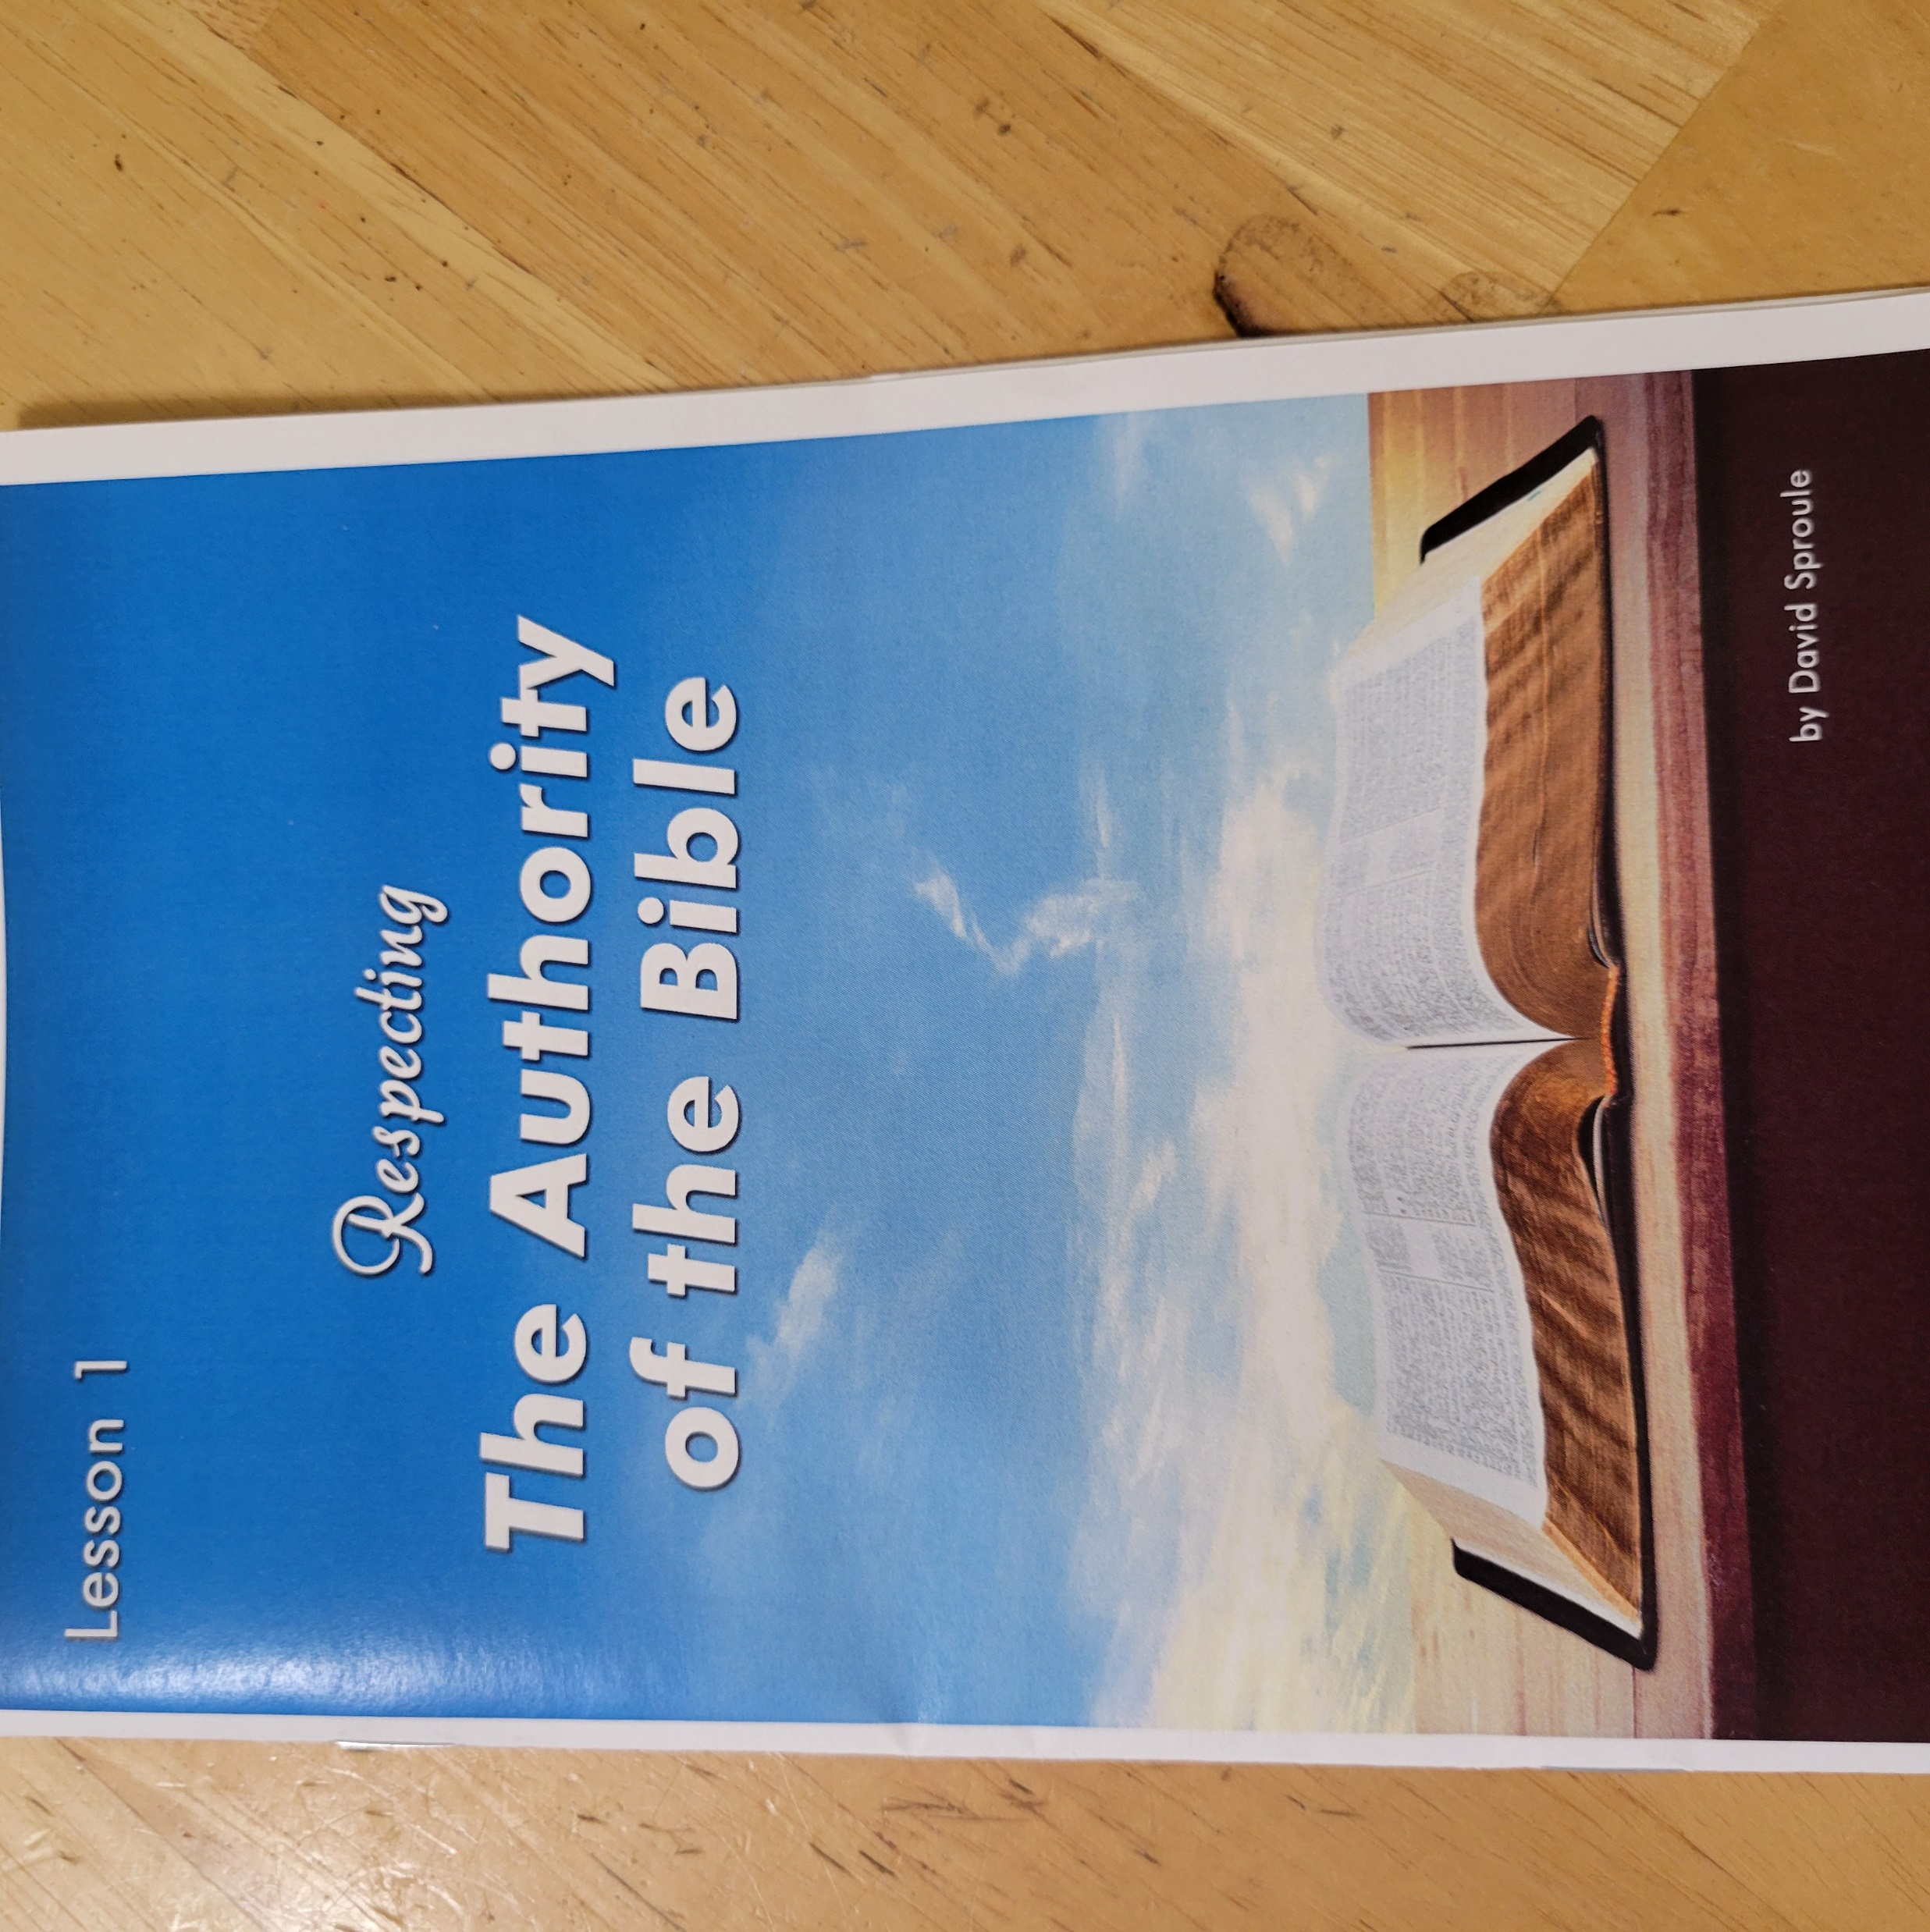
The Evangelistic Spirit of the
Early Christians

Slide 3
The Evangelistic Spirit of the
Early Christians
1. The power of love is strong.
“The love of Christ compels us” 2 Cor. 5:14
2. Every person you see has a soul. Matt. 10:28
3. That is more valuable than the whole world. Matt. 16:26
4. We must learn to see souls.
5. Every souls you see needs Jesus

Slide 4
The Evangelistic Spirit of the
Early Christians
Creating Opportunities to teach
You can show genuine interest in people.
You can show genuine interest in children.
You can help people in need.
You can visit people when they are in the hospital.
You can visit the bereaved and prepare meals.

Slide 5
The Evangelistic Spirit of the
Early Christians
Teach the Gospel
Creating opportunities to teach is not teaching the gospel.
Christianity is a taught religion.
World evangelism is not personal evangelism
Friendship evangelism is not personal evangelism.
Personal evangelism requires personal teaching.

Slide 6
The Evangelistic Spirit of the
Early Christians
Every Christian has a personal duty and obligation to the Lord.

Slide 7
The Evangelistic Spirit of the
Early Christians
Difficulties facing the early Christians
*Social life in communities was full of idolatry.
*They didn’t got o games, plays or read pagan literature.
*Finding a job was difficult. They were not allowed in guilds.
The guild met in pagan temples and worshiped pagan gods.

Slide 8
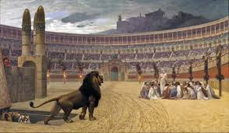
The Evangelistic Spirit of the
Early Christians
Difficulties facing the early Christians
Justin Martyr noted,
“The Romans did not like to watch Christians killed in the games
by animals or gladiators because the Christians were not afraid.
Instead, the prayed and sang.

Slide 9

The Evangelistic Spirit of the
Early Christians
“ The early church increased in number dramatically in a
relative short period of time for a variety of reasons.
Yet, one reason for a rapidly expanding first century church
often gets ignored on today’s shallow, better-felt-than-
defended religious environment: the early Christians’
commitment to apologetics.”
Eric Lyons – Apologetics Press

Slide 10
The Evangelistic Spirit of the
Early Christians
The Early Growth
*About 3,ooo souls obeyed the Gospel the very day the church
was established. Acts 2:41
*The Lord added… daily those who were being saved. 2:47
*Many of those believed, came to about 5,000 men. 4:4
*Multitudes were added. 5:14

Slide 11
The Evangelistic Spirit of the
Early Christians
The Early Growth
*the disciples multiplied greatly, even a great many of the Jewish
priests. 6:7
*multitudes with one accorded heeded the things spoken by Philip. 8:12
*churches through out all Judea, Galilee and Samaria increased. Acts 9:31
*many myriads of Jews had come to believe Jesus. Acts 21:20
*In less than 30 years, the Lord’s church became many tens of thousands.

Slide 12
The Evangelistic Spirit of the
Early Christians
Through out
Many
Multiplied
Multitudes
Myriads

Slide 13
The Evangelistic Spirit of the
Early Christians
Early Christians’ Beliefs
Emotions (feel good) | Truth (God’s Word)

Slide 14

The Evangelistic Spirit of the
Early Christians
Early Christians’ Beliefs
Emotions (feel good) | Truth (God’s Word)

Slide 15
The Evangelistic Spirit of the
Early Christians
Causes of Growth
1. God purposed the time and place. 2 Tim. 1:9
2. Special and specific point in history.
(We should not be surprised that the early church
grew rapidly in a short amount of time)

Slide 16
The Evangelistic Spirit of the
Early Christians
Causes of Growth
3. Early Christians were courageous.
4. Early Christians believed is the same doctrine.
5. Early Christians put a priority on souls and eternal salvation.
Not materialism or temporary matters.
6. Seems death was the only thing that could stop them.
7. Not even death was enough to stop the growth.

Slide 17
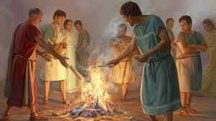
The Evangelistic Spirit of the
Early Christians
Causes of Growth
8. They acknowledged their sins. Acts 2:37, 8:24
9. Repented of those sins. Acts 19:19
10. Lovingly sacrificed their material possessions. 4:32-37

Slide 18

The Evangelistic Spirit of the
Early Christians
Living 1 John 3:16 -17

Slide 19
The Evangelistic Spirit of the
Early Christians
In 361 AD, Emperor Julian said,
“the godless Galileans fed not only their
poor, but also ours.”

Slide 20
The Evangelistic Spirit of the
Early Christians
Pivotal verse
“ and they continued steadfastly in the apostles’
doctrine and fellowship, in the breaking of bread,
and in prayers” Acts 2:42

Slide 21
The Evangelistic Spirit of the
Early Christians
Causes of Growth
Stephen
1. Stephen did great wonders among the people. Acts 6:9
2. A great persecution arose in Jerusalem, and they all scattered
through out the regions of Judea and Samaria.
3. The church spread after the dispersion. Acts 8: 1-4 11:19-20

Slide 22
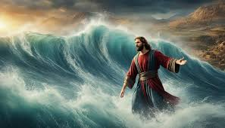
The Evangelistic Spirit of the
Early Christians
Confirming the Word
Reason for miracles was to confirm the Word. Mark 16:20.
Can we confirm the Word today?

Slide 23
The Evangelistic Spirit of the
Early Christians
Can We Confirm the Word Today ?
We have an account of Jesus and His teachings.
We have an account of Jesus and His miracles
We have an account of the Apostles and their actions.
All accounts come to us from the Holy Spirit.

Slide 24
The Evangelistic Spirit of the
Early Christians
Apologetics
*In its simplest form (apologia) an answer given in reply.
*Rational response against the objections people
bring up against Christianity.

Slide 25
The Evangelistic Spirit of the
Early Christians
Early Christians used apologetics and so can we.
1. Peter’s Defense on Pentecost
a. Peter did not use emotion, but reason.
b. What transpired was a fulfillment of Joel’s
800-year-old prophecy.
c. People could actually see the evidence.

Slide 26
The Evangelistic Spirit of the
Early Christians
Early Christians used apologetics and so can we.
1. Peter’s Defense on Pentecost
d. Peter directed the assembly to evaluate the
evidence for Jesus resurrection.
* The empty tomb Acts 2:24, 29-32
* Fulfillment of Psalm 16-8-11
* Witnesses testified they saw the risen Savior.

Slide 27
The Evangelistic Spirit of the
Early Christians
Early Christians used apologetics and so can we.
2. Apologetics and the Preaching of Paul
a. What God did through Paul resulted in so many
people in the first century hearing the Gospel
and becoming dedicated servants in the Kingdom of God?
Eric Lyons, Apologetics Press

Slide 28
The Evangelistic Spirit of the
Early Christians
Early Christians used apologetics and so can we.
2. Apologetics and the Preaching of Paul
b. Paul used (sumbibazon) “to present a logical conclusion”
c. Paul gave evidence that led people to the conclusion
that Jesus is the promised Messiah, the Savior.

Slide 29
The Evangelistic Spirit of the
Early Christians
Early Christians used apologetics and so can we.
2. Apologetics and the Preaching of Paul Thessalonica
d. Reasoned with them from scripture. 17:2-4
e. Contrast this to the unbelievers. 17:5-9
f. The Gospel of Christ was built on facts that he explained
and demonstrated using the O.T. and the historical
life of Jesus.

Slide 30
The Evangelistic Spirit of the
Early Christians
Early Christians used apologetics and so can we.
3. Statement from Wayne Jackson
The Apostles’ method of argument
a. Appeal to the authoritative O.T. scriptures.
b. Direct attention to the prophecies concerning Christ.
c. Discuss the suffering, death, and resurrection.
d. Press the conclusion that fulfills the prophecies regarding
the promised Messiah.

Slide 31
The Evangelistic Spirit of the
Early Christians
Early Christians used apologetics and so can we
4. Paul using apologetics with the Bereans
a. Bereans searched the scripture daily. 17:11
b. They studied (anakrino) Exact research in a legal process
c. They investigated Paul’s teachings and found them to be
true.

Slide 32
The Evangelistic Spirit of the
Early Christians
Early Christians used apologetics and so can we
5. Paul using apologetics in Athens.
a. Athens was spiritually ignorant and idolatrous. 17:16
b. Paul never directly quoted from the Scriptures.
c. He began with something the Greeks would recognize.

Slide 33
The Evangelistic Spirit of the
Early Christians
Early Christians used apologetics and so can we
5. Paul using apologetics in Athens.
d. Paul reasoned with them about the existence of the
true God.
f. He reasoned with them that the true God was Lord
of Heaven and Earth. And did not need anything.

Slide 34
The Evangelistic Spirit of the
Early Christians
Early Christians used apologetics and so can we
6. Paul using apologetics in Ephesus
a. Paul found disciples and reasoned with them to
be baptized into Christ. 19: 1-5
b. Paul found great success by taking the disciples to the
school of Tyrannus. 19: 8-10

Slide 35
The Evangelistic Spirit of the
Early Christians
* The Apostles did not follow cunningly devised fables.
2 Peter 1:16. What about religious people today?
* The Apostles continually offered evidence for the case of
Christianity. They spoke “words of truth and reason”
Acts 26:25

