Slide 1
Understanding Paganism in Ephesus
Eph. 5:11-19

Slide 2
The Text—Ephesians 5:11-19
11 And have no fellowship with the unfruitful works of darkness, but rather expose them.
12 For it is shameful even to speak of those things which are done by them in secret.
13 But all things that are exposed are made manifest by the light, for whatever makes manifest is light.
14 Therefore He says: "Awake, you who sleep, Arise from the dead, And Christ will give you light."
15 See then that you walk circumspectly, not as fools but as wise,
16 redeeming the time, because the days are evil.
17 Therefore do not be unwise, but understand what the will of the Lord is.
18 And do not be drunk with wine, in which is dissipation; but be filled with the Spirit,
19 speaking to one another in psalms and hymns and spiritual songs, singing and making melody in your heart to the Lord,

Slide 3
Ephesus in the First Century
It served as the gateway in all of Asia Minor

Slide 4
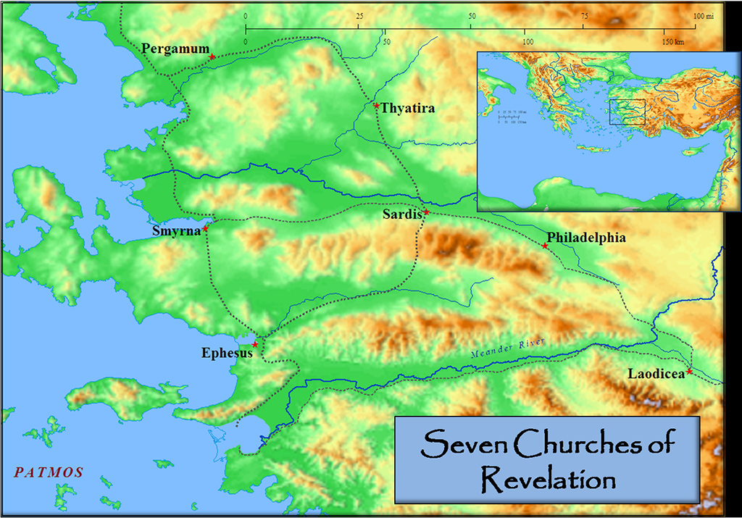
Ephesus, Then and Now

Slide 5
Ephesus in the First Century
It served as the gateway in all of Asia Minor
MAP OF EPHESUS
PICTURE OF EPHESUS, then and now

Slide 6
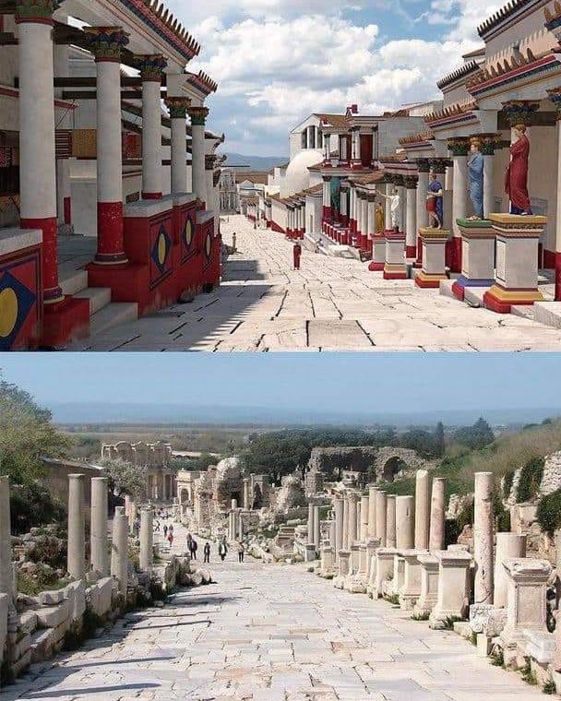
Ephesus, Then and Now

Slide 7
Ephesus, Then and Now

Slide 8
Ephesus in the First Century
It served as the gateway in all of Asia Minor
MAP OF EPHESUS
PICTURE OF EPHESUS, then and now
Many gods and their temples in Ephesus

Slide 9
Ephesus in the First Century
It served as the gateway in all of Asia Minor
MAP OF EPHESUS
PICTURE OF EPHESUS, then and now
Many gods and their temples in Ephesus
Two major ones in tonight’s lesson: Diana and Dionysus (Bacchus)

Slide 10
Ephesus in the First Century
It served as the gateway in all of Asia Minor
MAP OF EPHESUS
PICTURE OF EPHESUS, then and now
Many gods and their temples in Ephesus
Two major ones in tonight’s lesson: Diana and Dionysus (Bacchus)
Understanding both temples helps understand paganism/the church

Slide 11
Ephesus in the First Century
It served as the gateway in all of Asia Minor
MAP OF EPHESUS
PICTURE OF EPHESUS, then and now
Many gods and their temples in Ephesus
Two major ones in tonight’s lesson: Diana and Dionysus (Bacchus)
Understanding both temples helps understand paganism/the church
Temple of Diana (Acts 19); one of the ancient world’s seven wonders

Slide 12
Ephesus in the First Century
It served as the gateway in all of Asia Minor
MAP OF EPHESUS
PICTURE OF EPHESUS, then and now
Many gods and their temples in Ephesus
Two major ones in tonight’s lesson: Diana and Dionysus (Bacchus)
Understanding both temples helps understand paganism/the church
Temple of Diana (Acts 19); one of the ancient world’s seven wonders
PICTURE OF THE TEMPLE OF DIANA and description of it

Slide 13
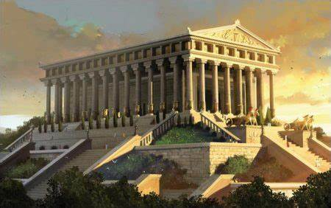
The Temple of Diana in Ephesus

Slide 14
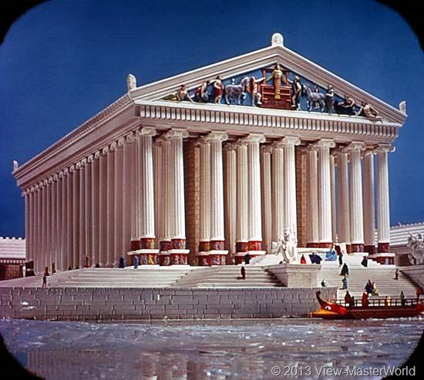
The Temple of Diana in Ephesus

Slide 15
Ephesus in the First Century
It served as the gateway in all of Asia Minor
MAP OF EPHESUS
PICTURE OF EPHESUS, then and now
Many gods and their temples in Ephesus
Two major ones in tonight’s lesson: Diana and Dionysus (Bacchus)
Understanding both temples helps understand paganism/the church
Temple of Diana (Acts 19); one of the ancient world’s seven wonders
PICTURE OF THE TEMPLE OF DIANA and description of it

Slide 16
Ephesus in the First Century
It served as the gateway in all of Asia Minor
MAP OF EPHESUS
PICTURE OF EPHESUS, then and now
Many gods and their temples in Ephesus
Two major ones in tonight’s lesson: Diana and Dionysus (Bacchus)
Understanding both temples helps understand paganism/the church
Temple of Diana (Acts 19); one of the ancient world’s seven wonders
PICTURE OF THE TEMPLE OF DIANA and description of it
The TEMPLE OF DIONYSUS (BACCHUS); and description of it

Slide 17
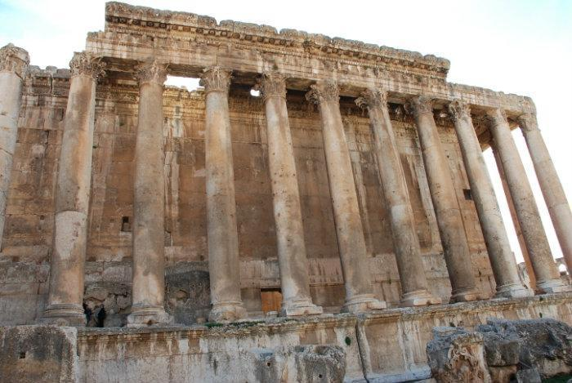
The Temple of Dionysus
Possibly the one in Ephesus

Slide 18
Ephesus in the First Century
It served as the gateway in all of Asia Minor
MAP OF EPHESUS
PICTURE OF EPHESUS, then and now
Many gods and their temples in Ephesus
Two major ones in tonight’s lesson: Diana and Dionysus (Bacchus)
Understanding both temples helps understand paganism/the church
Temple of Diana (Acts 19); one of the ancient world’s seven wonders
PICTURE OF THE TEMPLE OF DIANA
The TEMPLE OF DIONYSUS (BACCHUS); and description of it

Slide 19
Ephesus in the First Century
It served as the gateway in all of Asia Minor
MAP OF EPHESUS
PICTURE OF EPHESUS, then and now
Many gods and their temples in Ephesus
Two major ones in tonight’s lesson: Diana and Dionysus (Bacchus)
Understanding both temples helps understand paganism/the church
Temple of Diana (Acts 19); one of the ancient world’s seven wonders
PICTURE OF THE TEMPLE OF DIANA
The TEMPLE OF DIONYSUS (BACCHUS); and description of it

Slide 20
Ephesians 5:1-10
1 Therefore be imitators of God as dear children.
2 And walk in love, as Christ also has loved us and given Himself for us, an offering and a sacrifice to God for a sweet-smelling aroma.
3 But fornication and all uncleanness or covetousness, let it not even be named among you, as is fitting for saints;
4 neither filthiness, nor foolish talking, nor coarse jesting, which are not fitting, but rather giving of thanks.
5 For this you know, that no fornicator, unclean person, nor covetous man, who is an idolater, has any inheritance in the kingdom of Christ and God.
6 Let no one deceive you with empty words, for because of these things the wrath of God comes upon the sons of disobedience.
7 Therefore do not be partakers with them.
8 For you were once darkness, but now you are light in the Lord. Walk as children of light
9 (for the fruit of the Spirit is in all goodness, righteousness, and truth),
10 finding out what is acceptable to the Lord.

Slide 21
The Text—Ephesian 5:11-19
11 And have no fellowship with the unfruitful works of darkness, but rather expose them.
12 For it is shameful even to speak of those things which are done by them in secret.
13 But all things that are exposed are made manifest by the light, for whatever makes manifest is light.
14 Therefore He says: "Awake, you who sleep, Arise from the dead, And Christ will give you light."
15 See then that you walk circumspectly, not as fools but as wise,
16 redeeming the time, because the days are evil.
17 Therefore do not be unwise, but understand what the will of the Lord is.
18 And do not be drunk with wine, in which is dissipation; but be filled with the Spirit,
19 speaking to one another in psalms and hymns and spiritual songs, singing and making melody in your heart to the Lord,

Slide 22
Walking in the Light of Salvation
      Believe John 8:24
      Repent Luke 13:3
      Confess Your Faith Romans 10:9
      Baptized/Immersed Acts 2:38
      When You Do These, He Adds You to His Flock, His Church
      As a Christian, Live Faithfully Until You Die Rev. 2:10

