Slide 2
Before,
during and
after your interaction with lost souls,
PRAY!

Slide 3
There are some things you can GIVE:
A church business card.
An invitation card to the church or event.
A Bible tract.
A Bible bookmark.
A copy of the church bulletin.
A printed article on a Biblical subject.
A copy of a brotherhood periodical.
A “Searching for Truth” DVD.
A good book on Christian evidences, salvation or the church.
A Bible.
Don’t forget to follow up later.

Slide 4
There are some things you can SEND:
A link to your church website.
A link to a sermon.
A link to a Bible article on a trusted website (like ApologeticsPress.org, ChristianCourier.com, HouseToHouse.com).
A link to a trusted video on a particular Bible subject (like ApologeticsPress.org→Videos) or to a specific time marker in a video.

Slide 5
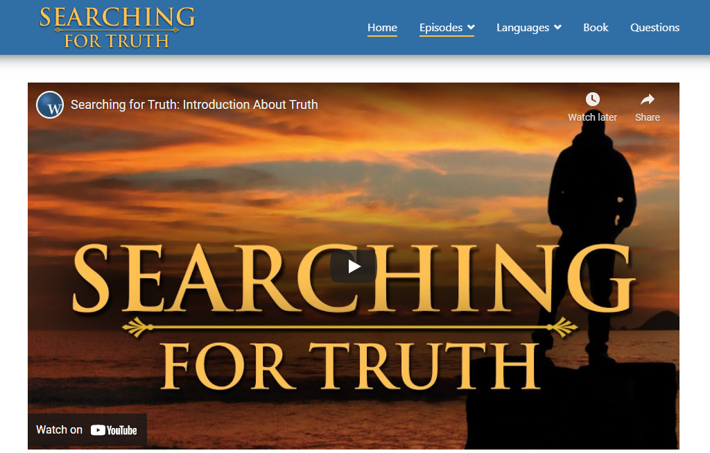
There are some things you can SEND:
A link to the “Searching for Truth” lessons online (www.searchingfortruth.org).

Slide 6
There are some things you can SEND:
An encouraging Bible verse to read and contemplate.
A short note that explains how important Christianity is to you and why you’d like to share it with them.
Your notes on a particular Bible topic that you have studied (complete with Bible references), and ask them to look over what you’ve studied and share their thoughts.
The first lesson in a Bible Correspondence Course and encourage them to sign up for all the lessons.
Note: Many of the things that you can “GIVE” and “SEND” are things that you can also “POST” on your social media pages.
Don’t forget to follow up later.

Slide 7
There are things to which you can INVITE:
To worship on Sunday.
To Bible Study on Wednesday night.
To bring their children to Bible class.
To a church event or get-together.
To “have coffee” with you, just for a visit.
To your place for dinner, just for a visit.

Slide 8
A special note about visitors to our worship services.
Visitors are prime prospects for the gospel.
While they are at the building, be friendly and make them feel genuinely welcome (from the moment they arrive to the moment they leave).
After their visit, follow up with them to encourage them to come back and to offer them a personal, home Bible study.

Slide 9
There are things you can TELL:
That you prayed for him/her today.
“How great” church was on Sunday.
About something that is happening at the church.
How God has worked in your life recently.
How thankful you are to be a Christian.
How concerned you are about the moral decline and the departure from God in our nation.
One reason you love “your church.”
One reason you’re looking forward to heaven.

Slide 10
There are things you can ASK:
“I sure am ready for Jesus to come back. How about you?”
“I sure am ready to go to heaven. How about you?”
“I’ve been reading my Bible a lot recently. Have you read much of it?”
“God has made a huge difference in my life. I'd like to tell you how some time. Ok?”

Slide 11
There are things you can ASK:
“Do you go to church anywhere? I’d love for you to come with me sometime. How about this Sunday?”
“Do you know about the church of Christ? I’d love to share it with you sometime.”
“Did you know that God has a plan for your life? Can I share it with you sometime?”
“Is there anything I can include for you in my prayers today?”
“Is there anything I can do to help you spiritually today?”
“Would you be interested in a personal Bible study (either with me or with someone from my church)?”

Slide 12
There are things you can DO:
You can show genuine interest in people.
You can show genuine interest in children.
You can show genuine interest in other people’s interests.
You can help people in time of need.
You can visit people when they are in the hospital.
You can comfort the bereaved through visitation and preparing meals.
You can speak out when ungodly speech and behavior prevail around you.
You can talk openly about your Savior, your church, your Christian life, etc.
You can be benevolent to those who are in need.

Slide 13
To create an opportunity to teach the gospel:
PRAY!
There are some things you can give.
There are some things you can send.
There are some things to which you can invite.
There are some things you can tell.
There are some things you can ask.
There are some things you can do.
The purpose of this is simply to prepare the soil, plant seeds and open potential doors for future Bible study.

