Slide 1

Judges
Palm Beach Lakes
April-May 2024
Dan Jenkins

Slide 2
Faithful
“Clock”
of the Judges

Slide 3
Faithful
“Clock”
of the Judges
Idolatry

Slide 4
Faithful
“Clock”
of the Judges
Idolatry
Repentance

Slide 5
Faithful
“Clock”
of the Judges
Deliverer/Judge
Idolatry
Repentance

Slide 6
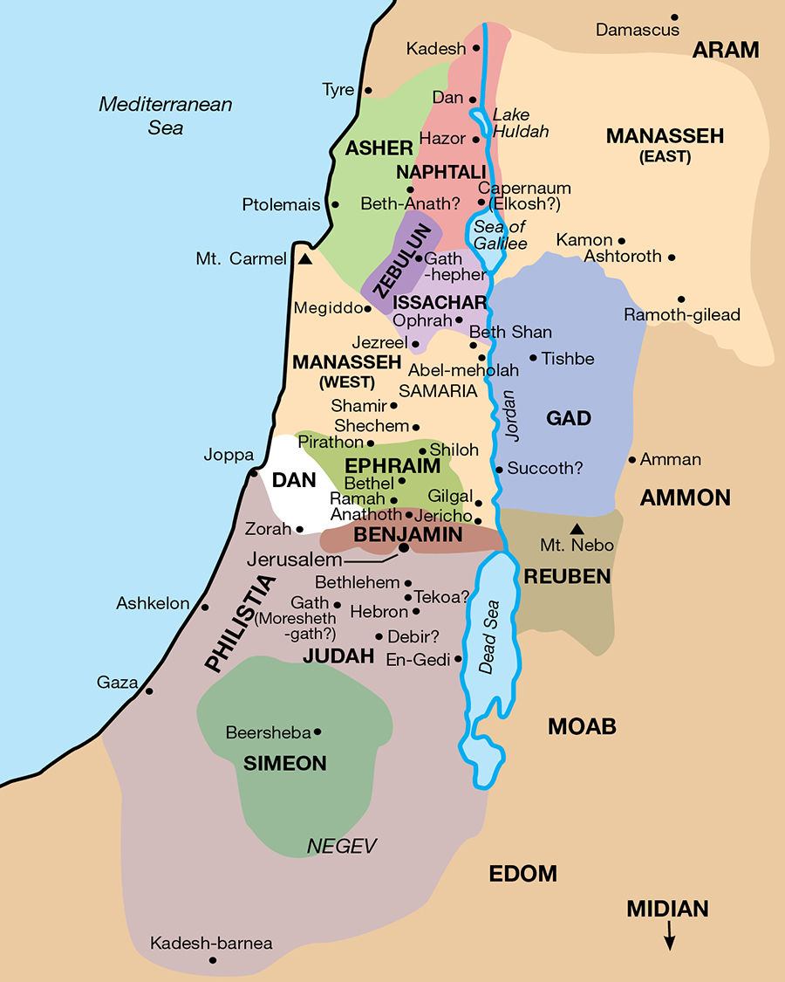

Slide 7
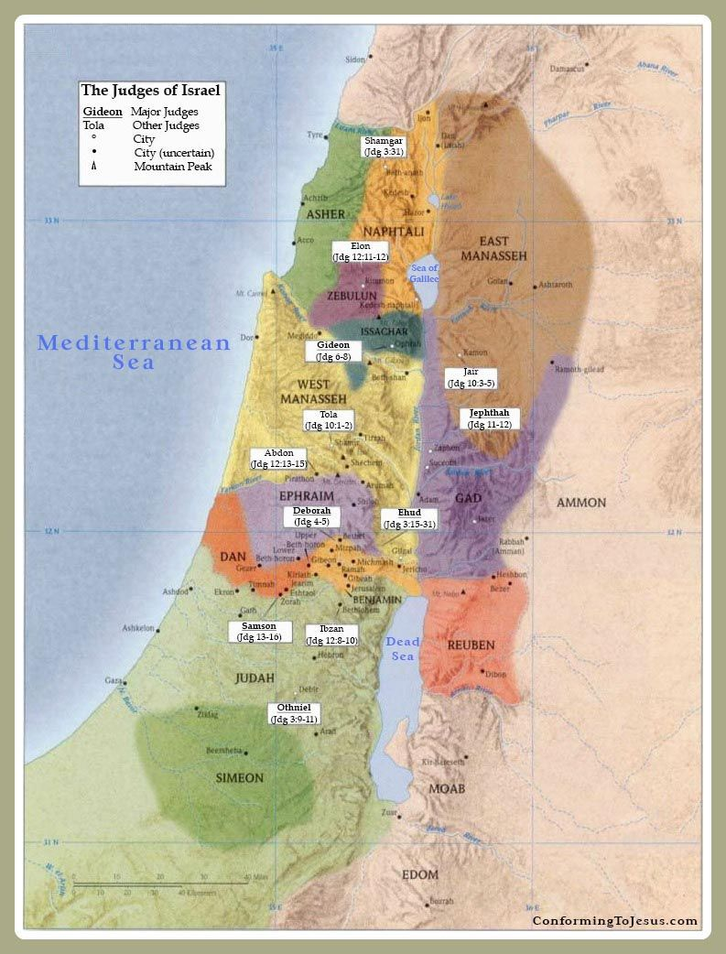
Shamgar
Othniel
Ehud
Shamgar
Deborah
Gideon, Abimelech
Tola, Jair, Jephthah
Ibzan, Elon, Abdon
Samson, Eli, Samuel

Slide 8
Othniel—Caleb’s son-in-law
Ehud
Shamgar
Deborah
Gideon
Abimelech
Tola, Jair
Jephthah
Ibzan, Elon, Abdon
Samson
Eli, Samuel

Slide 9
Othniel—Caleb’s son-in-law
Ehud—The Left-handed judge
Shamgar
Deborah
Gideon
Abimelech
Tola, Jair
Jephthah
Ibzan, Elon, Abdon
Samson
Eli, Samuel

Slide 10
Othniel—Caleb’s son-in-law
Ehud
Shamgar—killed 600 Philistines with an ox goad
Deborah
Gideon
Abimelech
Tola, Jair
Jephthah
Ibzan, Elon, Abdon
Samson
Eli, Samuel

Slide 11
Othniel—Caleb’s son-in-law
Ehud
Shamgar
Deborah—The woman judge
Gideon
Abimelech
Tola, Jair
Jephthah
Ibzan, Elon, Abdon
Samson
Eli, Samuel

Slide 12
Othniel—Caleb’s son-in-law
Ehud
Shamgar
Deborah
Gideon—Army of 300 men, killed 120,000 Midianites
Abimelech
Tola, Jair
Jephthah
Ibzan, Elon, Abdon
Samson
Eli, Samuel

